Slide 1
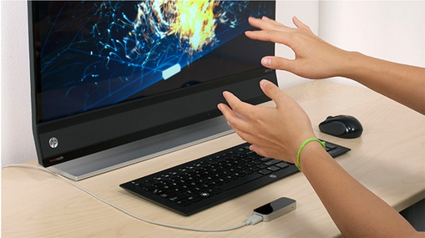
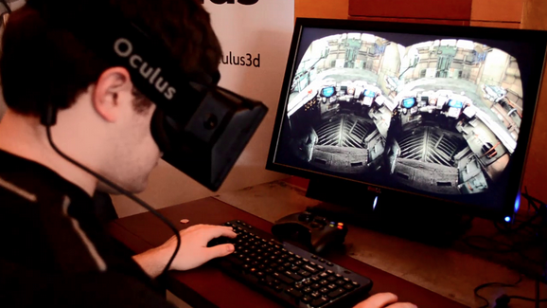
LEAP reference: http://edition.cnn.com/2013/07/22/tech/gaming-gadgets/leap-motion-controller-review/
Oculus VR Rift reference: https://www.maxxor.com/blog/past-future-oculus-rift/

