Slide 1

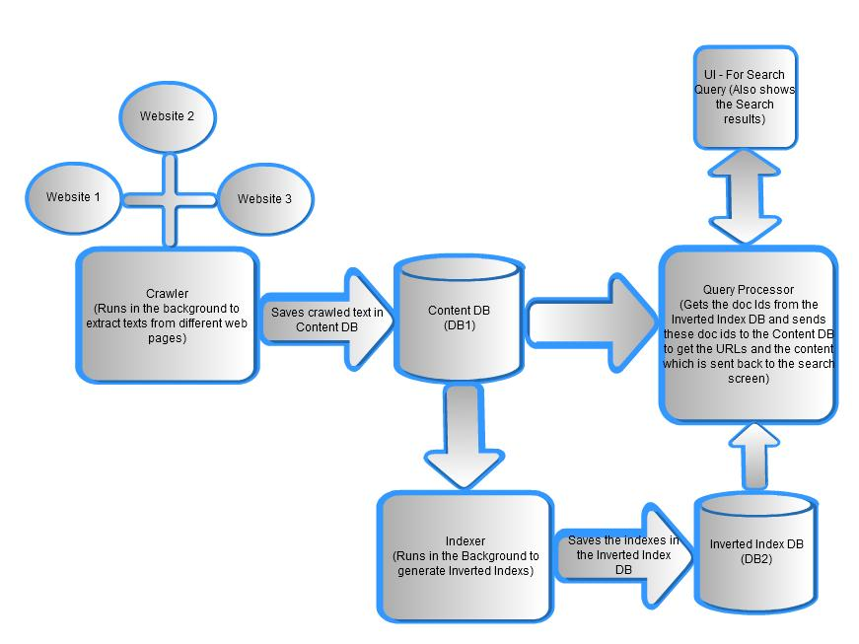
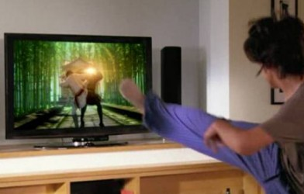
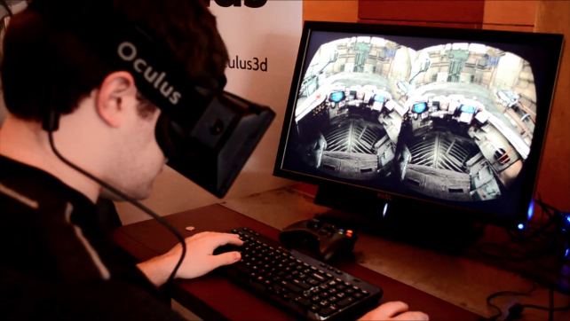
User Interface Layer
Search Engine Architecture
LEAP Motion Controller (ref:http://www.businessinsider.com/leap-motion-controller-fun-with-flaws-2013-7?IR=T)
User Model
Xbox (ref: http://www.kinect-hire.co.uk/xbox-kinect-hire/)
Oculus Rift (ref: http://www.gamerhub.tv/articles/oculus-rift-virtual-reality-is-unreal/2013/03/31/)

