Slide 1

Module 2 QUIZ

Slide 2
1. You need to convert every string in an array to uppercase (same number of elements, transformed values).

Slide 3
2. You need to keep only users whose age is 18 or older (some elements removed).

Slide 4
3. You need to compute the total price from an array of item prices (single final total).

Slide 5
4. You need to add a prefix 'ID-' to every numeric ID in an array.

Slide 6
5. You need to keep only numbers greater than 100 from a list.

Slide 7
6. You need to multiply every number in an array by 2.

Slide 8
7. You need to combine an array of words into a single sentence.

Slide 9
8. You need to keep only non-empty strings from an array of inputs.

Slide 10
9. You need to convert an array of temperatures in Celsius to Fahrenheit.

Slide 11
10. You need to find the product (multiplication) of all numbers in an array.

Slide 12
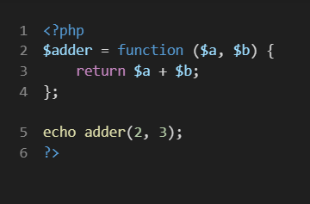
Your fix (brief): ________________________________________________
First-class identification (1-2 lines): ___________________________

Slide 13
Your fix (brief): ________________________________________________
First-class identification (1-2 lines): ___________________________
Use $adder(2, 3);
First-class: function stored in a variable and invoked.

Slide 14
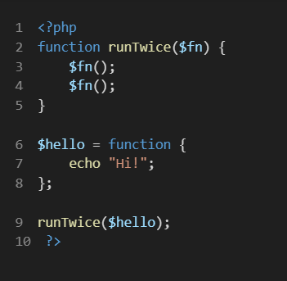
Your fix (brief): ________________________________________________
First-class identification (1-2 lines): ___________________________

Slide 15
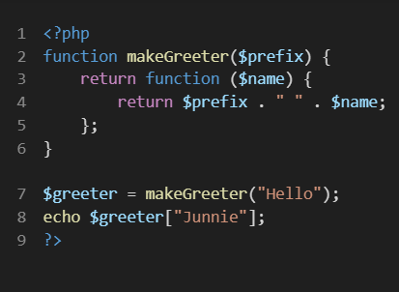
Your fix (brief): ________________________________________________
First-class identification (1-2 lines): ___________________________

Slide 16
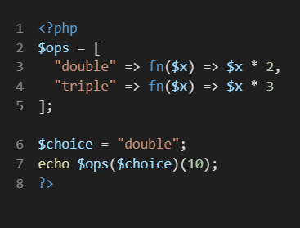
Your fix (brief): ________________________________________________
First-class identification (1-2 lines): ___________________________

Slide 17
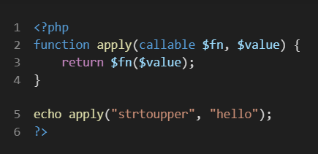
Your fix (brief): ________________________________________________
First-class identification (1-2 lines): ___________________________

Slide 18
$hello = function() { ... };
First-class: passing $hello as an argument.

Slide 19
Use 'use ($prefix)' and call $greeter('Junnie’);
First-class: returning a function.

Slide 20
Use $ops[$choice](10);
First-class: functions stored in an array and selected by key.

Slide 21
Works as-is; note that 'strtoupper' is passed as a callable (function name as value).

