Slide 1
ProcTool: Artifact Tracing via Process IO Monitoring
November 2020
Innovation Labs

Slide 2
Index
01
The Problem
02
ProcTool’s Approach

Slide 3
The Problem
01

Slide 4



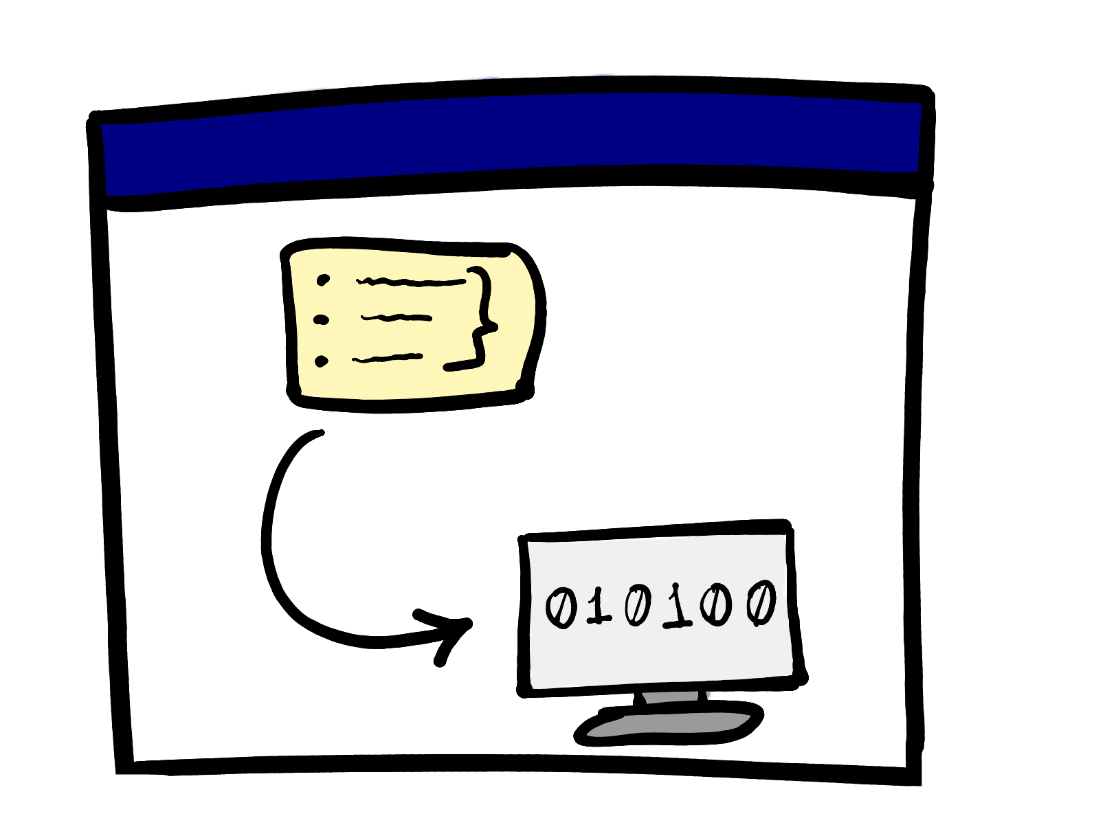

Artifact Generation Process
Git
Source Code
Compiler
Linker
Artifact
.EXE
Notes:
Well-known workflow where source code stored in a repository is compiled + linked to produce binaries.

Slide 5
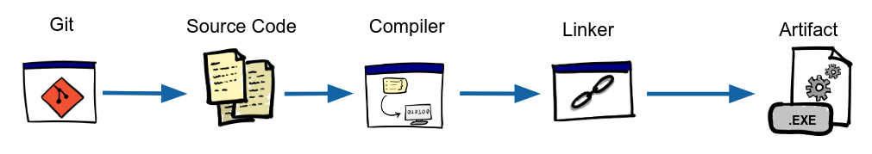
The Issue of Trust in the Artifact Generation Process
Build tools are critical, must be certified
If you don’t know which tools affect the build, you have to validate and remember all of them
Bugs affecting build tools may affect produced artifacts. Which ones?
If needed (e.g: audit), no strong evidence can be provided that links a set of sources and tools with a deployed artifact
Notes:
To ensure the trustiness of an artifact we must consider the trustiness of *all* the tools involved in the production of the artifact.
If either the source code *or* the tools involved in the production are compromised, the artifact produced can potentially be affected.
Consider newly discovered bugs in the source code as well as in the tools.

Slide 6

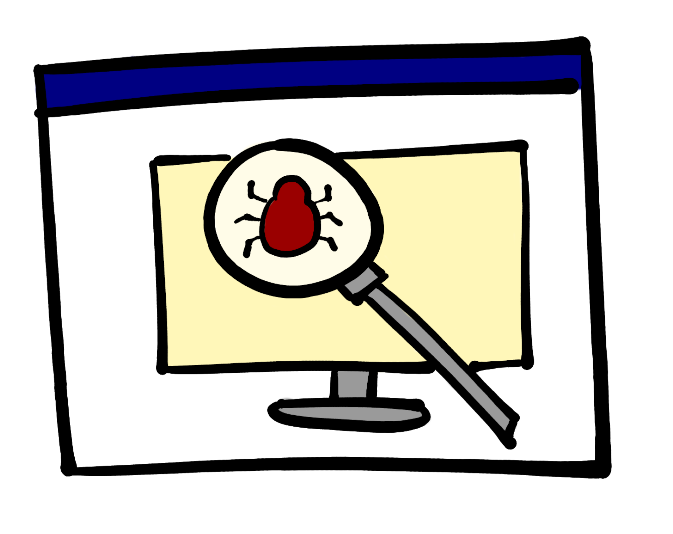


Artifact Generation Process
Git
Source Code
Compiler
Linker
Artifact
.EXE
Security Report
Security Scanner
Test
Report
Test Runner
Notes:
With more sophisticated workflows, security scanners and test runners that produce reports are also involved.

Slide 7
Artifact Generation Process
Source Code
Compiler
Linker
Artifact
.EXE
Security Report
Security Scanner
Test
Report
Test Runner
Notes:
There is no established practice in the industry to associate the reports to the artifact.

Slide 8
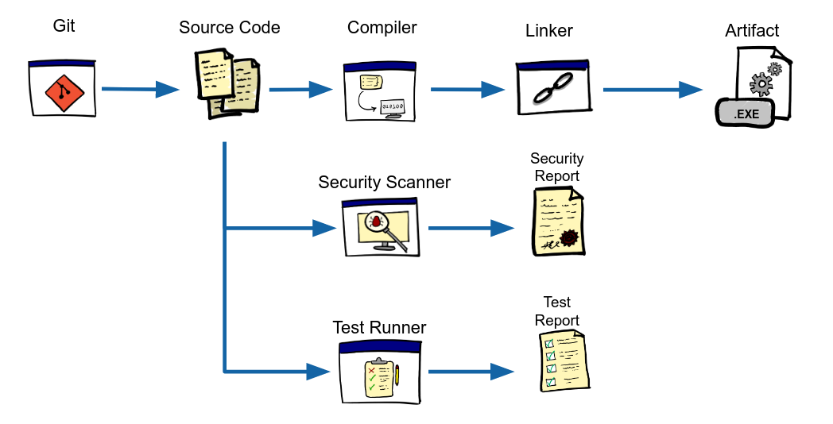
The Issue of Matching Reports with Artifacts
Gathering all info pertinent to a deployed artifact is hard
Knowing the precise version of the QA tools is essential
The same with their configuration and databases
The info linking reports to artifacts is only present (with luck!) on the CI/CD logs
Gathering this info is usually a manual process
Notes:
What happens if the Security Scanner DB is not current? A recently discovered vulnerability might go unnoticed.
Also, the configuration is important; it might be set to ignore certain files or vulnerabilities.

Slide 9
Introducing
Artifact Tracing via IO
Monitoring
02

Slide 10


Looking for Patterns
Source Code
Artifact
Compiler
.EXE
Source Code
Security Scanner
Security Report
Vuln. DB
Artifact
Test
Report
Test Runner
Test Cases
.EXE

Slide 11

The IPO Pattern
INPUT
OUTPUT
Input file 1
Output file 1
Input file 2
PROCESS
Output file 2
Input file n
Output file n
Notes:
By PROCESS we mean precisely an operating system process.

Slide 12

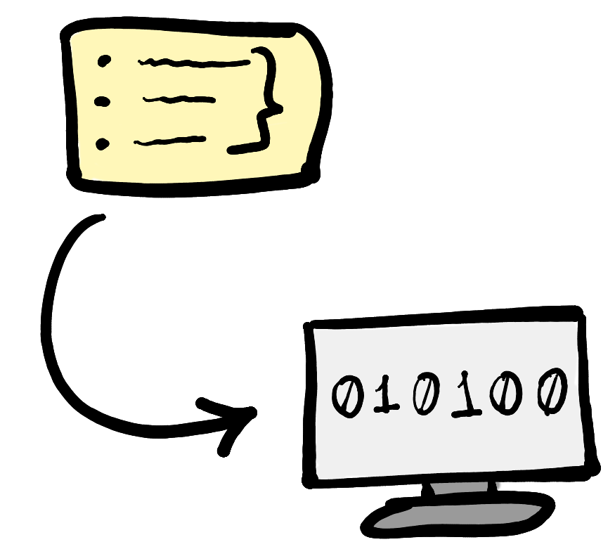




Extracting Triplets with the IPO Pattern
INPUT
OUTPUT
Compiler
Artifact
Source
Code
PROCESS
/bin/gcc
.EXE
INPUT
OUTPUT
Source
Code
Security Scanner
Security Report
Vuln. DB
PROCESS
/bin/secscan
INPUT
OUTPUT
Test Runner
Test
Report
Artifact
PROCESS
Test Cases
.EXE
/bin/cucumber
Notes:
Source Code -> COMPILER -> Artifact
Source Code + Vuln. DB -> Security Scanner -> Security Report
EXE Artifact + Test Cases -> Test Runner -> Test Report
We consider the executed binary as part of the input set.

Slide 13
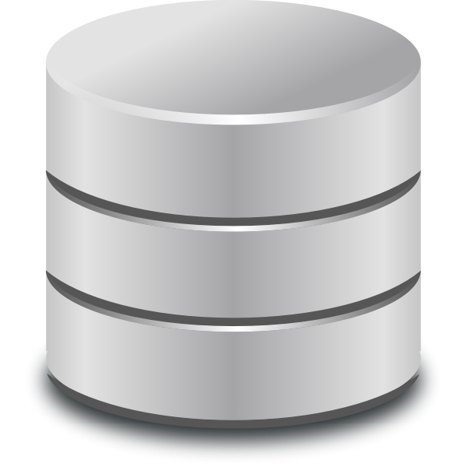
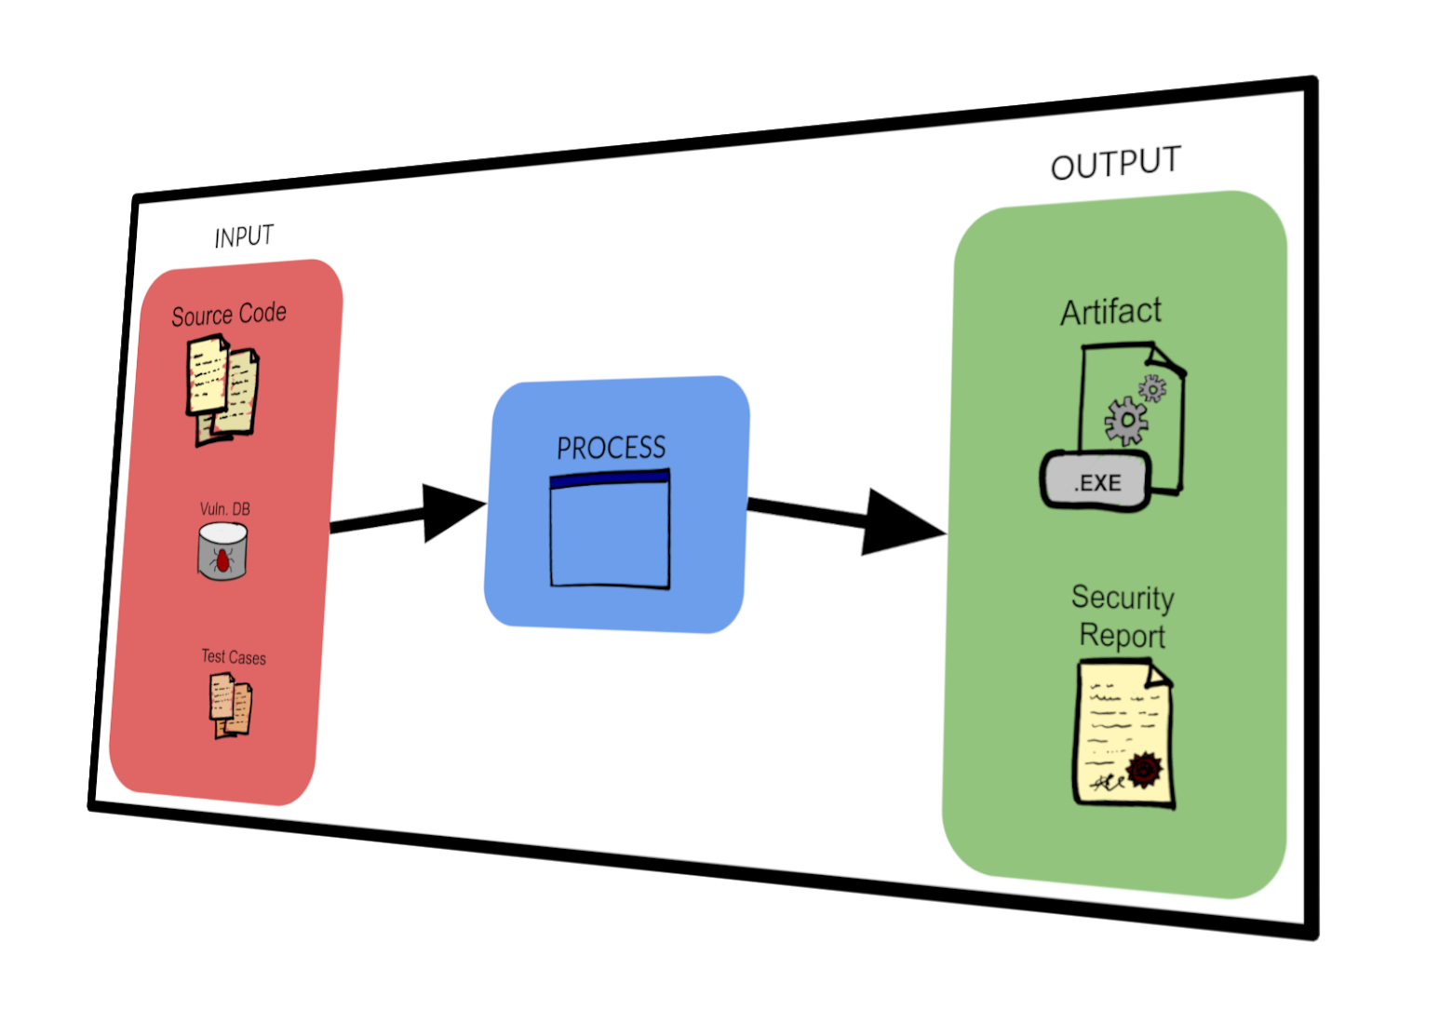
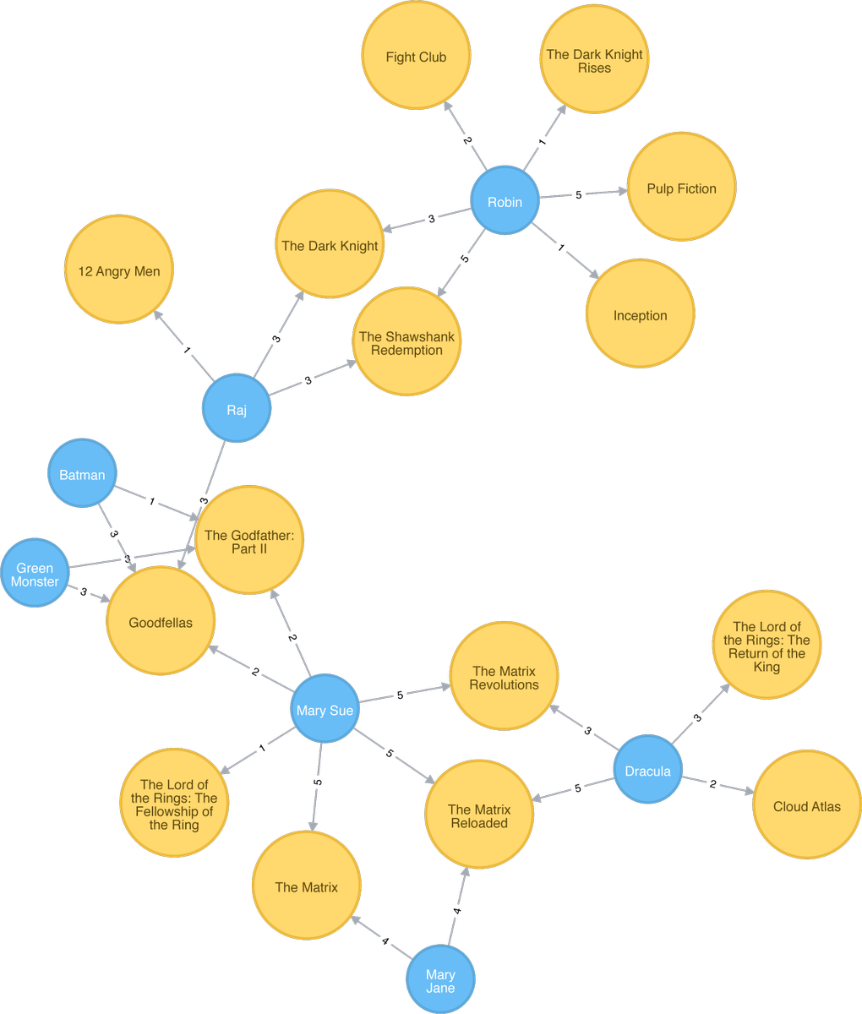
Making Sense of the Triplets
We can load the collected IPO triplets into a graph database.
The connections we seek are reduced to finding paths on a digraph.

Slide 14
Demo time!
(See demo folder)

Slide 15
Benefits of Artifact Tracing
No developer cooperation required if enforced at the CI/CD
Compatible with any Linux process, independent of the programming language
No added complexity for developers
Logged data can be checked at any given time
Provides an alternative to internal CPE-like schemes

Slide 16
Next Steps
Implement a PoC based on eBPF + LSM|FUSE
Develop an end-to-end workflow for ProcTool
How to store, share and query all gathered data

Slide 17
Thank you!

