Slide 1

Microbit:Projekt Atari Breakout
Projekt of: Jan Nägeli & David Coso

Slide 2
General Information
As it is common practise to use English in IT related matters we have decided to do the Documentation of the Projekt in English. We have also decided to Present our Project in English .
English is widely considered as a lingua franca for Programming related matters, most of the current technical documentations, tutorials, and forums are in English.

Slide 3
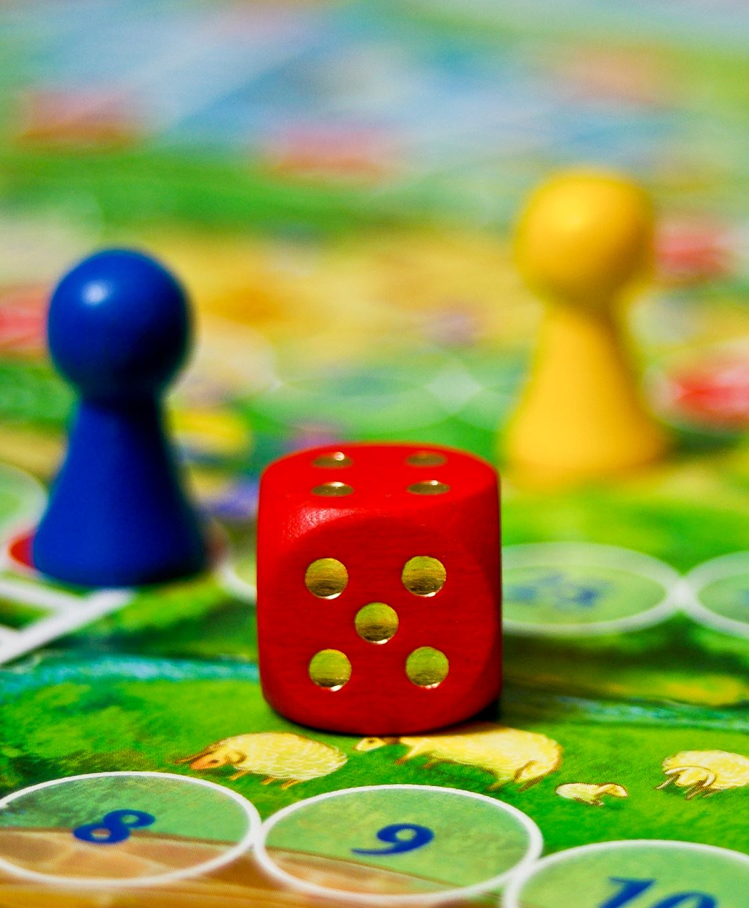
Table of Content
Introduction
Materials needed
Setting up the Microbit
Programming the game
Video Proof
Conclusion
Questions

Slide 4
Introduction
Microbit is a small, programmable device that can be used to create a wide range of projects.
It has an LED matrix display, two buttons, and a variety of sensors and inputs.
Atari Breakout is a classic arcade game where the player controls a paddle to hit a ball towards a wall of bricks and clear them all. The game was first released by Atari in 1976.

Slide 5

Materials used
Microbit board
USB cable
Computer with internet connection
Coding Software (CLion, VS Code)

Slide 6

Setting up the Microbit
Download the MicrobitFile.hex files from the repository.
Connect your micro:bit to your computer using a USB cable.
Upload the code from your computer to your micro:bit.

Slide 7
Programming the game
Setup and Test Basic Functions of the MicroBit.
Setup Event Handler for Asynchronos Button presses.
Progamm Bar and test movement.
Programm Collision Detection of Bar and Screen Boarder.
Programm Moving Ball.
Programm Collision Detection of Ball and Screen Boarder.
Programm Colission Detection of Ball and Bar.
Add Game States (Game Over).
Add Scoring System.
Add Animations.
Add Levels

Slide 8

Video Proof

Slide 9
Conclusion
We have learned how to program Atari Breakout on a Microbit using C/C++ with help of the Lanchester University Documentation
We have seen how to set up the Microbit, create a basic layout of the game, detect collisions, and add features like scoring and multiple levels.

Slide 10

Questions?

