Slide 1
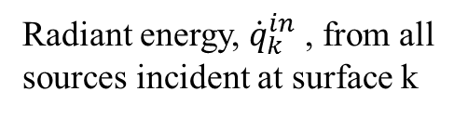



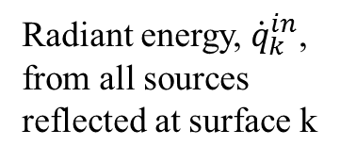
Outgoing Radiation
Incoming Radiation
Grey body surface radiation
Radiant energy, ${\dot{q}}_{k}^{in}$, from all sources reflected at surface k
Radiant energy, ${\dot{q}}_{k}^{in}$ , from all sources incident at surface k
$$A_{k}σε_{k}T_{k}^{4}$$
$$(1−ε_{k}){\dot{q}}_{k}^{in}$$
$${\dot{q}}_{k}^{in}$$
Radiant energy required for steady state
Surface k

