Slide 1
Pairwise Sequence Alignment
Kaynak: Caltech Bi181 ‘Introduction to Bioinformatics’ dersi

Slide 2
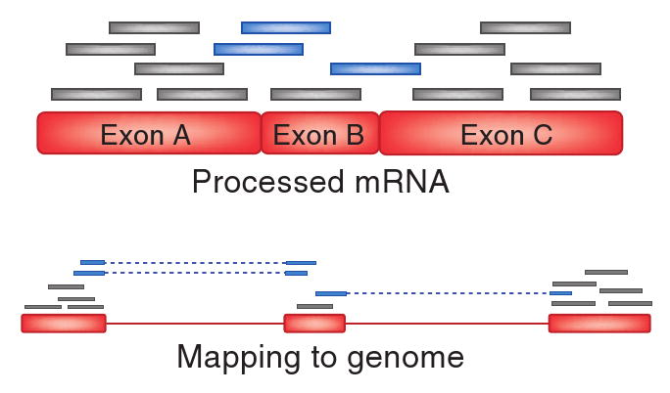
Iki sekansi nasil siralariz?

Slide 3
Sekans siralama (sequence alignment) uygulama alanlari?
Turler arasi sekans karsilastirma
Orn: Insan ve fare
Genleri karsilastirma
Orn: Benzer bolgeleri arastirma
cDNA dizisini (RNA dizileri) genoma eslestirme
Sekanslari genoma eslestirme
Mesela kisa diziler

Slide 4
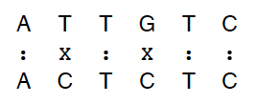
Iki diziyi karsilastirirken nasil skor veririz?
Hamming mesafesi: Iki dizi arasinda degisen bazlarin sayisi
Distance=2

Slide 5
Hamming mesafesi ideal degil
Su iki sekansa bakalim
ATATATAT
xxxxxxxx
TATATATA
Distance=8

Slide 6

Ama bu iki sekans gercekten o kadar farkli mi?
Sekansi bir pozisyon ilerlettigimizde iyi bir eslesme var

Slide 7
Alternatif olcme yontemleri
Edit mesafesi: Bir stringin digerine donusmesi icin yapmamiz gereken minimum edit/hamle
Boylece farkli uzunluktaki sekanslari karsilastirabiliriz

Slide 8
Iki sekans arasindaki minimum edit mesafesini nasil buluruz?
Create an Alignment of the sequences
At each position in the alignment there are 3 possibilities:
A match (or mismatch) between the bases
An insertion of a base
A deletion of a base

Slide 9

A sequence alignment
Match
Deletion
Insertion

Slide 10
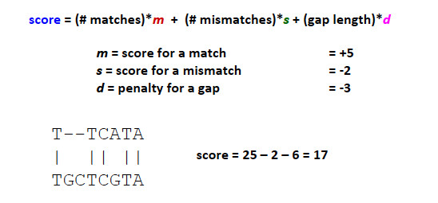
Scoring an alignment

Slide 11
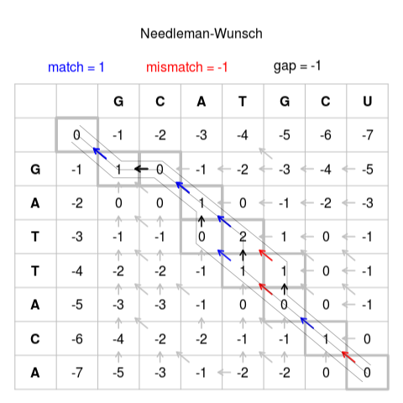
Edit graph of two sequences
Kaynak: Vikipedi

Slide 12
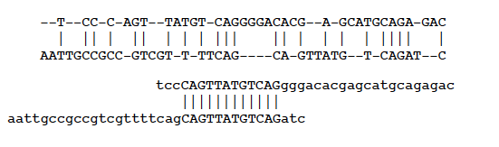
Global versus Local Alignment
Global Alignment: An alignment that matches the entire length of both sequences
Local Alignment: An alignment that includes the best matching, highest-scoring region in 2 sequences

Slide 13
Edit graph of two sequences
https://en.wikipedia.org/wiki/Smith%E2%80%93Waterman_algorithm#/media/File:Smith-Waterman-Algorithm-Example-En.gif

Slide 14
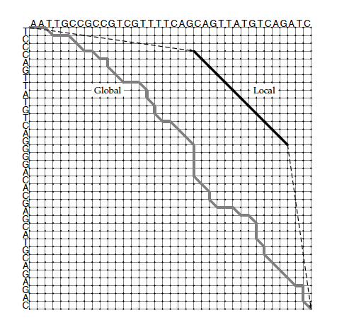
How do we find Local Alignments?

Slide 15
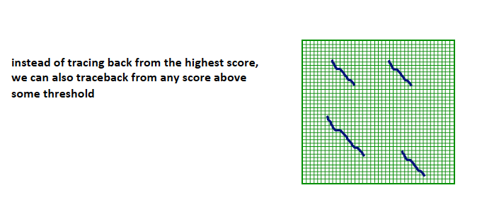
Finding multiple subalignments

Slide 16
BLAST: Basic Local Alignment Search Tool
Created in 1990 by Altschul, Gish, Miller, Myers, & Lipman.
Idea: Search sequence databases for local alignments to a query.
Recall: Smith-Waterman Algorithm

Slide 17
Features of BLAST
Great improvement in speed, with a modest decrease in sensitivity.
Minimizes search space instead of exploring entire search space between two sequences.
Finds short exact matches (“seeds”), and only explores locally around these “hits.”
Notes:
1.

Slide 18
BLAST Algorithm
Keyword search of all words of length w from a query of length n in database of length m with score above threshold.
w = 11 for DNA queries
w =3 for proteins
Perform local alignment extension for each keyword.
Extend results until longest match above a given threshold is achieved.

