Slide 1
Classification Model to Detect Primary Headache Using Quantified Self Data from Wrist-Worn Wearable Devices
Anne Hoelgaard, Andreas B. Lauridsen, Jacob Ponsaing, Erik Smedegaard

Slide 2

Current state of headaches in Denmark
High cost of headaches annually
Increasing ambulant visits and hospitalisation
Golden standard is medication
Leaves out undiagnosed cases

Slide 3
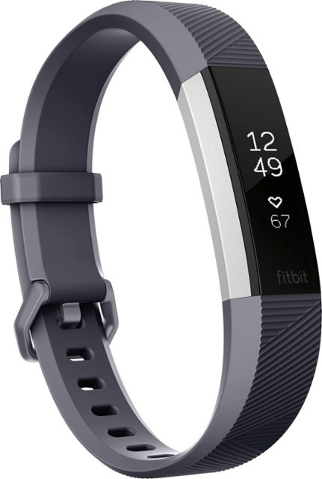
Quantified self
Quantified self obtains data related to headache
Quantified self an increasing movement
It has a large data pool

Slide 4
Aim of the Study
To evaluate a model to detect headache using quantified self data from Fitbit

Slide 5
Data collection
Automatically obtained body data
Manually obtained data regarding fluid and headache

Slide 6
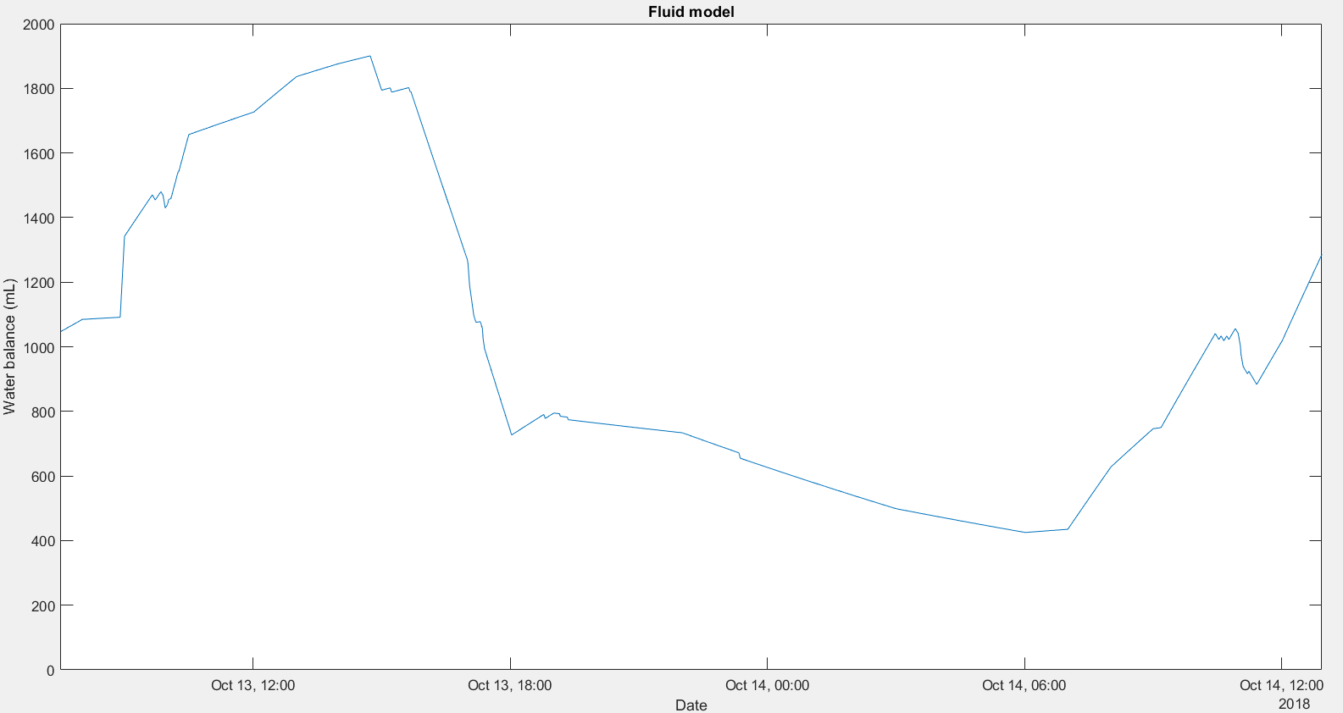
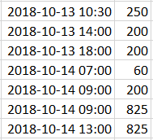
Data processing
Delayed features were used in ensemble methods
RUSBoost
Random Forest
The fluid intake is used as input for fluid balance model

Slide 7
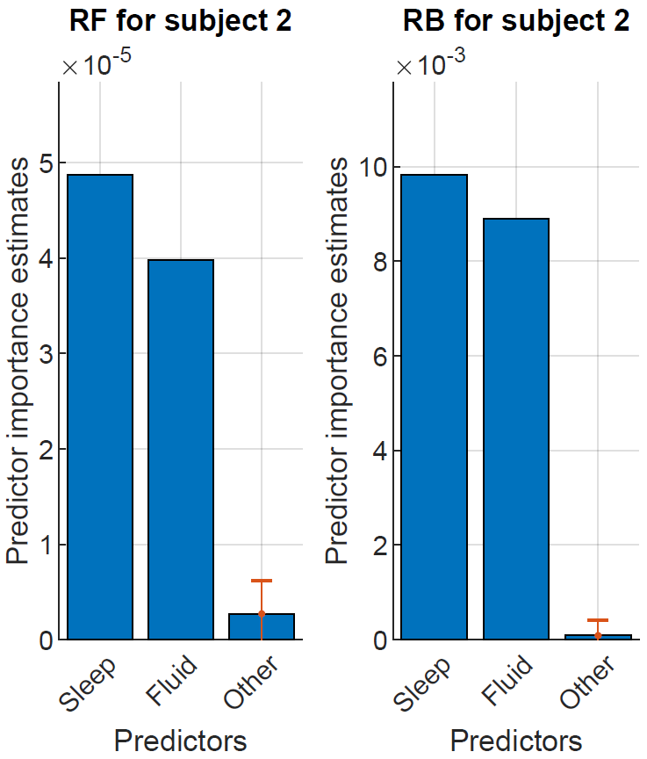
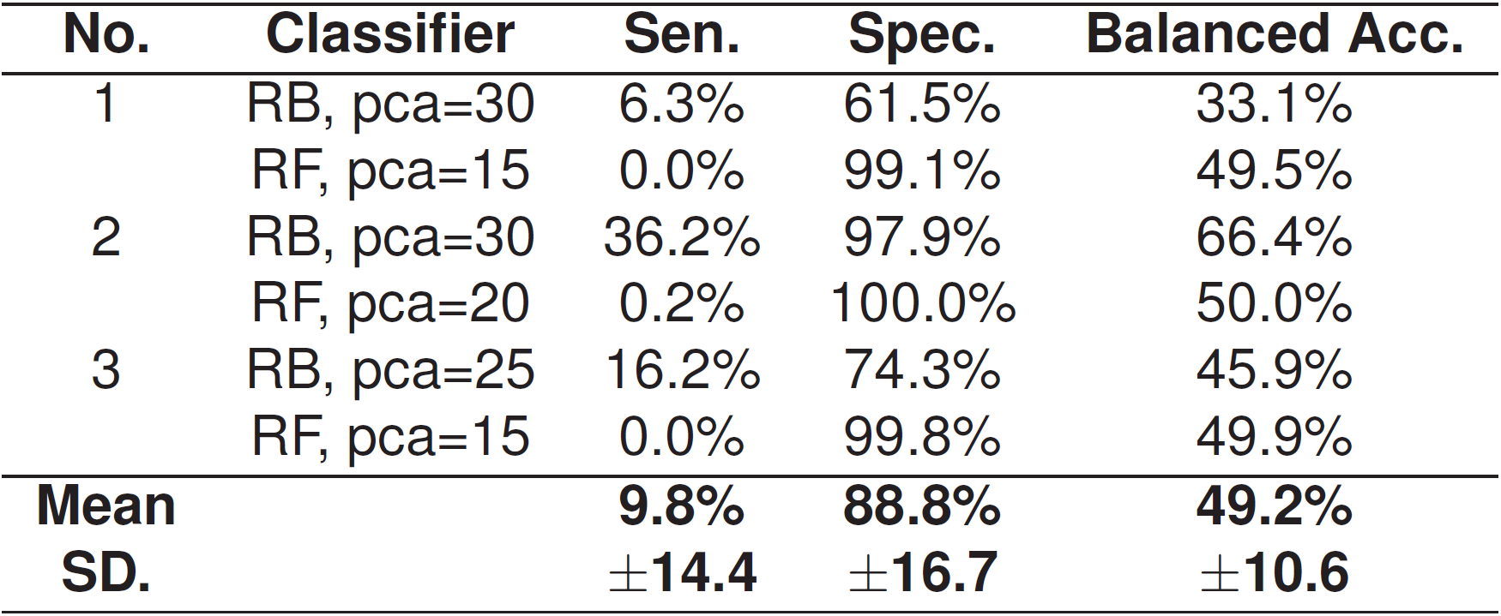
Results
RUSBoost outperforms compared to Random Forest
Fluid and sleep have high predictor values

Slide 8
Discussion
Fitbit was chosen over other devices despite the lack of features
Some features turned out to be largely irrelevant
Fluid approximation based on litterature instead of existing model
Overfitting issues due to grouping of data
Hawthorne effect and learning bias from subjects

Slide 9
Conclusion
RUSBoost outperforms Random Forest
Sleep and fluid importance

Slide 10
Future works
Improved feature extraction
Generalized version of the model

