Slide 1
Data Mining
AY 2014-2015
Taxi Trajectory Prediction
Ettore Randazzo
Vittorio Selo
Paolo Simone
Benedetto Vitale

Slide 2

Summary
Preprocessing
Postprocessing
Prediction Models
Particular Cases

Slide 3
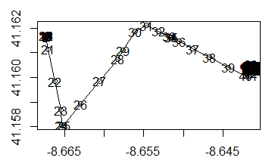
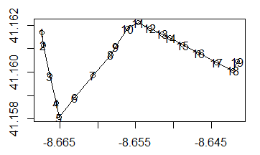
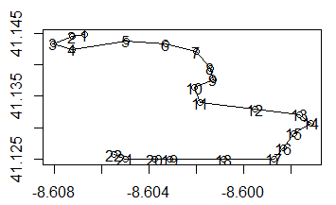
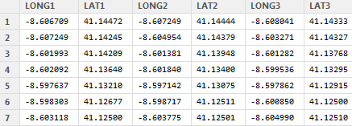
Preprocessing
Cleaning: GPS errors & close points
Disassemble: obtain constant number of attributes

Slide 4
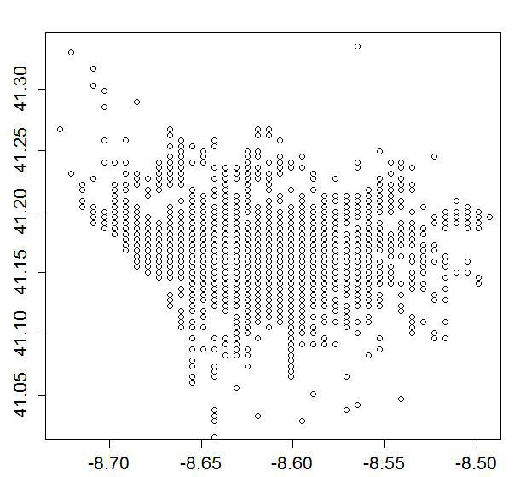
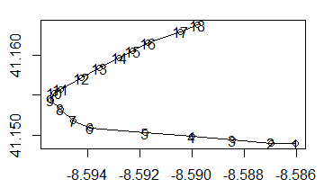
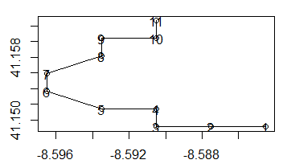

Preprocessing 2.0
Square clustering: uniform input points
… also known as "Snake preprocessing" :-)

Slide 5
Postprocessing
Extract prediction: destination predicted as factor to exploit correlation
Weightened Average: last segments are more meaningful

Slide 6
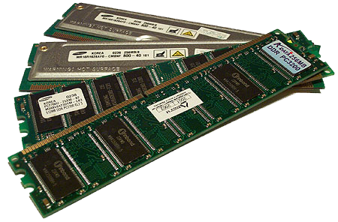
Prediction models
First attempts:
Classification trees (rpart)
Regression trees (anova)
K Nearest Neighbours (knn)
Naive Byas (e1071)
…
Until…
Random Forest!
Except… we don't have 10⁹ TB of RAM ☹

Slide 7
State of the art
Generate chunks of small size by sampling the dataset
Preprocess each new training set
Train a different forest on each chunk:
Call type
Day of the week
Day phase
Segment coordinate
Clusterized destination as factor (Classification)
Extract the prediction of each forest
Take the prediction that minimize the SSE wrt the others

Slide 8
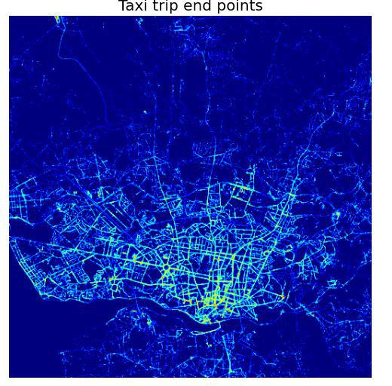
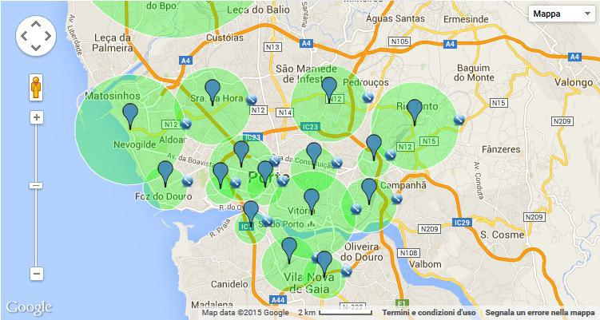
Sneaky tricky trips
If the trip doesn't contain enough points to be processed…
Clustering
Linear Interpolation

Slide 9

Q&A

