Slide 1
R4Intellij
Integration of R with Intellij IDEA

Slide 2
v0.6
Nothing yet

Slide 3
Documentation integration
StatET
Notes:
From statet website:
The final release of StatET 0.9.0 [2010-08-27] is available for download now.
The major visible new feature in StatET is the integration of R help with
A 'R Help' view allowing to read and browse through the help pages
An Eclipse 'R Help' search, including a full-text search mode
Integration in the R editor like an information hover for the help (mouse or keyboard shortcut F2)
To enable the R help features, the help pages must be indexed (see below).
A new R package 'rj' provides R functions for the R help integration and other features in StatET. It is recommended to install the package, so you can use all tools making your work more comfortable. The 'rj' package must be installed via the command line using:
R CMD INSTALL --no-test-load rj_*.tar.gz
It is recommended to check and complete the settings for your R environments in the Eclipse/StatET preferences.
When starting the R console in StatET, you will be asked if it may index your R libraries. Depending on the number of installed packages, this can take some minutes.

Slide 4
Next
Reference resolving
BnfAnnotator: psi-aware highlightling of syntax elements
BnfQuoteHandler
Fix parser
Windows connector
Notes:
Every element which can be renamed or referenced (a class definition, a method definition and so on) needs to implement the PsiNamedElement interface, with methods getName() and setName()
Proper error highlighting (see http://confluence.jetbrains.net/display/IDEADEV/Developing+Custom+Language+Plugins+for+IntelliJ+IDEA )

Slide 5
Roadmap (coming soon)
Live TemplatesCode formatter
Inspections and quickfixes for common problems
Incorrect subset (or if)
Basic refactorings to match StatET (rename variable, introduce local variable, inline local variable, extract function, Generate Element Comment)
Advanced navigation (structure view, go to declaration (Example: ArcChooser), ...)
Ctrl+Q (Quick documentation lookup) for internal commands, external commands and functions (learn from StatET!)
Highlight usages in file for functions and variables

Slide 6
To match StatET we would need in addition
File path completion (learn from bash plugin)
Better highlighting of syntax errors
Intention to add roxygen docu + code basic tag completion for roxygen comments
Intention to change function to S4 function
Connectors for xterm and Rgui on windows

Slide 7
Roadmap (later)
Check that function is available and provide import library statement if necessary
More context-aware auto-completion for variables, functions and file paths
Push to R also for windows
Example? Arc:ReplToolWindow
ColorSettingsPage (see Bash implementation)
Show parameter info

Slide 8
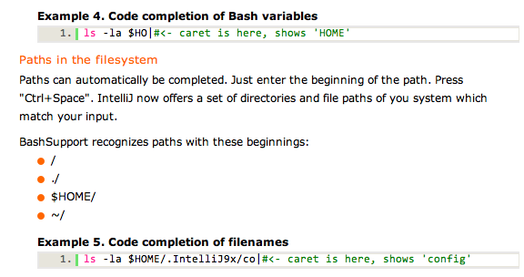
Roadmap (far future)
R Console for Idea
Learn from bash:AddReplAction
Use Rdaemon to access R session
Provide intentions for ggplot
Add path completion relative to getwd() (see bash plugin

Slide 9
Lexer
Just as the lexer is a source code spelling checker, the parser is a grammar checker
A utility such as JFlex builds a lexer from a specification file the programmer writes to define the 'words' (lexical tokens) in the desired language

Slide 10
Parser
The parser works by setting pairs of markers (PsiBuilder.Marker instances) within the stream of tokens received from the lexer. Each pair of markers defines the range of lexer tokens for a single node in the AST tree. If a pair of markers is nested in another pair (starts after its start and ends before its end), it becomes the child node of the outer pair.
The element type for the marker pair (and for the AST node created from it) is specified when the end marker is set (by a call to PsiBuilder.Marker.done())
BashElementTypes vs BashTokenTypes

Slide 11
Parser Basics: LL-Parser
Ein LL-Parser heißt LL(k)-Parser, wenn er während des Parsens k Tokens vorausschauen kann und im Gegensatz zum LF-Parser den Kellerinhalt benutzt. k wird dabei als Lookahead bezeichnet
Obwohl die LL(k)-Grammatiken relativ eingeschränkt sind, werden LL(k)-Parser oft benutzt. Die Entscheidung, nach welcher Regel expandiert wird, kann allein durch Analyse des Lookahead getroffen werden. Eine einfache Möglichkeit zur Implementierung dieser Parsertechnik bietet die Methode des rekursiven Abstiegs
Eine kontextfreie Grammatik heißt LL(k)-Grammatik für eine natürliche Zahl k, wenn jeder Ableitungsschritt eindeutig durch die nächsten k Symbole der Eingabe (Lookahead) bestimmt ist
Notes:
http://de.wikipedia.org/wiki/LL-Parsevr
http://de.wikipedia.org/wiki/LL(k)-Grammatik

Slide 12
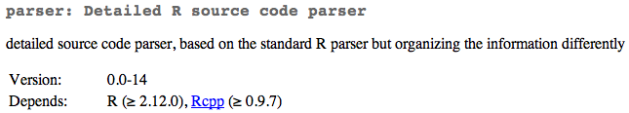
Parser package for R
Uses almost identical version of R grammar
According to parser docu: created using bison
Source file creates c-parser

Slide 13
Psi parser
Try the grammar kit
The Clojure parser is probably the simplest and smallest of all the custom language plugins that are maintained by us
No, IDEA currently does not have a ready solution for using generated parsers. The typical approach when writing parsers in IDEA is to create a method parseSmth(). for each rule in the grammar, and implement the rule in terms of PsiBuilder markers.
write lexer and parser manually (lexer is jflex-generated and parser is completely by hand) since you have to continue your parsing whatever user types in.
Language construction never been easy, it doesn't matter if you do it by hand or by Antlr

Slide 14
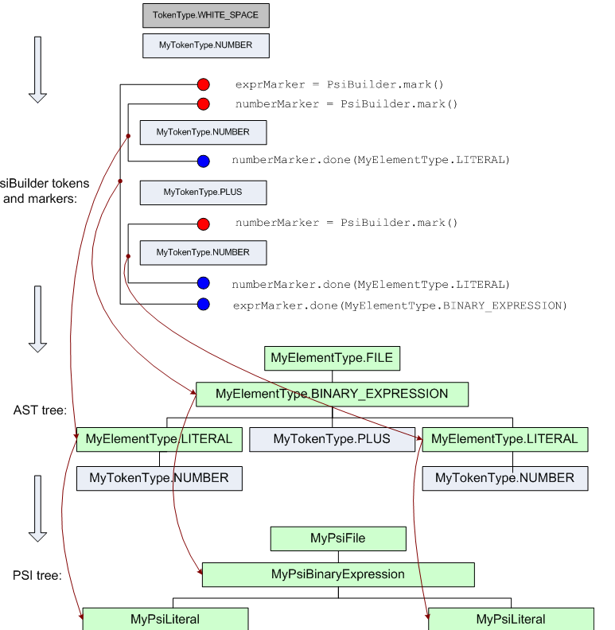
PsiParser
Notes:
http://www.jetbrains.com/idea/plugins/PsiBuilder.gif

Slide 15
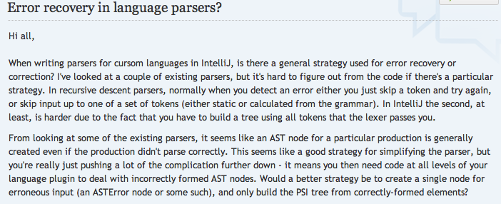

Slide 16
Recursive descent parser
kind of top-down parser built from a set of mutually-recursive procedures
Notes:
http://en.wikipedia.org/wiki/Recursive_descent_parser

Slide 17
GrammarKit Notes
All used special characters must be named in the token-section of the grammar header
Other tokens will be picked up on the fly from the grammar rules (e.g. string, number, id in the bnf-example)
They will be translated into RTokenTypes (→Rtypes)
They must be produced by the Lexer! (And just those, as other tokens will be ignored by the generated parser)

Slide 18
ANTLR notes
ANTLR imposes the convention that lexer rules start with an uppercase letter and parser rules with a lowercase letter

Slide 19
PEG
Indirect left-recursion is when a rule R calls a rule R′ which then calls R (where R and R′ are distinct rules). Indirect left-recursion adds a number of challenges
Direct Left-Recursive Parsing Expression Grammars → PEGs can be (indirect) left-recursive
Warth idea for packrat parsers: In essence, the parser turns from (recursive) top-down in normal operation to (iterative) bottom-up when left-recursion is detected

Slide 20
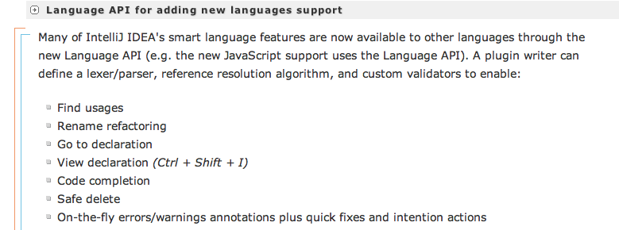
Custom Language: R
Notes:
http://www.jetbrains.com/idea/features/open_api_plugin_manager.html#link2

Slide 21
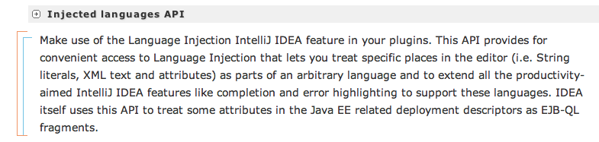
Language Injection

Slide 22
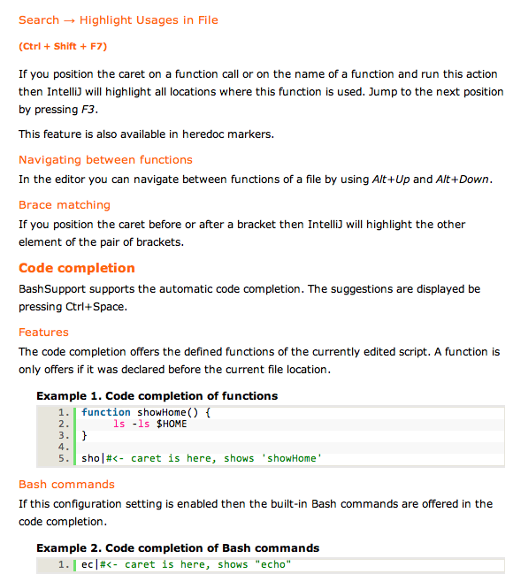
Bash plugin for Intellij
Well done: http://www.ansorg-it.com/en/products_bashsupport.html

Slide 23
Options for code snippet evaluation
R Session has almost complete implementation for console, objects, etc
TextMate bundle
Start R in special mode that reads all input from file and writes all output to another one which then somehow imported into textmate
I think FindWindow and SendMessage are the functions you want to use, in general.
Use the clipboard
Tinn-R: It also pops up additional menu and toolbar when it detects Rgui running on the same computer. These addons interact with the R console and allow to submit code in part or in whole and to control R directly.
It seems to have some limitations
Maybe DOM is a solution: rdom, RDCOMClient
Or white
Or most promising, we could try to use the windows API via VBScript or C#

Slide 24
R Console for Idea
Use RSession solution
Learn from TinnR

Slide 25
Tinn-R
Allows for Rgui interaction to evaluate line or selection
including list variables or objects, clearing console, even stopping the current process.
Code formatter
Bracket matching & checking
Commenting uncommenting

Slide 26
RStudio

Slide 27
