Slide 1
The importance of healthy eating
Good health is the basis for a healthy diet.
A healthy diet contributes to the optimal functioning of body and mind.

Slide 2

Physical and mental health
Healthy weight and shape.
Higher energy levels.
Reduced risk of chronic diseases.

Slide 3
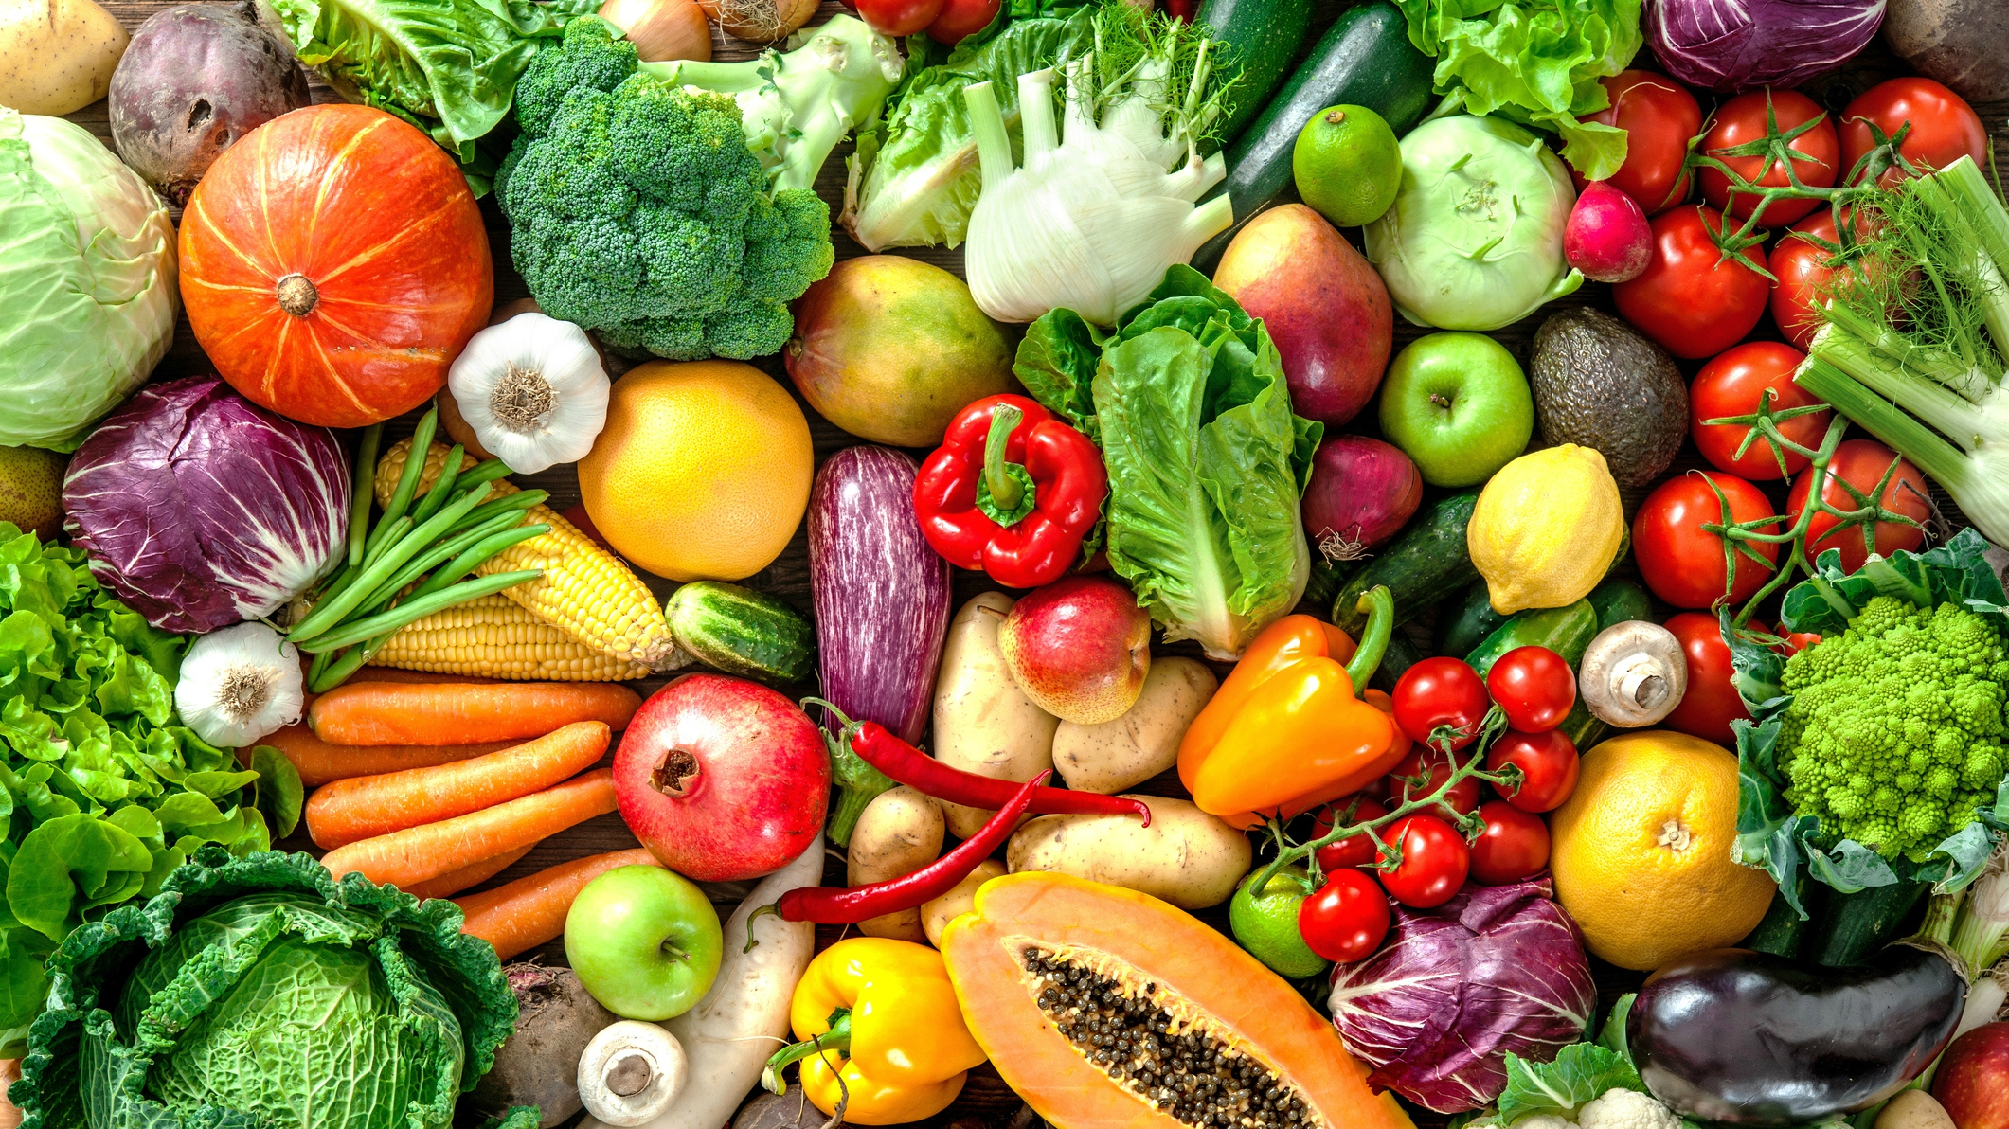

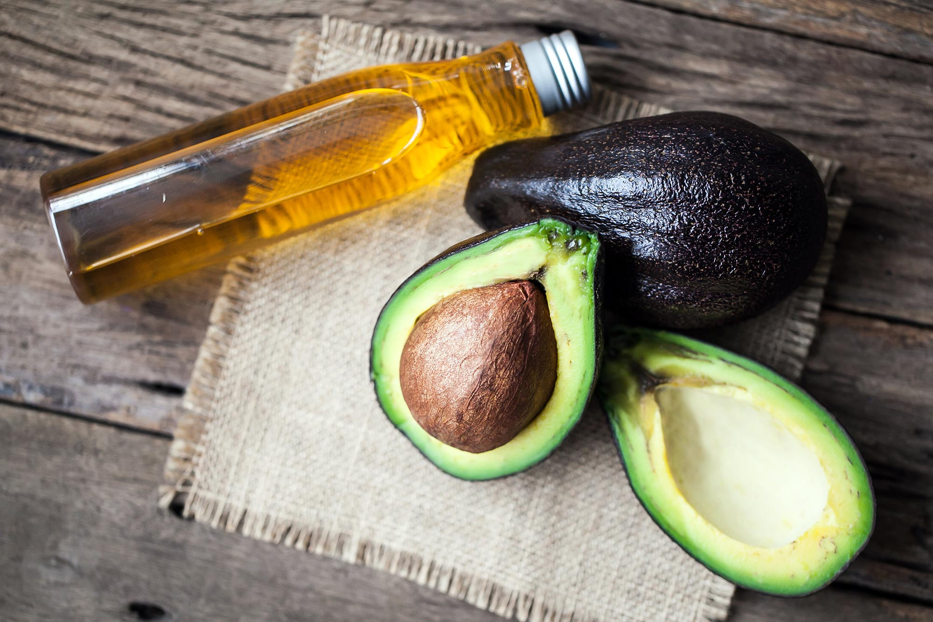

Basic foods
Vegetables and fruit.
Whole grains.
Healthy fats: olive oil, avocado.
High protein foods: meat, fish, pulses.

Slide 4



The factors to avoid
Sugar and refined foods.
Excessive salt intake.
Junk food.

