Slide 1
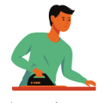
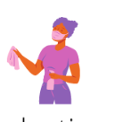


Sharing housework
Distribution of Tasks:
Practice of assigning tasks among individuals.
Typically within a group or team.
Teamwork Promotion:
Encourages collaboration.
Fosters a sense of collective responsibility.
Notes:
Housework sharing is the practice of distributing tasks or assignments
among individuals, typically within a group or team.
It promotes teamwork, encourages diverse perspectives, and fosters
a sense of collective responsibility for the shared goals or objectives.

Slide 2
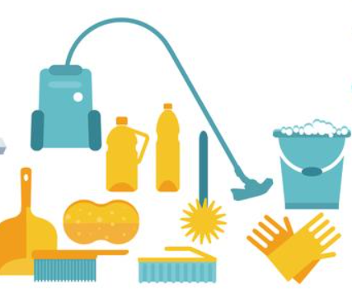
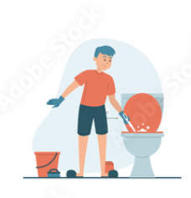
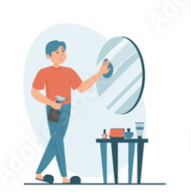
Sharing housework
Dividing tasks in a group speeds up work and enhances outcomes through collective input.
Homework sharing lightens individual workloads.
It creates a conducive environment for skill development.

Slide 3
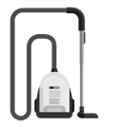
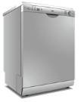
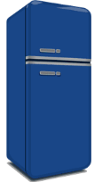



Labour saving devices
Today, there are many tools to help you in your everyday life
Notes:
Household appliances are essential for modern living, providing convenience, efficiency, and improved quality of life. They save time, enhance comfort, and contribute to a healthier and more organized home environment.

Slide 4
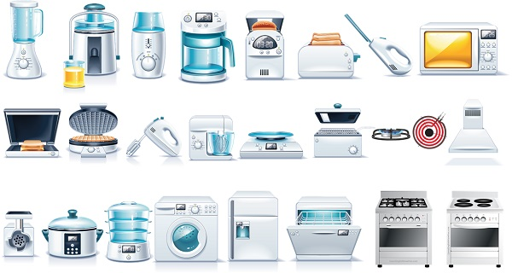
Labour saving devices
Cleaning tools:
Vacuum cleaner
Washing machine
Dishwasher
Kitchen equipments:
Blender
Toaster
Coffee maker
Kettle
Mixer
Food processor
Notes:
Household appliances, such as refrigerators and washing machines, play a crucial role in easing daily chores and maintaining a comfortable home environment.
Modern kitchens are equipped with a variety of appliances, from microwaves for quick cooking to blenders and mixers for food preparation.

Slide 5
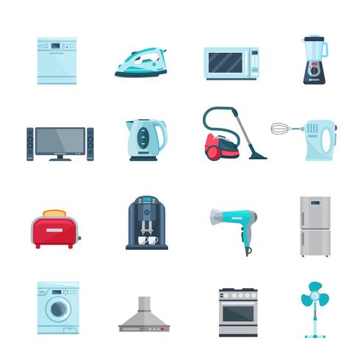
Labour saving devices
Other household appliances:
Microwave oven
Iron
Trash can
Air purifier
Cooling and heating:
Refrigerator
Oven

Slide 6
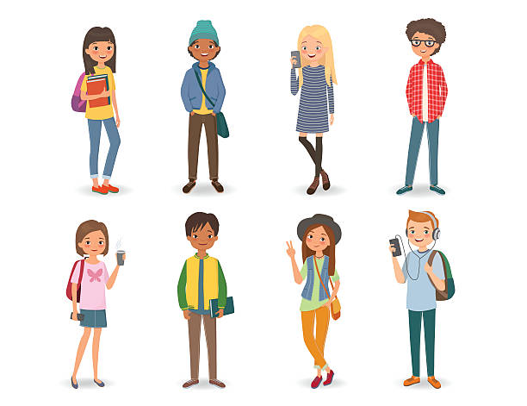
Typical tasks of teenagers at home
Chores
Homework and Study
Personal Responsibilities
Meal Preparation
Errands
Notes:
Chores: Contributing to household chores such as cleaning, laundry, or dishwashing.
Homework and Study: Spending time on academic responsibilities, completing homework, and studying.
Personal Responsibilities: Taking care of personal spaces, such as keeping rooms tidy and organized.
Meal Preparation: Helping with meal preparation or cooking under supervision.
Errands: Running simple errands, like grocery shopping or picking up items.

