Slide 1
Eating out

Slide 2
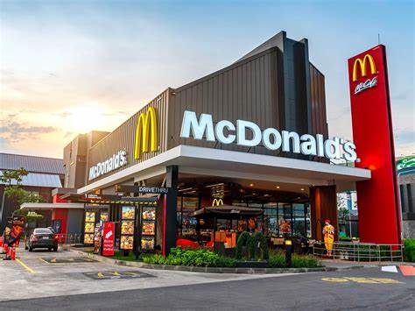
Types of food and drinks you can choose:
Fast Food Restaurants:
Fast food restaurants typically offer a limited menu.
Standardized dishes and pre-packaged ingredients.
Popular items include hamburgers, fries, sandwiches, pizza, and chicken, tortillas, kebabs.
Drinks: refillable cups, non-alcoholic drinks (soda, soft drinks: sparkling, still mineral water, juice and fruit drinks)

Slide 3
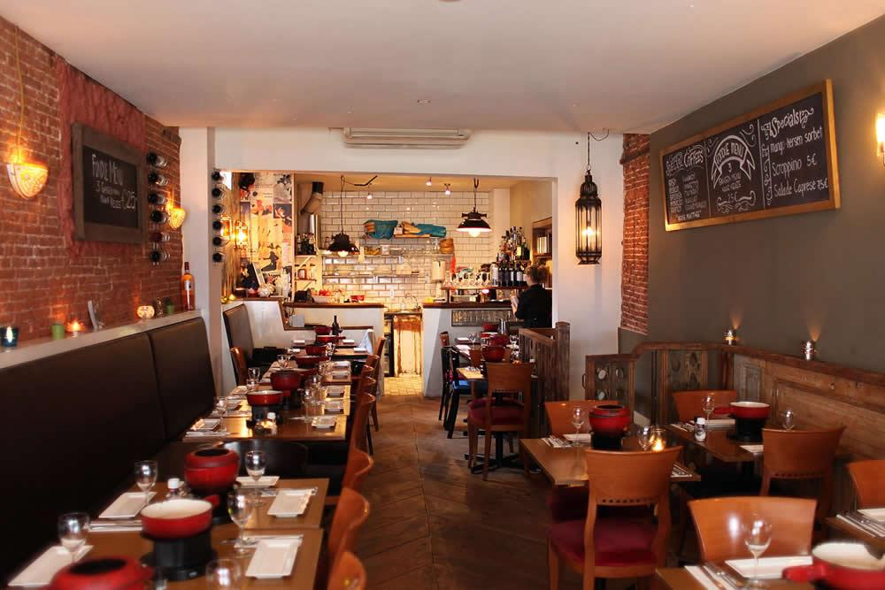
Types of food and drinks you can choose:
Traditional Restaurants:
Traditional restaurants offer a wider variety of dishes.
Including freshly prepared food with a wider range of ingredients.
The menu may include traditional dishes as well as international cuisine.
Food: startres, soup, pasta, meat dishes, side dish, desserts
Drinks: alcoholic and non-alcoholic

Slide 4
Prices and Atmosphere:
Fast Food Restaurants:
Traditional Restaurants:
Fast food restaurants are generally less expensive than traditional restaurants.
They often offer combo meals and discount deals.
Traditional restaurants are typically more expensive than fast food restaurants.
Individual items are more expensive, and there are fewer discount options.

Slide 5
Ordering and Payment:
Fast Food Restaurants:
Traditional Restaurants:
Fast food restaurants typically have a counter or self-service kiosk where customers can order and pay or you can order online
Traditional restaurants typically have a waiter or waitress who takes the customer's order and brings the food to the table.
Payment is usually made at the end of the meal, at the waiter.
Usually 10% tips are expected (often included in the bill)

Slide 6
Feature: | Fast Food Restaurants: | Traditional Restaurants:
Menu Variety: | Limited, pre-prepared meals | Wider selection, focus on fresh ingredients
Ordering Process: | Counter service, self-service kiosks | Tableside service
Pricing: | Affordable, $5-10 per meal | Higher prices, $15-50+ per meal
Atmosphere: | Casual, fast | Relaxed, refined, more elegant

Slide 7
Thank you for your attention!
Made by: Piros Zsolt, Szabó Roland, Molnár Barnabás

