Slide 1
Different ways of spending free time
Made by: Szabó Zoltán, Szabó Bence

Slide 2
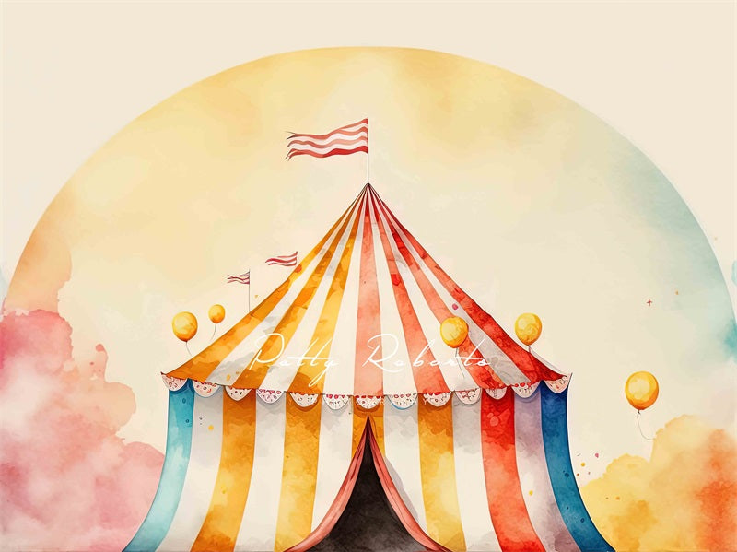
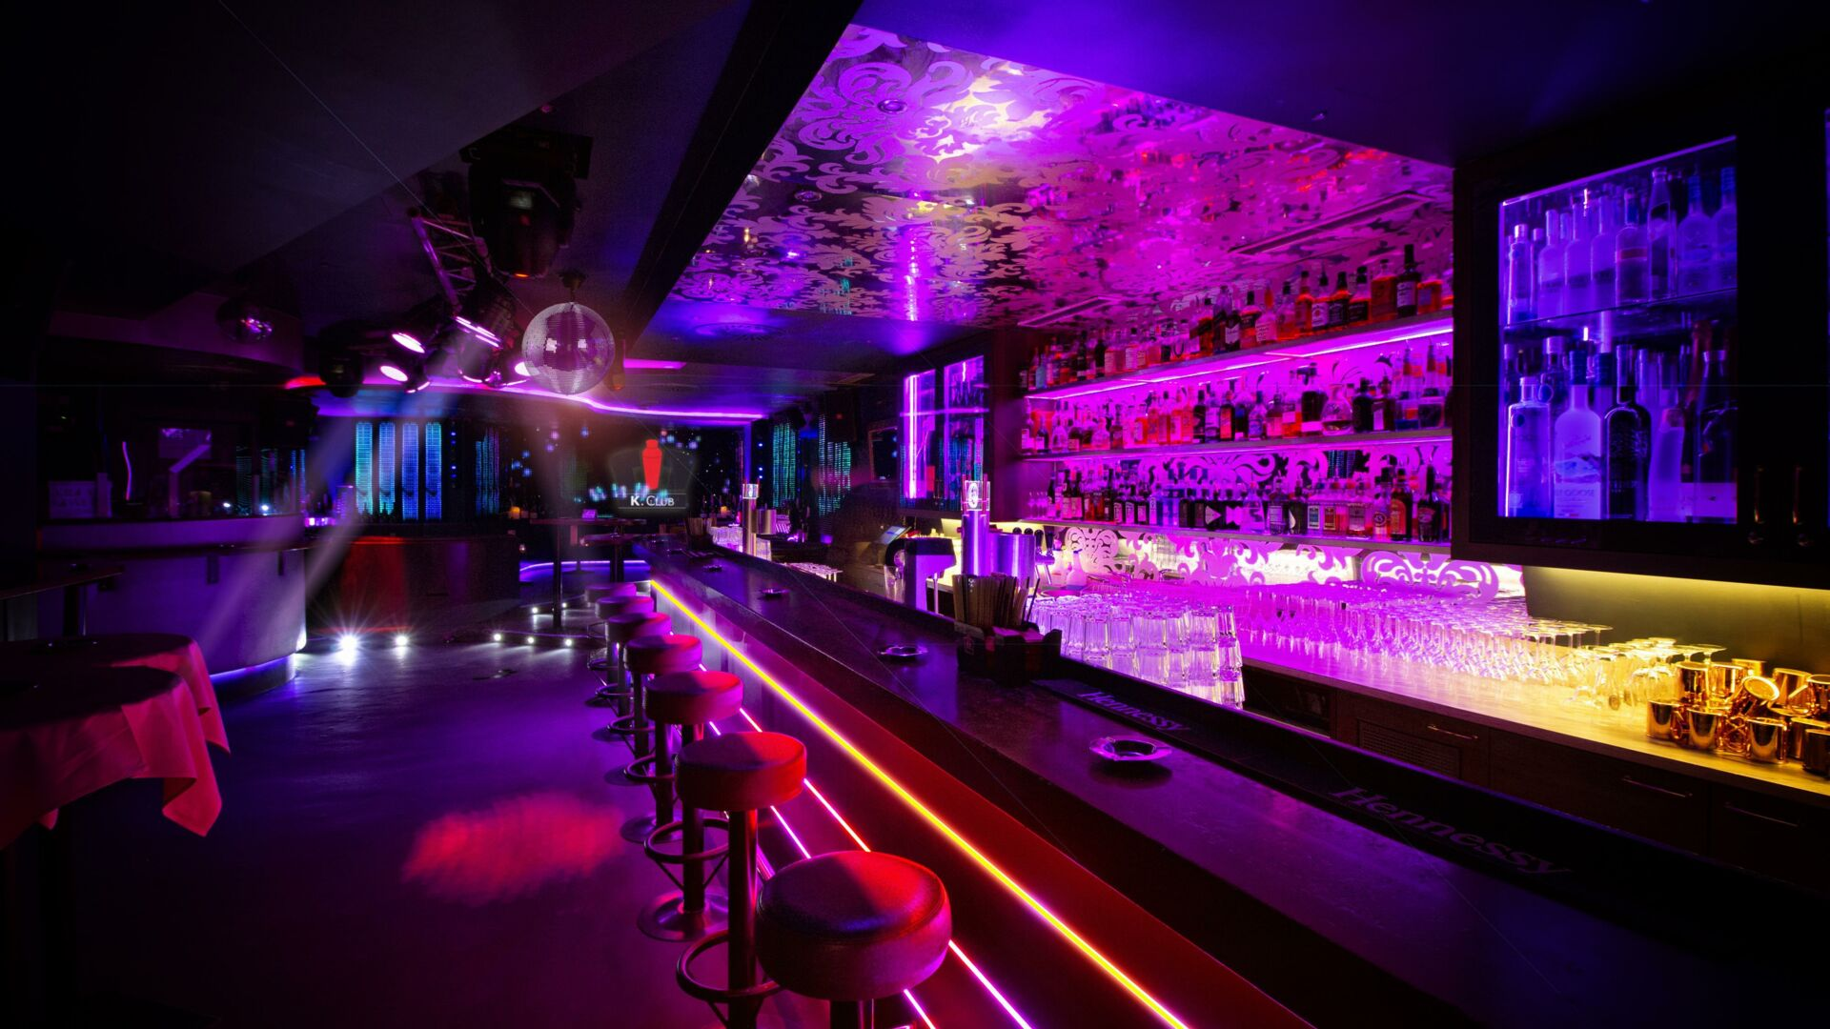
Places for entertainments
In the past
Nowadays
Theater
Community Halls
Social Clubs
Libraries
Circus
Concerts, music festivals
Sporting events
Clubs
Social Media Platforms
Cinema

Slide 3
Advantages
Cinema
Relax
Eat while watching
Atmosphere and Ambiance
Latest Releases
Sport
Physical activity
Stress Relief
Teamwork and Cooperation
Skill Development

Slide 4
Disadvantages
Cinema
You can’t pause the movie
Limited Movie Choices
Crowds and Noise
Expensive snacks
Sport
Expensive equipment
Weather dependent
Injuries
Time-consuming

Slide 5
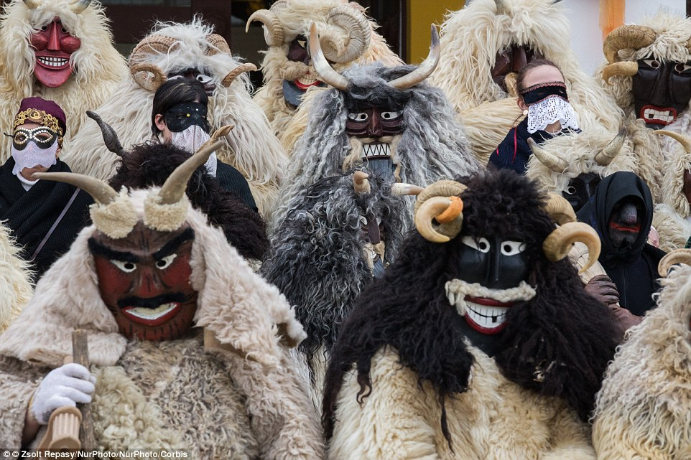
Popular free time activities in Hungary
Thermal Baths and Spas
Cultural Events and Festivals
Fitness and Wellness Activities
Concerts

Slide 6

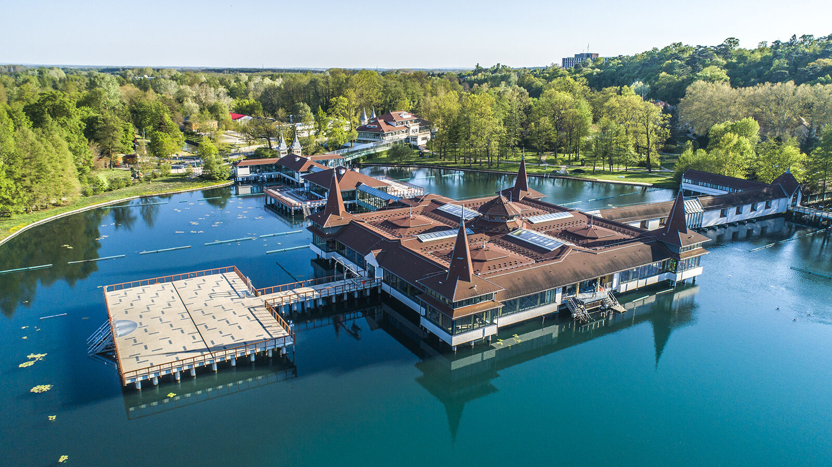
Most popular free time activity in Hungary
Hungary has a lot of thermal water
Lot of cities have termal baths
Daily ticket is cheap
Good for the health
No limits for the people you go with
There is no age limit
Thermal Baths and Spas

Slide 7
Thanks for watching

Slide 8
Sources
Free time activities
Image1
Image2
Image3
Image4

