Slide 1
Healthy eating:
The Key to Health
Made by: Dudás René & Gombkötő Dávid

Slide 2
Topics
The importance of healthy eating
Physical and mental health
Basic foods
The factors to avoid

Slide 3

The importance of healthy eating
Good health is the basis for a healthy diet.
A healthy diet contributes to the optimal functioning of body and mind.

Slide 4

Physical and mental health
Healthy weight and shape.
Higher energy levels.
Reduced risk of chronic diseases.

Slide 5
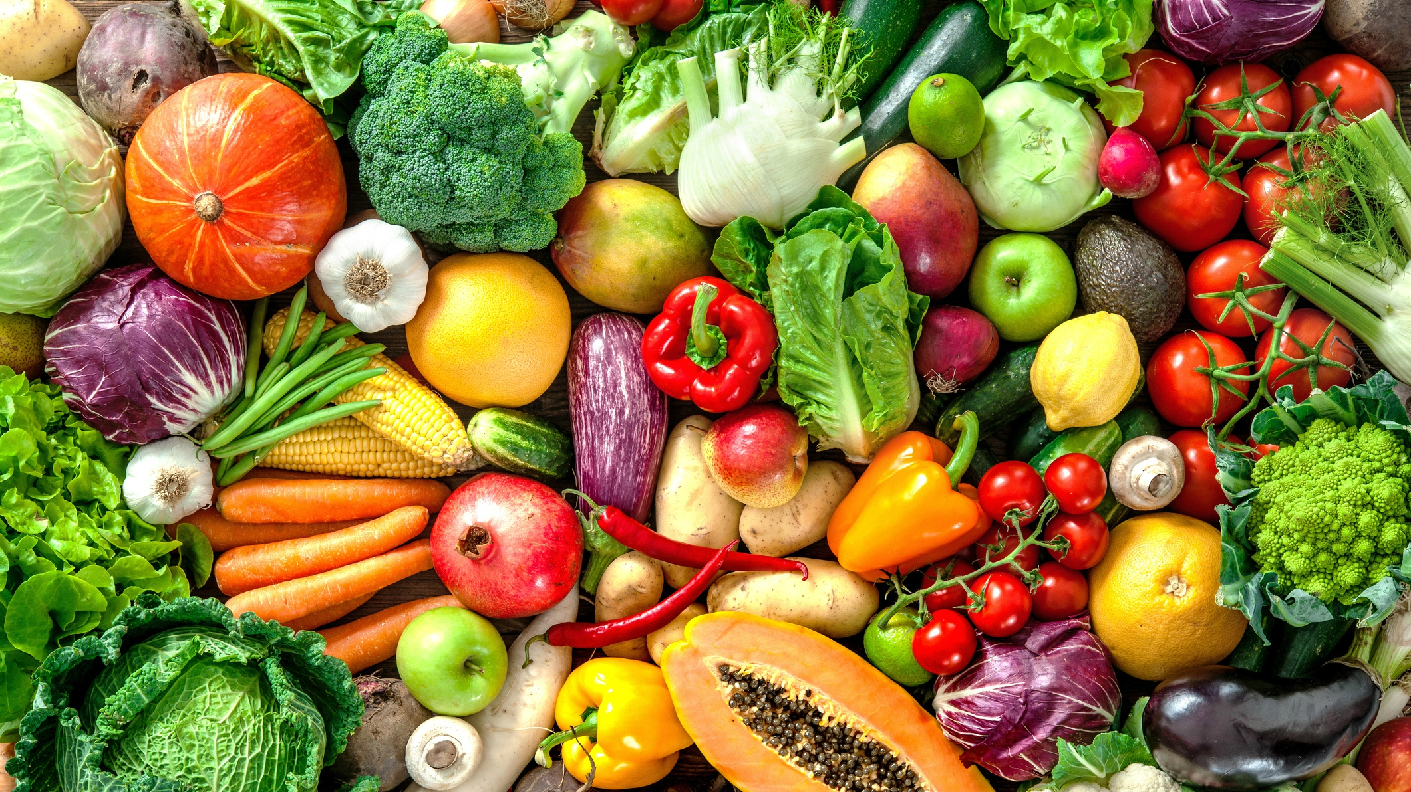
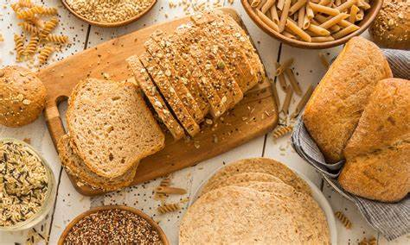
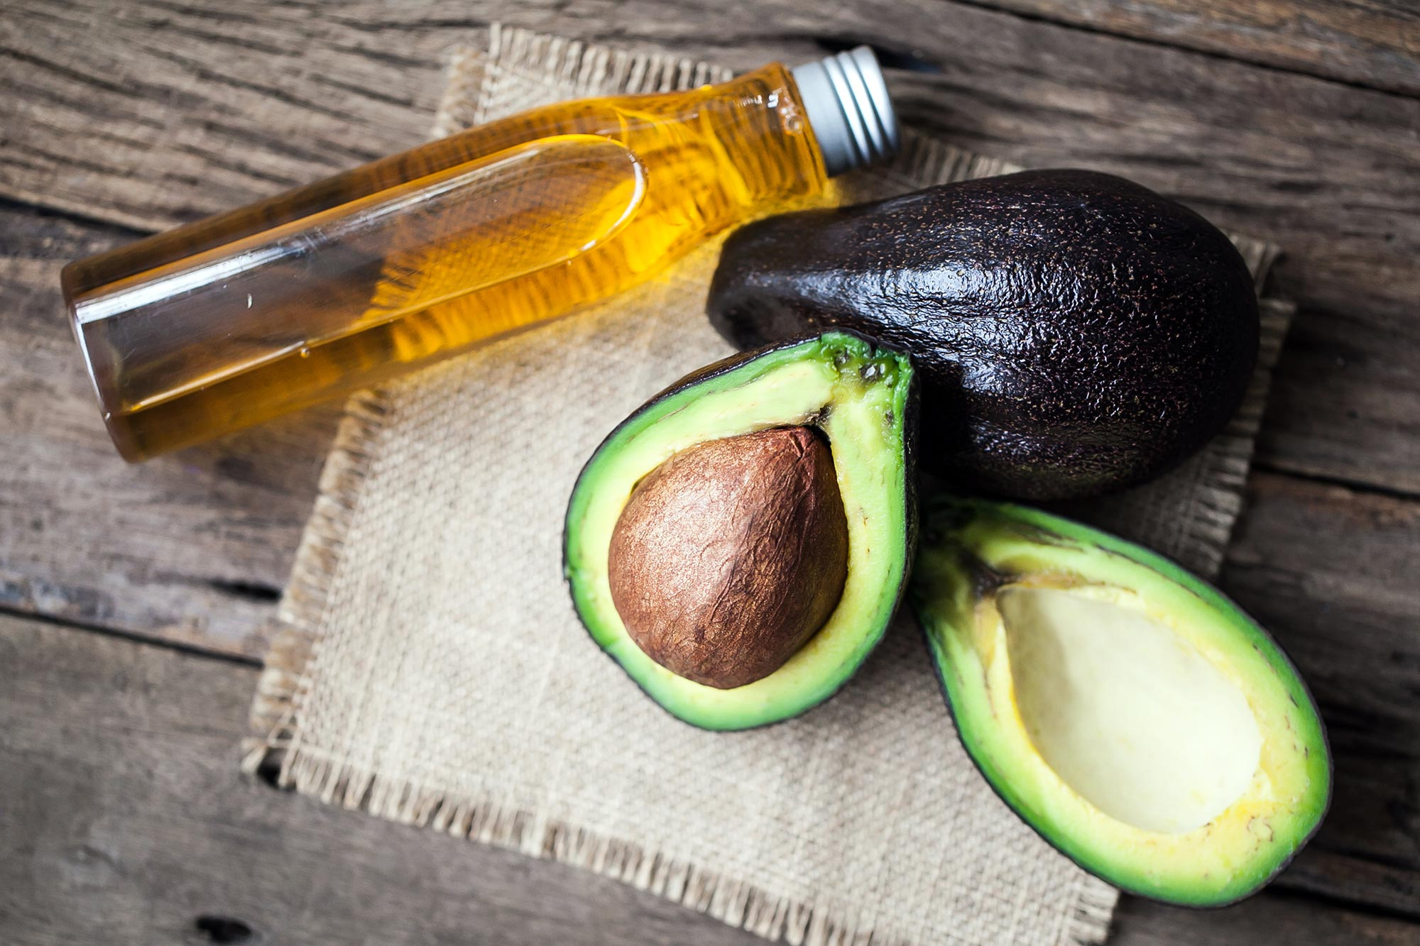
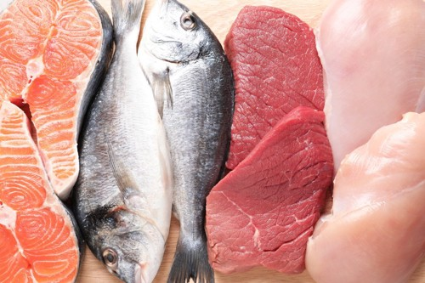
Basic foods
Vegetables and fruit.
Whole grains.
Healthy fats: olive oil, avocado.
High protein foods: meat, fish, pulses.

Slide 6

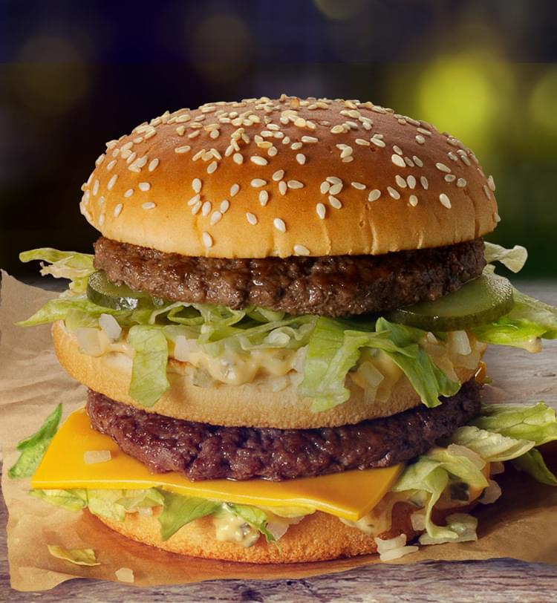

The factors to avoid
Sugar and refined foods.
Excessive salt intake.
Junk food.

Slide 7
Sources
https://www.bing.com/images
McDonald’s HU (mcdonalds.com)
Wikipédia, a szabad enciklopédia (wikipedia.org)
ChatGPT (openai.com)

Slide 8
Thank you for your attention!

