Slide 1
Housework
Bárkányi Bence, Bencsik Attila

Slide 2
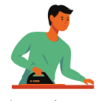
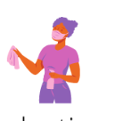
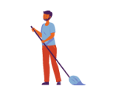
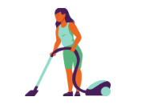
Sharing housework
Distribution of Tasks:
Practice of assigning tasks among individuals.
Typically within a group or team.
Teamwork Promotion:
Encourages collaboration.
Fosters a sense of collective responsibility.
Notes:
Housework sharing is the practice of distributing tasks or assignments
among individuals, typically within a group or team.
It promotes teamwork, encourages diverse perspectives, and fosters
a sense of collective responsibility for the shared goals or objectives.

Slide 3
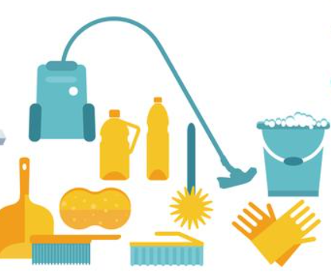
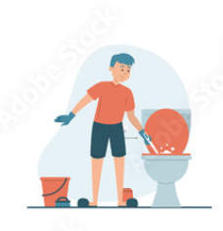
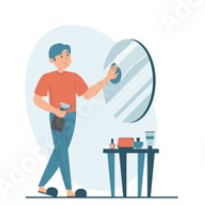
Sharing housework
Dividing tasks in a group speeds up work and enhances outcomes through collective input.
Homework sharing lightens individual workloads.
It creates a conducive environment for skill development.

Slide 4
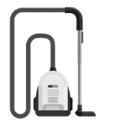
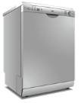
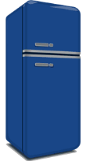



Labour saving devices
Today, there are many tools to help you in your everyday life
Notes:
Household appliances are essential for modern living, providing convenience, efficiency, and improved quality of life. They save time, enhance comfort, and contribute to a healthier and more organized home environment.

Slide 5
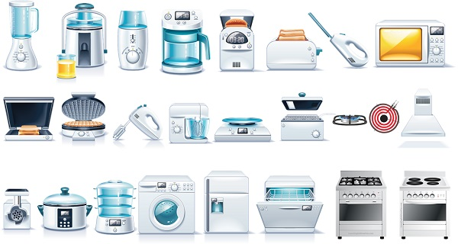
Labour saving devices
Cleaning tools:
Vacuum cleaner
Washing machine
Dishwasher
Kitchen equipments:
Blender
Toaster
Coffee maker
Kettle
Mixer
Food processor
Notes:
Household appliances, such as refrigerators and washing machines, play a crucial role in easing daily chores and maintaining a comfortable home environment.
Modern kitchens are equipped with a variety of appliances, from microwaves for quick cooking to blenders and mixers for food preparation.

Slide 6
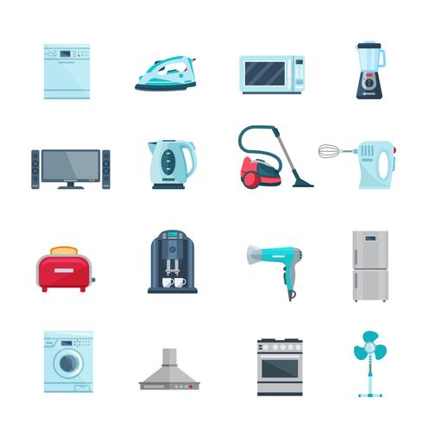
Labour saving devices
Other household appliances:
Microwave oven
Iron
Trash can
Air purifier
Cooling and heating:
Refrigerator
Oven
Notes:
Here you can see other tools to use around the house.

Slide 7
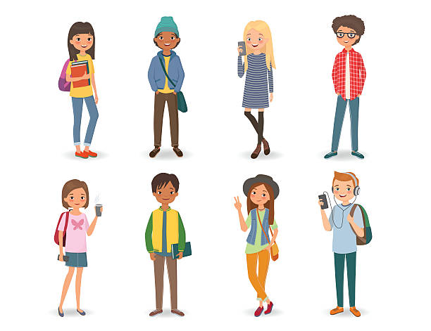
Typical tasks of teenagers at home
Chores
Homework and Study
Personal Responsibilities
Meal Preparation
Errands
Notes:
Chores: Contributing to household chores such as cleaning, laundry, or dishwashing.
Homework and Study: Spending time on academic responsibilities, completing homework, and studying.
Personal Responsibilities: Taking care of personal spaces, such as keeping rooms tidy and organized.
Meal Preparation: Helping with meal preparation or cooking under supervision.
Errands: Running simple errands, like grocery shopping or picking up items.

Slide 8

Thank you for your attention

Slide 9
Sources:
https://www.istockphoto.com/hu/illusztrációk/teenager
https://imgflip.com/i/3g4qb2
https://www.vecteezy.com/vector-art/466883-flat-color-icons-set-of-household-appliances
https://content.cambly.com/2016/08/28/topic-household-appliances/
https://ru.pinterest.com/pin/840836192906111425/
https://myenglishteacher.co.uk/2021/07/05/how-to-talk-about-housework/
https://stock.adobe.com/dk/images/housework-set-vector-isolated-collection-of-men-doing-house-work-vacuum-cleaning-clothes-ironing-cooking-wiping-dust-male-characters-cleaning-window-and-mirror/423172775

