Slide 1
Learning languages
Surin patrik, tószögi olivér

Slide 2


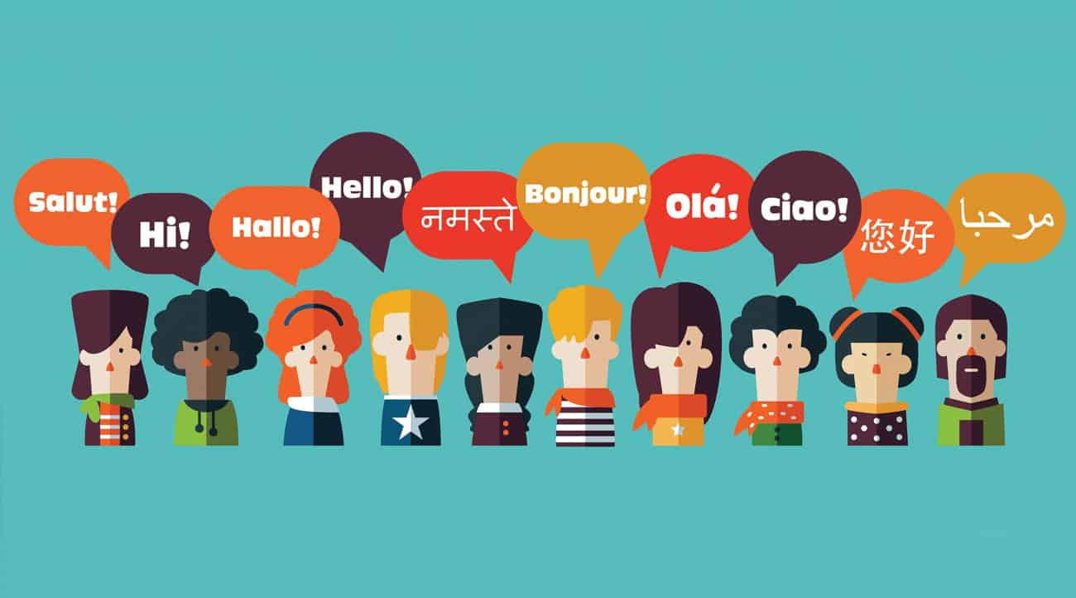
Ways of learning languages
Watch films or series in foreign language
If you can afford you should travel in foreign countries
There are lot of courses online
Play video games with strangers

Slide 3

Importance of learning languages
Employability
Higher earnings
orientation

Slide 4

Most popular languages
1. English
Known as the official language of business, English is the most widely spoken language in the world.
There are around 86 countries with English as the official language or second language.

Slide 5

Most popular languages
2. Mandarin
Over 1.1 billion people speak Mandarin, but Chinese is not a single language. Actually, it's a group of related languages, where Mandarin is the largest.

Slide 6
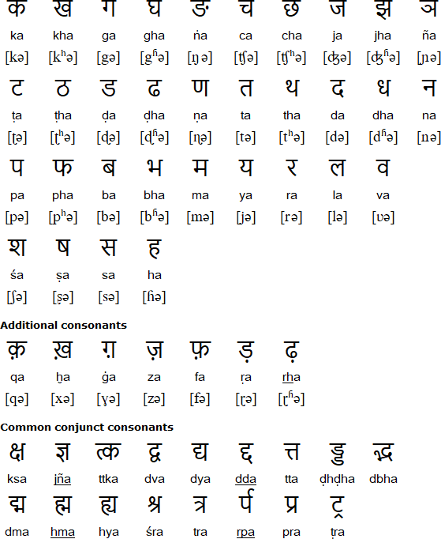
Most popular languages
3. Hindi
Hindi is one of India's official languages, and its large population of native speakers has led Hindi to become one of the world's most spoken languages. More than 250 million people speaking it as their first language.

Slide 7
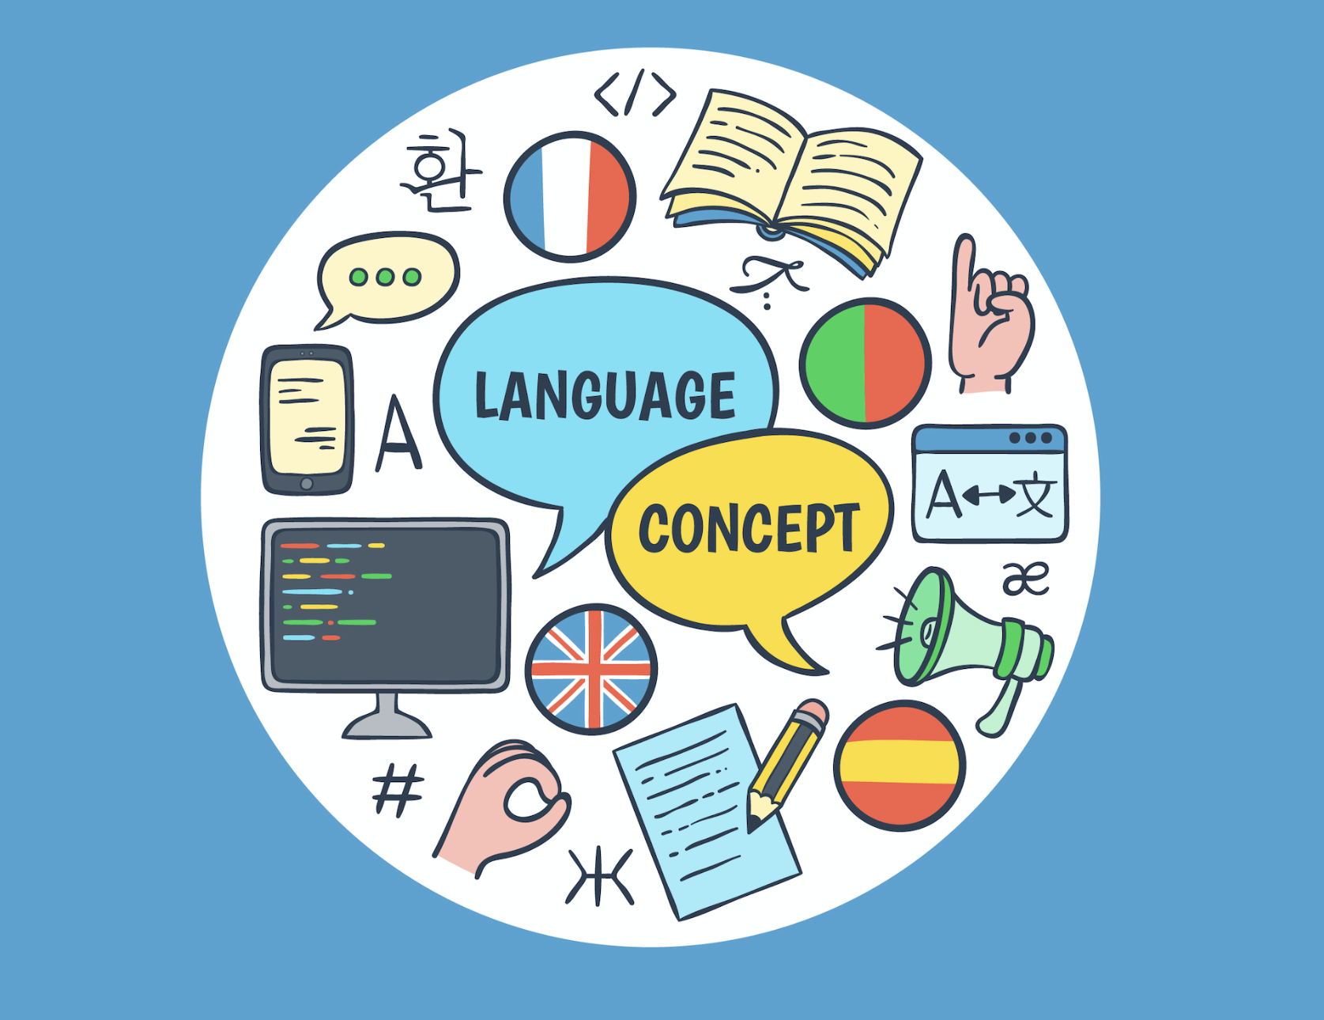
Thank you for your attention!

