Slide 1

Job types and examples

Slide 2
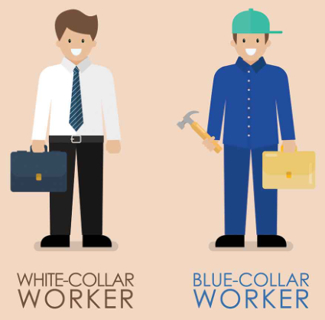
What’s the difference between White-collar worker, and Blue-collar Worker?

Slide 3
Advantages of White- and Blue-Collar Jobs:
- Advantages of White-Collar Workers: (mental jobs)
Higher education.
Workplace.
Higher pay.
More respected
Sometimes more flexible
More comfortable
- Advantages of Blue-Collar Workers: (manual jobs)
Work in skilled trades.
Lower education is needed for entry.
Accessibility. (more opportunities, easier to find)
Useful skills

Slide 4
Disadvantages of White- and Blue-Collar Jobs:
- Disadvantages of White-Collar Workers:
Working hours.
High expectations.
Monotony.
Lack of stability
stressful
- Disadvantages of Blue-Collar Workers:
Physically demanding.
Lower pay.
High risk of injury, dangerous

Slide 5
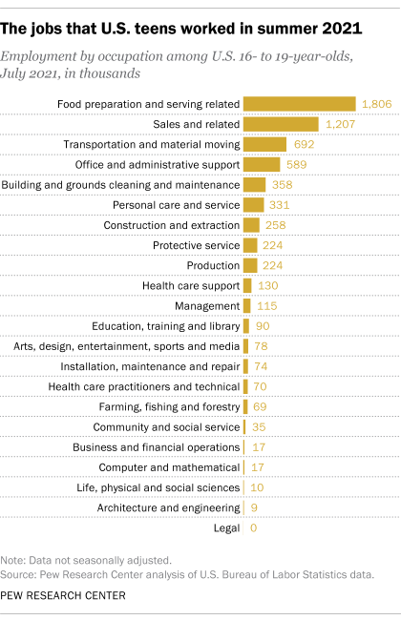
Advantages of Summer Jobs for Students:
Work Experience:
Valuable experience.
Practical skills increase.
More pocket money
Soft Skills Development:
Social skills: Communication, team work
Time management.
Independence
Responsibility

Slide 6
Disadvantages of Summer Jobs for Students:
Low Pay:
Entry-level.
Limited financial reward.
Repetitive or Monotonious Tasks:
Boring worktime
Students not interested in.

Slide 7
Examples of Summer
Jobs for Students:
Retail Positions:
Shop assistant
Retail assistant.
Hospitality Industry:
Host/hostess at a restaurant.
Hotel front desk clerk or housekeeping assistant.
Cleaner, kitchen hand
Factory work
Working in the fields
Delivery person
Examples of White-and Blue-Collar Jobs:
Examples of White-Collar Jobs:
Financial analyst.
IT professional.
Doctor
Engineer
Examples of Blue-Collar Jobs:
Construction worker.
Factory worker.

Slide 8
Thank you for your attention
Source: https://hu.wikipedia.org/wiki/.jobs
Made by:Tibor Kolarovszki, Hunor Baukó

