Slide 1
PPSR – transformation from XLSX to JSON incl. Schema
Chrisa Tsinaraki, Sven Schade, Irena Mitton
Notes:
These slides lay out the process the we used to transform the (master) content on PPSR – from an excel file – into an according JSON Schema. This JSON Schema thus provides an implementation of the standard. We also illustrate how we then transformed an exiting inventory of citizen science projects into a JSON file that follows the structure of standard. We show that this file validates against the previously generated JSON Schema.
We hope that this helps others to implement the standard as well, and to automatically provide implementation structures (JSON Schemas) of future versions of the standard.
The process is implemented using open source tools in order to maximize possible reuse.

Slide 2
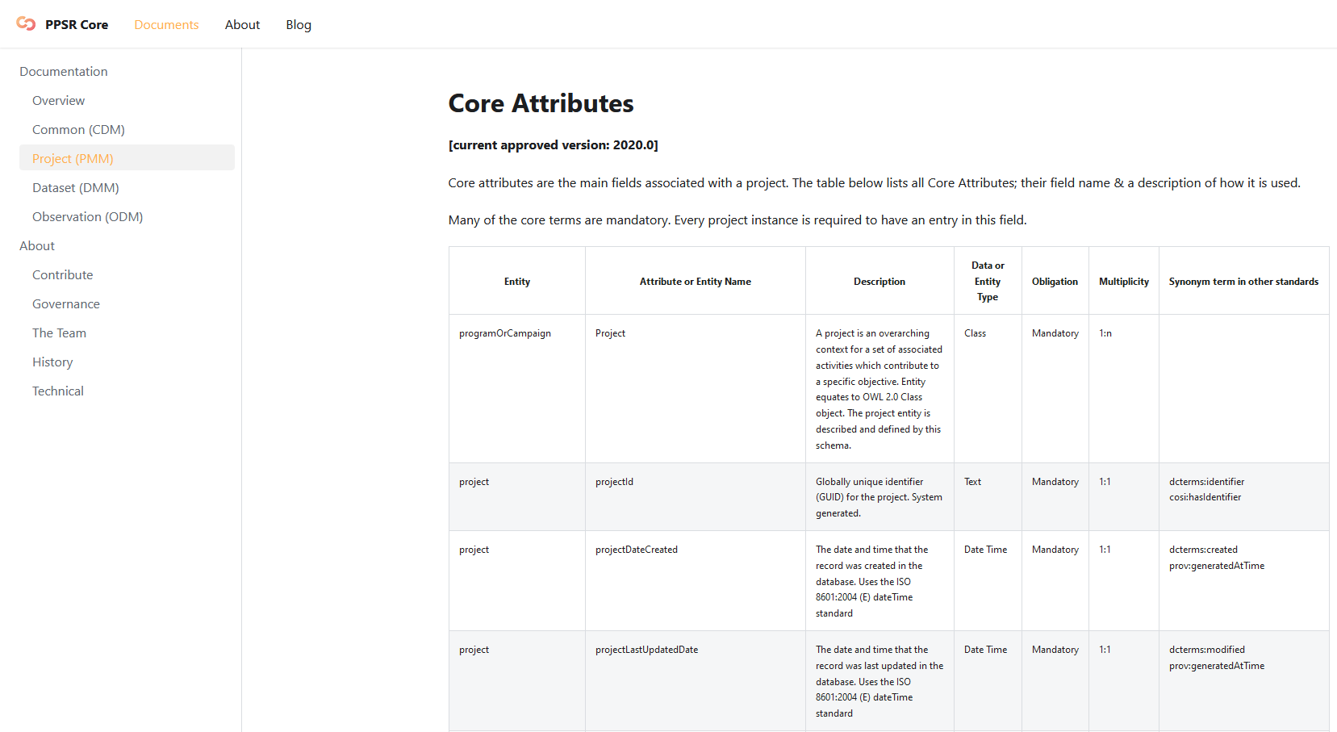
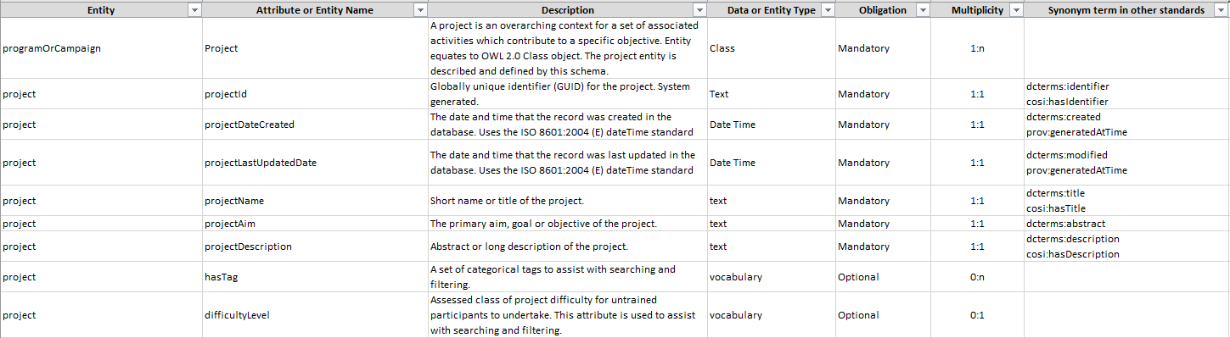
From GitHUB PPSR model, creating a XLSX file…
https://core.citizenscience.org/
Notes:
It is most important to one single source (master) that captures the most recent version of PPSR as a standard. Only when this exists and all derived resources (documentaiton, visualizations, schemas, etc.) are automatically generated from it, we can ensure synchronicity.
This slide illustrates our starting point: the Excel table provided by the Citizen Science Association (CSA)-hosted International Working group on Citizen Science Data and Metadata.
The model taken is the PPSR metadata model for the project descriptions, including all core attributes and associated vocabulary

Slide 3

Pentaho Data Integration PDI (Spoon)
Download: https://sourceforge.net/projects/pentaho/
Features:
ETL tool
Extracts data
Transforms data
Loads data
drop-and-drag, graphical invironment with progress feedback
Spoon application, is a graphical user interface to design transformation and jobs
Notes:
We used Pentaho as an open source tool for implementing the transformation we needed. The choice was made because this is an open and widely used tool.

Slide 4
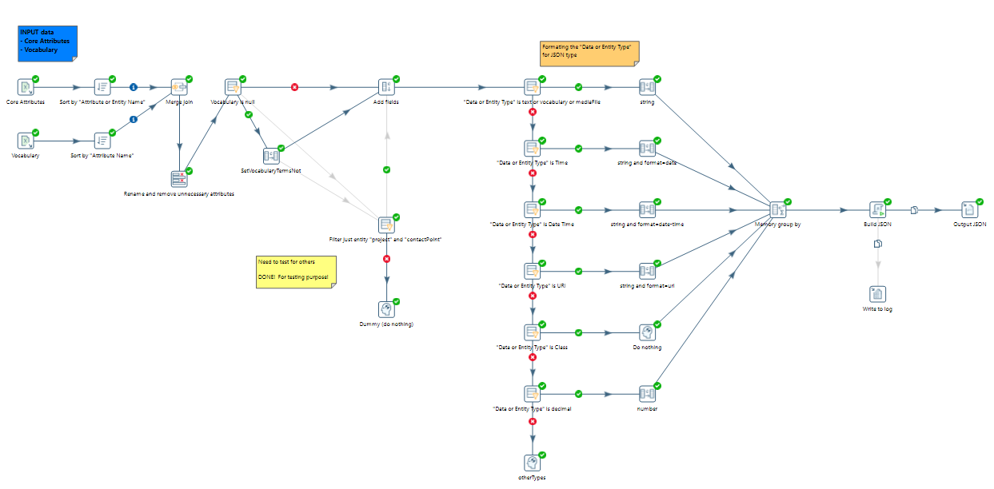
Pentaho DI workspace (JSON Schema)
Transformation
Renaming/adding attributes
Transformation for
JSON Schema
Build JSON and Output
Input data
Notes:
Using the Pentaho graphical user interface, we created the workflow that generates from the Excel table (input data) and produces an according JSON Schema.
In between loading the input file, and writing the output schema, this includes a series of transformations, which are separates into two blocks.

Slide 5
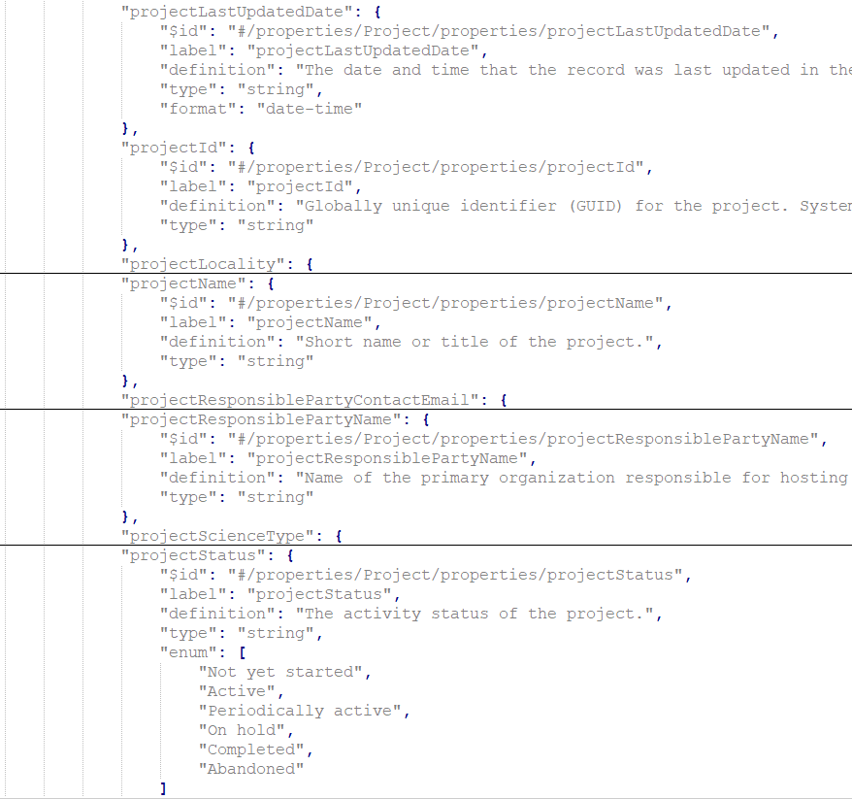
Structuring a JSON Schema
type-specific keyword
specifies the data type for a schema
format keyword
semantic validation on certain kinds of string
required keyword (mandatory attributes)
list of required properties
patternProperties keyword
control the handling of extra stuff
enumerated values
restrict a value to a fixed set of values
oneOf
allowing a value to be validated against multiple criteria at the same time
...
" projectId " :
{type:string}
" projectLastUpdatedDate" : {type:string,
format : date-time}
Notes:
Looking into the details of the generated JSON Schema, it is important to highlight some specific decisions taken, and their implications on the final schema.

Slide 6
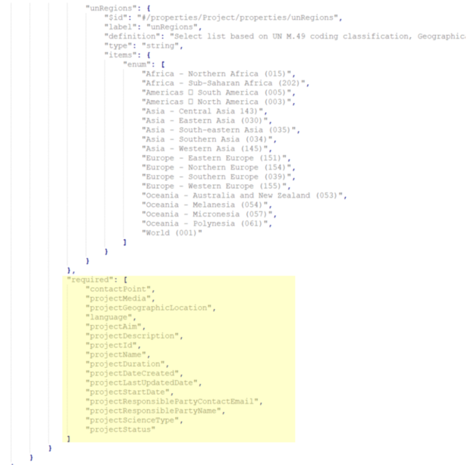
Structuring a JSON Schema
"required": [
"contactPoint",
"projectGeographicLocation",
"projectMedia",
"language",
"projectAim",
"projectDescription",
"projectDuration",
"projectDateCreated",
"projectId",
"projectName",
"projectResponsiblePartyContactEmail",
"projectResponsiblePartyName",
"projectScienceType",
"projectStatus",
"projectLastUpdatedDate",
"projectStartDate"
],
type-specific keyword
specifies the data type for a schema
format keyword
semantic validation on certain kinds of string
required keyword (mandatory attributes)
list of required properties
patternProperties keyword
control the handling of extra stuff
enumerated values
restrict a value to a fixed set of values
oneOf
allowing a value to be validated against multiple criteria at the same time
...
Notes:
Looking into the details of the generated JSON Schema, it is important to highlight some specific decisions taken, and their implications on the final schema.

Slide 7
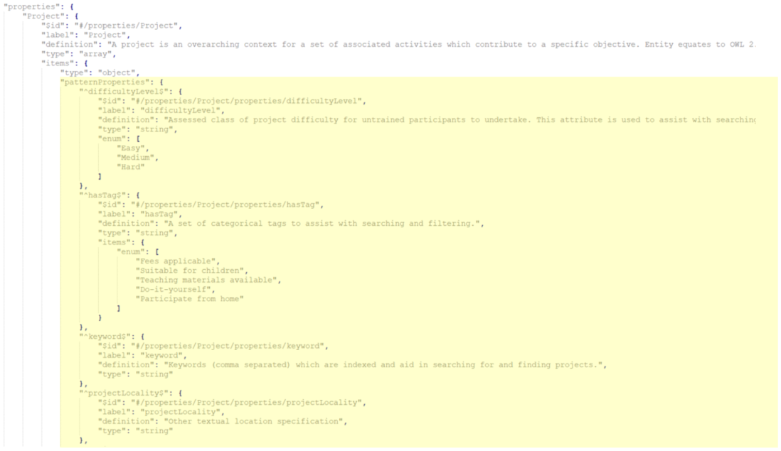
Structuring a JSON Schema
type-specific keyword
specifies the data type for a schema
format keyword
semantic validation on certain kinds of string
required keyword (mandatory attributes)
list of required properties
patternProperties keyword
control the handling of extra stuff
enumerated values
restrict a value to a fixed set of values
oneOf
allowing a value to be validated against multiple criteria at the same time
...
"patternProperties": {
"^difficultyLevel$": {
"label": "difficultyLevel",
"definition": "Assessed class of project difficulty (...)
"type": "string",
"enum": [
"Easy",
"Medium",
"Hard"
]
},
"^projectEndDate$": {
"label": "projectEndDate",
"definition": "The actual date that the project ended. (...)
"type": "string"
},
(...)
Notes:
Looking into the details of the generated JSON Schema, it is important to highlight some specific decisions taken, and their implications on the final schema.

Slide 8
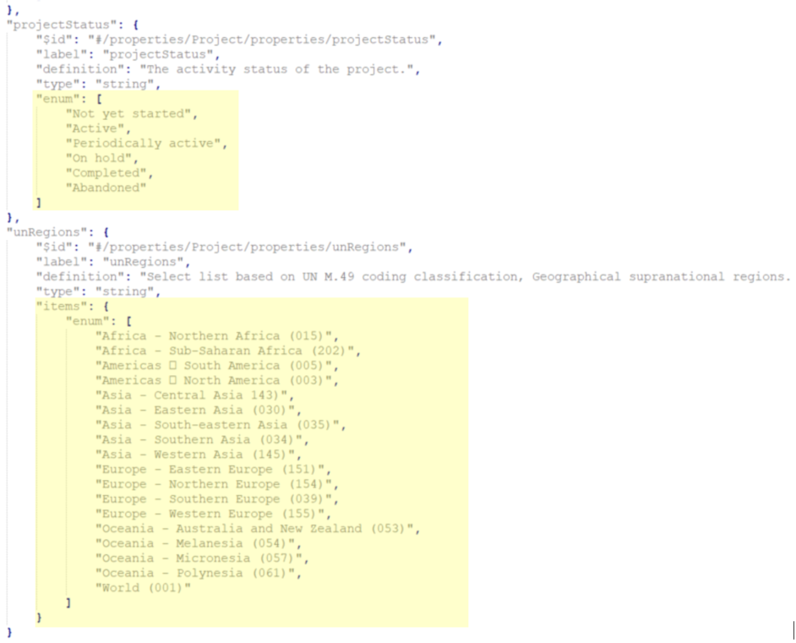
Structuring a JSON Schema
"projectStatus": {
(….),
"type": "string",
"enum": [
"Not yet started",
"Active",
"Periodically active",
"On hold",
"Completed",
"Abandoned"
]
},
type-specific keyword
specifies the data type for a schema
format keyword
semantic validation on certain kinds of string
required keyword (mandatory attributes)
list of required properties
patternProperties keyword
control the handling of extra stuff
enumerated values
restrict a value to a fixed set of values
oneOf
allowing a value to be validated against multiple criteria at the same time
...
"unRegions": {
(...),
"type": "array",
"items": {
"enum": [
"Africa - Northern Africa (015)",
"Africa - Sub-Saharan Africa (202)",
(...),
"World (001)"
]
}
}
Notes:
Looking into the details of the generated JSON Schema, it is important to highlight some specific decisions taken, and their implications on the final schema.

Slide 9
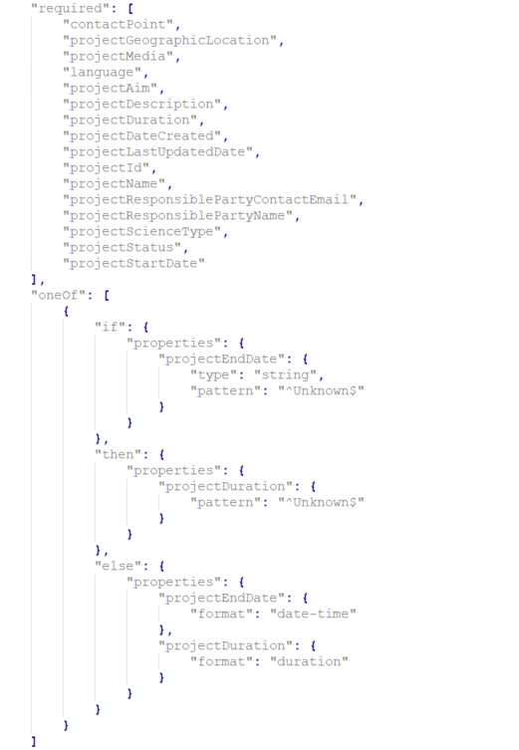
Structuring a JSON Schema
"oneOf": [
{
"if": {
"properties": {
"projectEndDate": {
"type": "string",
"pattern": "^Unknown$"
}
}
},
"then": {
"properties": {
"projectDuration": {
"pattern": "^Unknown$"
}
}
},
"else": {
"properties": {
"projectEndDate": {
"format": "date-time"
},
"projectDuration": {
"format": "duration"
}
}
}
}
]
type-specific keyword
specifies the data type for a schema
format keyword
semantic validation on certain kinds of string
required keyword (mandatory attributes)
list of required properties
patternProperties keyword
control the handling of extra stuff
enumerated values
restrict a value to a fixed set of values
oneOf
allowing a value to be validated against multiple criteria at the same time
...
Notes:
Looking into the details of the generated JSON Schema, it is important to highlight some specific decisions taken, and their implications on the final schema.

Slide 10
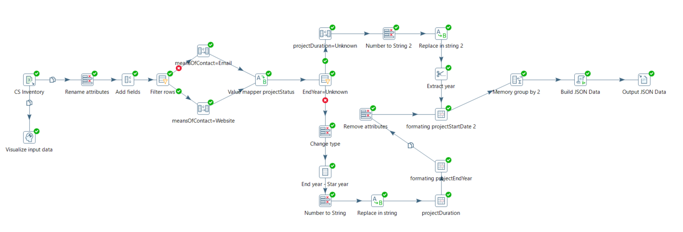
Example of JSON Data for CS Inventory Pentaho DI workspace (JSON data)
Input data
Renaming attributes
Value mapping
Build JSON and Output

Slide 11
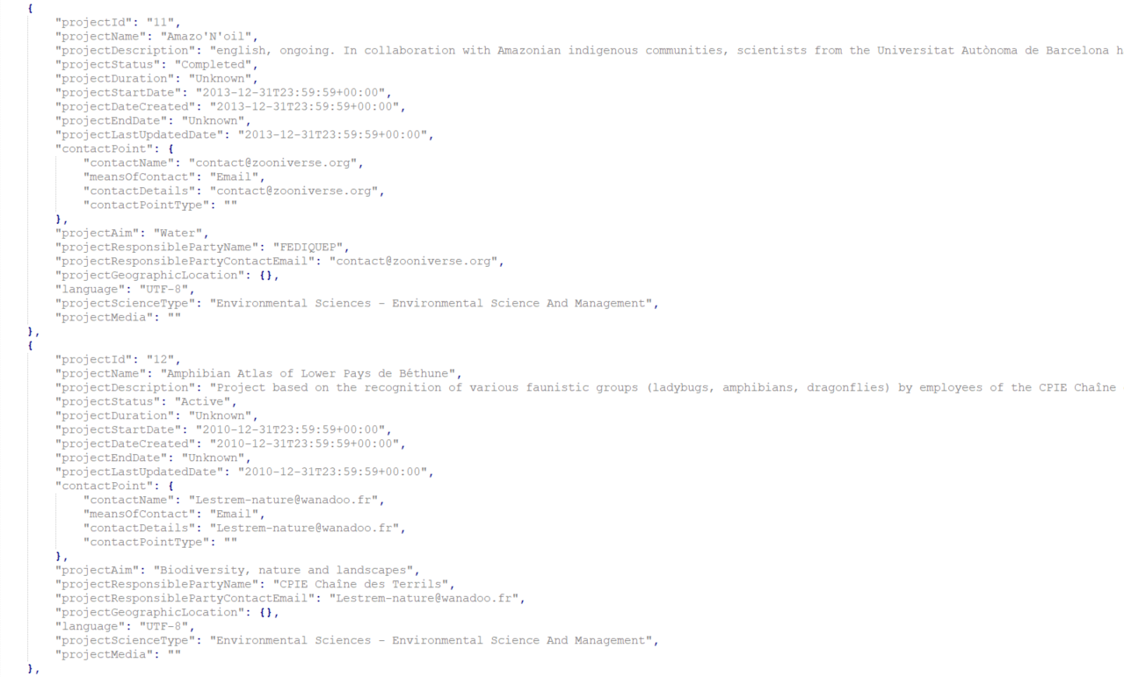
Example of JSON Data for CS Inventory
CS Attribute Name | CS Vocabulary terms
Still active | Yes No
"projectStatus": "Completed",
Attribute Name | Vocabulary terms
projectStatus | Not yet started Active Periodically active On hold Completed Abandoned
"projectStatus": "Active",

Slide 12
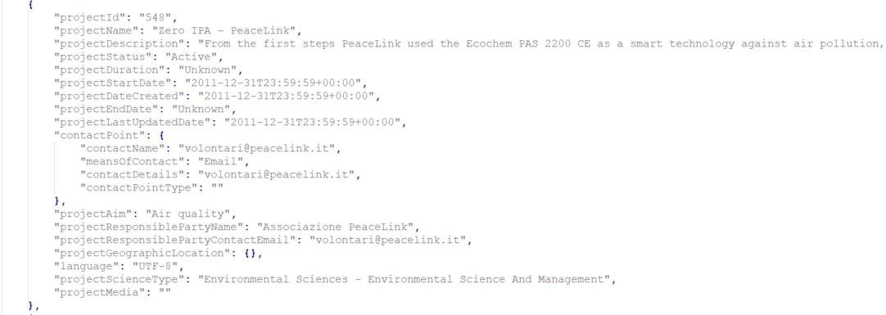
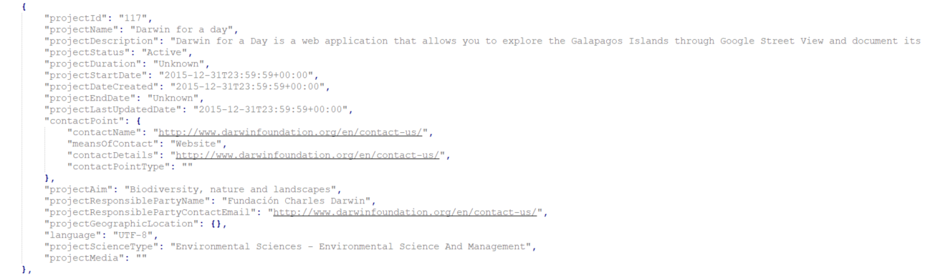
Example of JSON Data for CS Inventory
Attribute Name | Vocabulary terms
meansOfContact | Email Phone Website Physical address
"meansOfContact": "Email",
"meansOfContact": "Website",

Slide 13
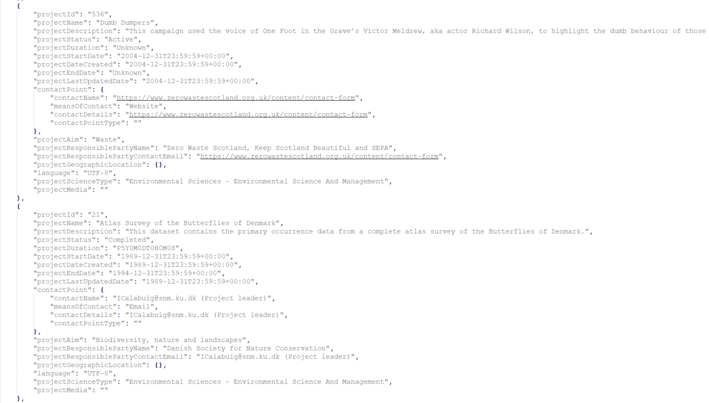
Example of JSON Data for CS Inventory
Attribute Name | Description
projectDuration | The duration or elapsed time over which a project was undertaken (…)
projectEndDate | The actual date that the project ended. (...)
"projectDuration": "Unknown",
"projectStartDate": "2004-12-31T23:59:59+00:00",
"projectDateCreated": "2004-12-31T23:59:59+00:00",
"projectEndDate": "Unknown",
"projectDuration": "P5Y0M0DT0H0M0S",
"projectStartDate": "1989-12-31T23:59:59+00:00",
"projectDateCreated": "1989-12-31T23:59:59+00:00",
"projectEndDate": "1994-12-31T23:59:59+00:00",

Slide 14
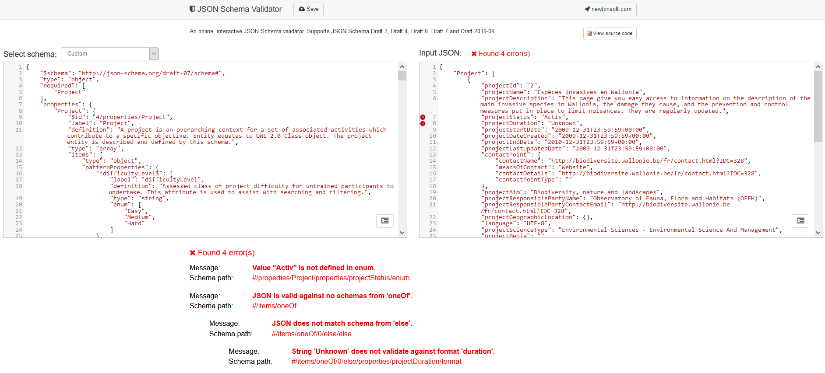
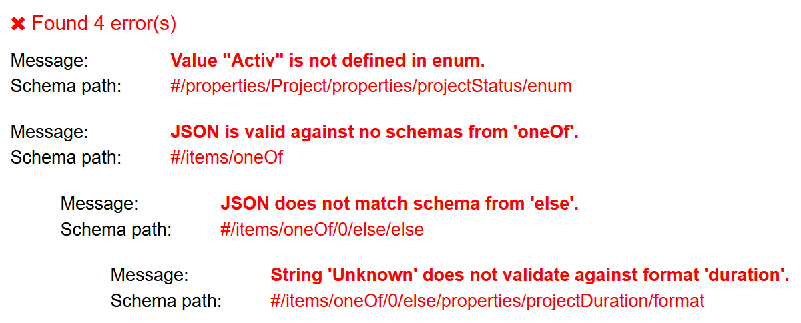
JSON Schema Validator
https://www.jsonschemavalidator.net/
Notes:
Having created both, the JSON Schema, and an according JSON file, we can use a standard online tool for validating if the created data file matches the actual schema. This screen capture illustrates that we two files validate. Anybody can replicate these transformation and test themselves. We hope that this supports the further take-up of the approach we just showcased.

Slide 15
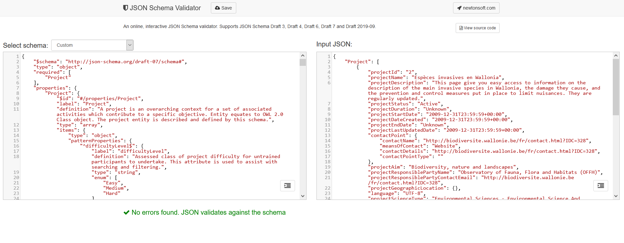
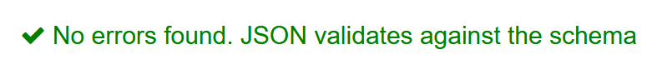
JSON Schema Validator
https://www.jsonschemavalidator.net/
Notes:
Having created both, the JSON Schema, and an according JSON file, we can use a standard online tool for validating if the created data file matches the actual schema. This screen capture illustrates that we two files validate. Anybody can replicate these transformation and test themselves. We hope that this supports the further take-up of the approach we just showcased.

Slide 16





Keep in touch
EU Science Hub: https://ec.europa.eu/jrc/communities/en/community/citizensdata
@EU_ScienceHub - #CitizenSData
EU Science Hub – Joint Research Centre
EU Science, Research and Innovation
Eu Science Hub
Notes:
If you have further questions, please do not hesitate to reach out and contact us.

Slide 17

Thank you
© European Union 2020
Unless otherwise noted the reuse of this presentation is authorised under the CC BY 4.0 license. For any use or reproduction of elements that are not owned by the EU, permission may need to be sought directly from the respective right holders.

