Slide 1
abstract report

Slide 2
A continuous motion feedback controller
A controller that can continuously feedback the motion state of dynamic objects under VR environment
Notes:
一个可以持续反馈vr动态物体运动状态的控制器

Slide 3
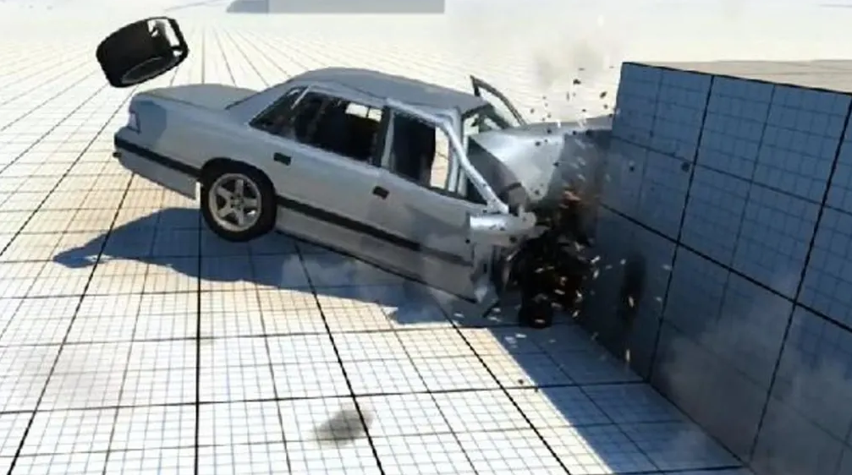
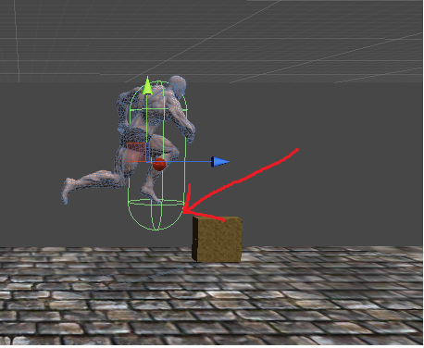
> A Survey on Simulation for Weight Perception in Virtual Reality
Inconsistency of vistual feedback and real hand motion
E.g. When the character in a scene encounters an obstacle and cannot move forward, the user will only see that the character cannot move forward, but does not know the movement state of the character when it cannot execute the command or has a problem.

Slide 4
purpose
This project is designed to reveal the motion state of the object or avatar under the VR environment, and give feedback to the user, in order to enhance the user's ability to manipulate the object so that the user is more aware of the interaction with the currently manipulated thing.
The motion state is the overall state of motion of the object, and is not limited to a single force situation, nor is it limited to the overall force of the vr object or the combined force of some areas
Through such motion state feedback, aim to enhance the user's operation under the VR environment, can help user understand the current object's motion state, enhance the synchronization rate and connection between the user and the manipulated object, enhance the VR immersion. Can also be applied with telexistence. Make the robot easier to operate, as well as quickly understanding of the movement state of various parts.

Slide 5
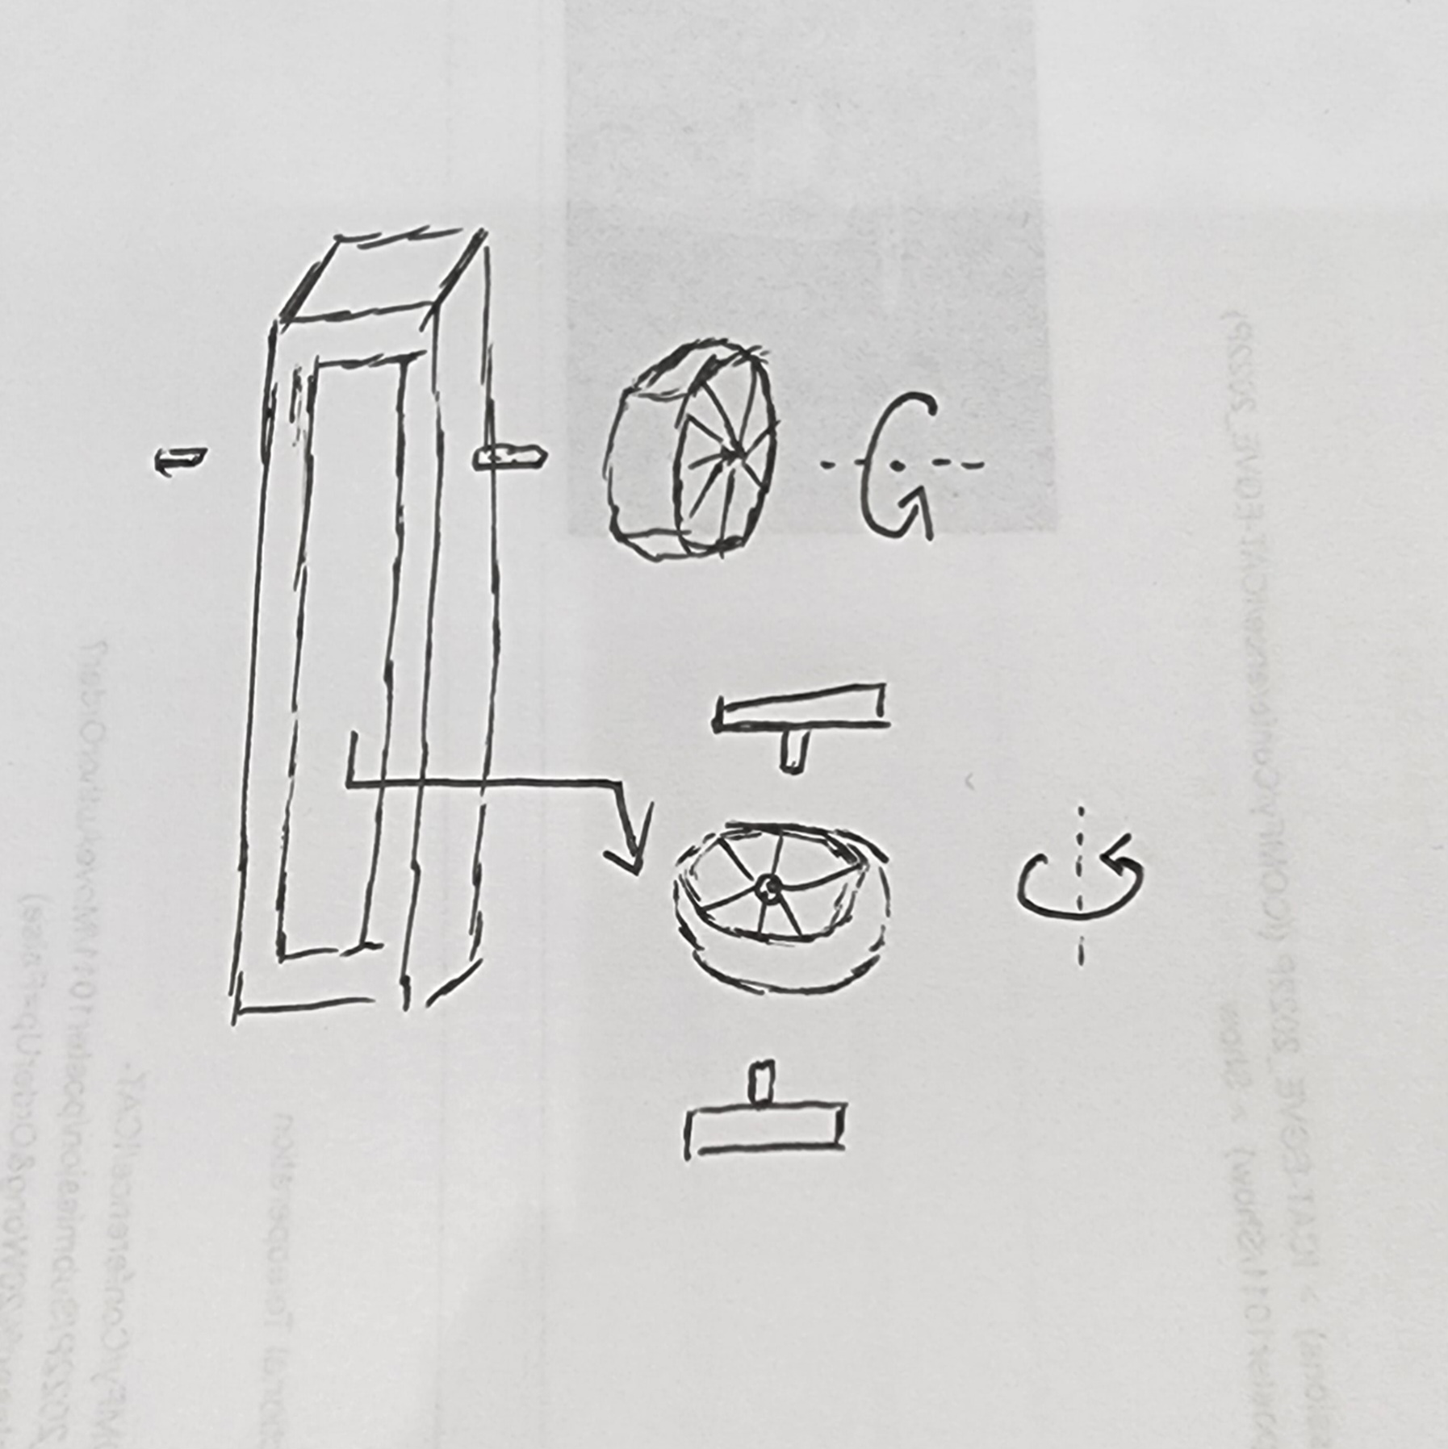
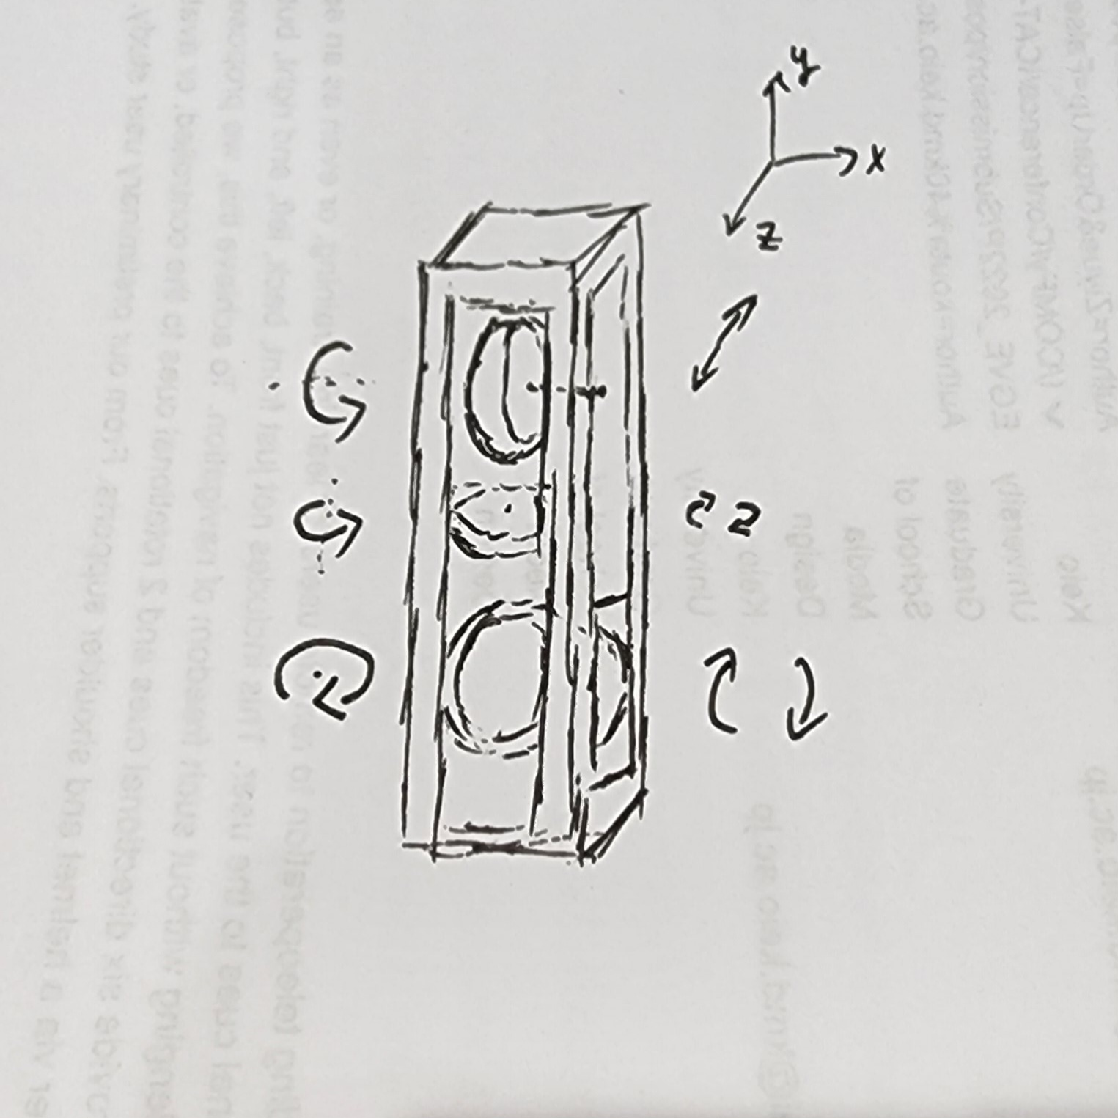
methods
Handheld controller, set some wheel structure in the center part, the wheel will react the motion state of the target object, the goal is to set 3 wheels to achieve 3dof feedback including front and back, left and right, up and down.

Slide 6
application
dynamic object, such as vr driving
avatar, such as the character
a part of the avatar, such as arm or handheld object
a physical thing, such as toto
a part of a physical thing, such as robotic arm

