Slide 1
reference report

Slide 2
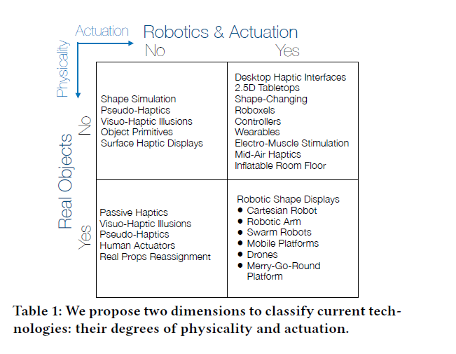
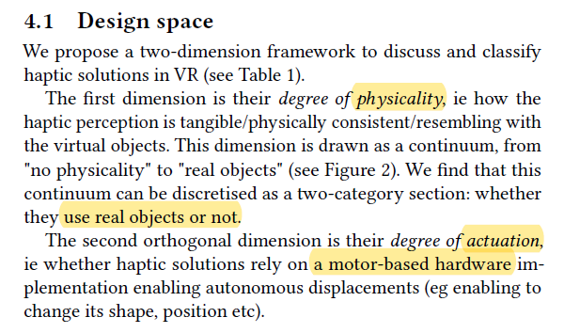
PA model
> “Can I Touch This?”: Survey of Virtual Reality Interactions via Haptic Solutions

Slide 3
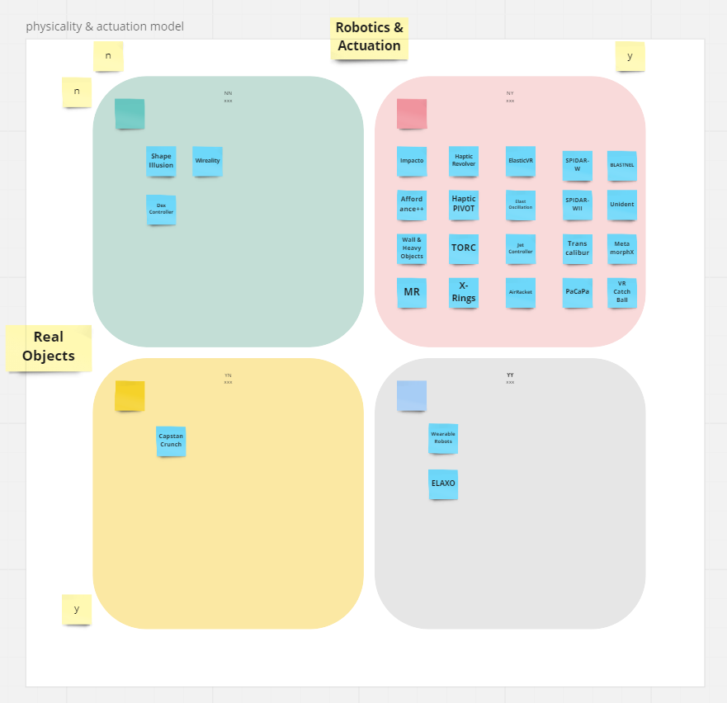
catalog by PA model

Slide 4
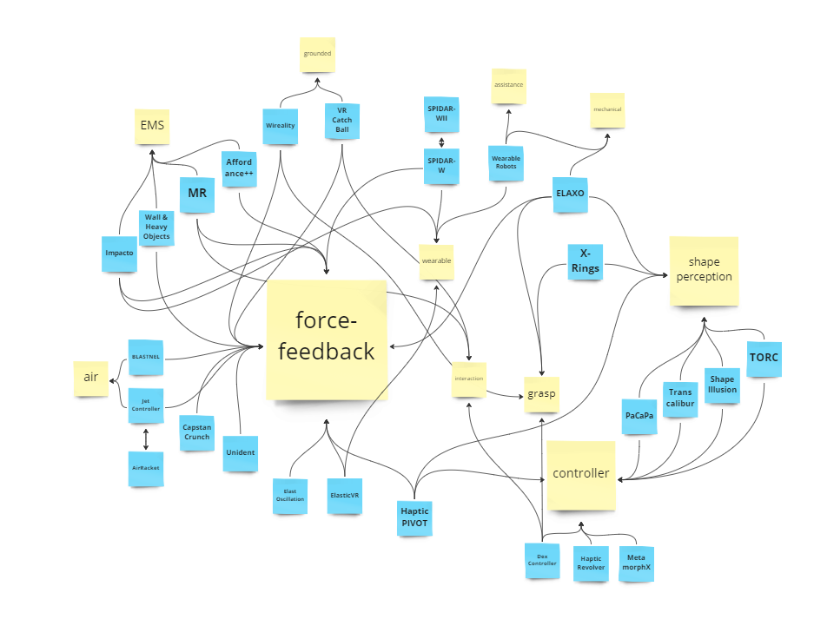
catalog by keywords
criteria：
keyword
abstract & introduction
compared to others
*Not classified to the category when it is not mentioned the concept.

Slide 5
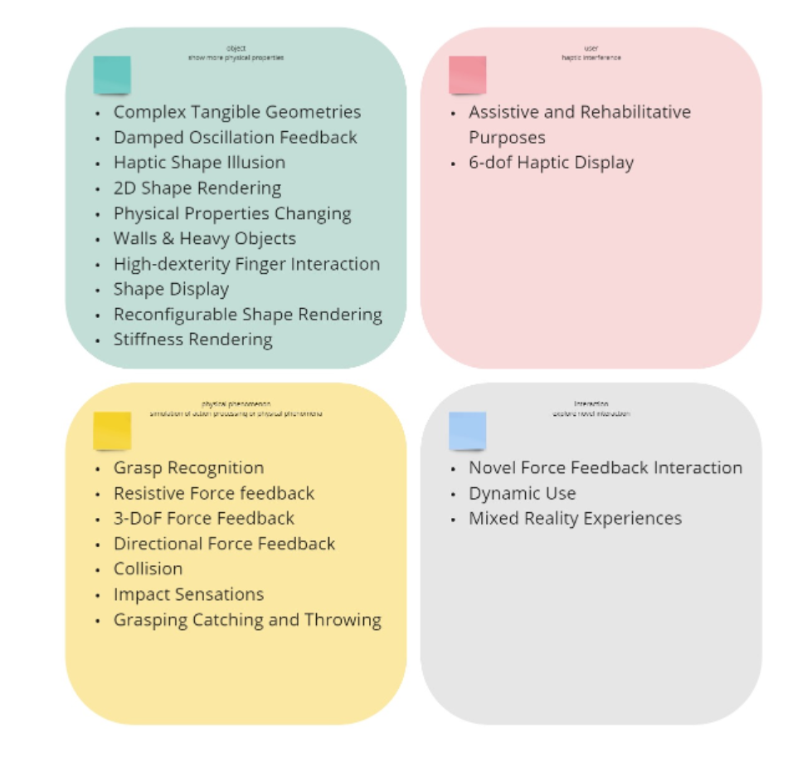
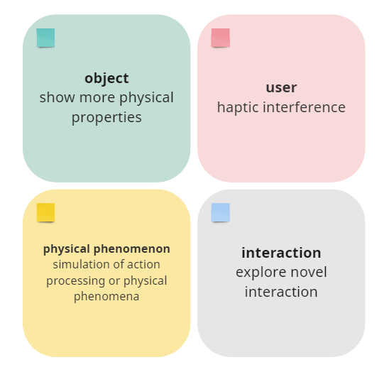
catalog by research object

Slide 6
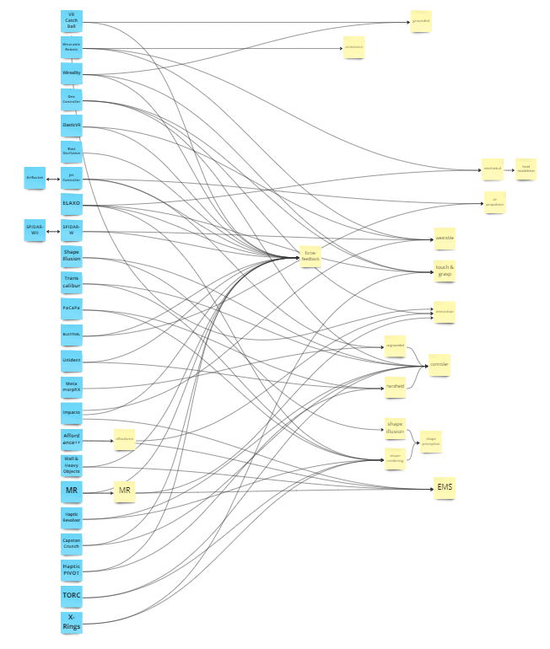
Redeployment
Notes:
可以清晰的看出，除了使用的结构特征对于没一类haptic具有典型性以外，主要的是以功能，或者说研究目的以及产品的表现形势这两大类划分。
所以接下来就按照 研究目的和产品的类别进行划分

Slide 7
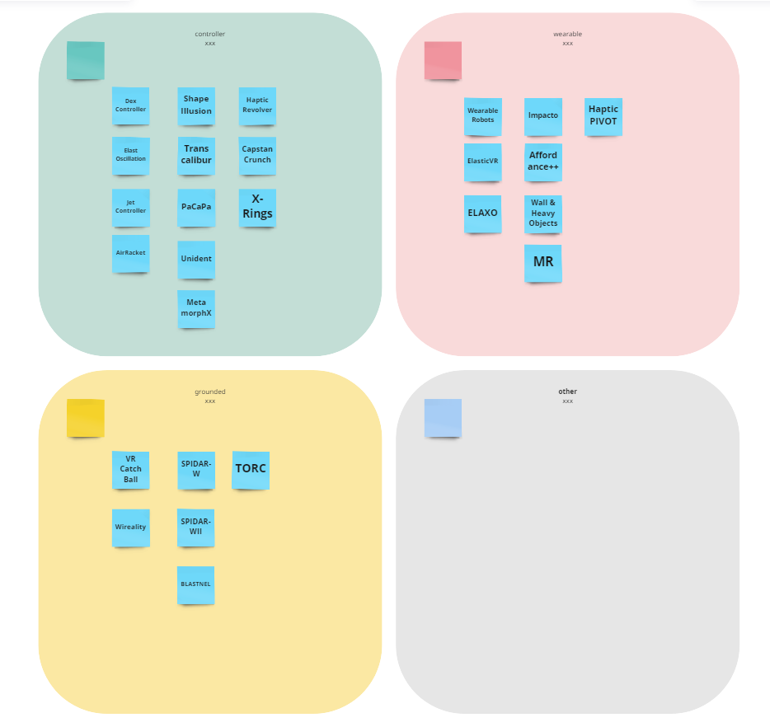
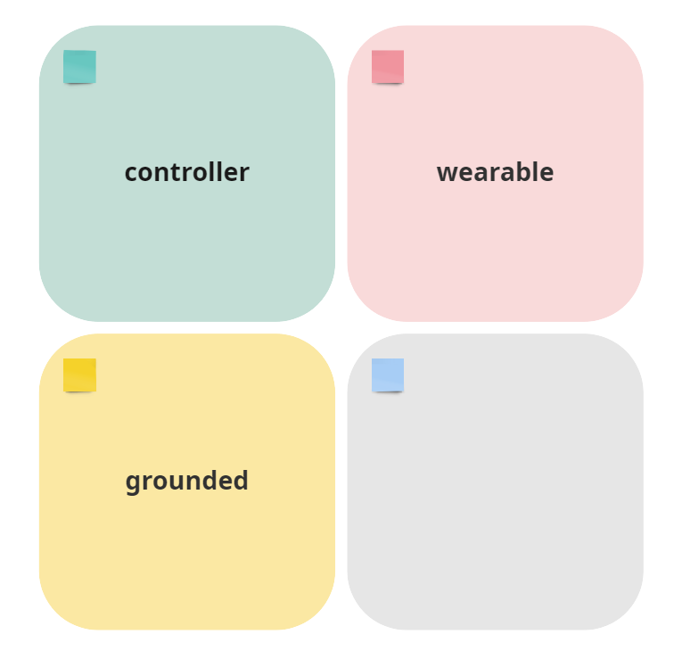
catalog by production type

Slide 8
A continuous motion feedback controller
A controller that can continuously feedback the motion state of dynamic objects under VR environment
Notes:
一个可以持续反馈vr动态物体运动状态的控制器

Slide 9
> A Survey on Simulation for Weight Perception in Virtual Reality
Inconsistency of vistual feedback and real hand motion

Slide 10
A continuous motion feedback controller
A controller that can continuously feedback the motion state of dynamic objects under VR environment
Notes:
一个可以持续反馈vr动态物体运动状态的控制器

Slide 11
A continuous motion feedback controller
A controller that can continuously feedback the motion state of dynamic objects under VR environment
Notes:
一个可以持续反馈vr动态物体运动状态的控制器

Slide 12
> A Survey on Simulation for Weight Perception in Virtual Reality
Inconsistency of vistual feedback and real hand motion

Slide 13
17 normal paper
+4 EMS haptic device
+5 Microsoft Research
+6 Survey
=32 reference

