Slide 1

public health meets social media: mining health info from twitter
Michael Paul (@mjp39)
University of Colorado, Boulder
Crowdsourcing and Human Computation

Slide 2
Learning about the real world through Twitter
Millions of people share on the web what they are doing every day
Can analyze social media to infer what is happening in a population
Can make inferences about the population’s health
Passive data monitoring
Work with data that’s already out there
vs active methods: soliciting data from people (e.g. surveys)
Faster, cheaper than traditional data collection – but noisier

Slide 3
This lecture: Key ideas
Applications
What can we learn about health? (and why would we want to do that?)
Methods
How do you mine Twitter?
Evaluation
How accurate is the mined data?
Ethics
How does social media mining fit in with current medical research practices?
Notes:
not necessarily in this order

Slide 4


Twitter: Data
Free streams of data provide 1% random sample of public status messages (tweets)
Search streams provide tweets that match certain keywords
Still capped at 1%, but more targeted
We collect tweets matching any of 269 health keywords
https://dev.twitter.com/docs/streaming-apis/keyword-matching
https://github.com/mdredze/twitter_stream_downloader

Slide 5

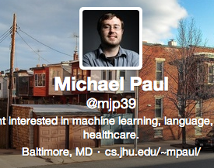
Twitter: Location data
Geolocation: often we need to identify where the authors of tweets are located
Some tweets tagged with GPS coordinates
Only 2-3% of tweets/users
Can improve coverage by tenfold by also considering self-reported location in user profiles

Slide 6

Twitter: Location data
Geolocation: often we need to identify where the authors of tweets are located
Carmen
Identifies where a tweet is from using GPS + user profile info, e.g. {"city": "Baltimore", "state": "Maryland", "country": "United States"}
Python software available:
https://github.com/mdredze/carmen-python

Slide 7
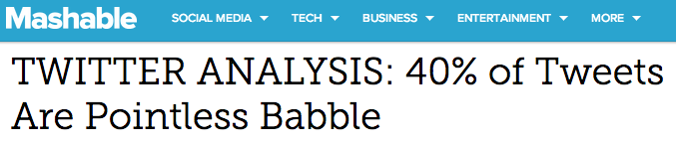

Twitter: Health data?
Twitter is a noisy data source
2012 study (André, Bernstein, Luther):

Slide 8
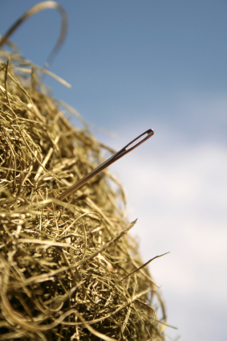
Twitter: Health data?
Estimate: about 0.1% of tweets are about tweeters’ health
(1.6 million out of 2 billion tweets in an earlier study)
0.1% of Twitter is still a lot of data!
~ half a million tweets per day
Lots of data, but hard to find in noise
Absolutely huge volume of data
Relatively tiny amount of relevant data

Slide 9
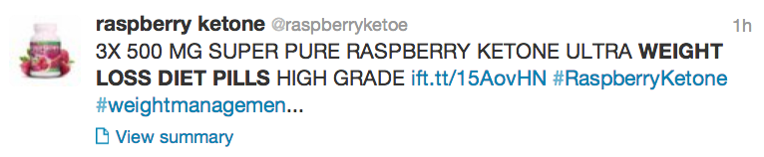
Finding health tweets
Step 1: keyword filtering
Filter out tweets unlikely to be about health
Large set of 20,000 keywords
Not all tweets containing keywords are actually about someone’s health
This tweet contains lots of health keywords:
Step 2: supervised machine learning

Slide 10

Finding health tweets
Step 2: supervised machine learning
Labeled data
5,128 tweets
About health | Unrelated to health | Not English
Labels collected through Mechanical Turk
Each tweet labeled by 3 annotators
Final label determined by majority vote
10 labels per HIT
Each HIT contained 1 gold-labeled tweet to identify poor-quality annotators

Slide 11
Finding health tweets
About 1% of tweets contained the 20,000 health keywords
About 15% of those were tagged as relevant by the health machine learning classifier
about 0.1% of all tweets are health-related
1.6 million health tweets from 2009-2010
Over 150 million collected since Aug 2011

Slide 12
Health tweets
So we can we do with health tweets?

Slide 13
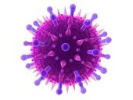
Flu surveillance
Idea: people tweet about being sick
More sick tweets will appear when the flu is going around
https://twitter.com/search?q=flu&src=typd&f=realtime
Why do we care?
Cheap data source to complement primary disease surveillance systems (e.g. hospital data, lab work)
Real-time, can be automated
Lofty goal: early detection of novel, serious epidemics
Notes:
distinguish infection tweets from other tweets mentioning flu
machine learning model trained from 10,000 tweets labeled by humans

Slide 14
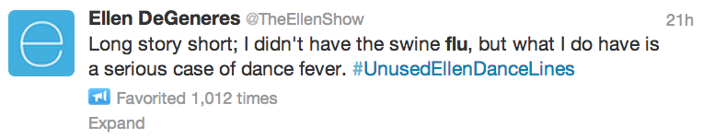
Flu surveillance
Goal: identify and count tweets that indicate the user is sick with the flu
Proxy for how many people in the population have the flu
Challenge: not all tweets that mention “flu” actually indicate a person is sick

Slide 15
Finding flu tweets
As before: supervised machine learning
Labeled data
11,990 tweets
Flu infection | General flu awareness | Unrelated to flu
Same quality control measures as before
Also hand-verified all labels in the end
Changed 14% of labels

Slide 16
Finding flu tweets
Machine learning classifiers identify tweets that indicate flu infection
Many features beyond n-grams:
Retweets, user mentions, URLs
Part-of-speech information
Word classes:
Infection | getting, got, recovered, have, having, had, has, catching, catch, …
Disease | bird, the flu, flu, sick, epidemic
Concern | afraid, worried, scared, fear, worry, nervous, dread, terrified
Treatment | vaccine, vaccines, shot, shots, mist, tamiflu, jab, nasal spray
… | …

Slide 17
Flu surveillance
Estimated weekly rate of flu on Twitter:
# tweets about flu infection that week
# of all tweets that week
Normalize by number of all tweets to adjust for change in Twitter volume over time

Slide 18
Flu surveillance (2009-10)
Large spike of flu activity around October
This was during the swine flu pandemic
Is this accurate?
Notes:
swine flu pandemic

Slide 19

Flu surveillance: Evaluation
Compare our estimates to “ground truth” data
We take government surveillance data to be ground truth
from the CDC (Centers for Disease Control and Prevention)
weekly counts of hospital outpatient visits for influenza-like symptoms
Common metric: Pearson correlation
compare temporal trend of Twitter estimates against CDC data

Slide 20
Flu surveillance (2009-10)
Correlation with CDC: 0.99
Notes:
swine flu pandemic

Slide 21
Flu surveillance (2012-13)
Correlation with CDC: 0.93
Notes:
swine flu pandemic

Slide 22
Flu surveillance: More evaluation
What if we just estimate the flu rate by counting tweets containing the words “flu” or “influenza”?
Not as highly correlated:
2009-10: 0.97 (2% reduction)
2012-13: 0.75 (20% reduction)
More spurious spikes from keyword matching
Notes:
swine flu pandemic

Slide 23

Flu surveillance: More evaluation
Cross-correlation
Measures similarity between curves when one of the trends is offset by some number of weeks (lead/lag)
Twitter neither leads/lags CDC
(but maybe certain keywords do?)

Slide 24
Flu surveillance: More evaluation
Basic correlation may overstate how good you are doing
As long as the peak weeks have above-average rates and the off-season weeks are below-average, you’ll get a pretty high number
Especially true if trend has high autocorrelation (cross-correlation with itself) at nonzero lag
Trend differencing
Subtract previous week’s rate from current week
Measures correlation of week-to-week increase/decrease
More directly measures what you probably care about
Box-Jenkins methods
Guidelines for applying differencing

Slide 25
Flu surveillance: More evaluation
Simple accuracy
How often does the weekly direction of the trend (up or down) match CDC?
Maybe more interpretable than correlation
Our Twitter infection classifier:
85% direction accuracy (2012-13)
Simple keyword matching: 46%

Slide 26
Beyond flu
The flu project was an in-depth study of one disease
Machine learning with human annotations
Time/labor intensive
Rich set of features

Slide 27
Beyond flu
The flu project was an in-depth study of one disease
Machine learning with human annotations
Time/labor intensive
Rich set of features
Alternative approach: broad, exploratory analysis
Find lots of diseases on Twitter
Unsupervised machine learning
No human input
Simple keyword-based models

Slide 28
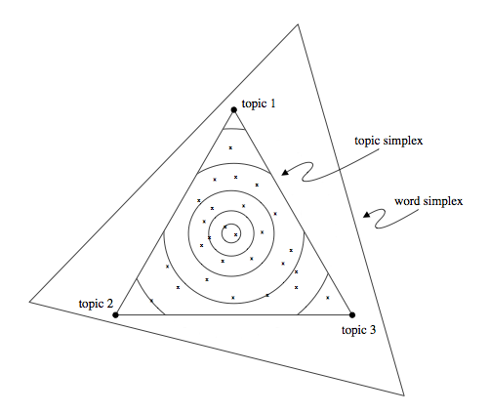
Topic modeling
Statistical model of text generation
decomposes data set into small number of “topics”
the topics are not given as labels
unsupervised model
Two types of parameters:
p(topic|document) for each document
p(word|topic) for each topic
Optimize parameters to fit model to data (a collection of documents)

Slide 29
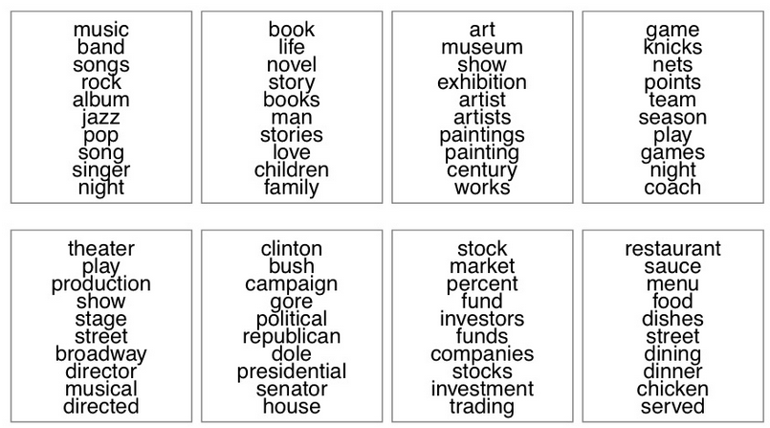
Topic modeling
Automatically groups words into topics
Automatically labels documents with topics
Example when applied to New York Times articles:
from Hoffman, Blei, Wang, Paisley

Slide 30
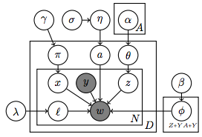
Topic modeling health tweets
We created a topic model specifically for finding health topics in Twitter
Ailment Topic Aspect Model (ATAM)
Distinguishes health topics from other topics in the data
Breaks down health topics by general words, symptom words, treatment words

Slide 31
Topic modeling health tweets
“Aches and Pains”
Notes:
red = symptoms, green = treatments, blue = general words

Slide 32
Topic modeling health tweets
“Insomnia”
Notes:
red = symptoms, green = treatments, blue = general words

Slide 33
Topic modeling health tweets
“Allergies”
Notes:
red = symptoms, green = treatments, blue = general words

Slide 34
Topic modeling: Evaluation
How accurately do these word clusters correspond to real-world concepts?
As before: find existing data sources to compare to

Slide 35
Topic modeling: Diet and exercise
Compare the “diet and exercise” health topic to government survey data about lifestyle factors
Track rates across U.S. states
Geographic trends (vs temporal trends)
Positively correlated with rates of physical activity and aerobic exercise
0.61 and 0.53
Negatively correlated with rates of obesity
-0.63

Slide 36

Topic modeling: Allergies
Allergies aren’t part of CDC surveillance systems
But private data sources exist
We compared to phone survey results from Gallup
“Were you sick with allergies yesterday?”

Slide 37
Topic modeling: Allergies
Correlation: 0.48
2011-12 season only: 0.84
higher predictions in 2012-13; conflated with strong flu season (similar symptoms: coughing, sneezing)

Slide 38
Topic modeling: Evaluation
Informal evaluation: visualize, check against intuition
Do word clusters make sense?
Is there obvious noise?
e.g. cold/flu symptoms mixed with allergies
Do geographic patterns make sense?
Are rates similar in nearby states?

Slide 39
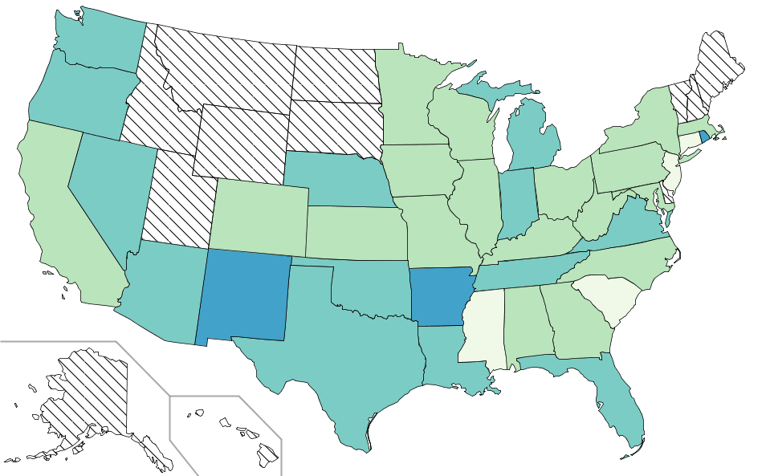
Topic modeling: Allergies
February 2010

Slide 40
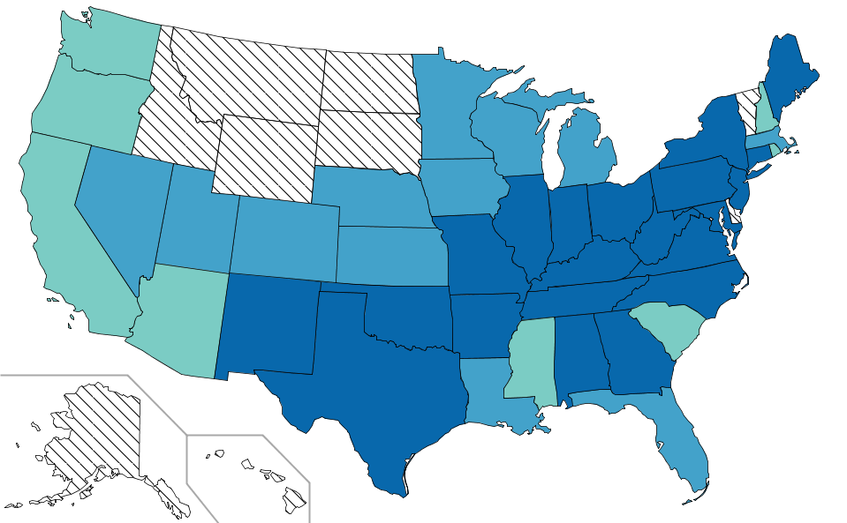
Topic modeling: Allergies
April 2010

Slide 41
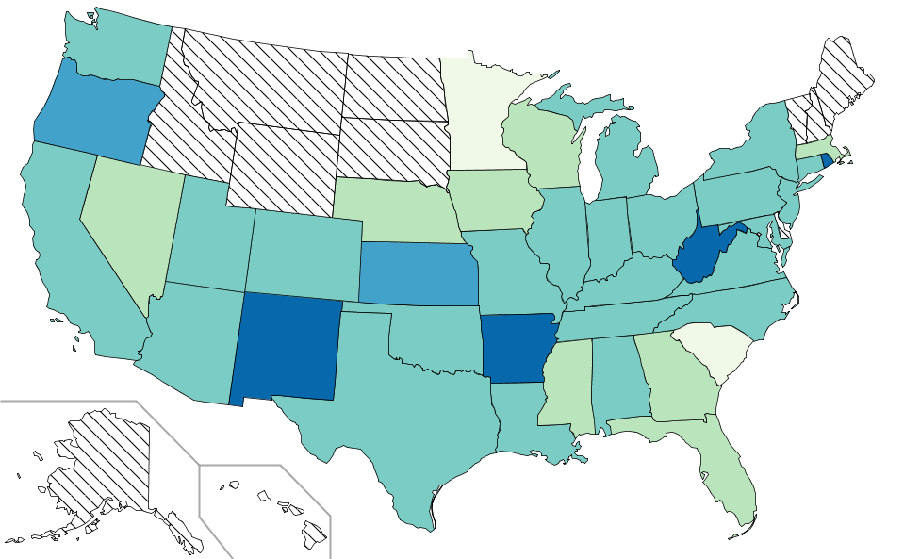
Topic modeling: Allergies
June 2010

Slide 42
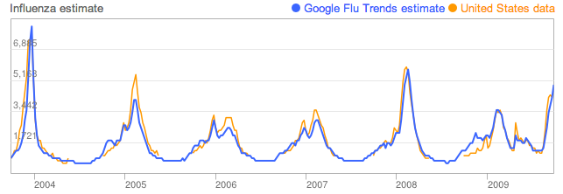
Other methods
(Linear) Regression
Explicitly train your system to predict ground-truth data
Approach used by Google Flu Trends (and others)
Manual analysis by humans
“small data” approach
Good option for ideas too difficult to automate with machine learning

Slide 43
Other applications
Broad health applications seem to work well enough
but the data may not support deeper medical questions
people share a lot but not everything
demographics differ between real world and social media
and can vary a lot between different social media sites
More hype than substance in many applications
Can Twitter predict the stock market?
I don’t know of anyone who has gotten rich from this yet…
Can Twitter predict elections?
If it could, Donald Trump would be president…
Notes:
Pew study – Twitter not consistent with polls, and it is inaccurate in inconsistent ways (sometimes more liberal but other times more conservative)

Slide 44

Ethics/Privacy
Ethics is an important part of human subject research
But there aren’t comparable guidelines for “human computation” research
So here are some things to think about…

Slide 45
Ethics: Guidelines
Modern medical research guided by IRBs (institutional review board)
IRB policy on social media data mining:
Data is public, therefore no approval required
This applied to what I showed you today
This policy may eventually change
There are still privacy norms surrounding public data
and it’s possible to use public data in creepy ways

Slide 46
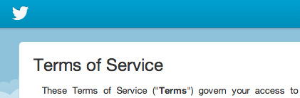
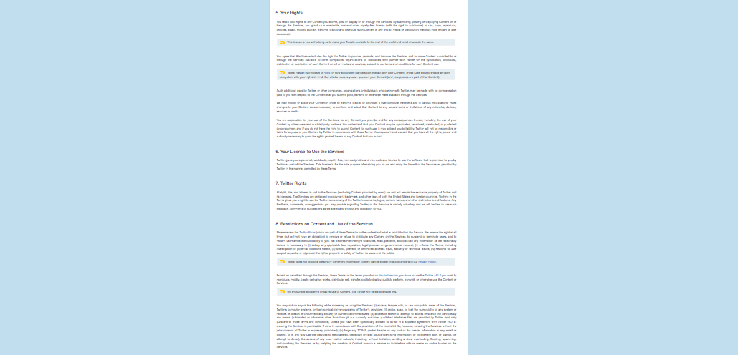
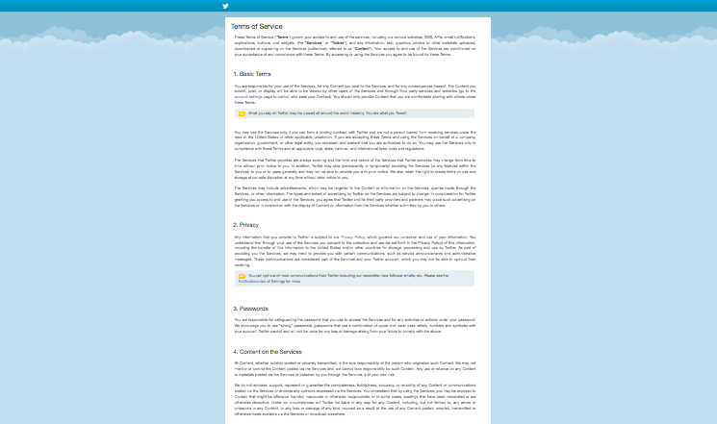
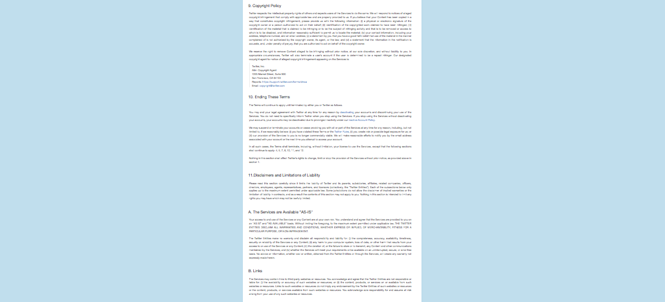
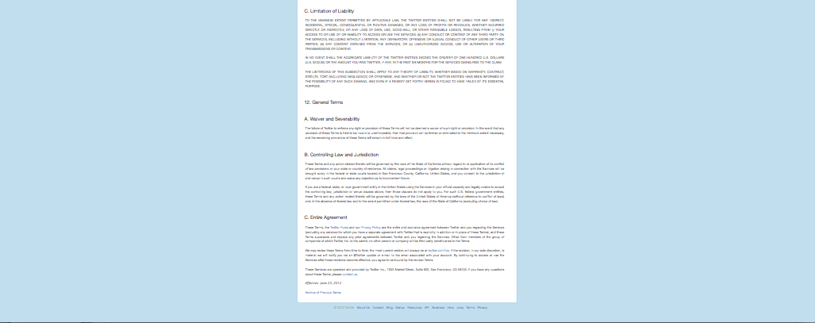
Ethics: Guidelines
Informed consent?
Technically, if people actually read this:
Tweets are public by default
not all users realize this
Even if users are aware the data is public, they might not expect it to be used in certain ways
Notes:
reading level of Twitter ToS is 4 grade levels higher than IRB requires for consent
companies write these terms to protect themselves, not to protect researchers and their subjects

Slide 47
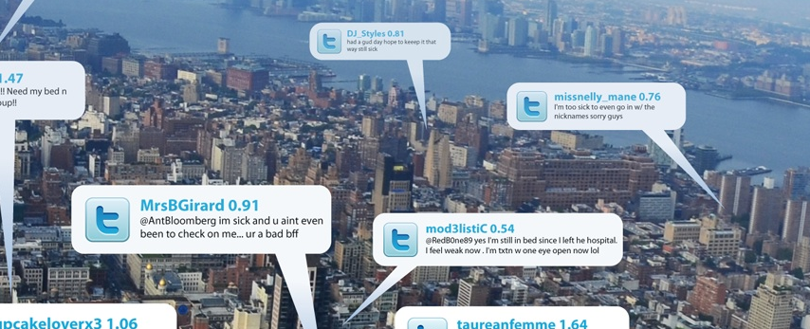
Ethics: Privacy
Aggregate statistics generally preserve privacy
as long as they aren’t aggregated in a town of 20 people
Analysis of individual users may deviate from privacy expectations
Sadilek, Kautz, Silenzio 2012

Slide 48
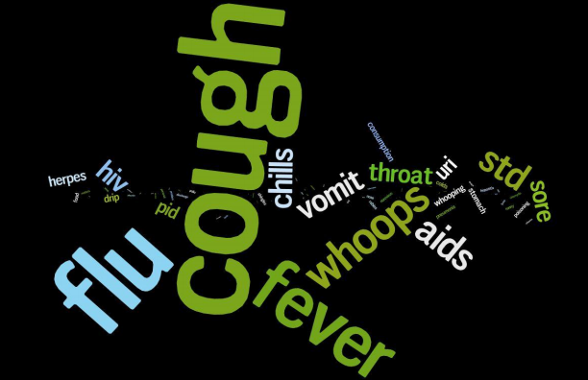
Ethics: Privacy
Health information is particularly sensitive and should be treated differently
Courtesy of MappyHealth by Social Health Insights

Slide 49
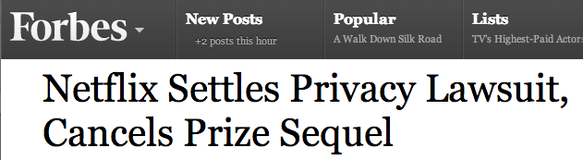
Ethics: Privacy
Hard to fully anonymize data
Same issue with medical records
Can be de-anonymized with more data, more context

Slide 50
Ethics: Rules of thumb
Stick to large-scale aggregate analysis
Don’t use more data than a user likely intended to share
Don’t use data that you don’t need for what you’re doing
Think about how users will react to your app or research
Good reading:
Slides by Caitlin Rivers: “Ethical user of Twitter for digital disease detection”
http://figshare.com/articles/Ethical_use_of_Twitter_for_DigDisDet/805198
Danah Boyd and Kate Crawford. 2012. Critical questions for Big Data. Information, Communication & Society: 15(5).

Slide 51
See more
socialmediahealthresearch.org
CIKM 2013 tutorial: Twitter and the real world
https://sites.google.com/site/twitterandtherealworld/
Conference on Digital Disease Detection
http://healthmap.org/ddd/
Apps/startups:
Sickweather – sickweather.com

Slide 52
Reminders
Friday is the drop deadline
If you have any concerns about whether should stay in the class, or if you haven’t received an email with your grades so far, come to my office hours today 3-5pm

