Slide 1

CSCI 1102 Computer Science 2
Meeting 3: Thursday 2/11/2021
A Stack ADT & an Application

Slide 2
Today
A String Stack ADT
A client: a postfix expression evaluator

Slide 3
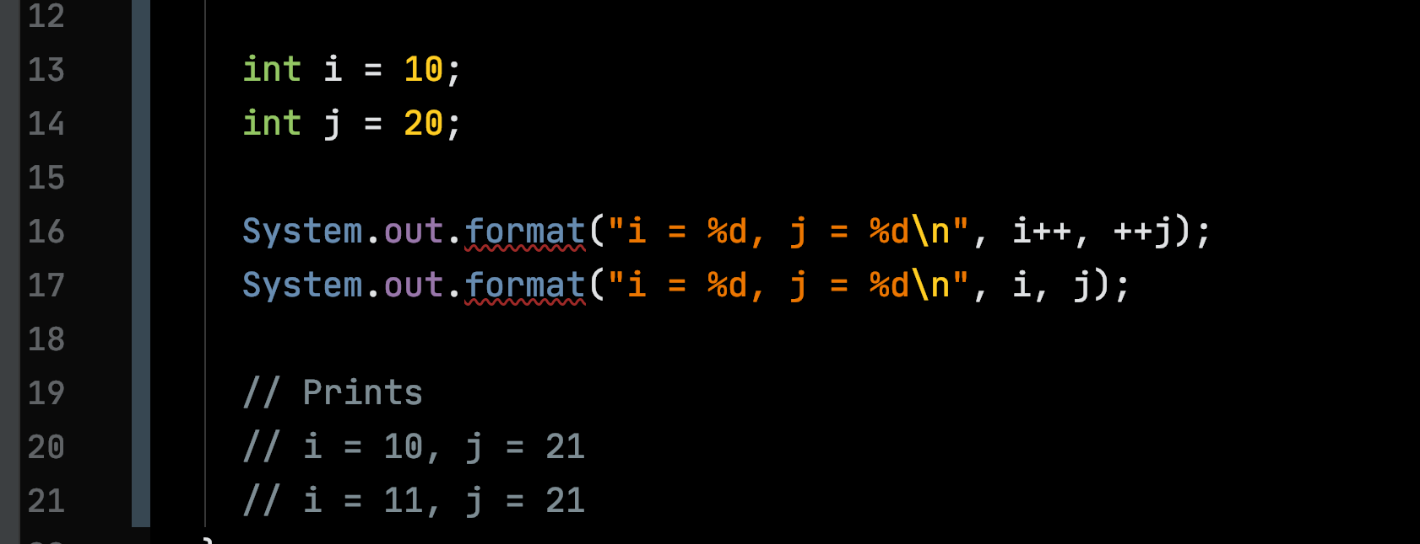
i++ and ++j

Slide 4
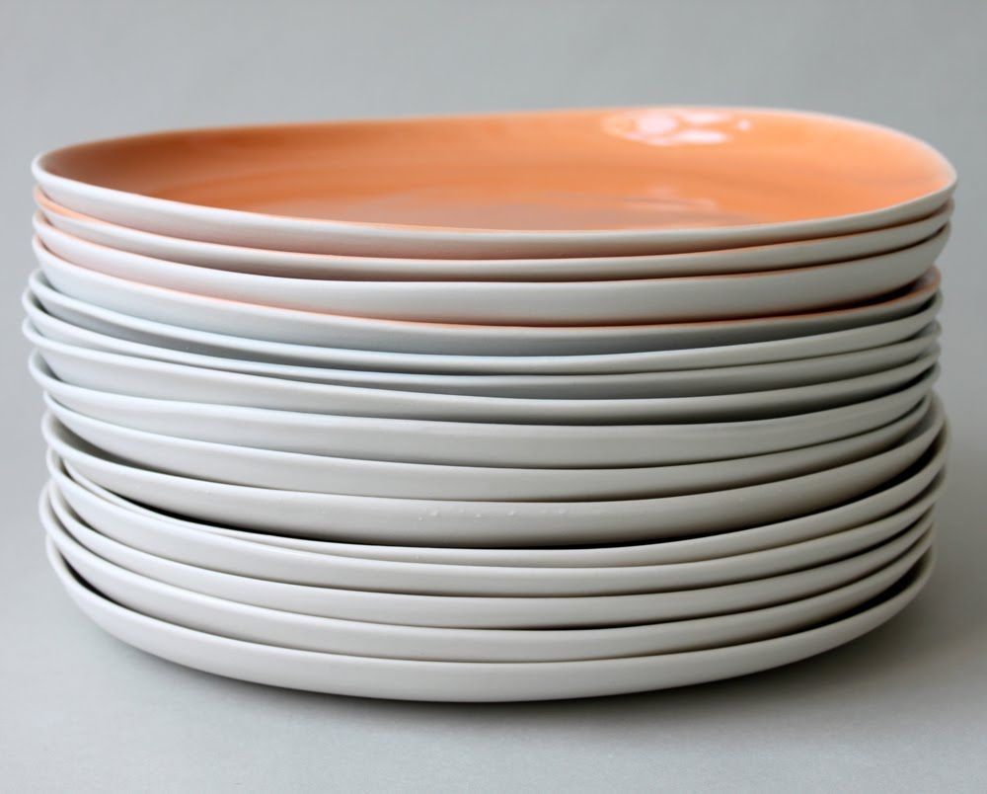
A Stack ADT Last-on, First-off

Slide 5
An empty stack

Slide 6
“Atlantic”
top
push(“Atlantic”)

Slide 7
“Atlantic”
top
push(“Pacific”)
“Pacific”

Slide 8
“Atlantic”
top
pop()
“Pacific”

Slide 9
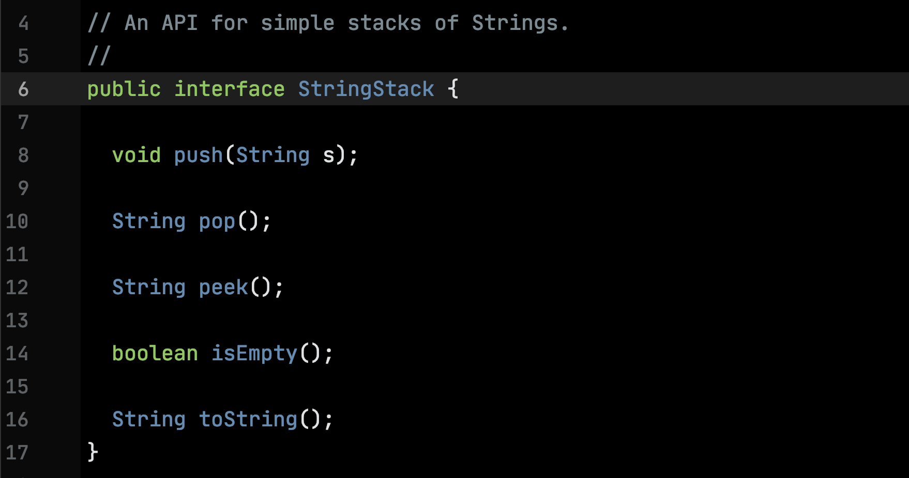

Slide 10
String Stack ADT Code

Slide 11
Postfix Expressions

Slide 12
2 + 3 * 4

Slide 13
2 + (3 * 4)

Slide 14
2 + (3 * 4)
+
2
*
3
4

Slide 15
Łukasiewicz (Polish/prefix) Notation (1924)
Preorder Traversal:
Visit the root
Traverse the left
Traverse the right
+
2
*
3
4

Slide 16
+ 2 * 3 4
Łukasiewicz (Polish/prefix) Notation
Preorder Traversal:
Visit the root
Traverse the left
Traverse the right
+
2
*
3
4

Slide 17
(+ 2 (* 3 4))
The Programming Language LISP uses Polish Notation
+
2
*
3
4

Slide 18
2 3 4 * +
Reverse Polish (postfix) Notation
Postorder Traversal:
Traverse the left
Traverse the right
Visit the root
+
2
*
3
4

Slide 19
Postfix Notation Evaluation with a Stack (Burks, Warren & Wright, 1954)
2 3 4 * +
3 4 * +
4 * +
2
3
2

Slide 20
Postfix Notation Evaluation with a Stack
4 * +
* +
+
3
2
4
3
2
12
2
14

Slide 21
Postfix Evaluation Code

