Slide 1

CSCI 1102 Computer Science 2
Meeting 3: Tuesday 2/9/2021
ADTs

Slide 2
Today
A few stray notes
Abstract Data Types

Slide 3
Stray Notes
Repos vs IntelliJ projects
jshell

Slide 4
Function Call Syntax

Slide 5
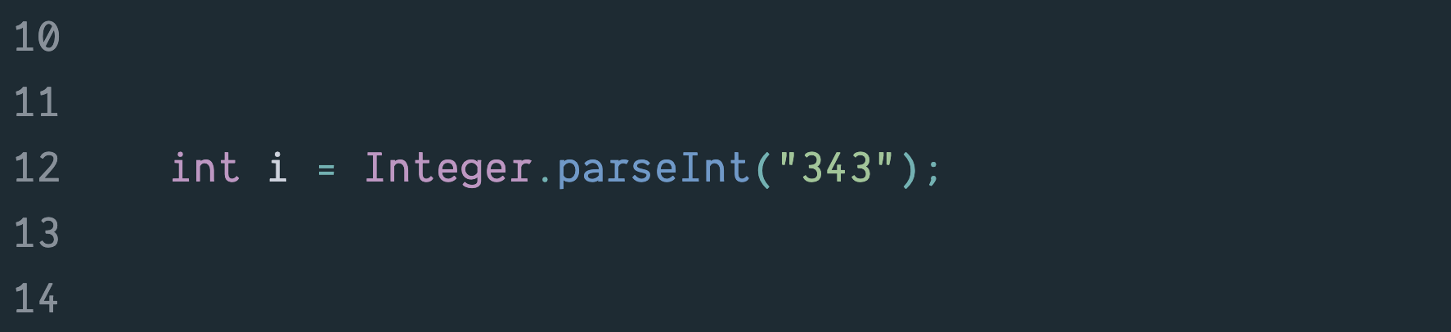
static vs dynamic functions
Static functions are accessed via their containing class symbol and called using standard function call notation.

Slide 6
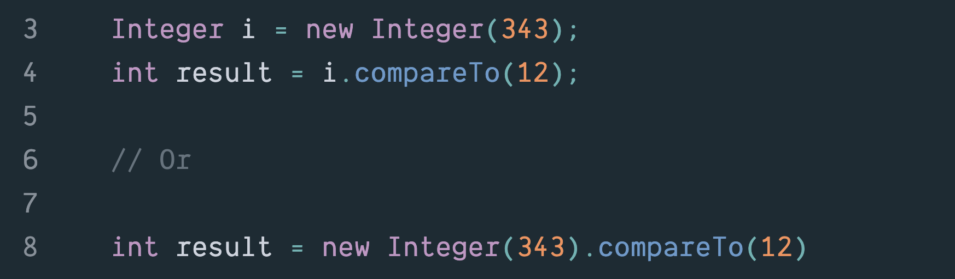
static vs dynamic functions
Dynamic functions are accessed via a value constructed with the new keyword and are called using message-passing style.

Slide 7
Scope

Slide 8
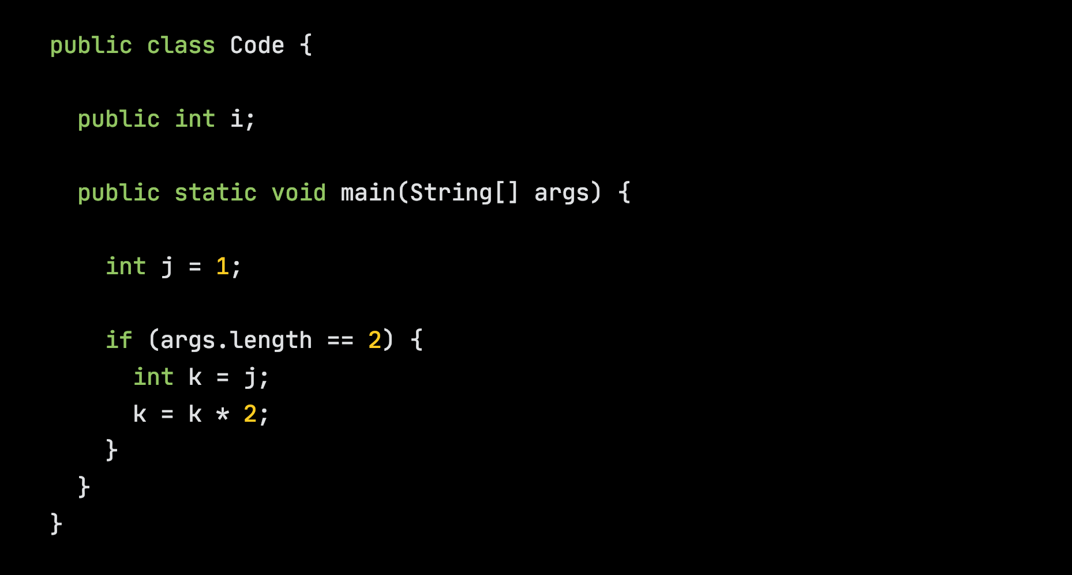

Slide 9
i in scope. args, j & k not in scope.

Slide 10
i in scope.
i, args & j in scope.
k not in scope.

Slide 11
i in scope.
i, args & j in scope.
i, args, j & k in scope.

Slide 12
Casting

Slide 13
Base Types & Wrapper Classes
Base Type | Wrapper Class/Type
int (32-bit integers) | Integer
long (64-bit integers) | Long
short (16-bit integers) | Short
byte (8-bit integers) | Byte
float (32-bit floats) | Float
double (64-bit floats) | Double
char | Character
boolean | Boolean

Slide 14
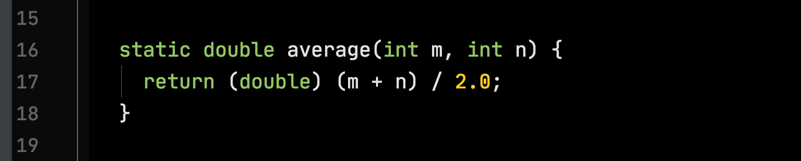
Casting

Slide 15
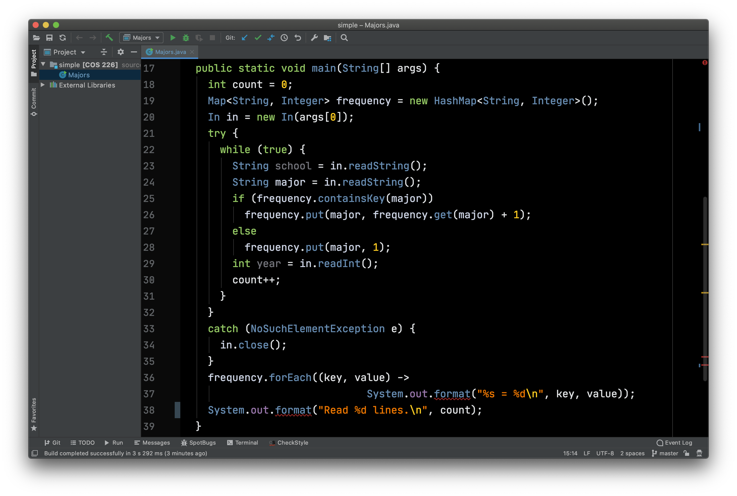
Compute a Frequency Table of Majors

Slide 16
Abstract Data Types

Slide 17
ADTs (B. Liskov)
We decide we need a new type;
Specify the name of the type and the type signatures of the operations;
Then develop one or more implementations.

Slide 18
ADTs
Specification/API

Slide 19
ADTs
Implementation
Specification/API
…
Implementation

Slide 20
Abstract
Client View
Concrete
Implementor View

Slide 21
ADTs & Information Hiding
The client knows only the type signatures of the operations and their performance properties.
The owner is free to manage the implementation.

Slide 22
ADTs in Java
Specification: use an interface;
Implementation: use a class.

Slide 23
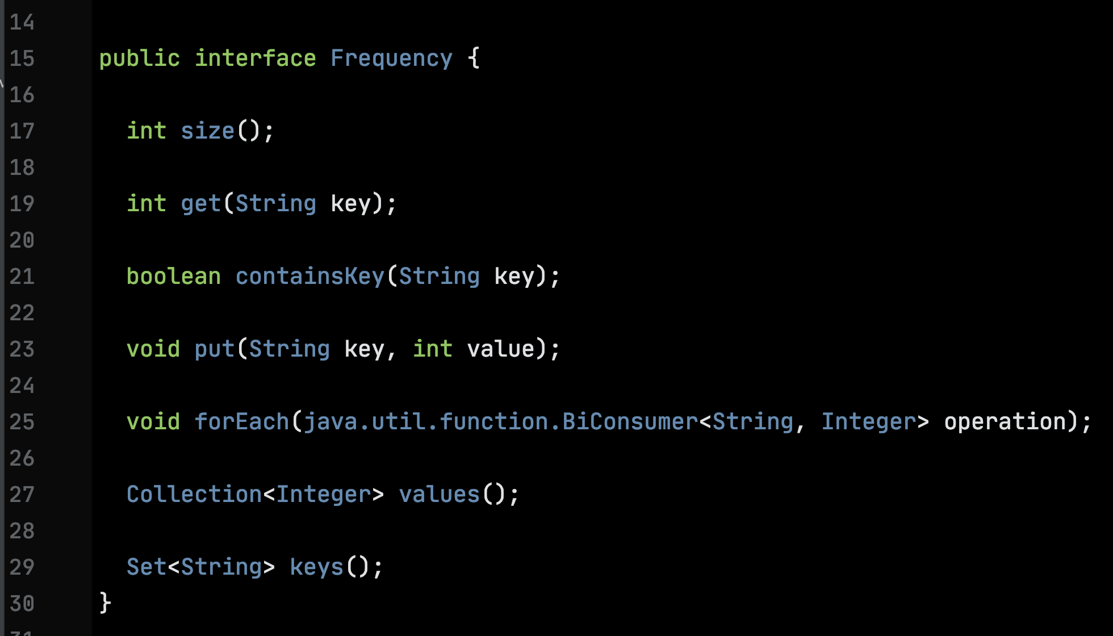
A Draft Frequency Type - the API
Type signatures for seven dynamic functions. Implicitly public.

Slide 24
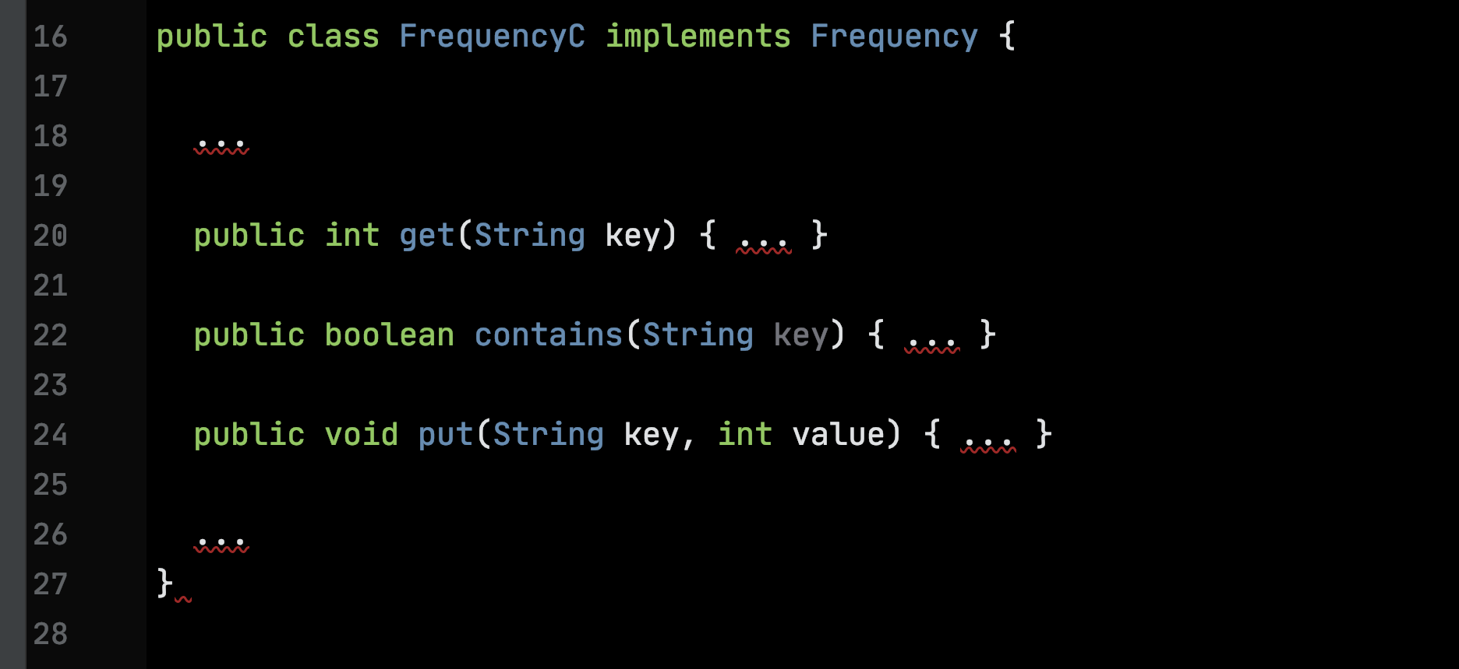
The Frequency Type – an Implementation

Slide 25
The Frequency Type – an Implementation
Instructs the Java compiler to confirm that this implementation agrees with the type signature specified in the interface. If it doesn’t, the program is rejected.

Slide 26
Constructors

Slide 27
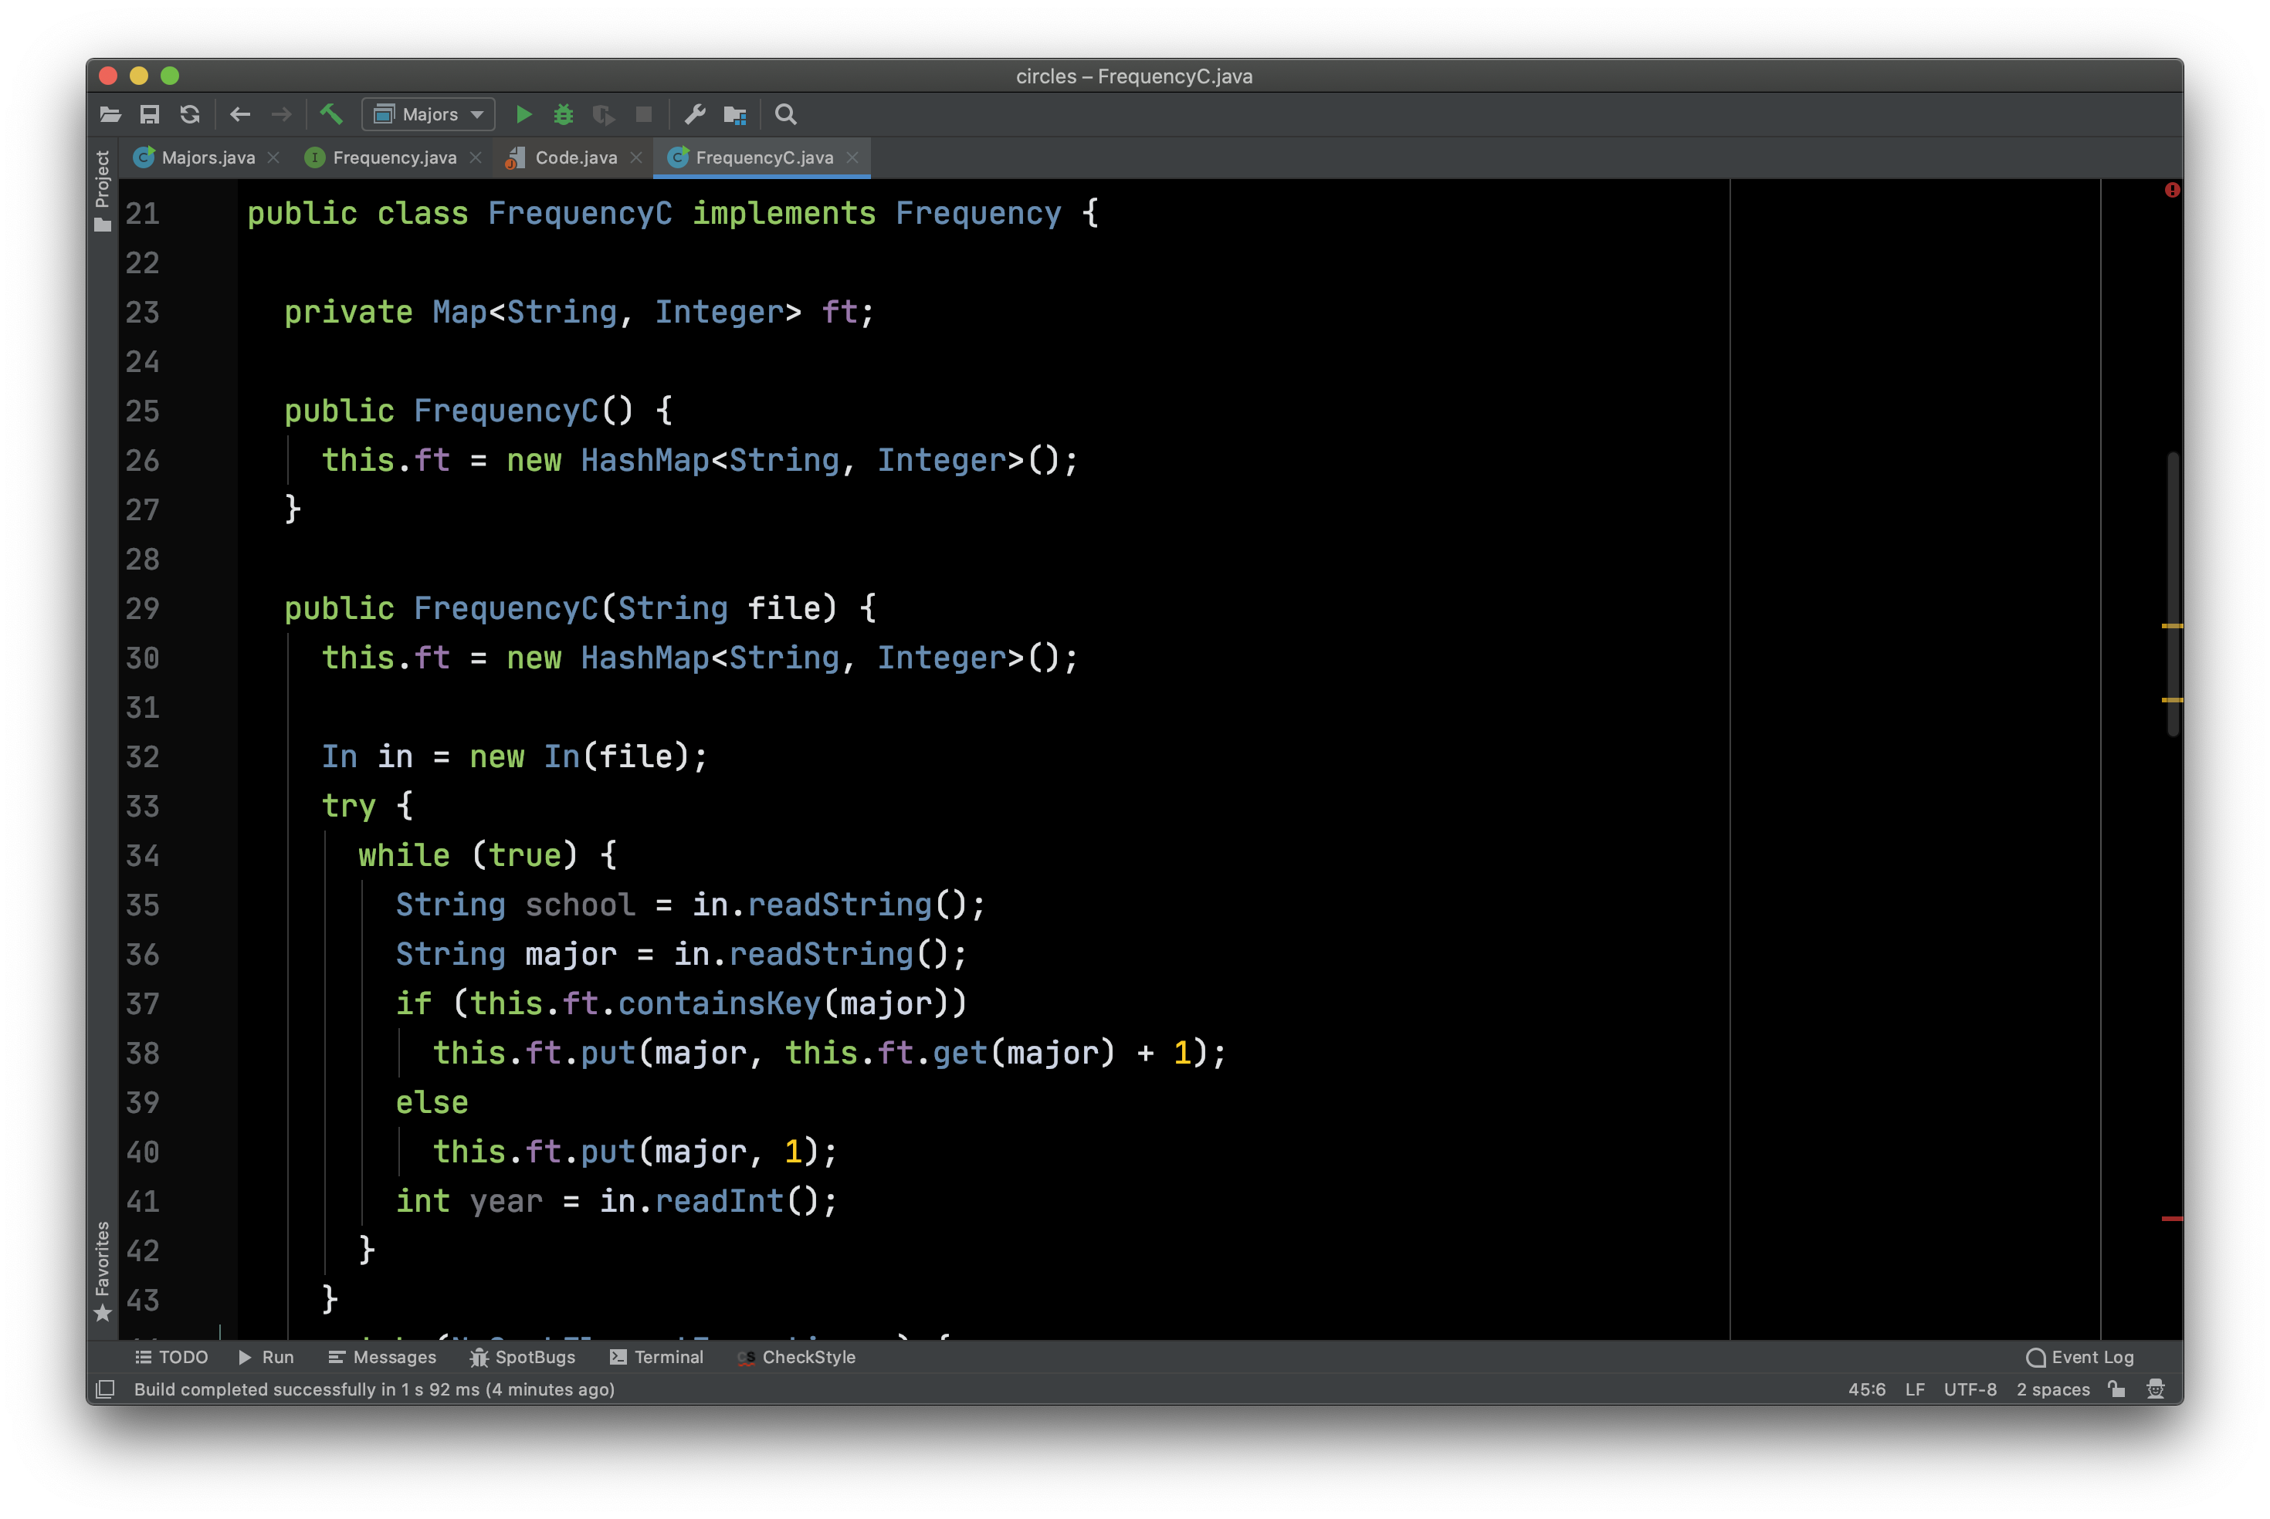
A special function for constructing a value. No return type. Name matches class name.

Slide 28
Overloading. Two functions of the same name, they must have different type signatures.

Slide 29
Building New Types Compositionally

Slide 30
A private instance variable. The concrete representation type is Map<String, Integer>.

Slide 31
For the purposes of this implementation we decided to use a java.util.HashMap as our concrete representation type.

Slide 32
This approach is sometimes called composition.
Classes defined in this way are sometimes called wrapper classes.

Slide 33
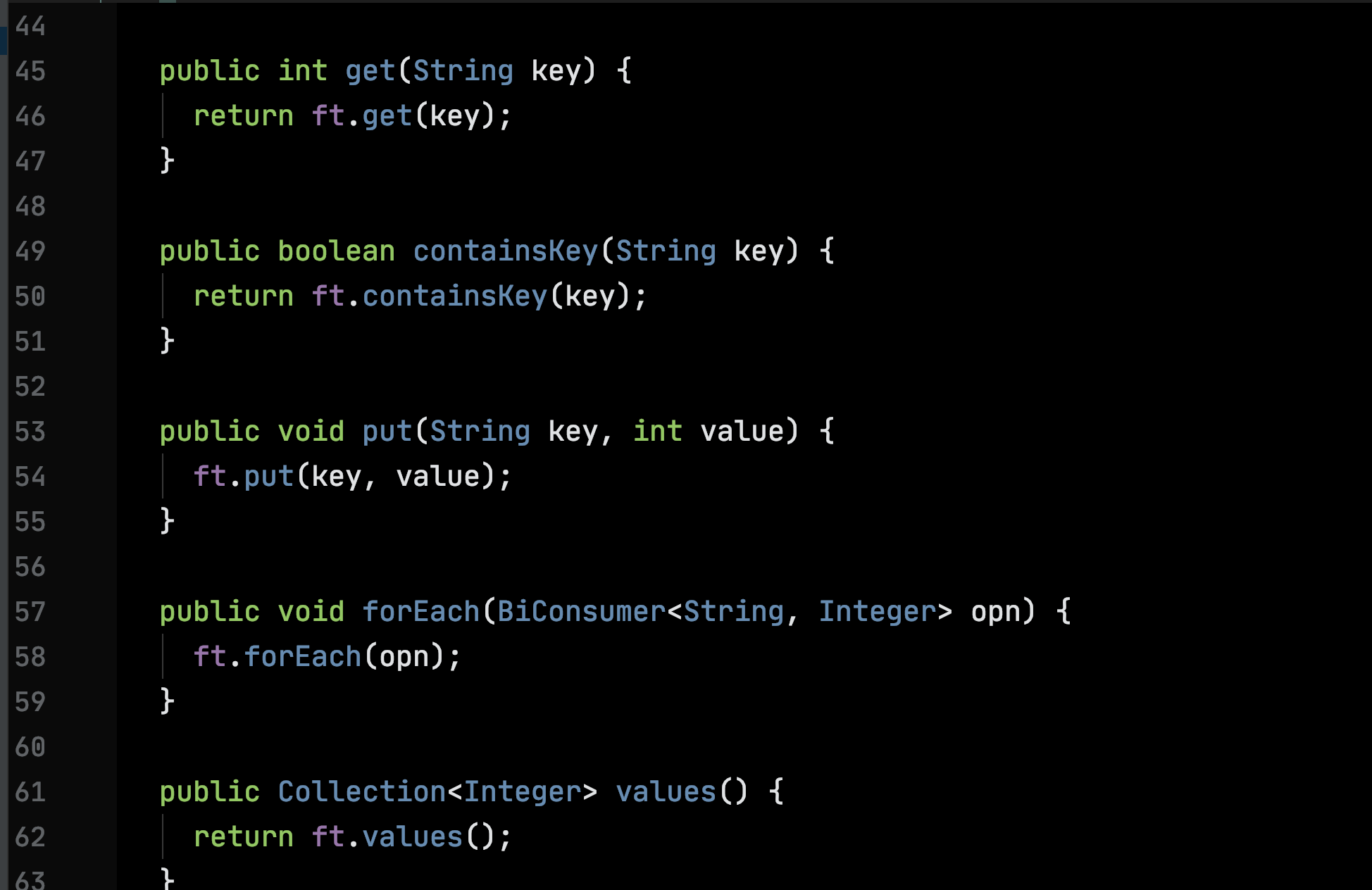
Forwarding or delegation.

Slide 34
Two Main Themes of CS1
How to design a reasonable API for an ADT
How to choose concrete representation types in the implementation of the ADT so that the required operations are performant.
Different applications of the ADT may have different performance requirements.

Slide 35
A Note on λ and Friends

Slide 36
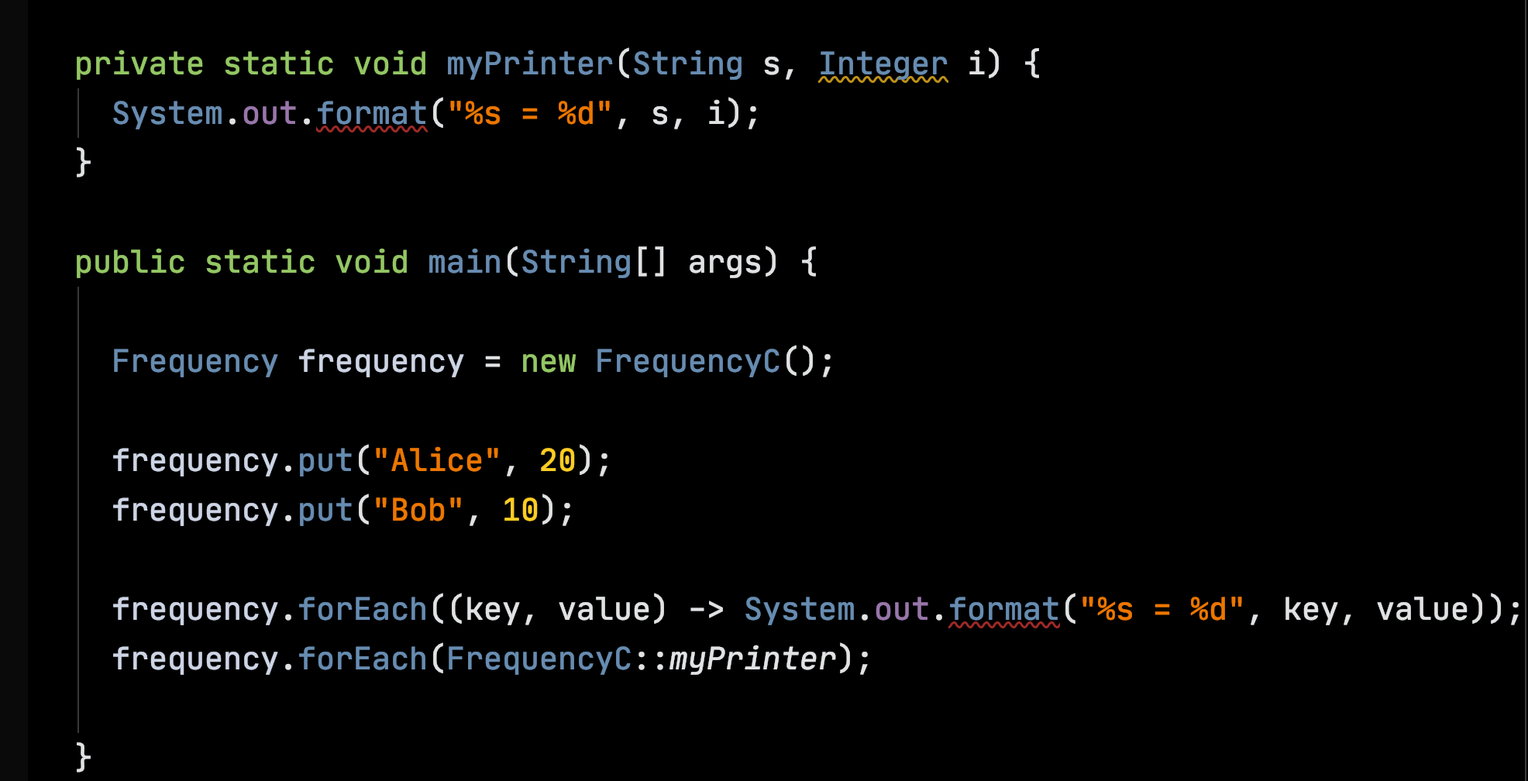
λ an anonymous function, no type information required for the parameters.

Slide 37
A static function defined in class FrequencyC
:: notation

