Slide 1

CSCI 1102 Computer Science 2
Meeting 7: Thursday 2/18/2021
Linked Stacks; Memory

Slide 2
Notes
First quiz next Thursday 2/25
A note on Object versus Generics

Slide 3
Generics vs Object

Slide 4
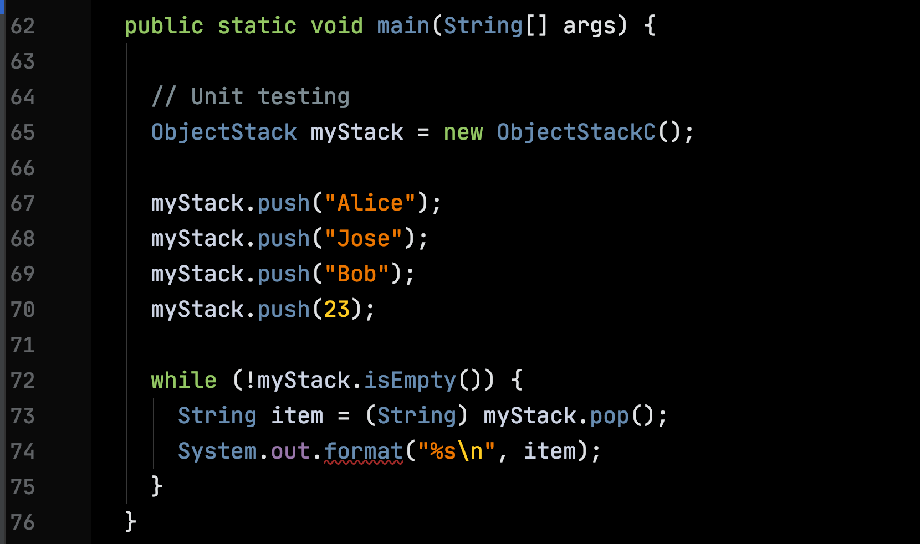
A run-time cast error
OK to mix, all of type Object,
successful compilation

Slide 5
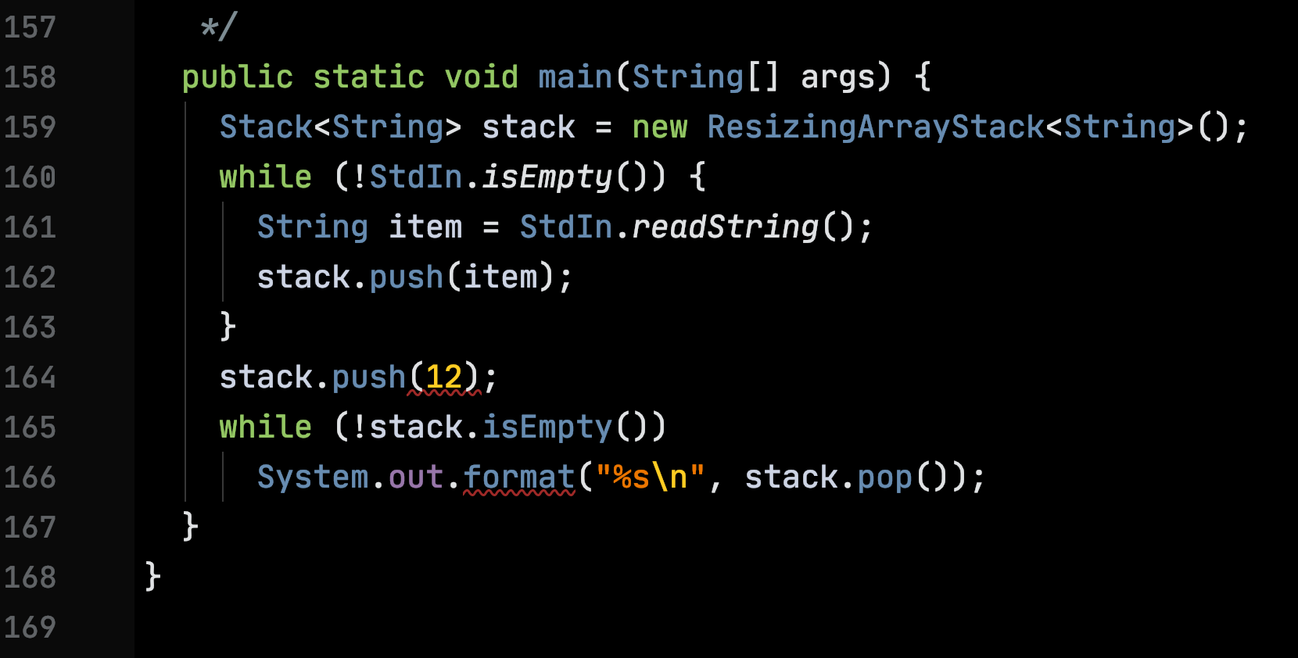
Mixing not allowed, a compile-time error

Slide 6
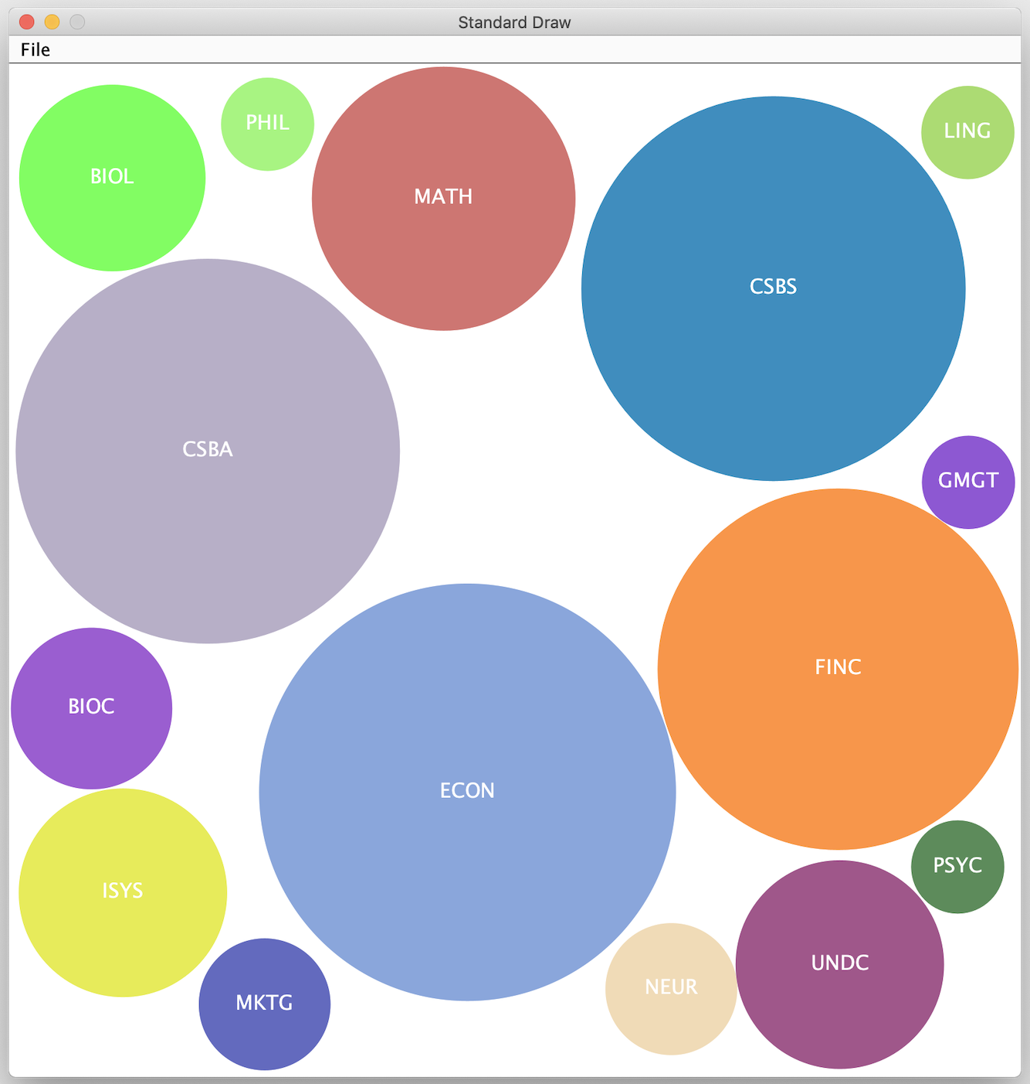

Slide 7
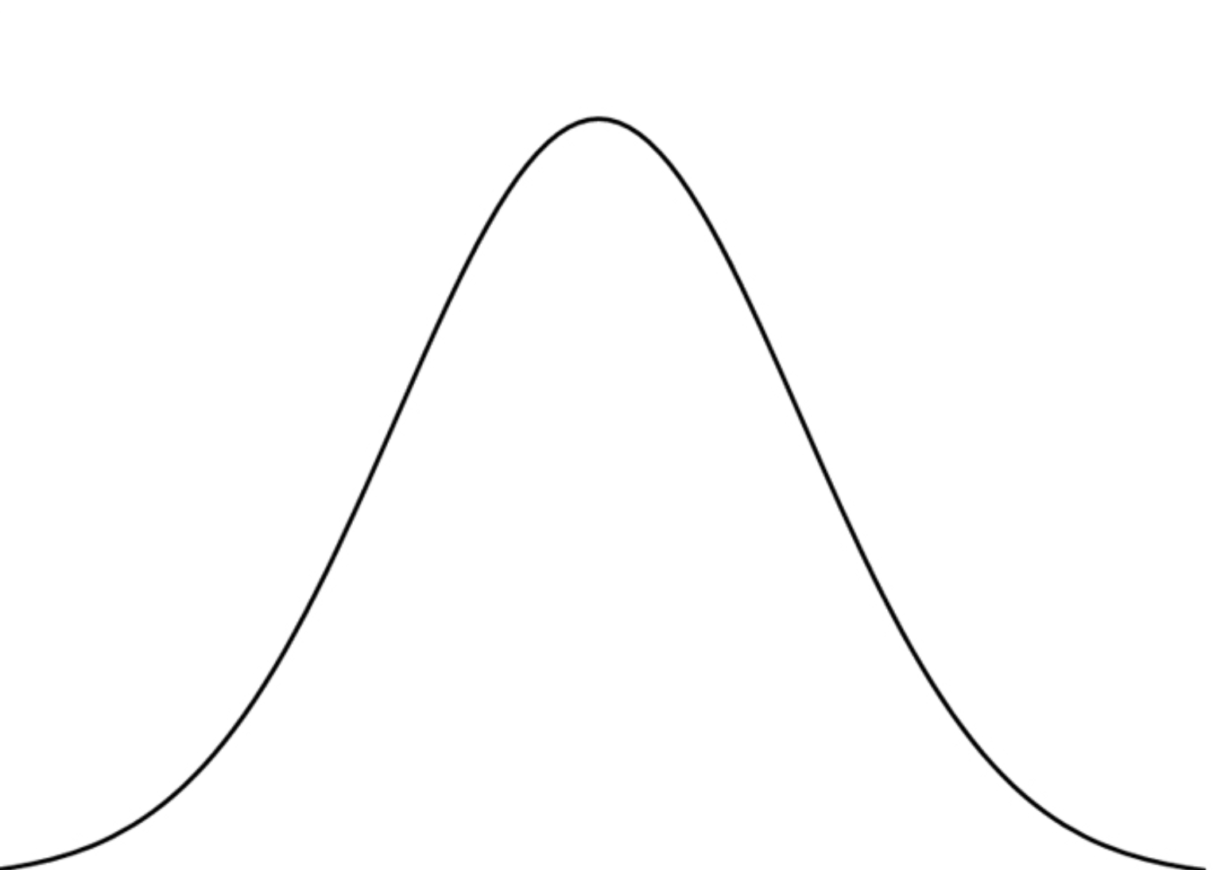

Slide 8
StdRandom.gaussian(1.0 - radius, stdev)

Slide 9
Linked Stacks

Slide 10
Linked Stacks
Pro: unlimited size with no linear resizing cost;
Con: Poor locality

Slide 11
stack.push(“Bob”)
“Bob”

Slide 12
“Alice”
stack.push(“Bob”)
stack.push(“Alice”)
“Bob”

Slide 13
Code

Slide 14
Memory

Slide 15
Basic unit of storage is the byte
7
4
3
0
0
1
0
1
1
0
1
0

Slide 16
There are 2⁸ = 256 8-bit patterns
0
0
0
0
0
0
0
0
…
1
1
1
1
1
1
1
1

Slide 17
We can abbreviate 4 bits with one hexadecimal (base 16) digit
Binary | Hex | Dec | Binary | Hex | Dec
0000 | 0 | 0 | 1000 | 8 | 8
0001 | 1 | 1 | 1001 | 9 | 9
0010 | 2 | 2 | 1010 | A | 10
0011 | 3 | 3 | 1011 | B | 11
0100 | 4 | 4 | 1100 | C | 12
0101 | 5 | 5 | 1101 | D | 13
0110 | 6 | 6 | 1110 | E | 14
0111 | 7 | 7 | 1111 | F | 15

Slide 18
Abbreviate an 8-bit byte with a pair of hex digits
7
4
3
0
0
1
0
1
1
0
1
0
5
A
0x5A

Slide 19
Representing Numbers
Non-negative integers: use binary positional numerals
All integers: use two’s complement:
0
1
0
1
1
0
1
0
Sign
bit 1 => negative, 0 => non-negative

Slide 20
Two’s Complement (8 bits)
Modus Operandi: to negate, flip all bits and add 1
0x02
0
0
0
0
0
0
1
0
= 2
1
1
1
1
1
1
0
1
flip
0xFE
1
1
1
1
1
1
1
0
= -2

Slide 21
Representing Numbers
8 bits unsigned: 2⁸ = 256 values 0 .. 255
8 bits signed: 2⁸ = 256 values -128 .. 127
Floating point: IEEE 754
3.14159 = 31459 x 10⁻⁴

Slide 22
Bitwise Operators
Shifting:
  m << n : shift m left n bits;
  m >> n : shift m right n bits, NB sign extension
Logic: &, |, ^ (xor), ~ (flip)
Seeing what is happening:
String.format(“%x”, expr)

