Slide 1
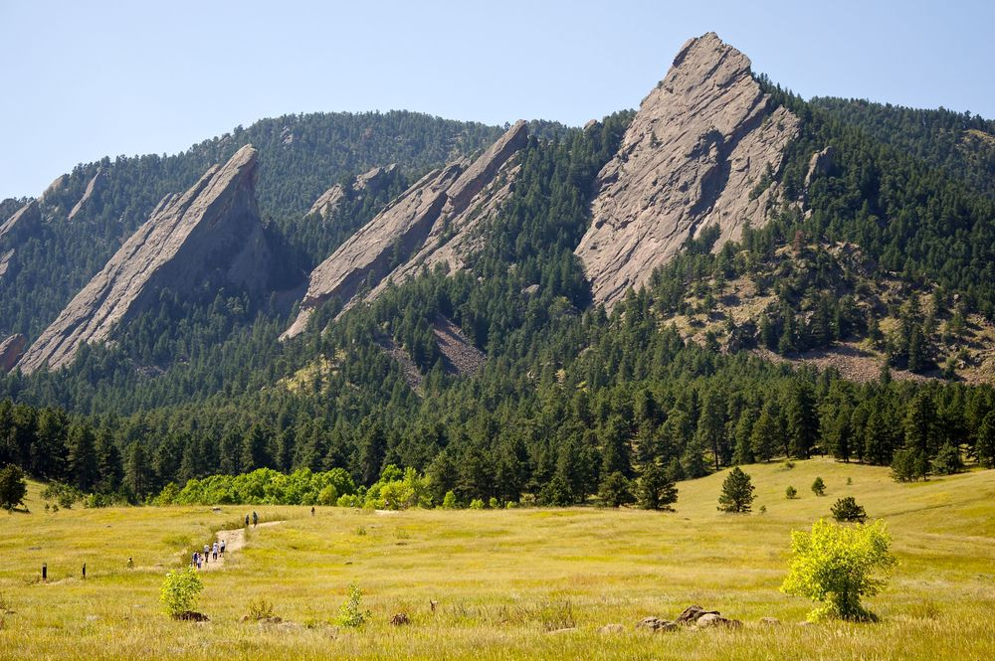
CSCI 1102 Computer Science 2
Meeting 9: Thursday 2/25/2021
Memory Organization

Slide 2
Mostly Random Access Memory (RAM)
Ephemeral Memory
Persistent
Storage
Flash Drive

Slide 3
RAM: Contiguously allocated bytes – each byte has a numerical address
Address
0000
0x00
0001
0x00
An 8-bit pattern
Addresses are natural numbers
0002
0x00
0003
0x00

Slide 4
32-bit words – 4 consecutive bytes
Address
0x0000
0x 03 02 01 00
0x0004
0x 07 06 05 04
0x0008
0x 0B 0A 09 08
0x000C
0x 0F 0E 0D 0C

Slide 5
64-bit words – 8 consecutive bytes
Address
0x0000
0x 07 06 05 04 03 02 01 00
0x0008
0x 07 06 05 04 03 02 01 00
0x0010
0x 07 06 05 04 03 02 01 00
0x0018
0x 07 06 05 04 03 02 01 00

Slide 6
Variables often hold Addresses
Address
0x0008
0x0000
0x 07 06 05 04 03 02 01 00
0x0008
0x 07 06 05 04 03 02 01 00
0x0010
0x 07 06 05 04 03 02 01 00
0x0018
0x 07 06 05 04 03 02 01 00

Slide 7
In diagrams, addresses are usually depicted abstractly as arrows, often called pointers
Address
0x0008
0x0000
0x 07 06 05 04 03 02 01 00
0x0008
0x 07 06 05 04 03 02 01 00
0x0010
0x 07 06 05 04 03 02 01 00
0x0018
0x 07 06 05 04 03 02 01 00

Slide 8
Ephemeral Memory
System Space
User Space

Slide 9
User Space
Dynamic Memory
Static Memory

Slide 10
User Space
Dynamic Memory
Data
Static Memory
Code

Slide 11
Static Memory
Data Segment
Images
Text Segment
Data Segment
Text Segment
Data Segment
Text Segment

Slide 12
All function/method definitions can be understood as images residing in static memory

Slide 13
Dynamic Memory
Stack
Heap

Slide 14
Dynamic Memory
Storage for function variables
Stack
Storage for large values (e.g., arrays) & long-living values
Heap

Slide 15
Managing Dynamic Memory
The stack: the compiler generates code that JVM manages the allocation and deallocation of call frames on the call stack
A call frame is placed on top of the stack on function call and removed on function return
The heap: managed by a run-time support routine called a garbage collector.

Slide 16
The Call Stack: Call Frames/Activation Records
function name
a = …
…
Slots for input parameters & local variables.
z = …
Operator stack
A fixed-size stack for expression evaluation
Body of function evaluated with respect to a call frame.

Slide 17
The Size of a Call Frame’s Operator Stack is Fixed
e
d
c
b
a
a + (b + (c + (d + e)))
a b c d e + + + +

Slide 18
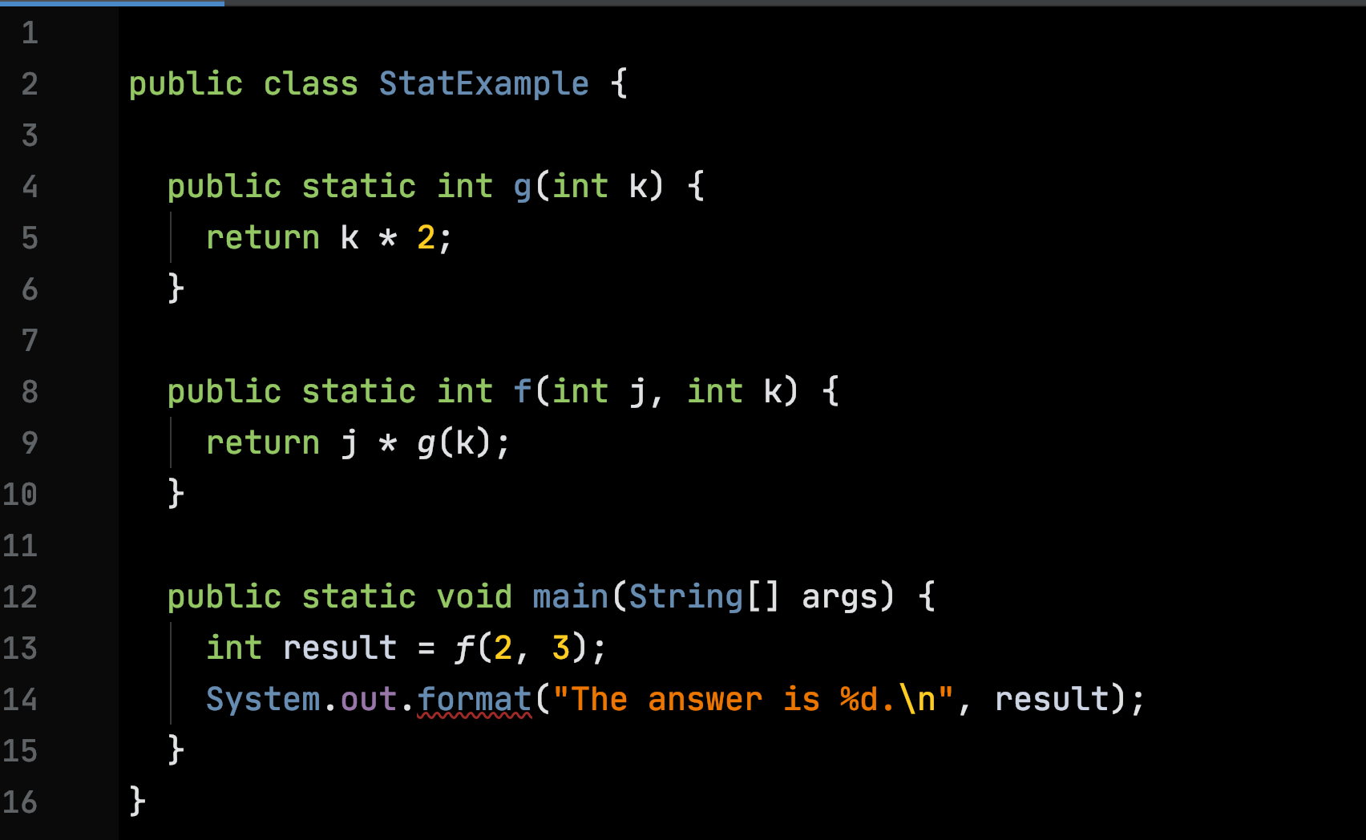
Static Function Example

Slide 19
Stack
Heap

Slide 20
Stack
Heap
StatExample.main
args:
0
result:

Slide 21
Stack
Heap
StatExample.f
j: 2
k: 3
StatExample.main
args:
0
result:

Slide 22
Stack
Heap
StatExample.g
k: 3
StatExample.f
j: 2
k: 3
StatExample.main
args:
0
result:

Slide 23
Stack
Heap
StatExample.g
k: 3
StatExample.f
6
j: 2
k: 3
StatExample.main
args:
0
result:

Slide 24
Stack
Heap
StatExample.g
k: 3
StatExample.f
j: 2
k: 3
StatExample.main
12
args:
0
result: 12

Slide 25
Stack
Heap
System.out.format
fmt:
…
arg: 12
StatExample.main
args:
0
result: 12

Slide 26
Stack
Heap
…
StatExample.main
args:
0
result: 12

Slide 27
Stack
Heap
…
0

Slide 28
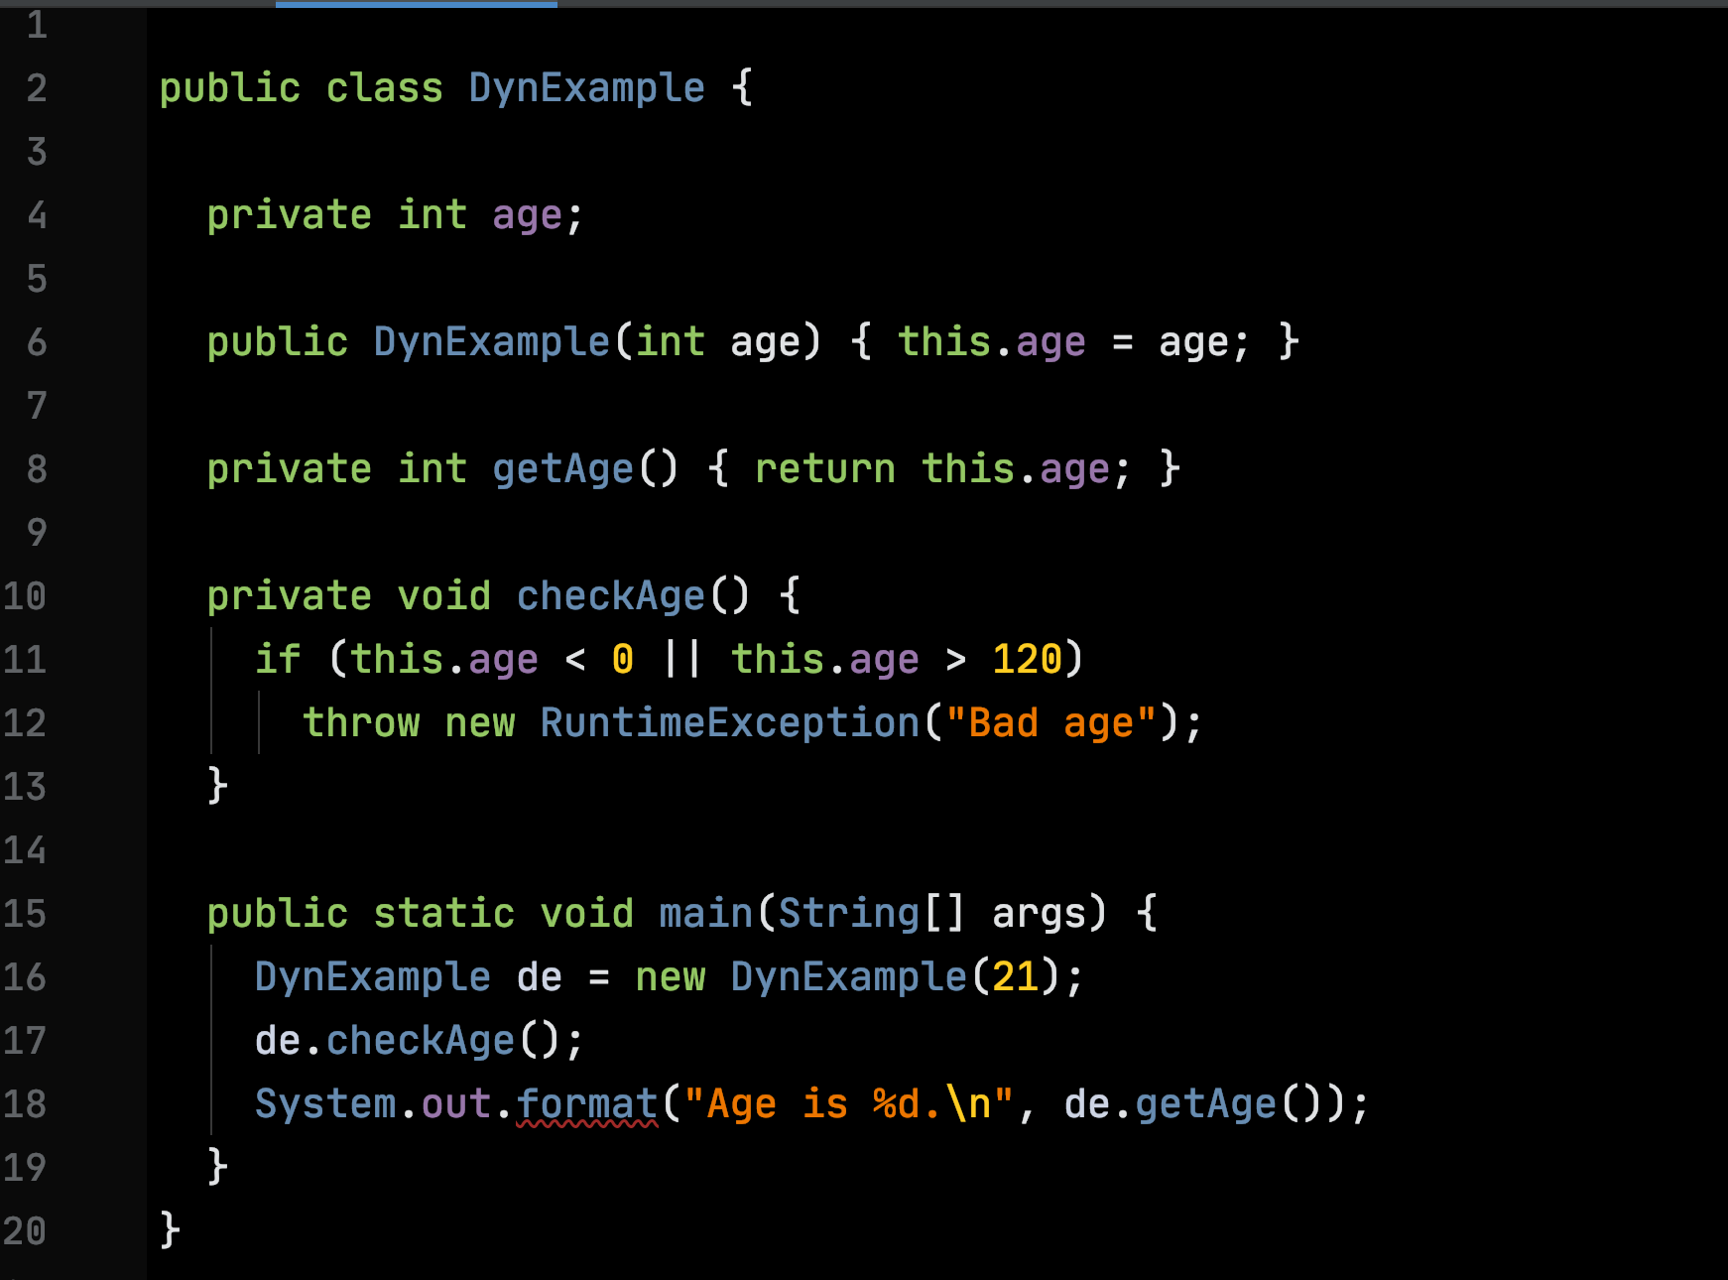
Dynamic Function Example

Slide 29
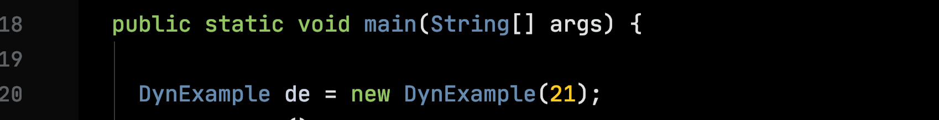
Every Class has a Dispatch Table
class data:
getAge:
Info on getAge
function
checkAge:
hashCode:
Info on hashCode function inherited from Object
hashCode etc inherited from Object
…

Slide 30
Dispatch Tables Support Inheritance and Override
class data:
getAge:
Override e.g., hashCode? Replace the arrow in the table
checkAge:
Object version of hashCode
hashCode:
Local version of hashCode
…

Slide 31
Dispatch Tables
All objects created with new can share the same dispatch table
Dispatch tables are fixed, they can be stored in static memory or in the heap.

Slide 32
Object Representation in the Heap
dispatch table:
class data:
age: 21
getAge:
checkAge:
hashCode:
Instance variables
…

Slide 33
Message-Passing Style
Dynamic functions use message-passing style;
Message-passing style is orthogonal to inheritance
move(point, dx, dy)
point.move(dx, dy)

Slide 34
Message-Passing style Plumbing

Slide 35
Stack
Heap
dispatch table:
age: 21
DynExample.main
de:
args:
0

Slide 36
Stack
Heap
dispatch table:
de.checkAge
age: 21
DynExample.main
de:
args:
0

Slide 37
How can de.checkAge access the instance variable age?

Slide 38
Replace all calls of dynamic functions
de.checkAge()
de.checkAge(de)

Slide 39
Replace all defs of dynamic functions
void checkAge() { … }
void checkAge(DynExample this) { … }

Slide 40
Stack
Heap
dispatch table:
de.checkAge
this:
age: 21
DynExample.main
de:
args:
0

Slide 41
Locality

Slide 42
Motherboard
CPU
RAM
SSD

Slide 43
CPU
Other Registers
ALU In 1
ALU In 2
Program Counter
Instruction Register
Arithmetic
& Logic Unit
Memory Address Register
Memory Data Register
ALU Out
CACHE

Slide 44
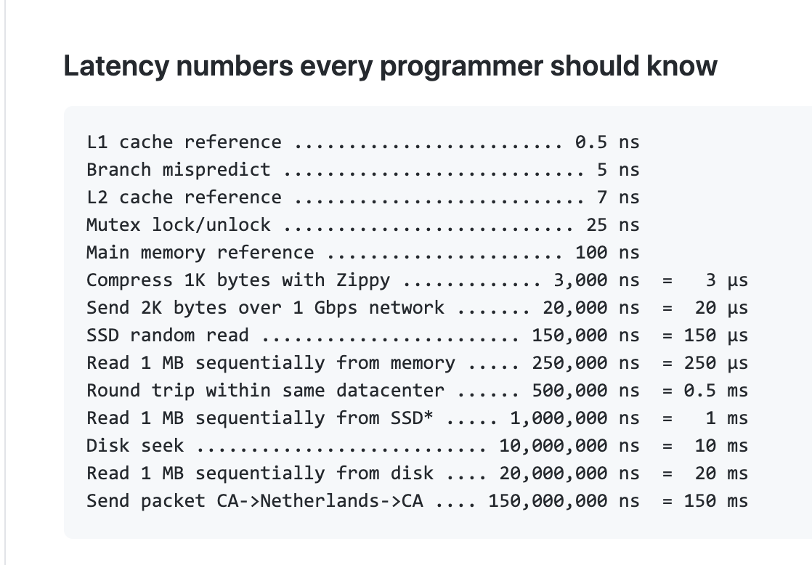

Slide 45
Linked Data Structures
Pro: unlimited size with no linear resizing cost;
Con: Poor locality

Slide 46
Block Storage & Linked Storage
0x0010
0x0010
0x0010

Slide 47
Block Storage & Linked Storage
a
0x0000
Class data for array type
0x0004
3
0x0008
a[0]
0x000C
a[1]
0x0010
a[2]

