Slide 1

CSCI 1102 Computer Science 2
Meeting 9: Thursday 2/25/2021
Memory Organization

Slide 2
Memory Organization

Slide 3
Linked Data Structures
Pro: unlimited size with no linear resizing cost;
Con: Poor locality

Slide 4
Mostly Random Access Memory (RAM)
Ephemeral Memory
Persistent
Storage
Flash Drive

Slide 5
RAM: Contiguously allocated bytes – each byte has a numerical address
Address
0000
0x00
0001
0x00
An 8-bit pattern
Addresses are natural numbers
0002
0x00
0003
0x00

Slide 6
64-bit words – 8 consecutive bytes
Address
0x0000
0x 07 06 05 04 03 02 01 00
0x0008
0x 07 06 05 04 03 02 01 00
0x0010
0x 07 06 05 04 03 02 01 00
0x0018
0x 07 06 05 04 03 02 01 00

Slide 7
Variables often hold Addresses
Address
0x0008
0x0000
0x 07 06 05 04 03 02 01 00
0x0008
0x 07 06 05 04 03 02 01 00
0x0010
0x 07 06 05 04 03 02 01 00
0x0018
0x 07 06 05 04 03 02 01 00

Slide 8
In diagrams, addresses are usually depicted abstractly as arrows, often called pointers
Address
0x0008
0x0000
0x 07 06 05 04 03 02 01 00
0x0008
0x 07 06 05 04 03 02 01 00
0x0010
0x 07 06 05 04 03 02 01 00
0x0018
0x 07 06 05 04 03 02 01 00

Slide 9
Ephemeral Memory
System Space
User Space

Slide 10
User Space
Dynamic Memory
Static Memory

Slide 11
User Space
Dynamic Memory
Data
Static Memory
Code

Slide 12
Static Memory
Data Segment
Images
Text Segment
Data Segment
Text Segment
Data Segment
Text Segment

Slide 13
All function/method definitions can be understood as images residing in static memory

Slide 14
Dynamic Memory
Stack
Heap

Slide 15
Dynamic Memory
Storage for function variables
Stack
Storage for large values (e.g., arrays) & long-living values
Heap

Slide 16
The Call Stack: Call Frames/Activation Records
function name
a = …
…
Word-size slots for local variables.
z = …
Body of function evaluated with respect to a call frame.

Slide 17
Managing Dynamic Memory
The stack: the compiler generates code that manages the allocation and deallocation of call frames on the call stack
A call frame is placed on top of the stack on function call and removed on function return
The heap: managed by a run-time support routine called a garbage collector.

Slide 18
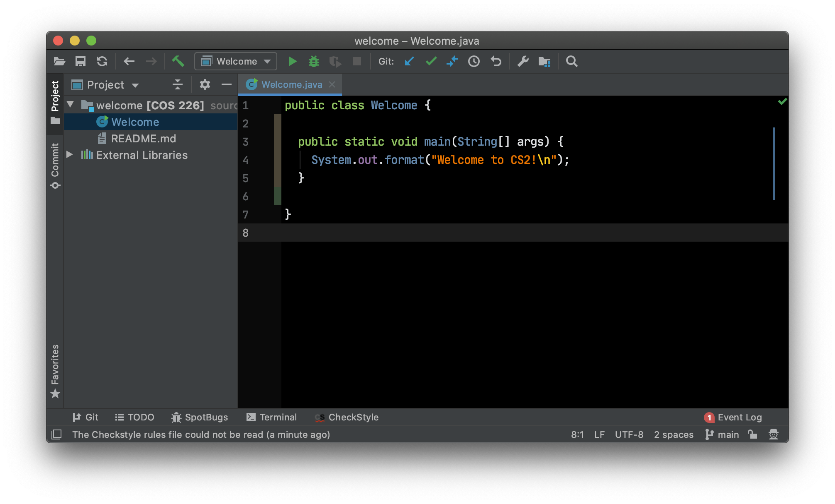
Example

Slide 19
Stack
Heap

Slide 20
Stack
Heap
Welcome.main
args
0

Slide 21
top
Heap
Stack
16
'W'
System.out.format
'e'
…
Welcome.main
'!'
args
0
'\n'

Slide 22
Stack
Heap
top
16
'W'
System.out.format
'e'
…
Welcome.main
'!'
args
0
'\n'

Slide 23
Stack
Heap
16
'W'
System.out.format
'e'
…
Welcome.main
'!'
args
0
'\n'

Slide 24
Stack
Heap
16
'W'
'e'
…
'!'
0
'\n'

Slide 25
Stack
Heap

Slide 26
Block Storage & Linked Storage
0000
3
0002
0x0010
0004
0x0020
0006
0x0030

Slide 27
Block Storage & Linked Storage
Consecutive words drawn side by side, i.e., 2-word blocks
0x0010
0x0004
0x0020
0x0030
0

Slide 28
Motherboard
CPU
RAM
SSD

Slide 29
CPU
Other Registers
ALU In 1
ALU In 2
Program Counter
Instruction Register
Arithmetic
& Logic Unit
Memory Address Register
Memory Data Register
ALU Out
CACHE

Slide 30
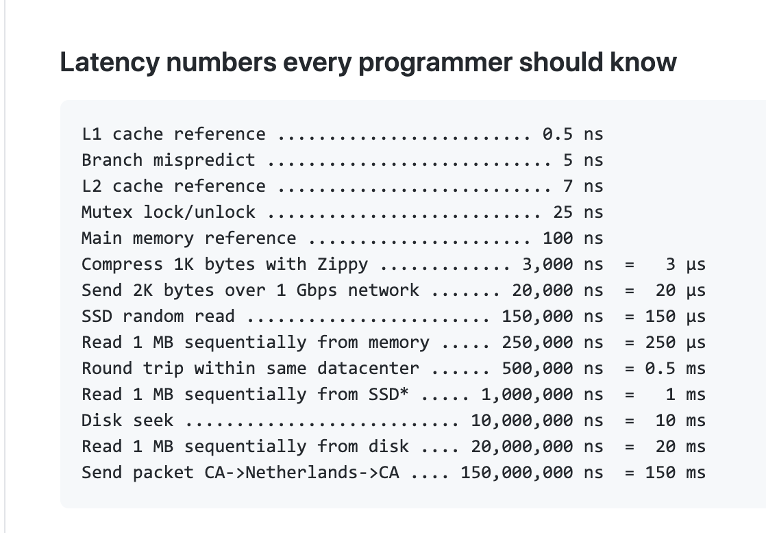

Slide 31
Work

Slide 32
How Much?
How much time does an operation take?
How much memory does it use?
In the worst case? On average?
How does the work grow as the input grows?

Slide 33
Measure the Input Size – N
Units of Work
Input Size – N

