Slide 1
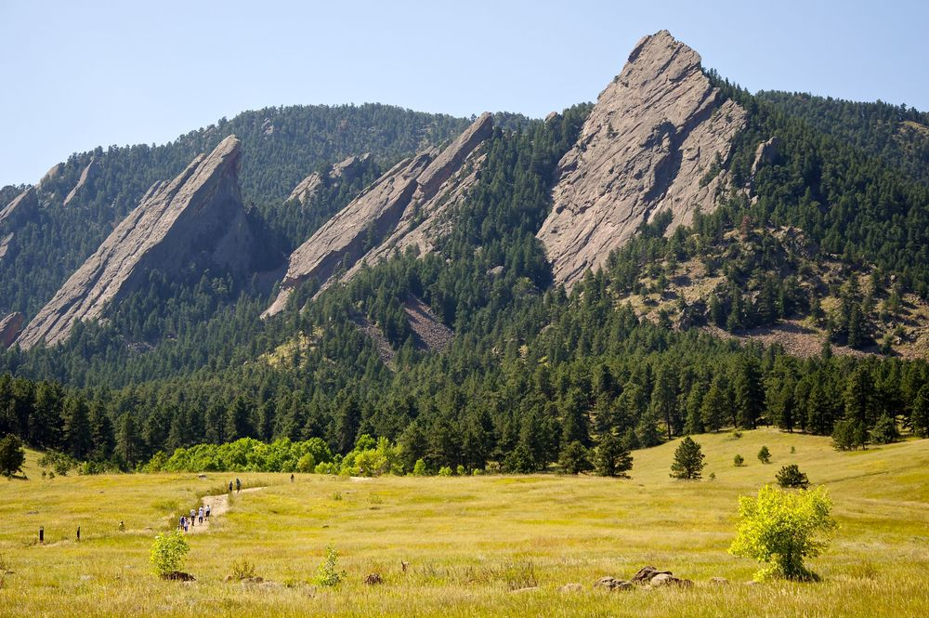
CSCI 1102 Computer Science 2
Meeting 8: Tuesday 2/23/2021
Queues

Slide 2

Queues
Queues

Slide 3
Simple Queues – First-in First-out (FIFO)
Deques – double-ended queues
Priority Queues

Slide 4
enqueue(A)
front
back
A

Slide 5
enqueue(B)
front
back
A
B

Slide 6
enqueue(C)
front
back
A
B
C

Slide 7
dequeue()
front
back
A
B
C

Slide 8
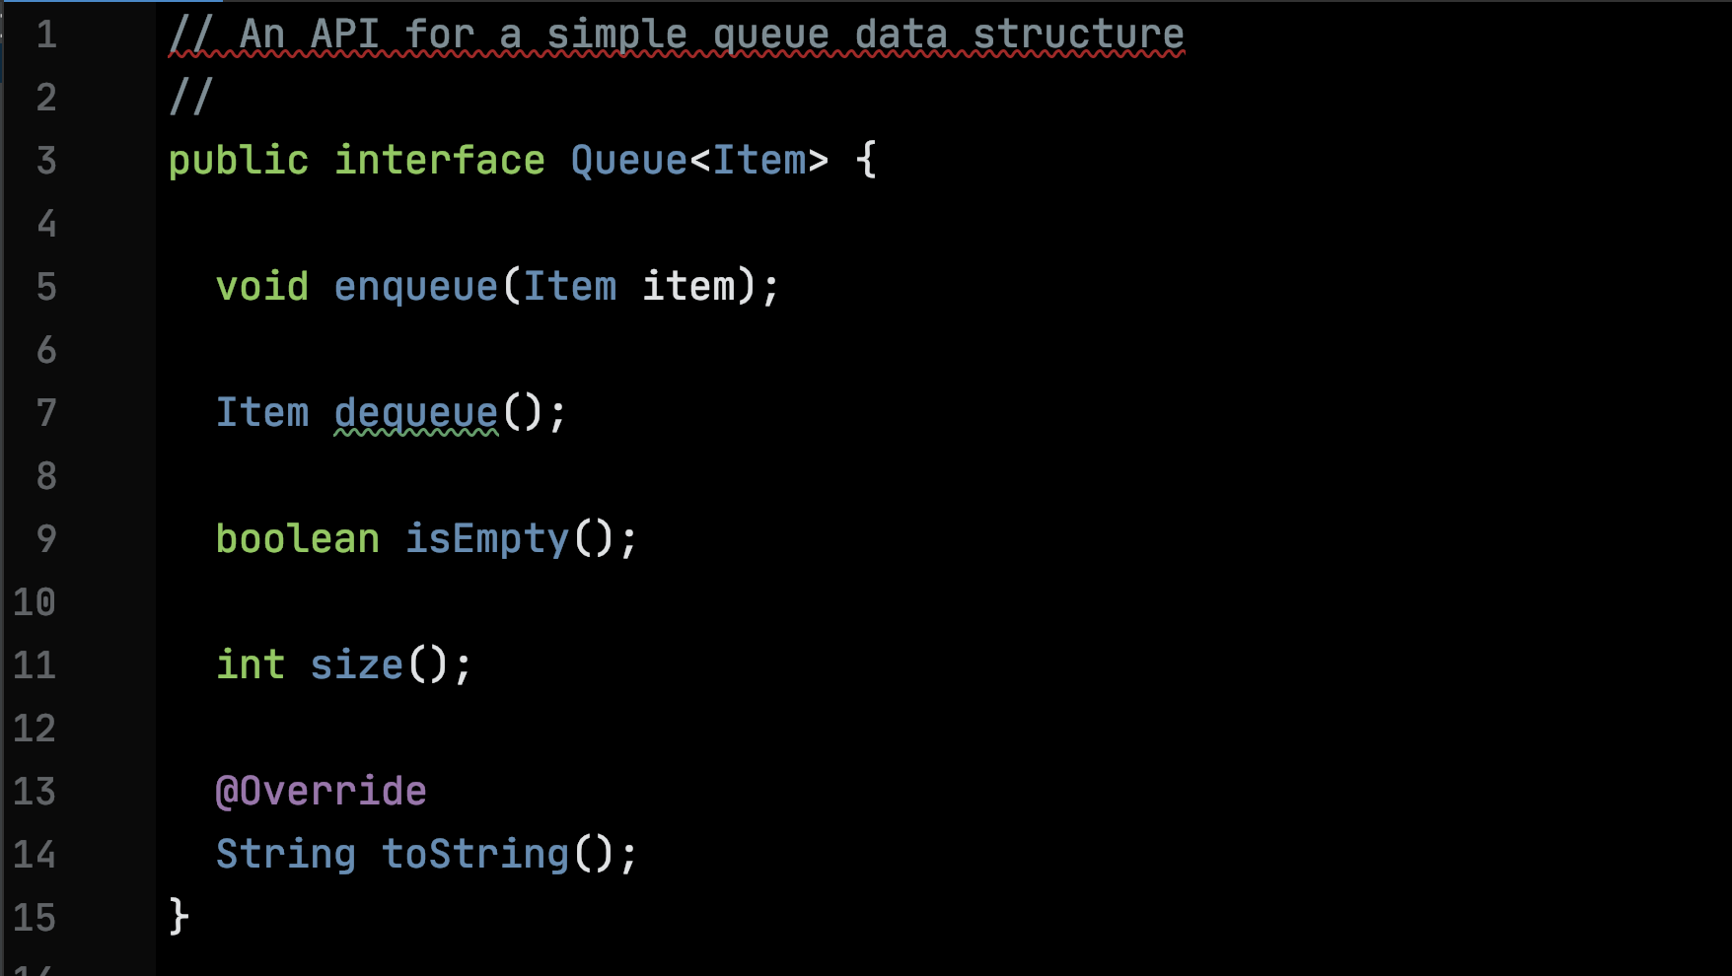

Slide 9
Double-ended Queues
Deques
Heads up! Deque != de-queue

Slide 10
pushLeft(C); pushLeft(B); pushLeft(A);
left
right
A
B
C

Slide 11
popRight(); popRight();
left
right
A
B
C

Slide 12
A Sequential Representation of Simple Queues
0
1
2
3
A
B
C
front
back

Slide 13
After dequeueing A & B
0
1
2
3
-
-
C
front
back

Slide 14
Could Slide Left – Linear Cost
0
1
2
3
C
front
back

Slide 15
0
1
3
2

Slide 16
front
0
1
A
B
C
3
2
back

Slide 17
dequeue(); dequeue();
0
1
-
-
C
3
2
back
front

Slide 18
enqueue(D); enqueue(E); enqueue(F);
0
1
E
F
back
D
C
3
2
front

Slide 19
resize()
1
2
D
E
0
3
front
C
F
back
7
4
6
5

Slide 20
Code

Slide 21
A Linked Representation of Simple Queues
Node
T info
Node next

Slide 22
A Header – empty queue
Node front
Node back

Slide 23
enqueue(A)
front
A
back

Slide 24
enqueue(B)
front
A
B
back

Slide 25
dequeue()
front
-
B
back
A

Slide 26
Code

