Slide 1
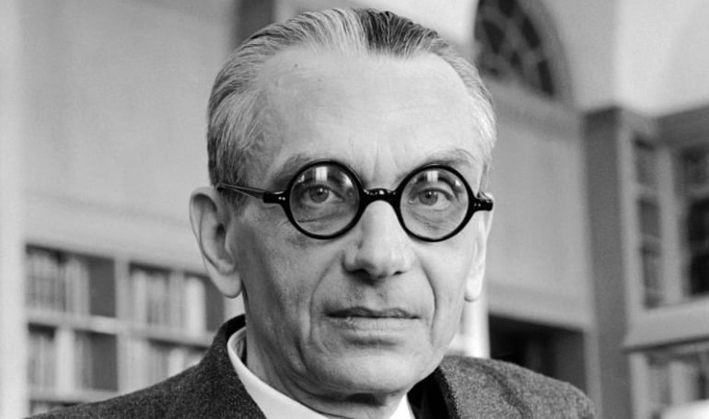
CSCI 1102 Computer Science 2
Meeting 12: Thursday 3/11/2021
Recursion & Iteration; Mutability; Order

Slide 2
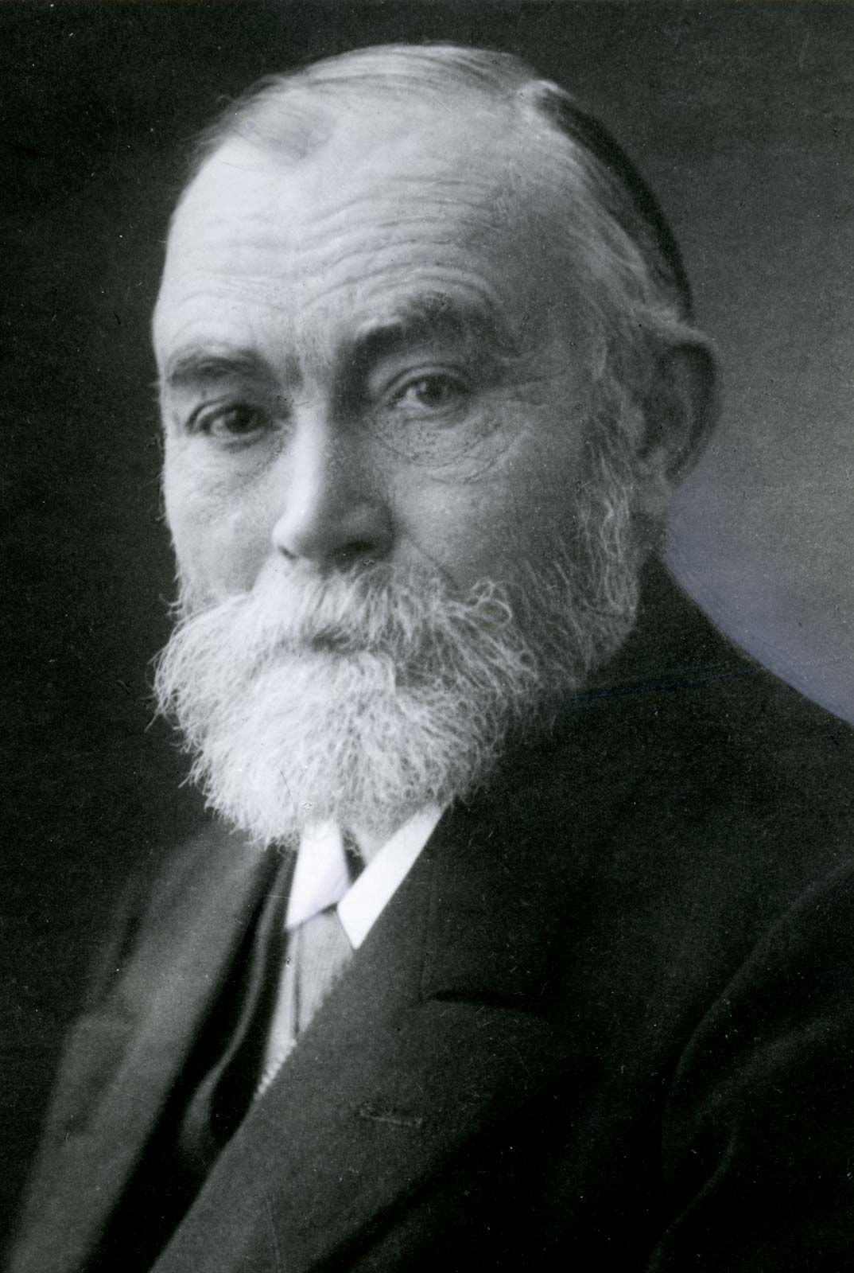
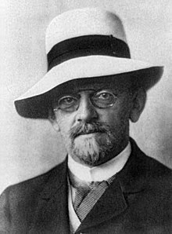
CSCI 1102 Computer Science 2

Slide 3
This statement is unprovable.

Slide 4
Today
Quiz Review
Iteration and Recursion
Mutation
2^{N} and log₂ N
Notes:
Concept-Script: A Formal Language for Pure Thought Modeled on that of Arithmetic

Slide 5
PLs & their Native Ways
Python & Java are imperative languages
imperative control forms for, while & mutable structures are natural;
recursive control & recursive structures are admissible but less natural in the case of Java and much less natural in the case of Python.

Slide 6
PLs & their Native Ways
Ocaml and related languages are functional (value-oriented, expression-oriented);
recursive control, pattern matching & immutable recursive structures are natural;
imperative forms & mutable structures are admissible but less natural.

Slide 7
Mutability & Immutability
-
0
-
0
X
1
X
1
P
2
Z
2
a[2] = Z;
M
3
M
3
E
4
E
4
L
5
L
5
E
6
E
6
Notes:
Concept-Script: A Formal Language for Pure Thought Modeled on that of Arithmetic

Slide 8
Generally Speaking …
If your concrete representation types involve block-storage/arrays, your first thought should be to consider imperative control forms for or while, probably together with mutation.
0
-
1
X
2
P
3
M
4
E
5
L
6
E

Slide 9
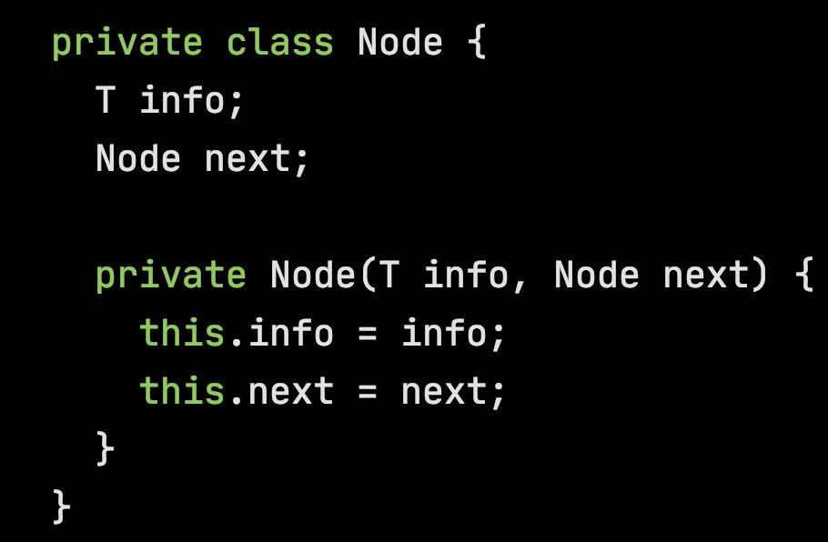
Generally Speaking …
If your concrete types are defined recursively, your first thought should be to use recursive control to process the recursively defined parts.
And you should carefully consider whether or not the data structure should be immutable.

Slide 10
Example: Merge 2 Ascending Arrays
0
A
0
B
0
A
1
C
1
D
1
B
2
E
2
C
3
F
3
D
4
E
5
F

Slide 11
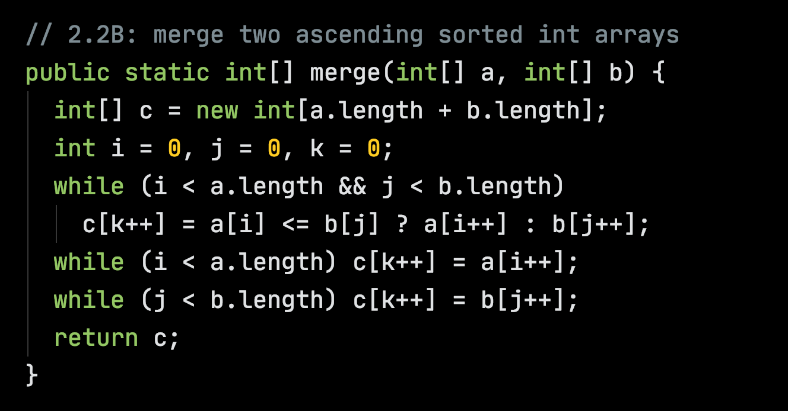
Example: Merge 2 Ascending Arrays

Slide 12
Node add(Node a, Node b)
a
2
3
b
4
5
6
7

Slide 13
Node add(Node a, Node b)
a
2
3
6
8
6
7
b
4
5
6
7

Slide 14
Node add(Node a, Node b)
a
Structure Sharing & Aliasing
2
3
6
8
b
4
5
6
7

Slide 15
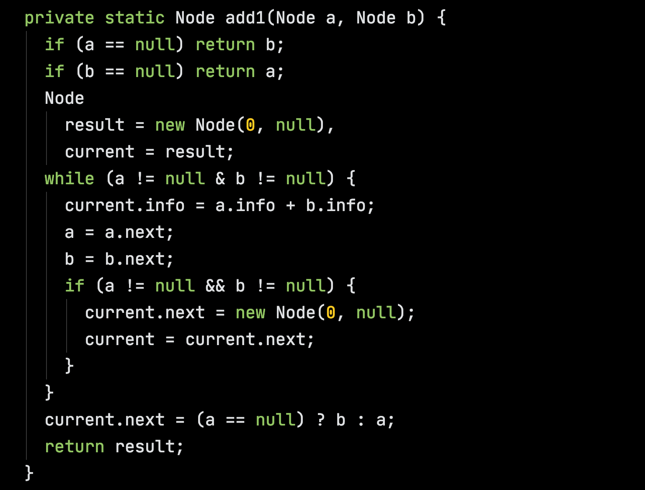

Slide 16
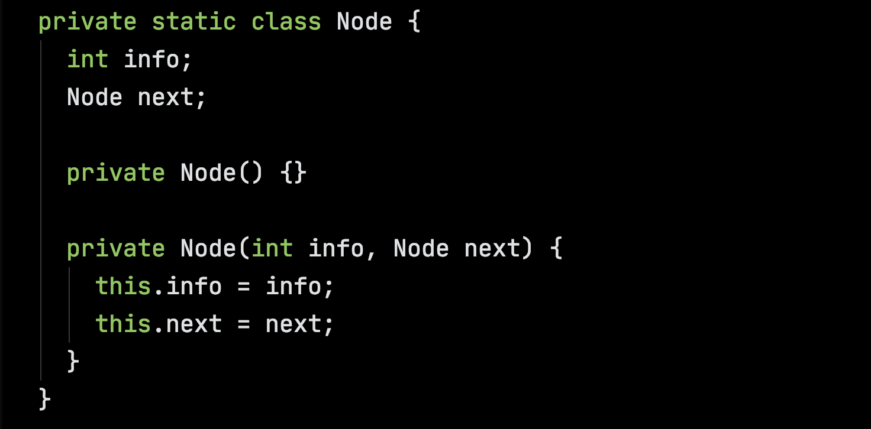

Slide 17
How to Think about Recursion
No sweat, if I handle the base case(s) correctly, a recursive call on a recursively defined field will always give me a complete, good-to-go result for the slightly smaller part;

Slide 18
add(a.next, b.next)
a
2
3
8
b
4
5
6
7

Slide 19
How to Think about Recursion
No sweat, if I handle the base case(s) correctly, a recursive call on a recursively defined field will always give me a complete, good-to-go result for the slightly smaller part;
Now what additional work needs to be done to use this smaller result to get the full result?

Slide 20
new Node(a.info + b.info, add(a.next, b.next))
a
2
3
6
8
b
4
5
6
7

Slide 22
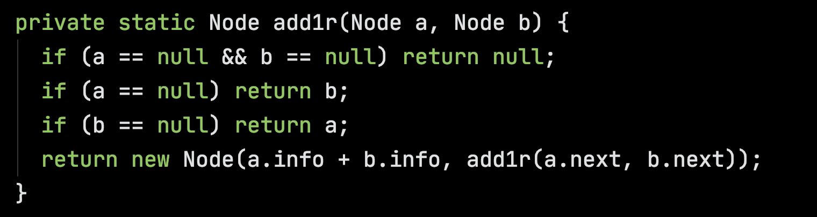

Slide 23
How to Think about Recursion
In addition to being the natural way to process recursively defined structures, recursion is natural for other ordered types such as non-negative integers;
There are many, many other cases where the algorithms are naturally recursive.

Slide 24

Issues with Mutation
Issues with Mutation

Slide 25
Issues with Mutation
Mutation complicates/disqualifies structure sharing
a
6
8
b
4
5
6
7
a.next.next.info = 10; alters b

Slide 26

Issues with Mutation
Mutation complicates/disqualifies structure sharing
a
Owner of b minding their own business…
6
8
b
4
5
10
7
a.next.next.info = 10; alters b

Slide 27
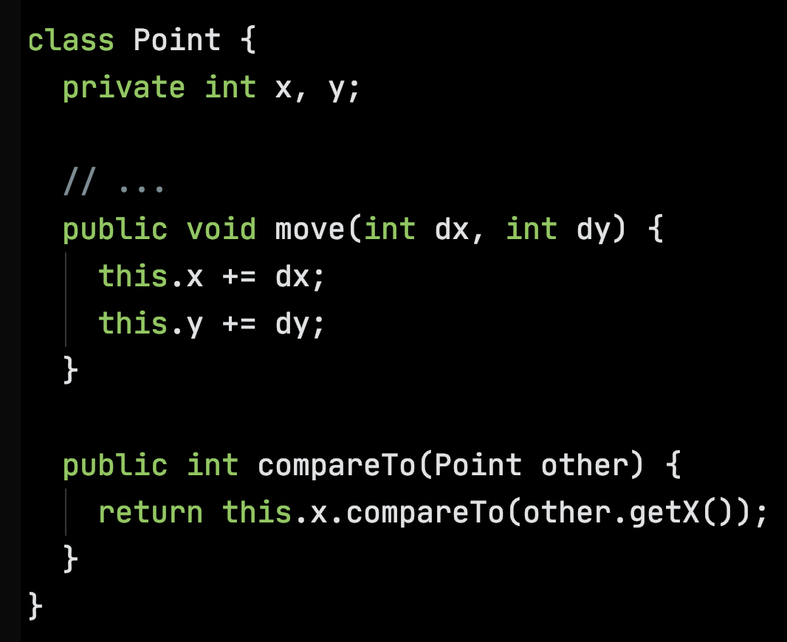
Issues with Mutation
Mutation can silently corrupt order sensitive data structures.

Slide 28
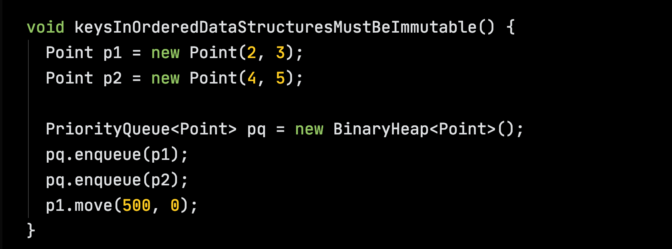
Issues with Mutation

Slide 29
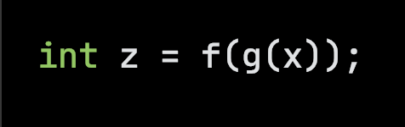
Issues with Mutation
Mutation compromises compositional reasoning about code.

Slide 30
Issues with Mutation
Mutation greatly complicates multi-threaded code.
Mutation generally superimposes a web of dependencies in code and the people and organizations involved with the code.

Slide 31
Reasonable & Unreasonable Numbers

Slide 32
Perfect Binary Tree – All depths are full
A
A
A
C
A
A
C
C
C
C
C
C

Slide 33
Properties of Perfect Binary Trees
A perfect binary tree
of height k has
2^{k} leaves
2^{k} – 1 interior nodes
2^{k+1} – 1 nodes
A
A
A
C
C
C
C

Slide 34
Two Sides of the Coin
A perfect binary tree of height k, has 2^{k} leaves. For not very large k, 2^{k} can be stupendously large.
A perfect binary tree with N leaves has height log₂ N. Even for stupendously large N, log₂ N is quite manageable.
For not very large height, visiting every leaf is infeasible but traveling from the root to a given leaf is very fast.

Slide 35
Example: the exponent side
Assuming your algorithm can process a leaf node in a very zippy 1 nanosecond (10⁻⁹ = 1 billionth of a second). Then processing all of the leaves of a perfect binary tree of height
60 takes …
70 takes …

Slide 36
Example: the exponent side
Assuming your algorithm can process a leaf node in a very zippy 1 nanosecond (10⁻⁹ = 1 billionth of a second). Then processing all of the leaves of a perfect binary tree of height
60 takes > 32 years;
70 takes ...

Slide 37
Example: the exponent side
Assuming your algorithm can process a leaf node in a very zippy 1 nanosecond (10⁻⁹ = 1 billionth of a second). Then processing all of the leaves of a perfect binary tree of height
60 takes > 32 years;
70 takes > 32 thousand years.

Slide 38
Example: the log₂ side
Stuck with ~10²¹ (one sextillion) data values? Can they be organized as nodes in a perfect binary tree?
If so, you can get to any one of them in ~70 steps.

