Slide 1
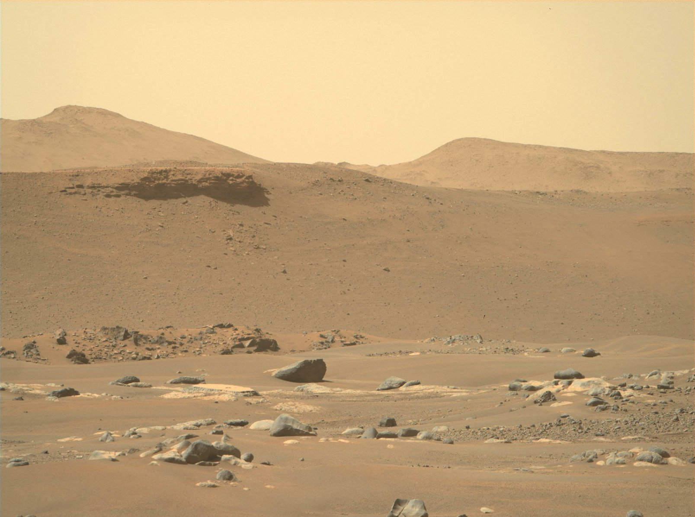
CSCI 1102 Computer Science 2
Meeting 11: Tuesday 3/9/2021
Priority Queues; Binary Heaps

Slide 2
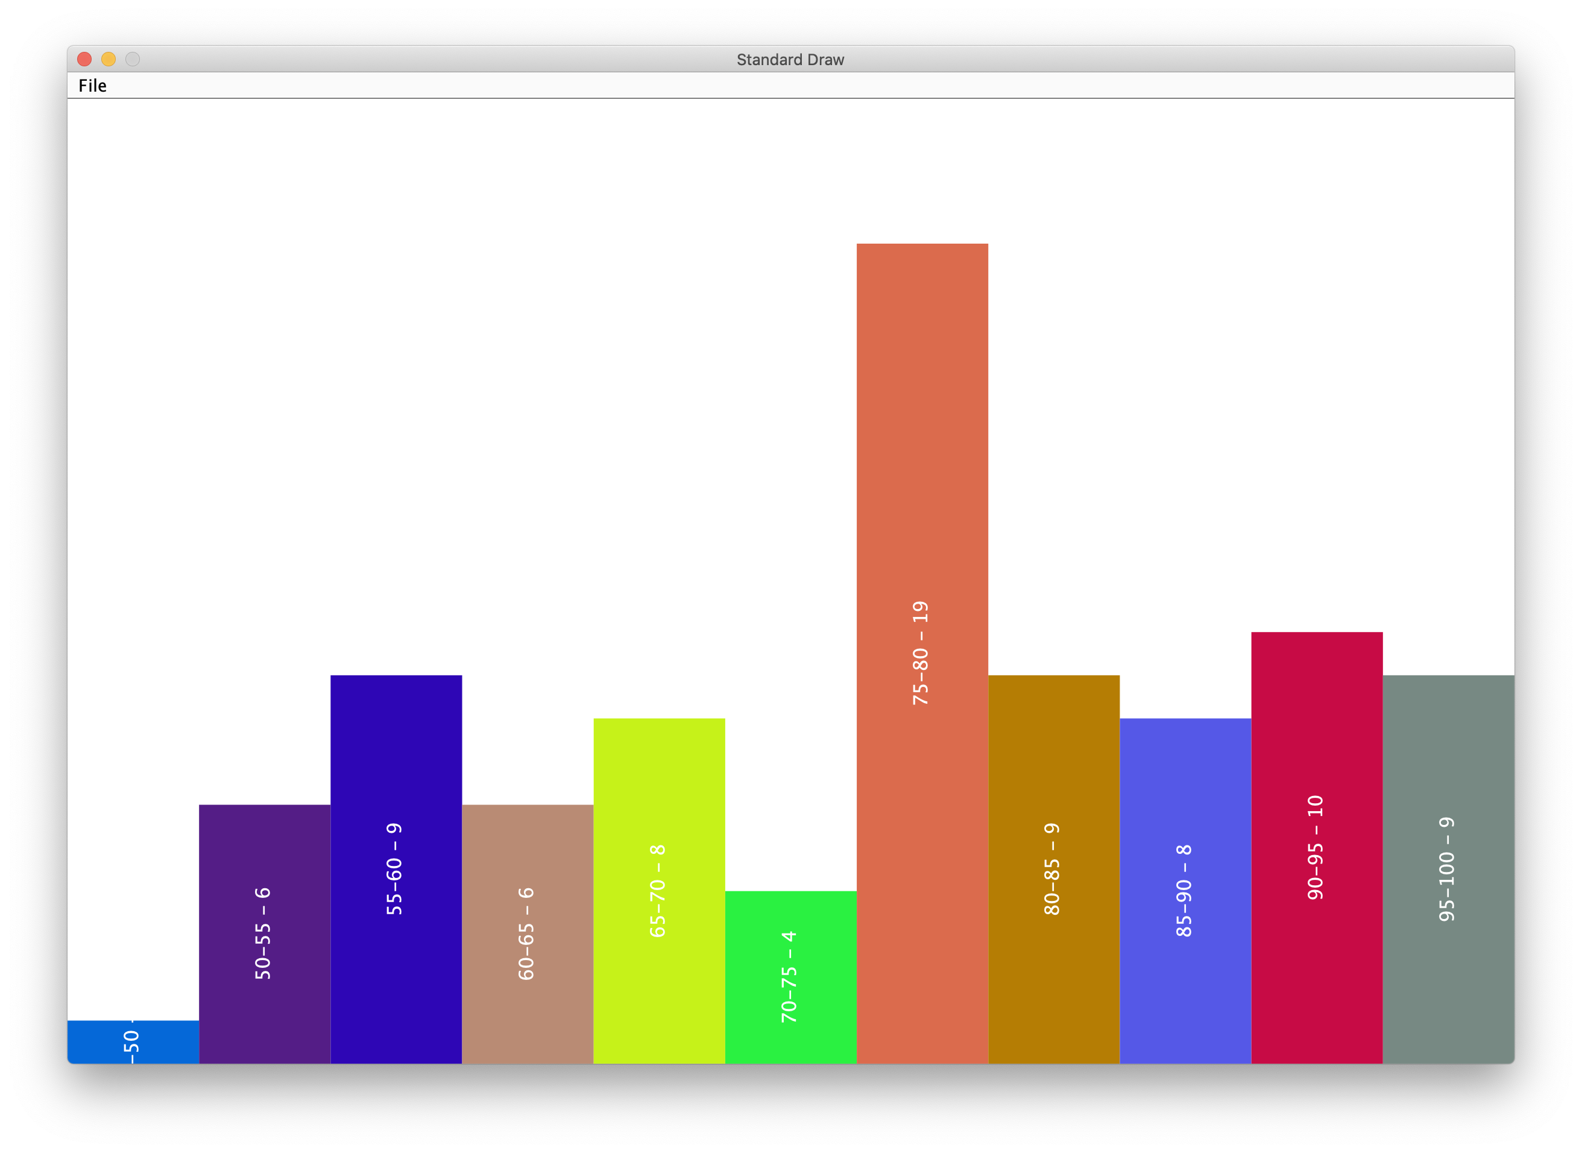
Quiz 1

Slide 3
Order Sensitive Data Structures

Slide 4
Example
There are ~10⁶⁰ small molecules that might be therapeutic drugs;
Only a small handful can be tested in vitro in a lab setting;
Many fewer still can be tested in vivo or in clinical trials;
Rank these candidates from highest to lowest priority, place in a Maximum Priority Queue (MaxPQ)

Slide 5
Simple Linked or Sequential Allocation lead to linear time enqueue.

Slide 6
enqueue(E)
1
2
D
F
0
3
front
C
G
back
7
4
6
5

Slide 7
enqueue(B)
front
A
C
back

Slide 8
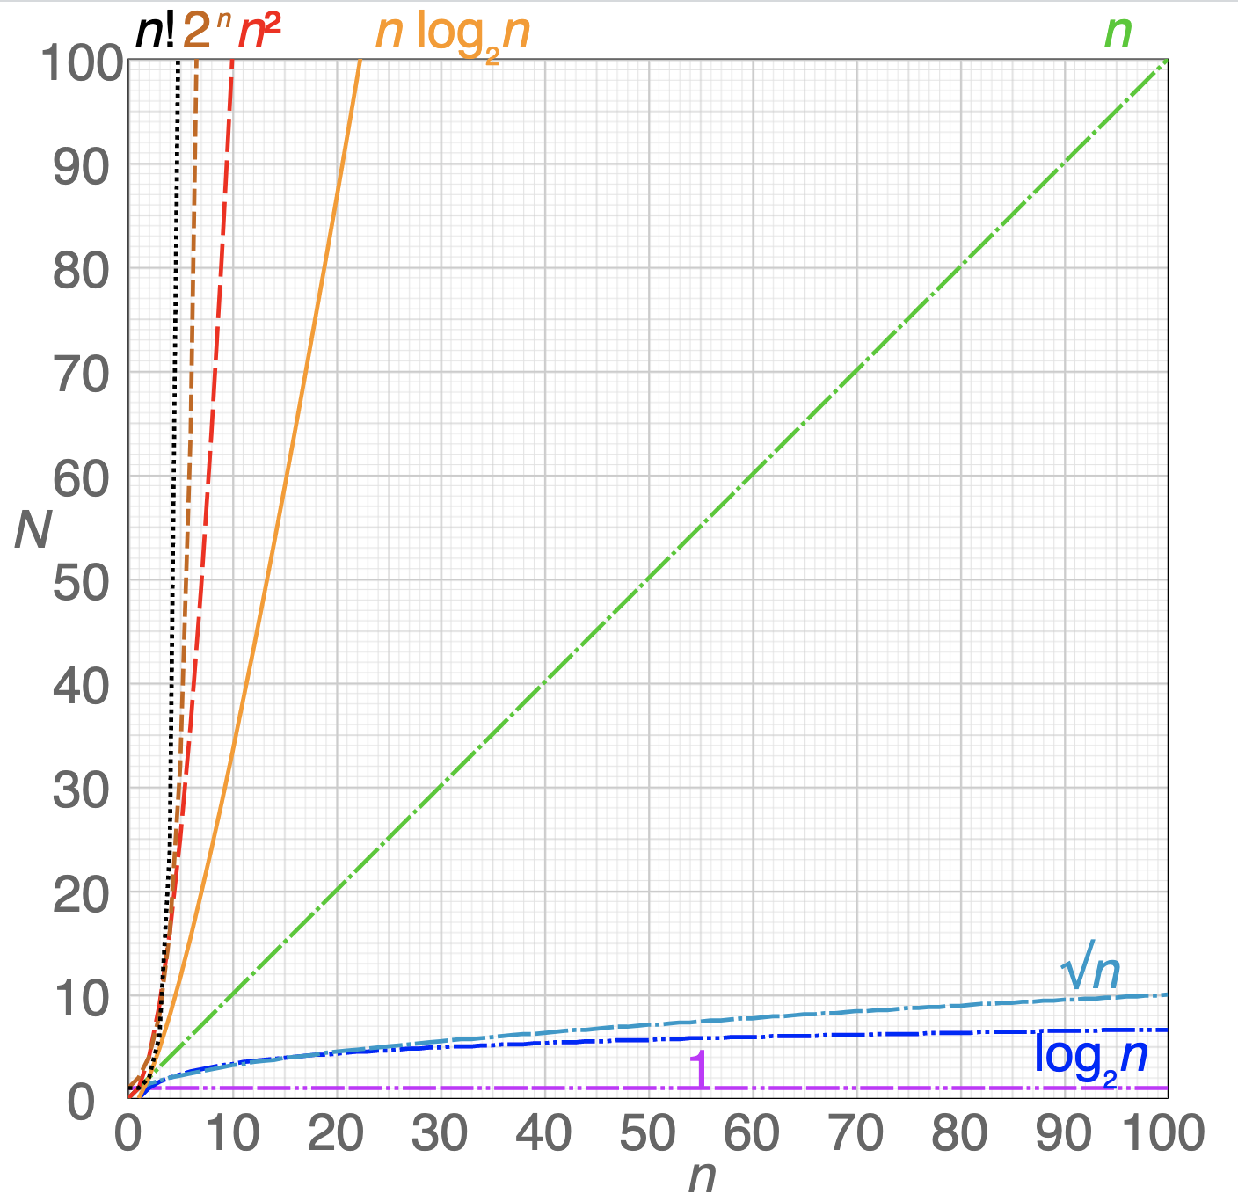
Work
Input Size

Slide 9
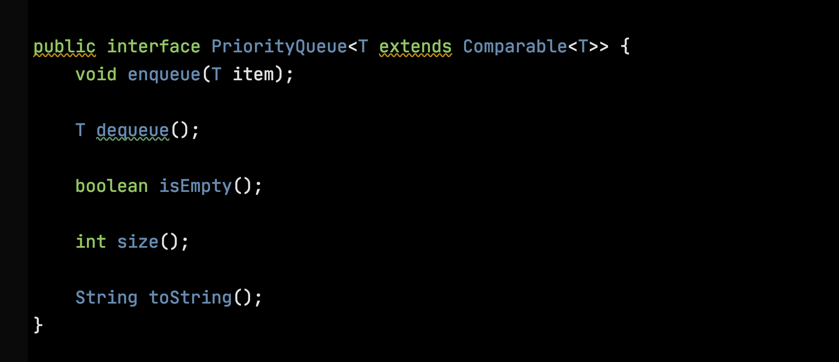

Slide 10
Trees
Symbol
A₂ B₁ C₀
Arity

Slide 11
S is a Set of Symbols
S = {A_{2,} B_{1,} C₀}

Slide 12
Trees(S)
Trees(S) = { A_{k}(t₁, …, t_{k}) | k >= 0,
A_{k} in S and
t_{i} in Trees(S) }
Trees are defined recursively.

Slide 13
Example
Trees({A_{2,} B_{1,} C₀}) =
{ C₀(),
B₁(C₀()),
A₂(C₀(), C₀()),
A₂(B₁(C₀()), C₀()),
…
}

Slide 14
Simplifying the Notation
If the arity is 0, leave out the parentheses. So C₀() is written as C₀.
Omit the arities
Trees({A_{2,} B_{1,} C₀}) = {C, B(C), A(C, C), A(B(C), C), … }

Slide 15
Tree Diagrams
C
B
A
A
C
C
C
B
C
C
C B(C) A(C, C) A(B(C), C)

Slide 16
Terminology
Nodes
A
B
C
C
Edges

Slide 17
Terminology
Interior
Nodes
A
B
C
C
Leaf Nodes

Slide 18
Terminology
A
A unique root node
B
C
C

Slide 19
Terminology
A
parent
B
C
left child
right child
C

Slide 20
A path is a Sequence of Edges
A
B
C
C
The path from the root to this node is of length 2.

Slide 21
Depth of a Node – length of path from root
A
depth = 0
B
C
depth = 1
C
depth = 2

Slide 22
Height of a Tree – maximum depth
A
depth = 0
B
C
depth = 1
C
depth = 2

Slide 23
Binary Tree – Maximum arity is 2
D
A
A
B
C
C
B
C
A
C
C
C
C
C

Slide 24
Binary Tree – Maximum arity is 2
D
A
A
B
C
C
B
C
A
C
C
C
C
C

Slide 25
Representations of Nodes in Binary Trees
T info
Node left
Node right

Slide 26
Threaded Representation of Nodes
Node parent
T info
Node left
Node right

Slide 27
Full Binary Tree – arity of every interior node = 2
A
A
A
B
C
C
B
C
A
C
C
C
C
C

Slide 28
Complete Binary Tree – All depths are full except possibly the last one, then all to the left
A
A
A
B
C
C
B
C
A
C
C
C
C
C
The middle tree is complete but not full.

Slide 29
Perfect Binary Tree – All depths are full
A
A
A
C
A
A
C
C
C
C
C
C
We’ll discuss perfect binary trees next time.

Slide 30
Complete binary trees are of interest because they have
a natural sequential representation
logarithmic height
0
-
1
X
2
P
X
1
3
M
P
M
4
E
2
3
5
L
E
L
E
E
4
5
6
6

Slide 31
Navigation in Complete Binary Trees
X
parent(N) = N / 2
1
leftChild(N) = N * 2
P
M
2
3
E
L
E
A
rightChild(N) = N * 2 + 1
4
5
6
7

Slide 32
Binary Heaps

Slide 33
A (max) binary heap is a complete binary tree in which the value at every interior node is greater than or equal to the values in the child nodes.
X
P
M
E
L
E
A

Slide 34
Migrating Values along Paths in a Heap
Sink
X
P
M
Swim
E
L
E
A

Slide 35
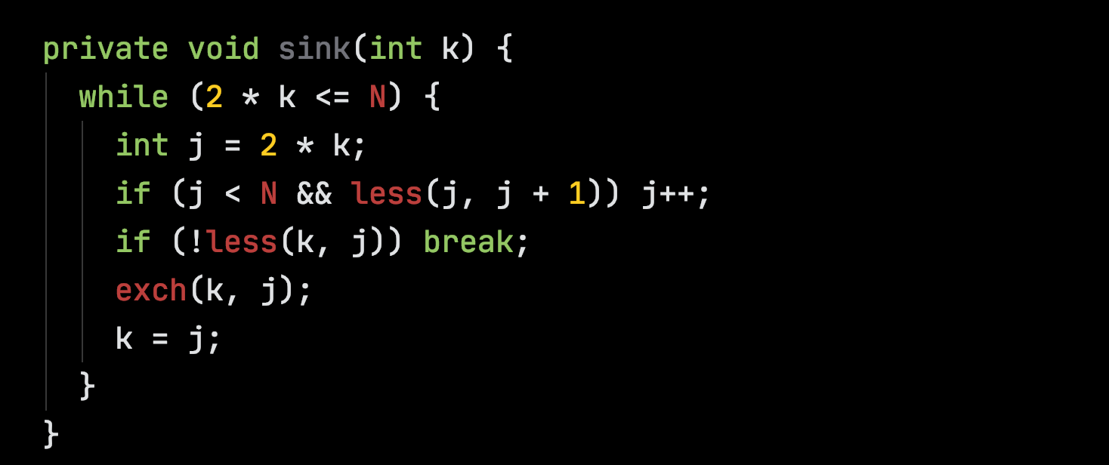
Sinking
k = 1
E
k = 2
X
k = 5
X
1
1
1
X
L
E
L
P
L
2
3
2
3
2
3
M
P
A
E
M
P
A
E
M
E
A
E
4
5
6
7
4
5
6
7
4
5
6
7

Slide 36
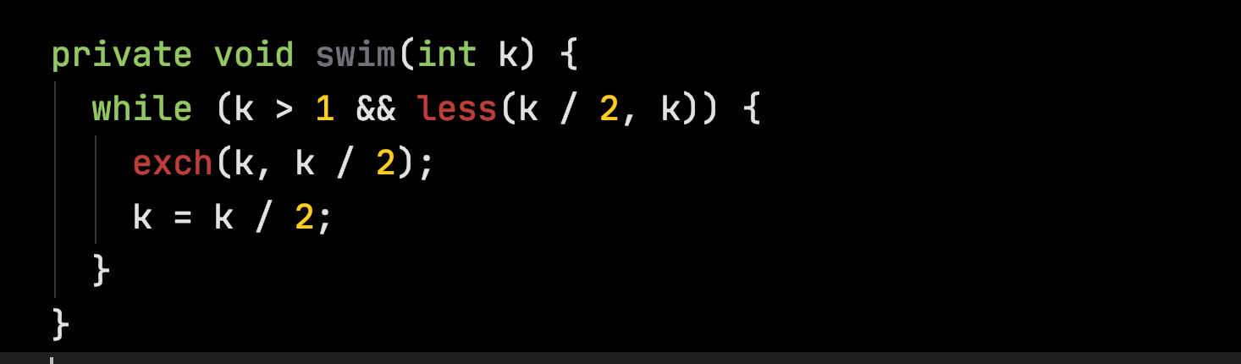
Swimming
k = 5
P
k = 2
P
k = 1
X
1
1
1
E
L
X
L
P
L
2
3
2
3
2
3
M
X
A
E
M
E
A
E
M
E
A
E
4
5
6
7
4
5
6
7
4
5
6
7

Slide 37
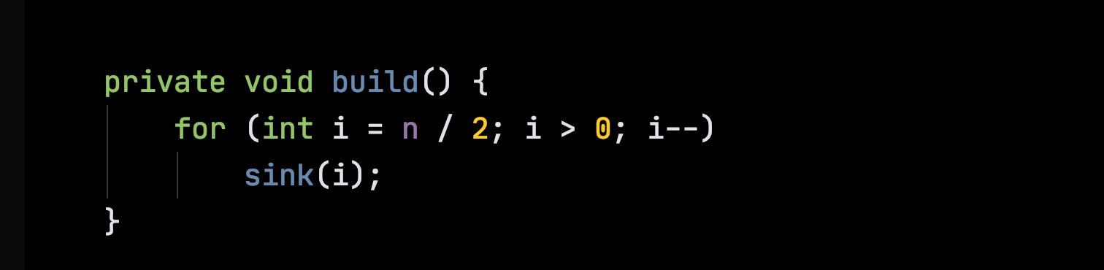
Build
i = 3
E
i = 2
E
i = 1
E
1
1
1
X
A
X
L
X
L
2
3
2
3
2
3
M
P
L
E
M
P
A
E
M
P
A
E
4
5
6
7
4
5
6
7
4
5
6
7

Slide 38
Build
i = 1
E
i = 1
X
i = 1
X
1
1
1
X
L
E
L
P
L
2
3
2
3
2
3
M
P
A
E
M
P
A
E
M
E
A
E
4
5
6
7
4
5
6
7
4
5
6
7

Slide 39
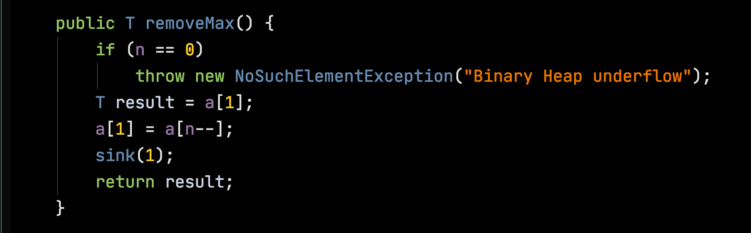
removeMax
X
X
1
1
P
L
P
L
2
3
2
3
M
E
A
E
M
E
A
E
4
5
6
7
4
5
6
7

Slide 40
removeMax
X
X
1
1
E
1
P
L
P
L
2
3
2
3
P
L
2
3
M
E
A
E
M
E
A
E
4
5
6
7
4
5
6
7
M
E
A
E
4
5
6
7

Slide 41
removeMax
E
P
P
1
1
1
P
L
E
L
M
L
2
3
2
3
2
3
M
E
A
M
E
A
E
E
A
4
5
6
4
5
6
4
5
6

Slide 42
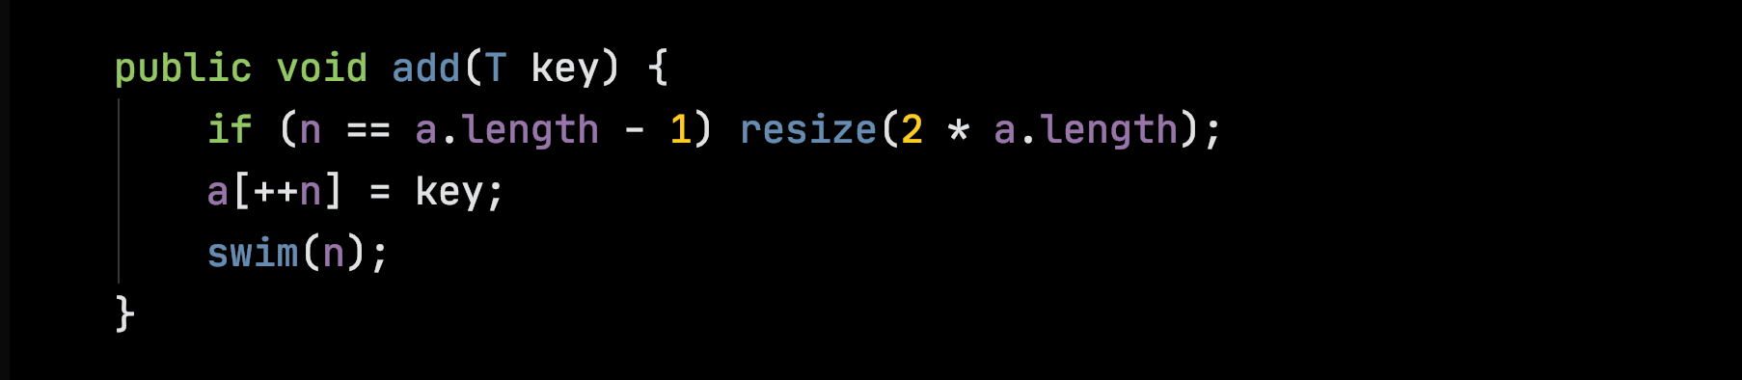
add
P
1
M
L
2
3
E
E
A
X
4
5
6
7

Slide 43
add
P
P
X
1
1
1
M
L
M
X
M
P
2
3
2
3
2
3
E
E
A
X
E
E
A
L
E
E
A
L
4
5
6
7
4
5
6
7
4
5
6
7

