Slide 1

CSCI 1102 Computer Science 2
Meeting 14: Thursday 3/18/2021
More Sorting; Order & Equality

Slide 2
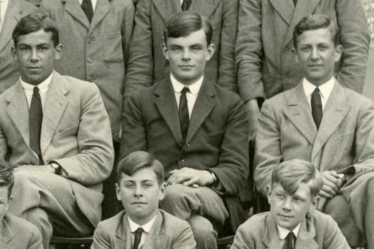
Alan Turing

Slide 3

A Machine Model for Effective Computability

Slide 4
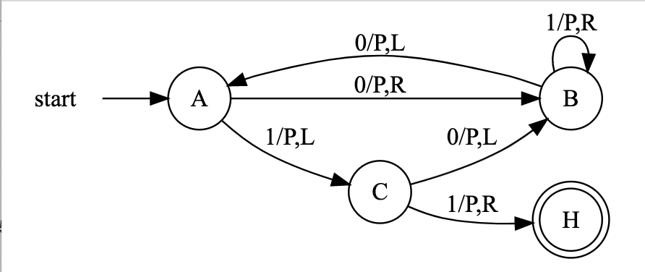

Slide 5
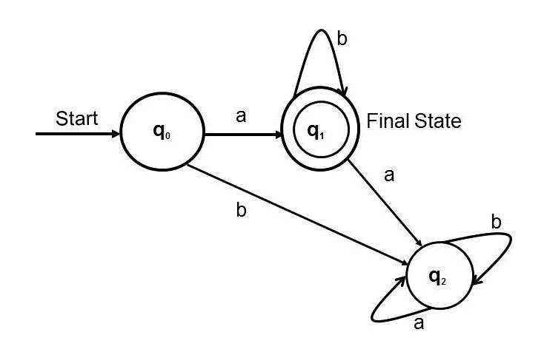

Slide 6
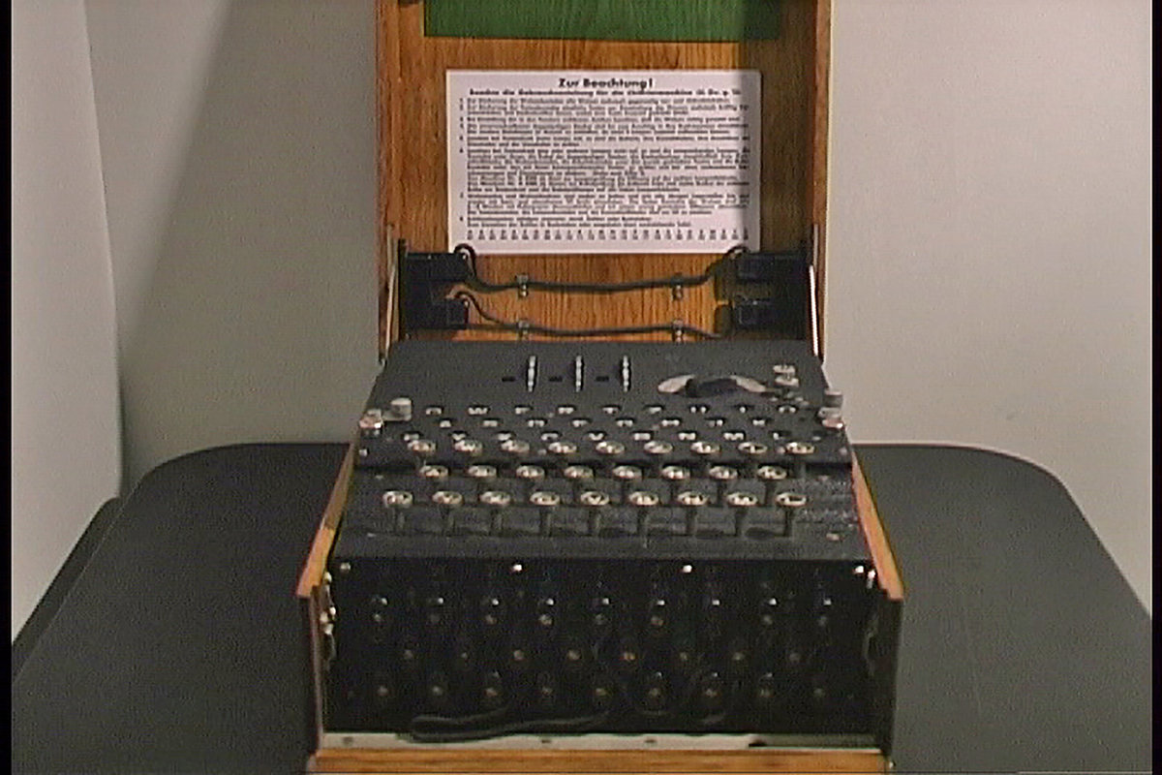
Enigma
The Imitation Game

Slide 7
Alan Turing
Turing Machine
Universal Machine
Enigma Cypher Machine
Turing Test in AI
Turing Award

Slide 8
Today
Quicksort & Insertion Sort
Order & Equality
Notes:
Concept-Script: A Formal Language for Pure Thought Modeled on that of Arithmetic

Slide 9
Mergesort
John von Neumann, 1945

Slide 10
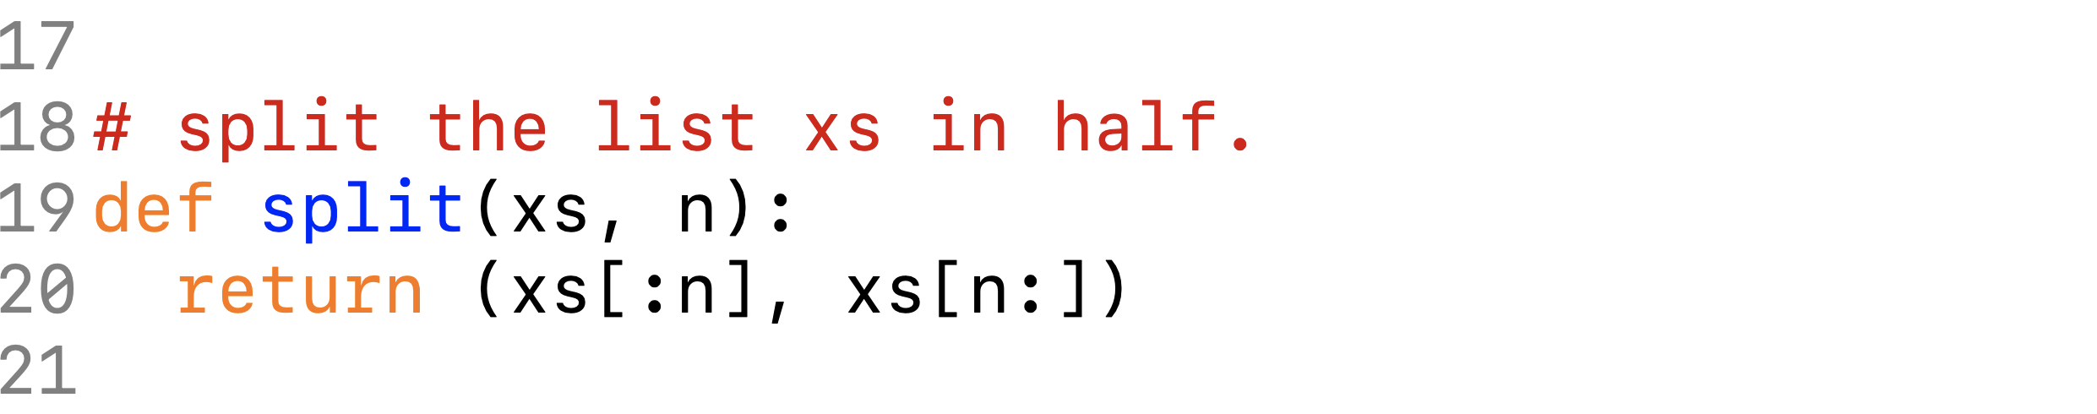
Memory Usage in Python
E
X
xs[:3]
E
X
A
A
(xs[:3], xs[3:])
M
M
P
P
xs[3:]
L
L
E
E

Slide 11
Memory Usage
E
A
Use another array as a work area.
X
E
A
E
M
L
P
M
L
P
E
X

Slide 12
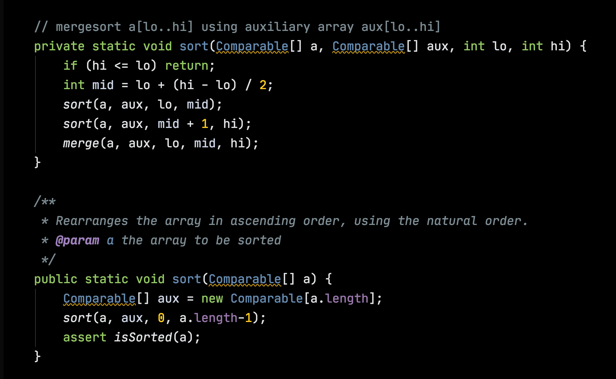

Slide 13
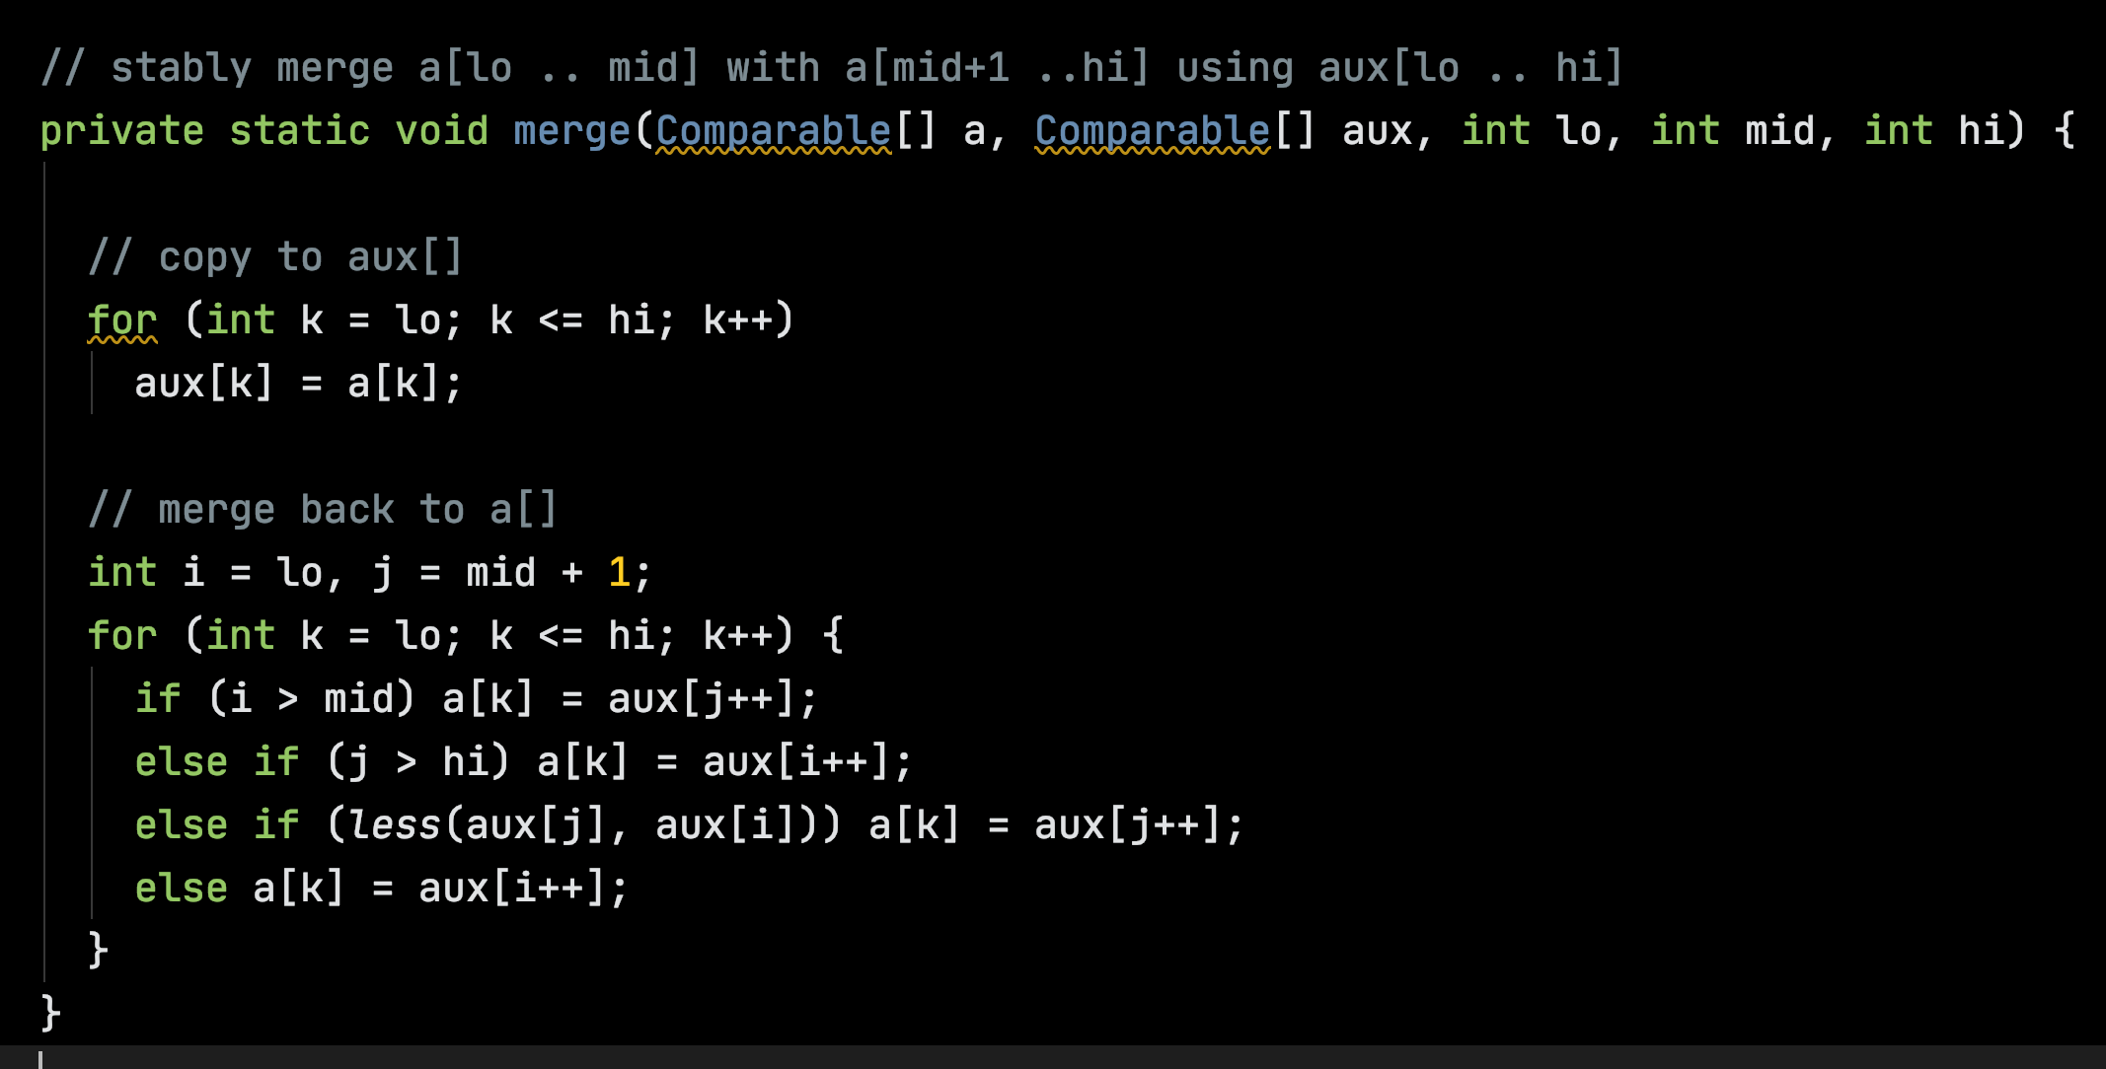

Slide 14
Quicksort
Tony Hoare, 1959

Slide 15
Divide-and-Conquer
M
E
L
B
O
U
R
N
E
E
L
B
E
M
O
U
R
N

Slide 16
M
E
L
B
O
U
R
N
E
E
L
B
E
M
O
U
R
N
B
E
E
L
N
O
U
R

Slide 17
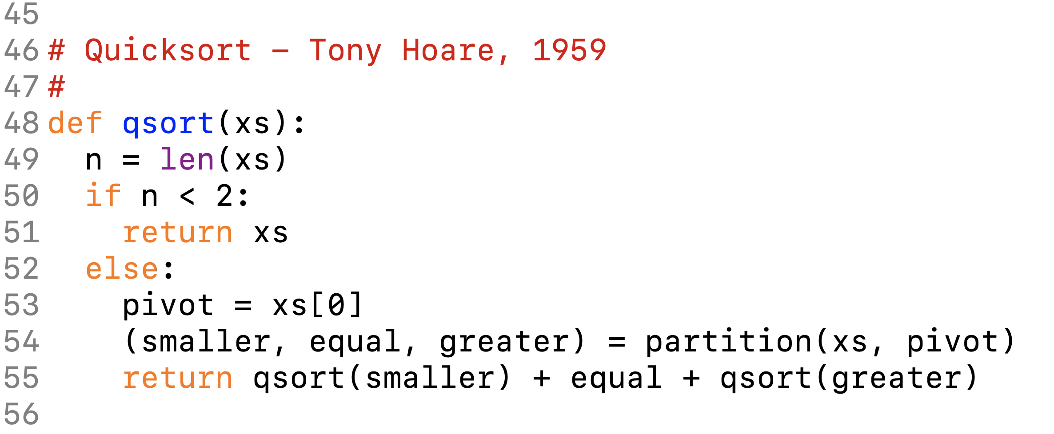
Append

Slide 18
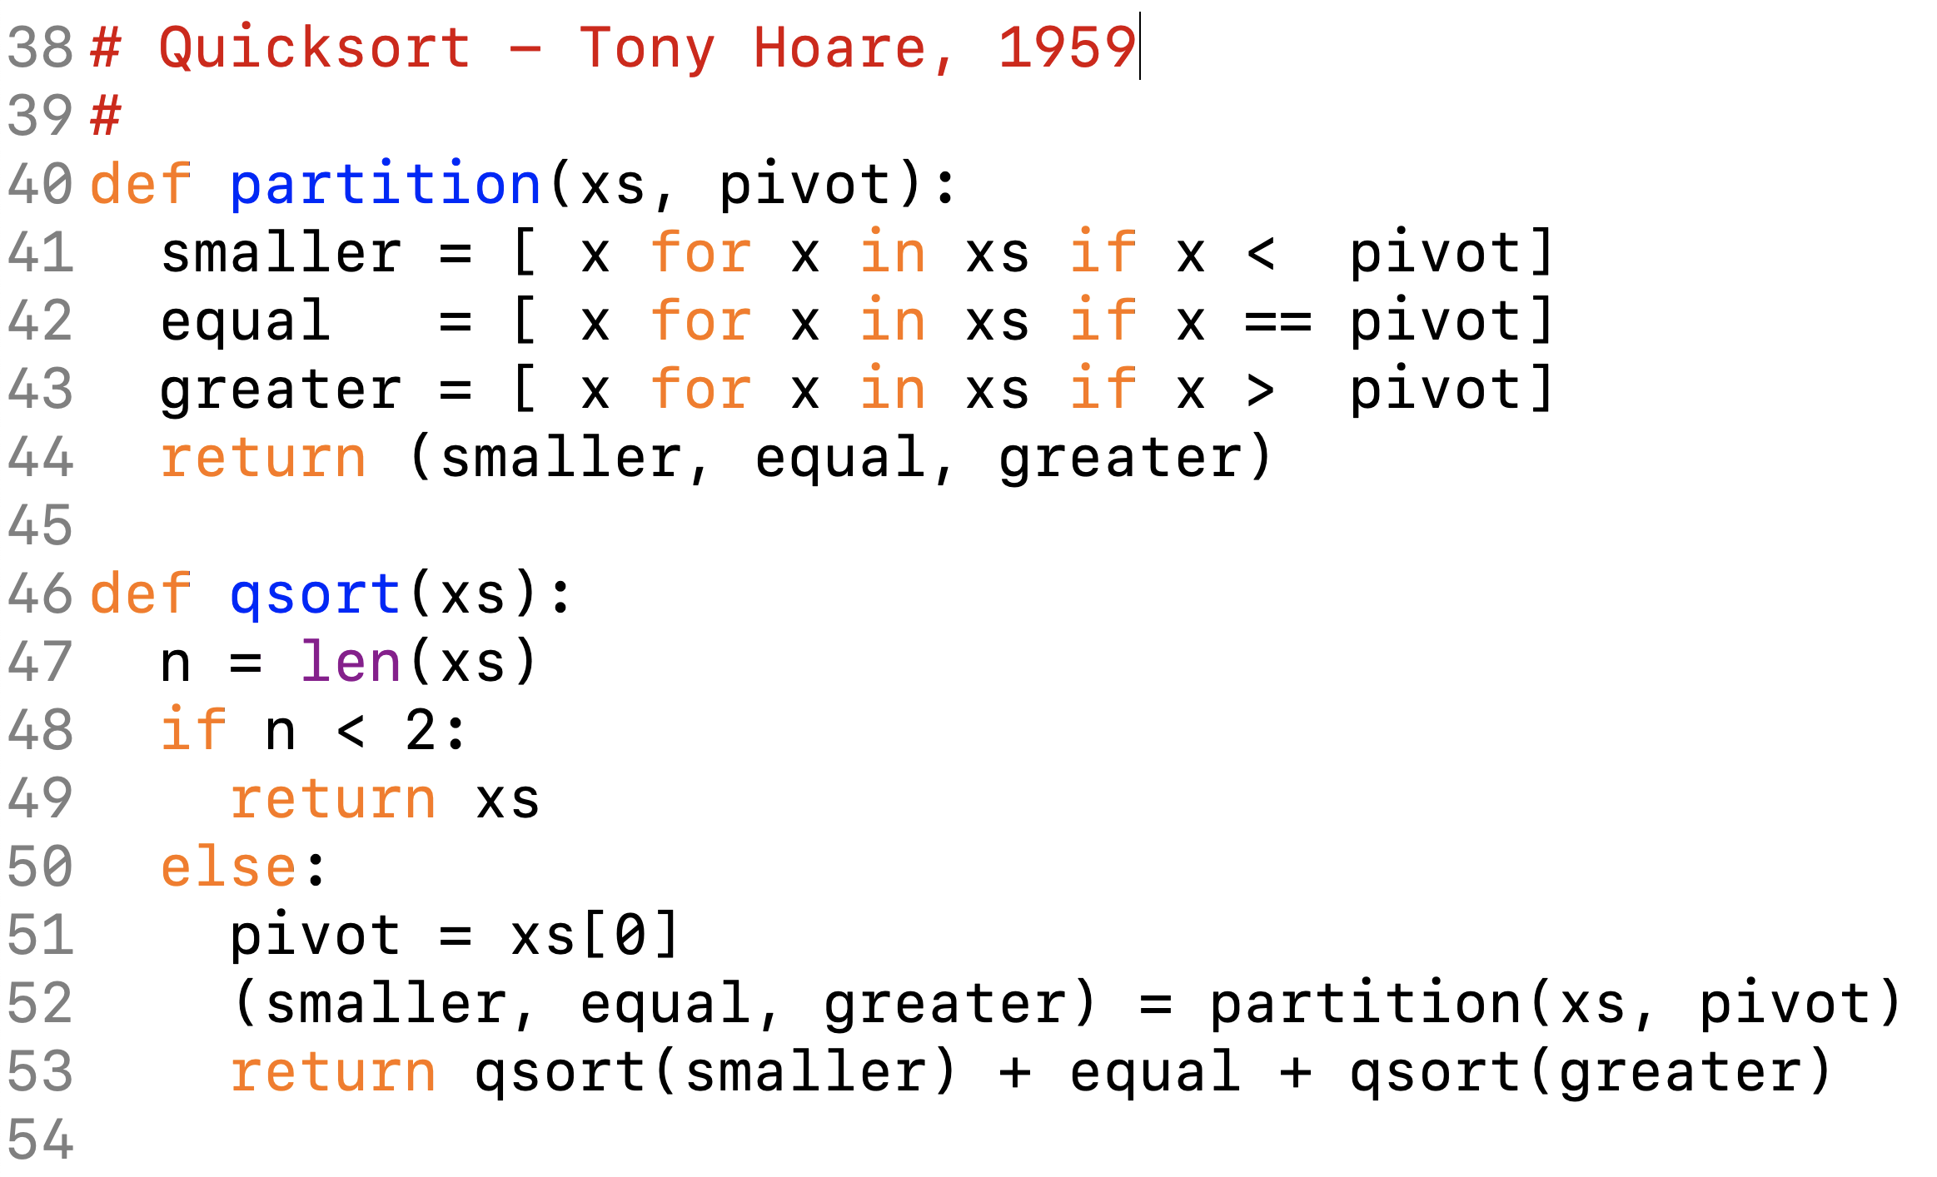

Slide 19
Memory Usage in Python
E
M
L
E
E
L
B
B
O
M
U
R
U
N
O
E
R
R

Slide 20
Memory Efficiency – Array in place
lo
hi
i
j
M
E
L
B
O
U
R
N
E

Slide 21
Memory Efficiency – Array in place
lo
hi
i
j
M
E
L
B
O
U
R
N
E
i
j
M
E
L
B
O
U
R
N
E

Slide 22
Memory Efficiency – Array in place
lo
i
j
M
E
L
B
E
U
R
N
O
lo
j
i
M
E
L
B
E
U
R
N
O

Slide 23
Memory Efficiency – Array in place
lo
hi
j
i
M
E
L
B
E
U
R
N
O
lo
j
i
E
E
L
B
M
U
R
N
O

Slide 24
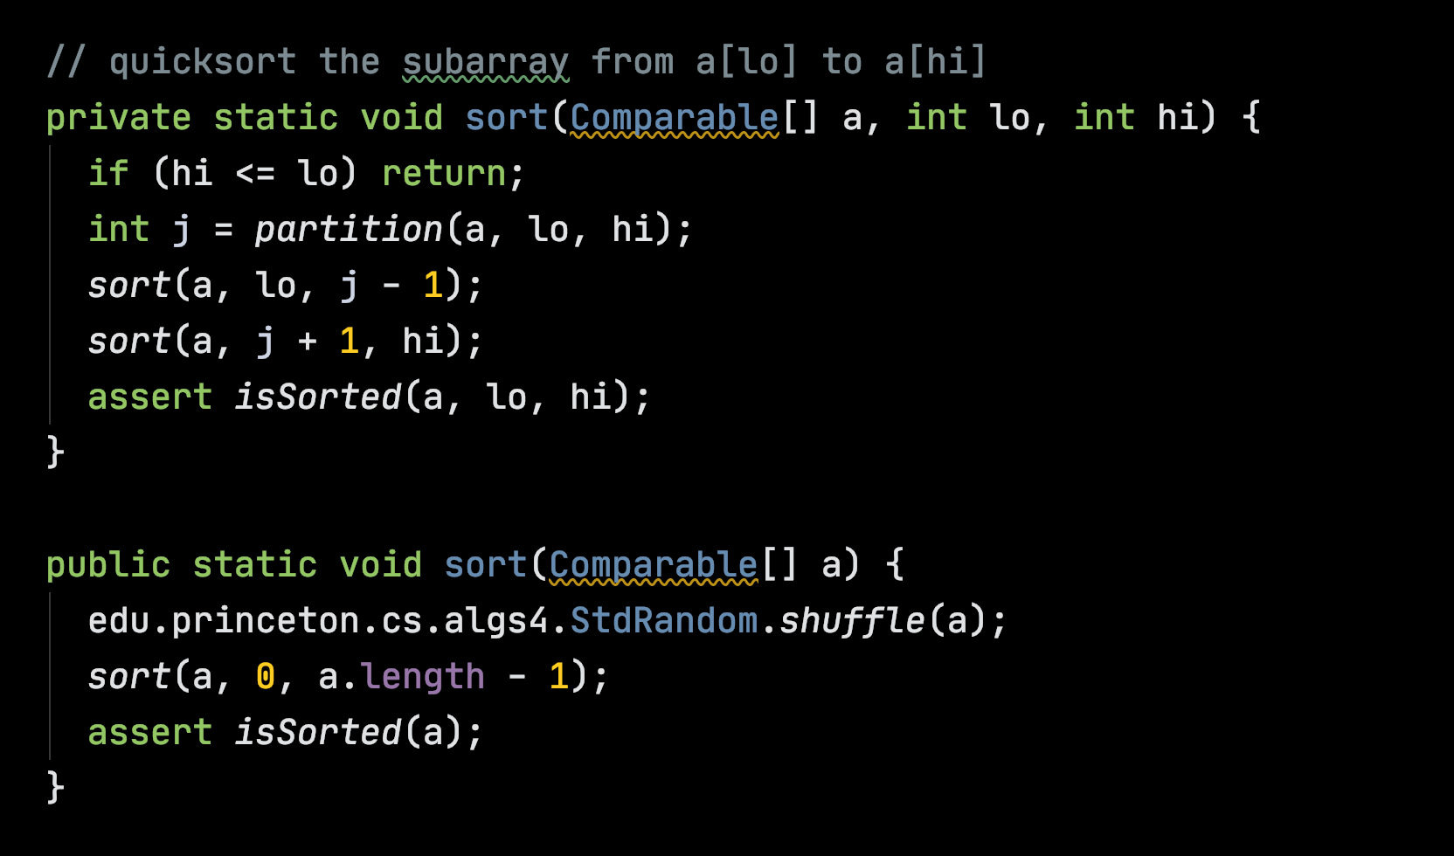

Slide 25
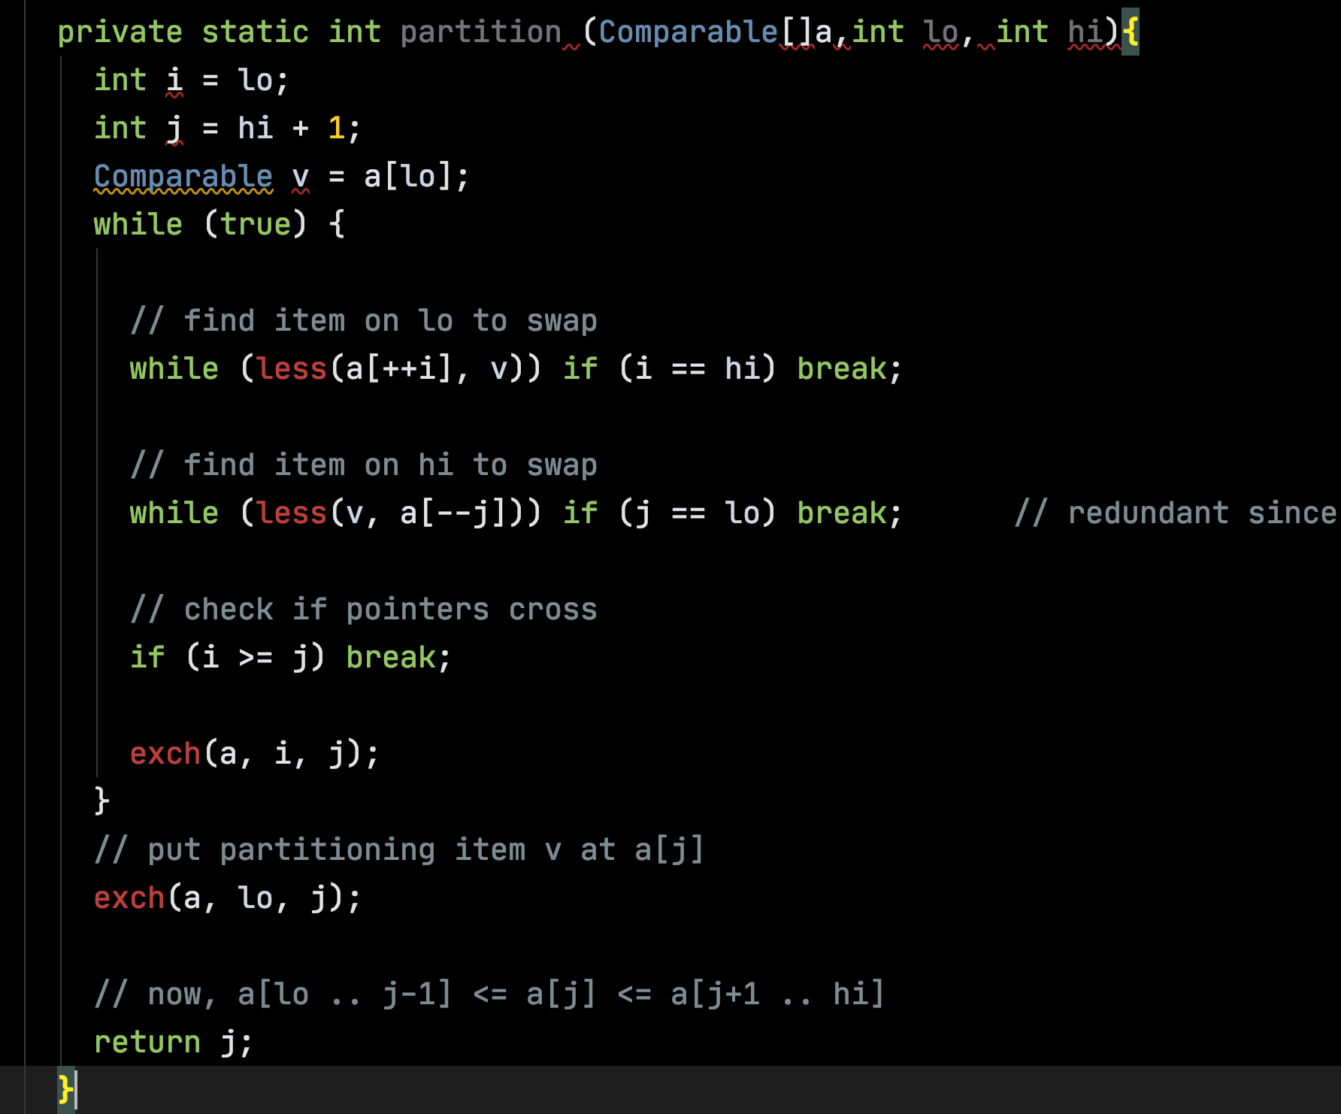

Slide 26
Bad Pivots => Worst Case O(N²)
A
B
S
T
E
M
I
O
U
S
-
A
B
S
T
E
M
I
O
U
S
-
A
-
B
S
T
E
M
I
O
U
S

Slide 27
Quicksort
O(N log N) on average, but O(N²) in the worst case.
Quicksort is unstable.
Quicksort is efficient with memory.

Slide 28
Insertion Sort

Slide 29
Insertion Sort
M
E
L
B
O
U
R
N
E
E
M
L
B
O
U
R
N
E
E
L
M
B
O
U
R
N
E
B
E
L
M
O
U
R
N
E

Slide 30
Insertion Sort is Stable
M
E
L
B
O
U
R
N
E
B
E
E
L
M
N
O
R
U

Slide 31
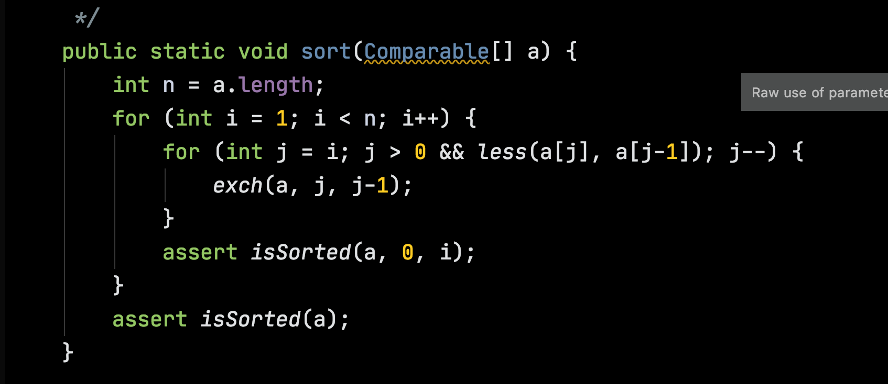

Slide 32
Insertion Sort
Is O(N²) in the worst case and the average case.
Is O(N) when the keys are nearly sorted. (!)
Sorts in place.
Is stable.

