Slide 1

CSCI 1102 Computer Science 2
Meeting 16: Thursday 3/25/2021
More on Order & Equality; Huffman Coding

Slide 2

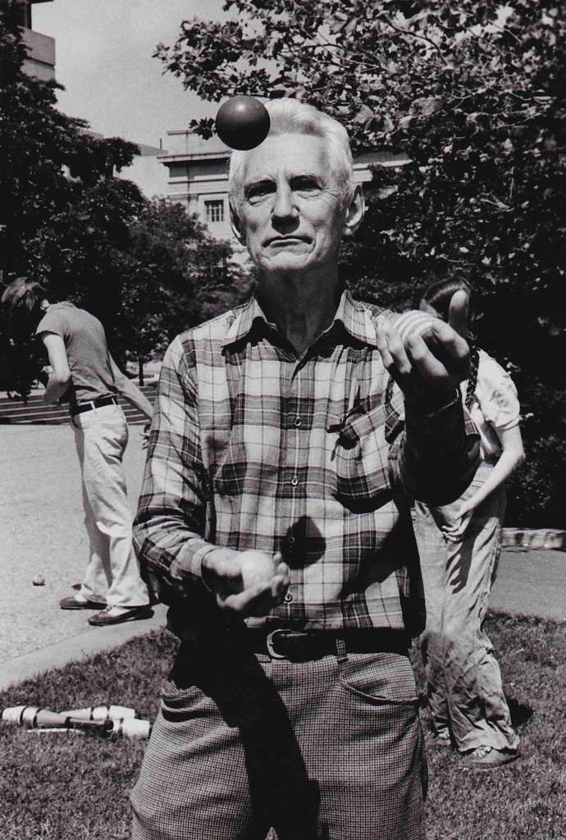
Claude Shannon

Slide 3
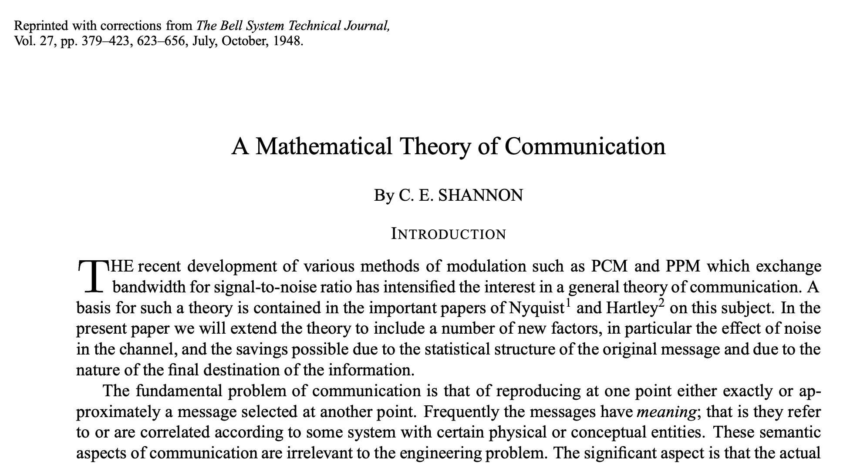

Slide 4
Order & Equality in Java

Slide 5
== versus equals
The == operator compares bits;
new Integer(6) == new Integer(6) is false because the two heap-allocated integers are stored in separate locations; == is comparing addresses.
== is fine for values of type int, long, short, ...

Slide 6
== and boolean
boolean a, b;
a == b or a != b are ok;
Instead of a == true, just use a
Instead of a == false, just use !a

Slide 7
Don’t use == on Strings or Floats
“Mei” == “Mei” is true
new String(“Mei”) == new String(“Mei”) is false
new String(“Mei”).equals(“Mei”) is true
Trouble with == and floats discussed below.

Slide 8
equals in Java
equals – should define an equivalence relation, for items x and y of the same type.
Defined in class Object so it is inherited by every reference type
When defining a new ADT usually want to @Override equals

Slide 9
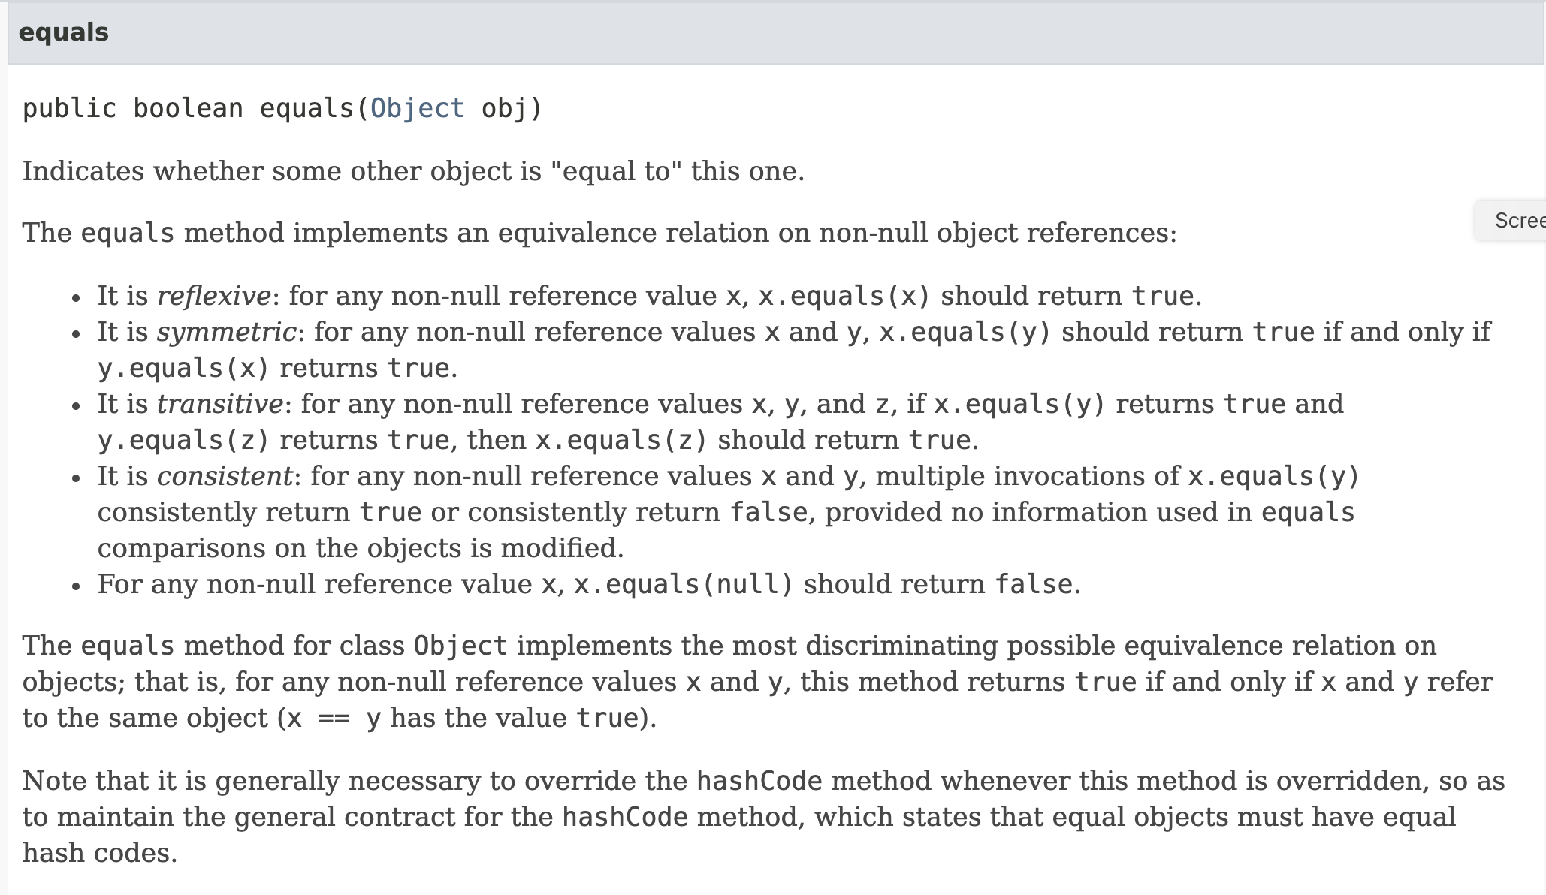

Slide 10
compareTo in Java
compareTo – should define a total order;
compareTo should be consistent with equals: for items x and y of the same type, it should be the case that:
x.compareTo(y) == 0 if and only if x.equals(y)

Slide 11
Ordered Colors

Slide 12
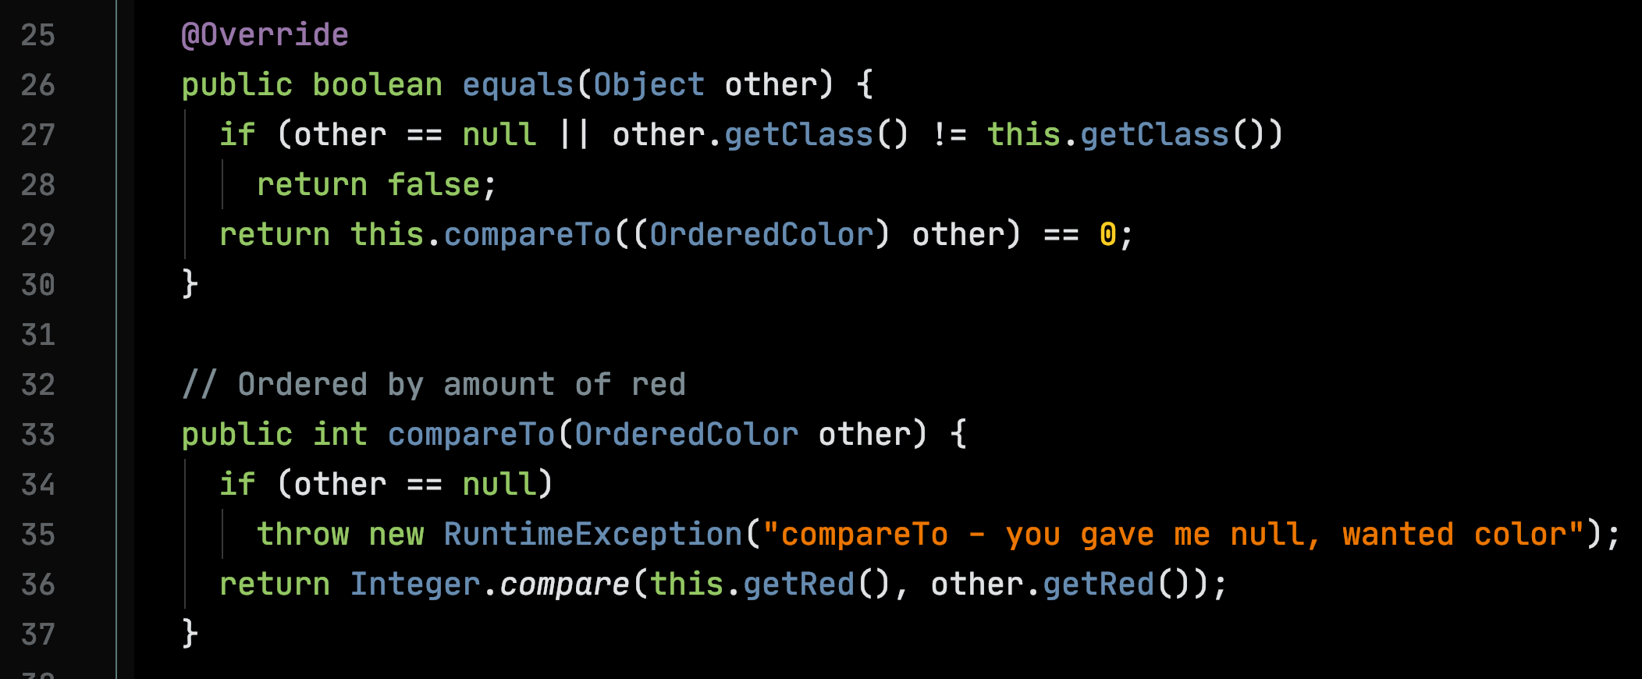

Slide 13
The usual proviso on Mutation
x.equals(y) is true
…
p(x)
…
x.equals(y) is false, p mutated x

Slide 14
Ordered Points & Lines

Slide 15
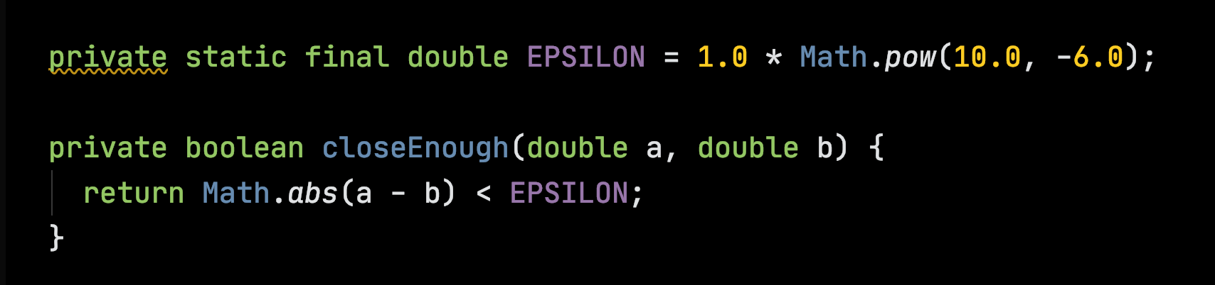
Ordered Points & Lines
Can’t use == operator on floating point numbers:
0.1 + 0.2 =/= 0.3

Slide 16
Ordered Points & Lines
Build Line orderings on Point ordering
Change Point ordering, all orderings remain synchronized

Slide 17
E.g., Order Points by x component alone

Slide 18
E.g., Order Points by x component alone
Range of equality depends on application, given by EPSILON

Slide 19
E.g., Order Points by distance from origin

Slide 20
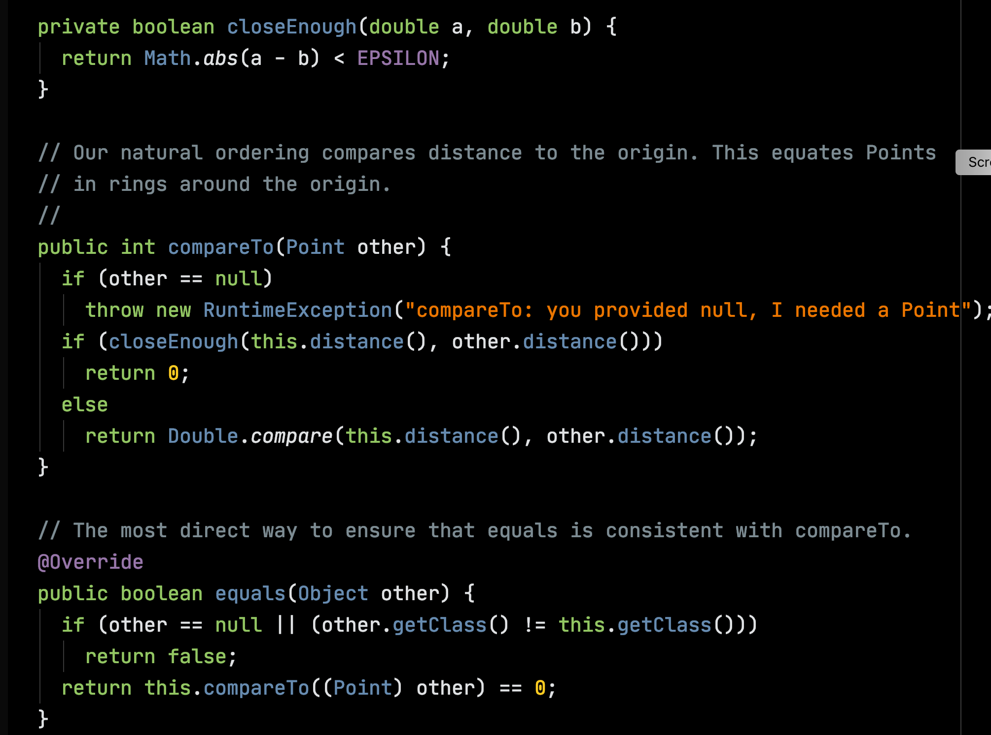

Slide 21
Ordering Single-Segment Lines by Midpoint

Slide 22
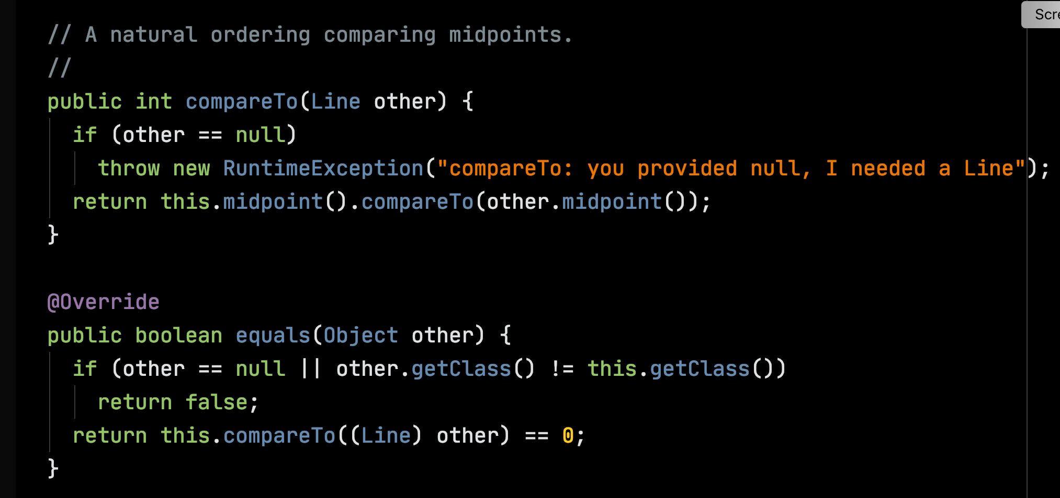

Slide 23

Ordering Multi-Segment Lines by Midpoint

Slide 24
Bounding Box

Slide 25
Bounding Box Midpoint

Slide 26
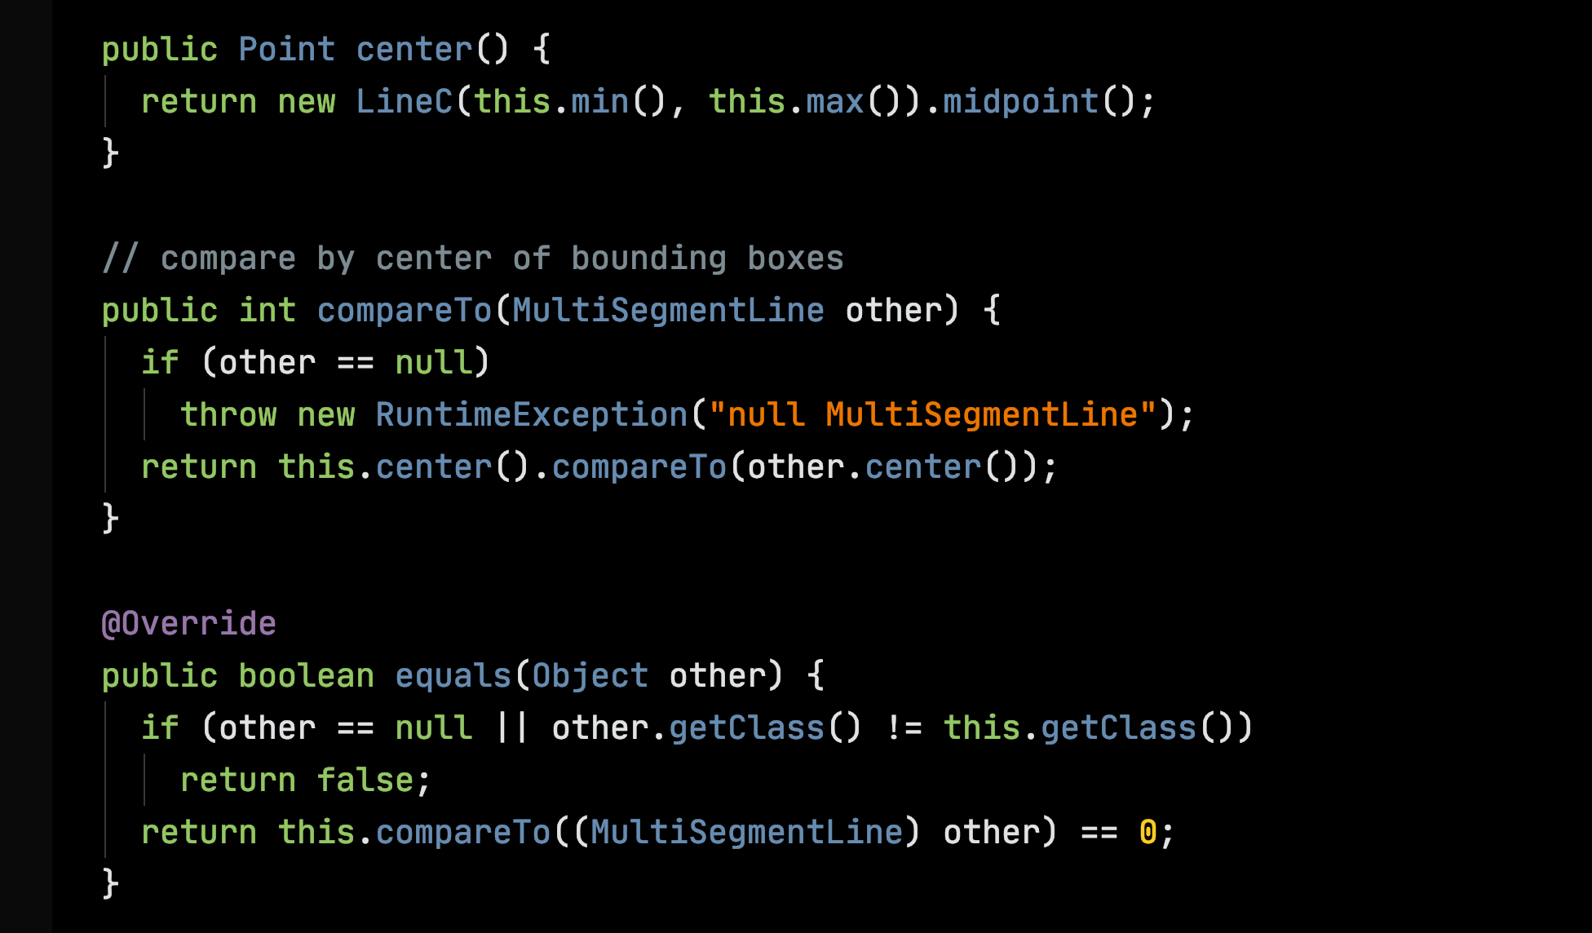

Slide 27
An aside on Streams in Java
Introduced in Java version 1.8, java.util.stream
“A sequence of elements supporting sequential and parallel aggregate operations.”
“Collections and streams, while bearing some superficial similarities, have different goals. Collections are primarily concerned with the efficient management of, and access to, their elements. By contrast, streams do not provide a means to directly access or manipulate their elements, and are instead concerned with declaratively describing their source and the computational operations which will be performed in aggregate on that source.”

Slide 28
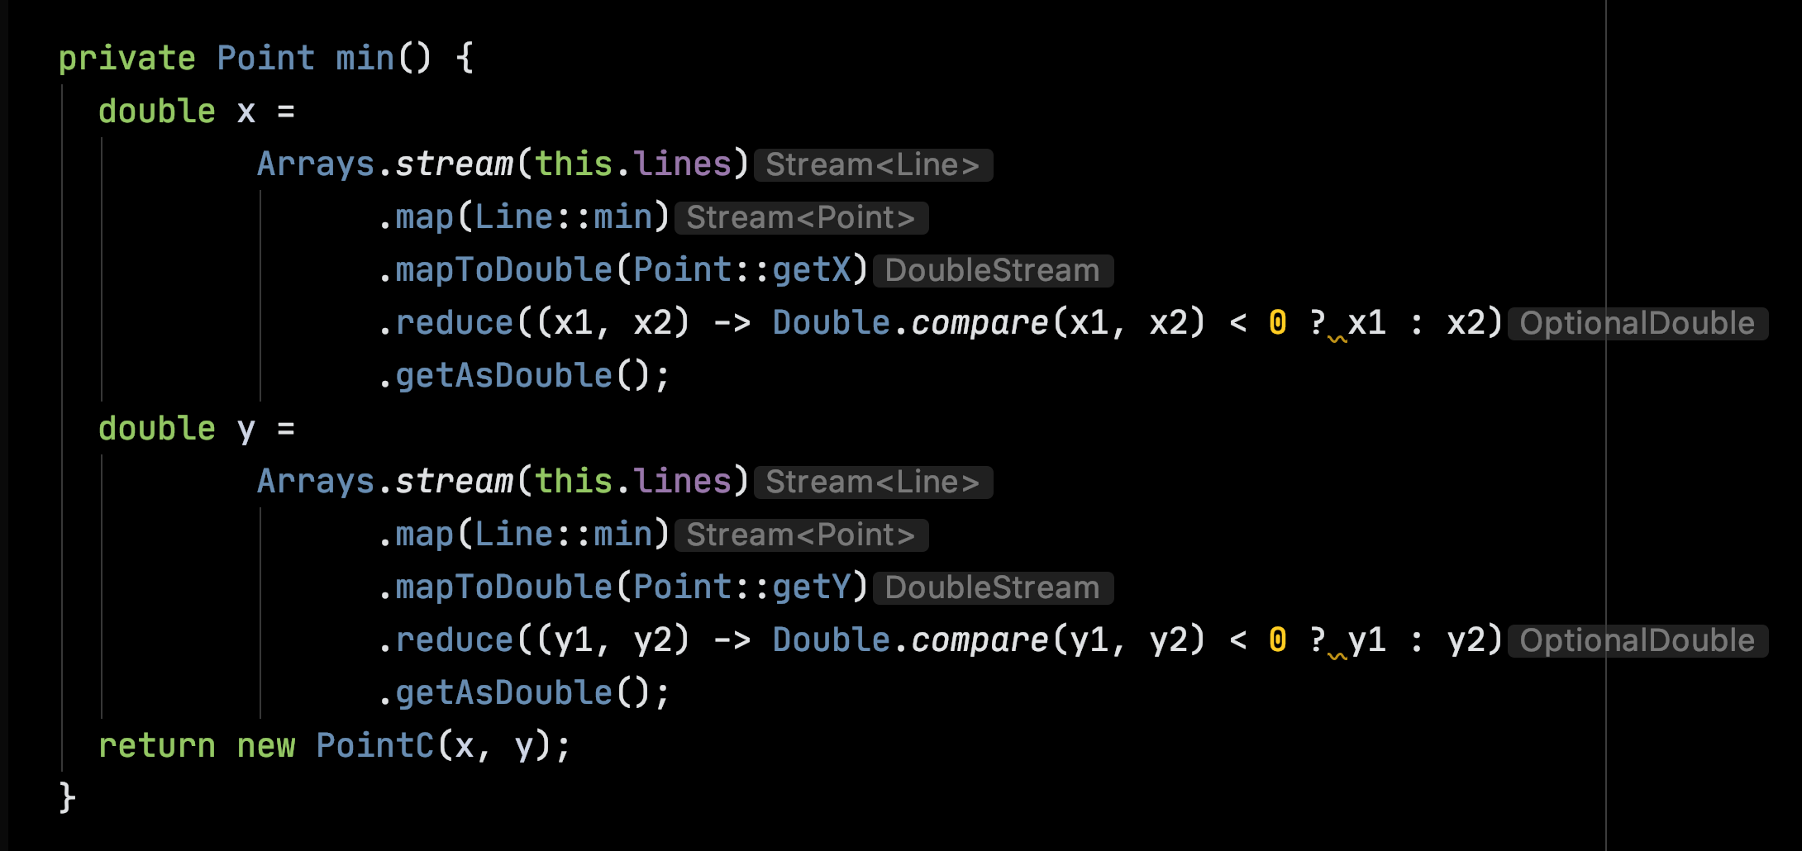
Using Streams to find the Bounding Box

