Slide 1
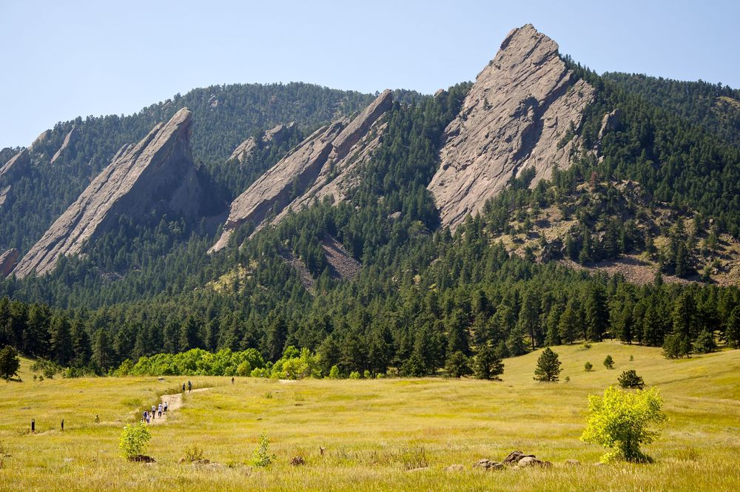
CSCI 1102 Computer Science 2
Meeting 17: Tuesday 3/30/2021
Huffman Coding; More on Binary Trees

Slide 2
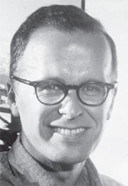
John Backus
Turing Award 1977
Inventor of first high-level programming language FORTRAN
Co-Inventor of Backus-Naur Form (BNF), a notation for describing syntax structure.
Claude Shannon

Slide 3
Huffman Coding

Slide 4
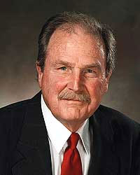

Slide 5
“ALABAMA”
‘A’ is run of the mill, ‘B’, ‘L’, & ‘M’
are more interesting, i.e., contain more
Information than ‘A’.

Slide 6
Instead of an 8-bit fixed-length code for a letter, choose a variable-length code reflecting the amount of information in the letter.

Slide 7
“ALABAMA”
A₄ L₁ B₁ M₁
A Frequency Table

Slide 8
B₁ L₁ M₁ A₄
Low frequency
=> High Priority, head of the queue!
(letters arrived in
alphabetical order)
High frequency
Low Priority,
back of the queue!

Slide 9
B₁ L₁ M₁ A₄
Algorithm step: while the priority queue has more than one entry, remove two entries, combine them and reinsert the result back into the priority queue.

Slide 10
B₁ L₁ M₁ A₄

Slide 11
B₁ L₁
M₁ A₄

Slide 12
2
M₁ A₄
B₁ L₁
The items in the priority queue are weighted trees.

Slide 13
B₁ L₁ M₁ A₄
M₁ A₄
2
B₁ L₁
The items in the priority queue are weighted trees.

Slide 14
M₁ A₄
2
B₁ L₁
A₄
3
M₁
2
B₁ L₁

Slide 15
A₄
3
M₁
2
B₁ L₁

Slide 16
7
A₄
3
M₁
2
B₁ L₁

Slide 17
The Huffman Coding Tree
7
A₄
3
M₁
2
B₁ L₁

Slide 18
The Huffman Coding Tree
7
A₄
3
M₁
2
B₁ L₁
Left = 0
Right = 1

Slide 19
7
0
1
A₄
3
0
1
M₁
2
B₁ L₁
0
1

Slide 20
7
0
1
A₄
3
0
1
M₁
2
B₁ L₁
0
1
M = 00, B = 010; L = 011; A = 1

Slide 21
A L A B A M A
1 011 1 010 1 00 1
M = 00, B = 010; L = 011; A = 1

Slide 22
ALABAMA
101110101001
12 bits << 56 bits
M = 00, B = 010; L = 011; A = 1

Slide 23
The .zip File
Magic Number 0x00BC
Frequency Table Size
Char
Frequency
…
Char
Frequency
Bit String

Slide 24
BinaryIn/BinaryOut
Magic Number 0x00BC
read/write Short
read/write Int
Frequency Table Size
Char
Frequency
read/write Byte
read/write Int
…
Char
Frequency
Bit String
readInt(int r)

Slide 25
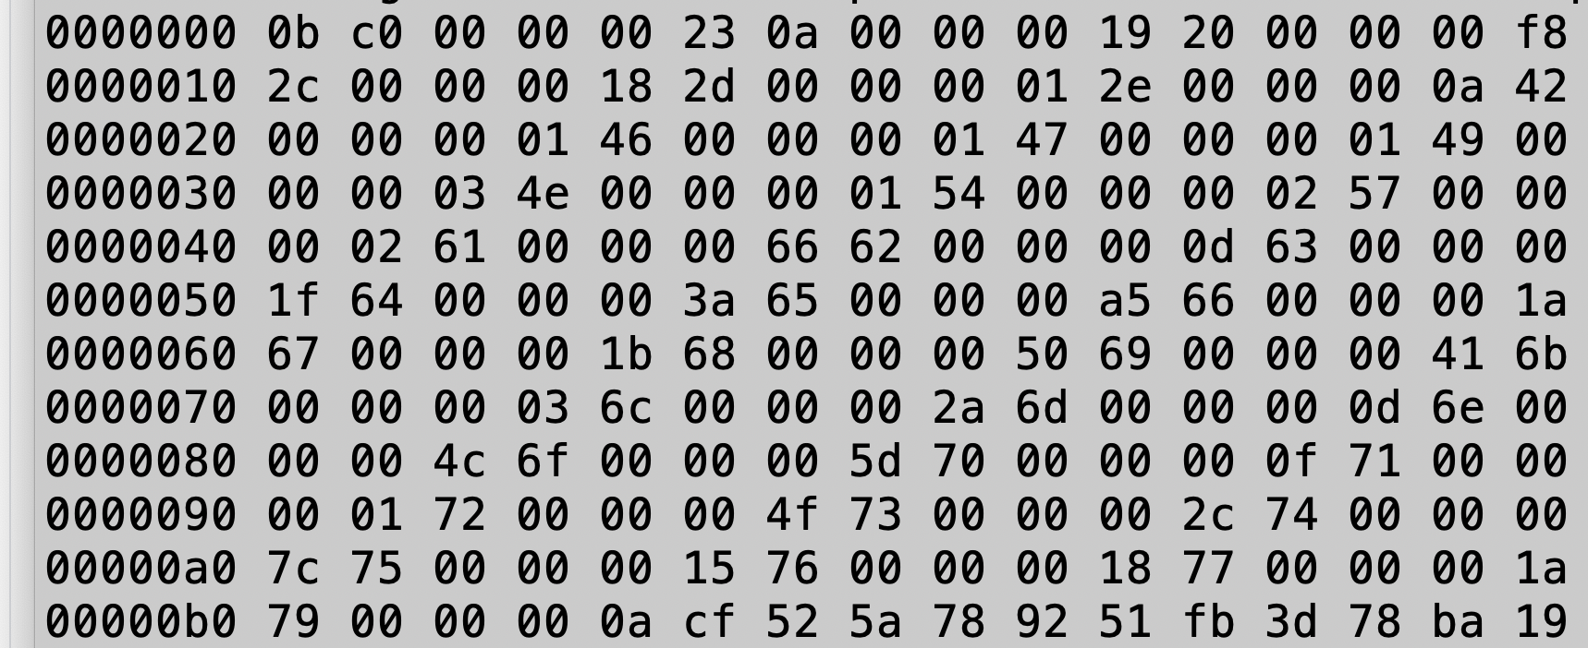
Unix hexdump of lincoln.zip

Slide 26
magic number 0x0bc0

Slide 27
Frequency table size 0x23 = 35₁₀

Slide 28
Table entry: 0x0a = newline, 0x19 =25₁₀

Slide 29
Frequency Table

Slide 30
Start of Bit Stream

