Slide 1
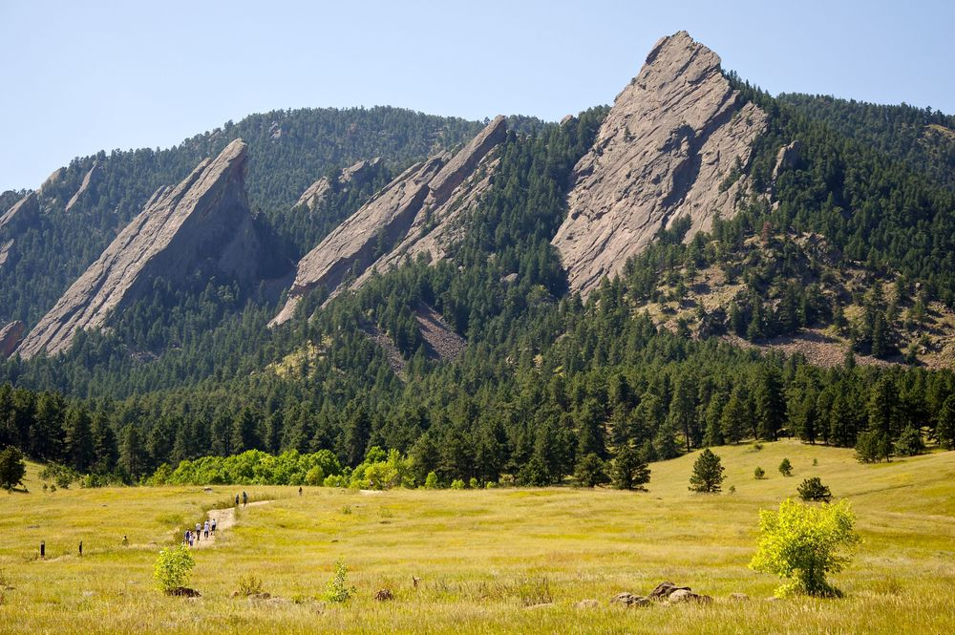
CSCI 1102 Computer Science 2
Meeting 20: Thursday 4/8/2021
More on BSTs

Slide 2

Donald Knuth
Turing Award 1974

Slide 3
Binary Search Trees
Smaller keys to the left
Larger keys to the right
M
H
R
E
K

Slide 4
Binary Search Trees
Smaller keys to the left
Larger keys to the right
M
H
R
bst.get(K)
E
K

Slide 5
Operations on BSTs must Preserve the Invariants

Slide 6
Binary Search Trees
Smaller keys to the left
Larger keys to the right
M
H
R
bst.put(S, 3)
E
K

Slide 7
Binary Search Trees
Smaller keys to the left
Larger keys to the right
M
H
R
bst.put(S, 3)
E
K
S

Slide 8
If the tree is balanced, log₂ insertion and find time.
M
H
R
E
K

Slide 9
Structure of tree depends on insertion order.
With an unlucky insertion order, the tree behaves like a singly-linked list.
R
M
H
E

Slide 10
Balanced binary search trees ensure that the tree remains well-balanced.
M
H
R
E
K

Slide 11
Finding the minimal key E – go left.
Finding the maximal key R – go right.
M
H
R
E
K

Slide 12
The floor of key is the greatest key less than or equal to key.
The floor of Z is R.
The floor of H is H.
The floor of B
doesn’t exist.
M
H
R
E
K

Slide 13
M
deleteMin
H
R
E
K
G

Slide 14
M
deleteMin
H
R
E
G
K

Slide 15
M
deleteMin
H
R
E
G
K

Slide 16
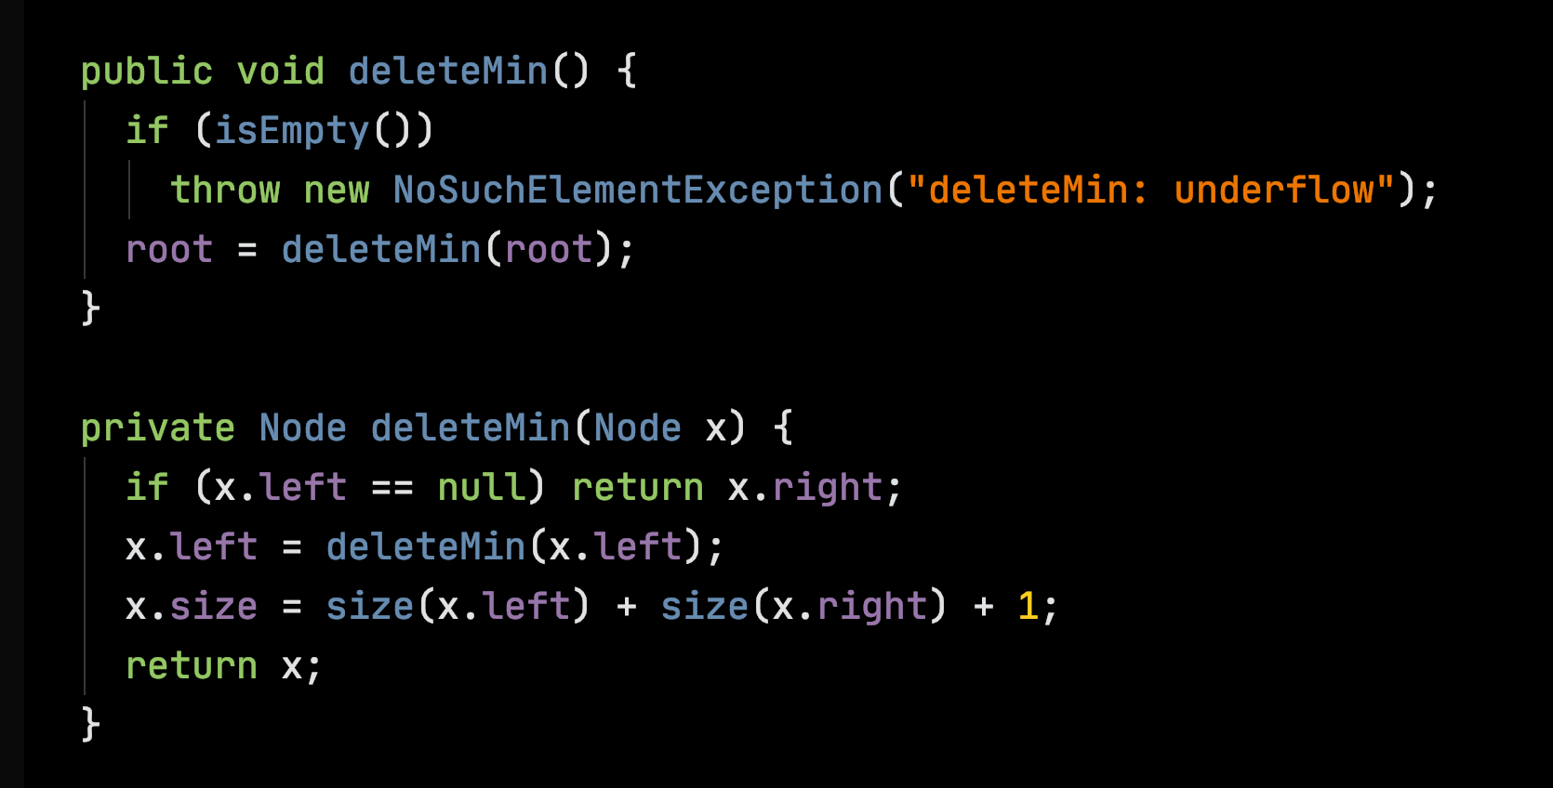

Slide 17
M
How to delete key H?
H
R
E
K
I
L
J

Slide 18
M
How to delete key H?
Replace it with its successor
(or
predecessor).
H
R
E
K
I
L
J

Slide 19
M
t
H
R
t.right
x, the successor is
min(t.right)
E
K
x
I
L
J

Slide 20
M
t
H
R
t.right
deleteMin(t.right)
E
K
x
I
J
L

Slide 21
M
x
I
H
R
t
Now plug t.left &
t.right into the left and right fields of x
E
K
J
L

Slide 22
M
x
I
H
R
Finally, plug x into the left field of the parent node.
E
K
J
L

Slide 23
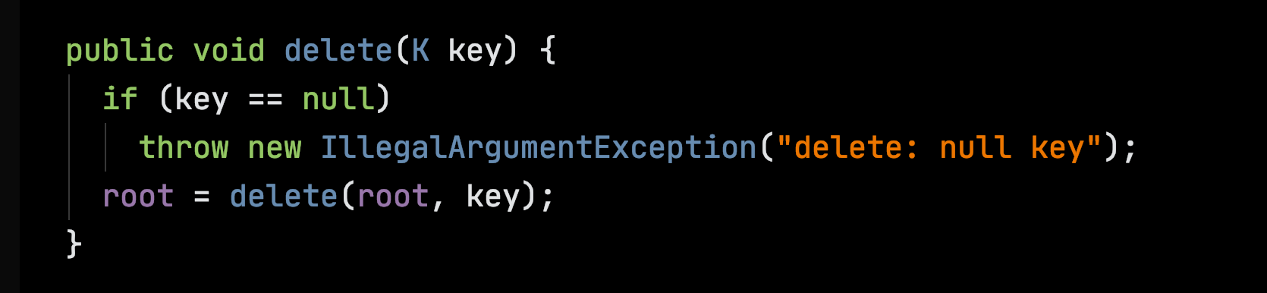

Slide 24
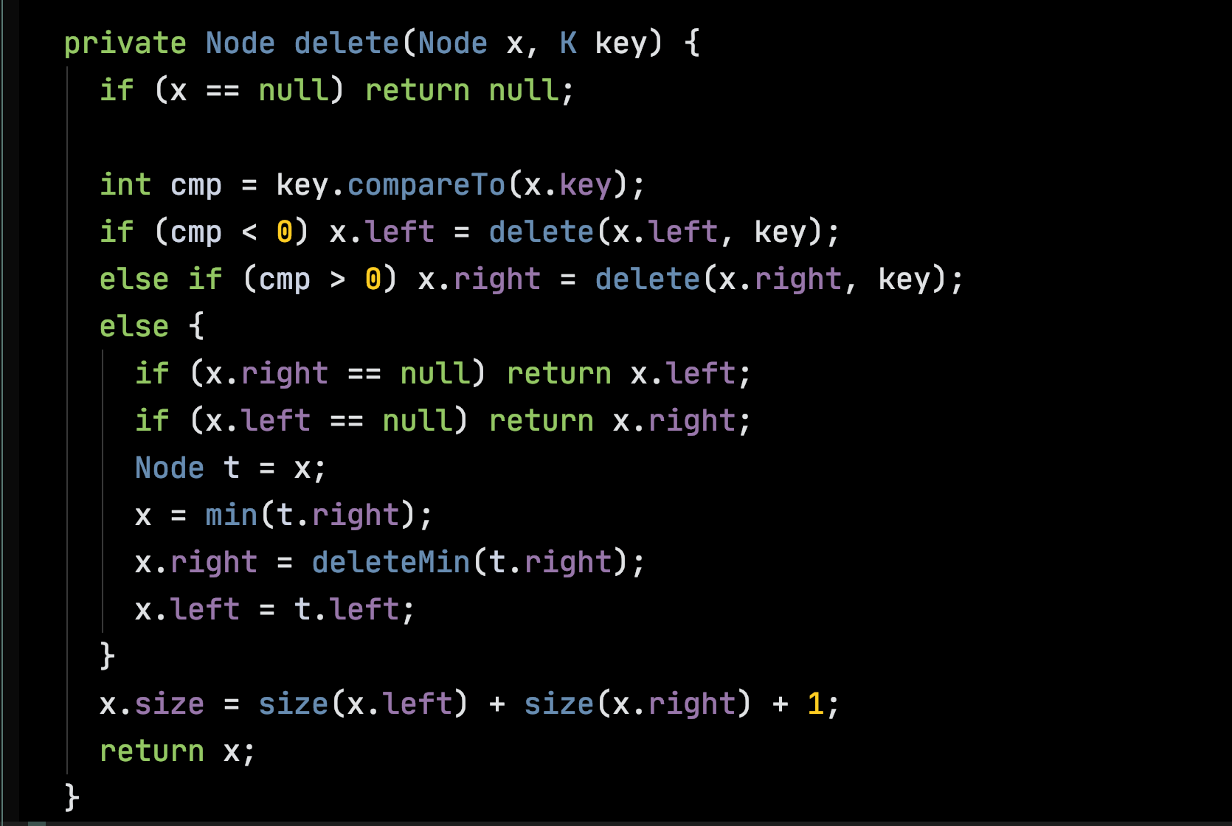

Slide 25
An Alternative API

Slide 26
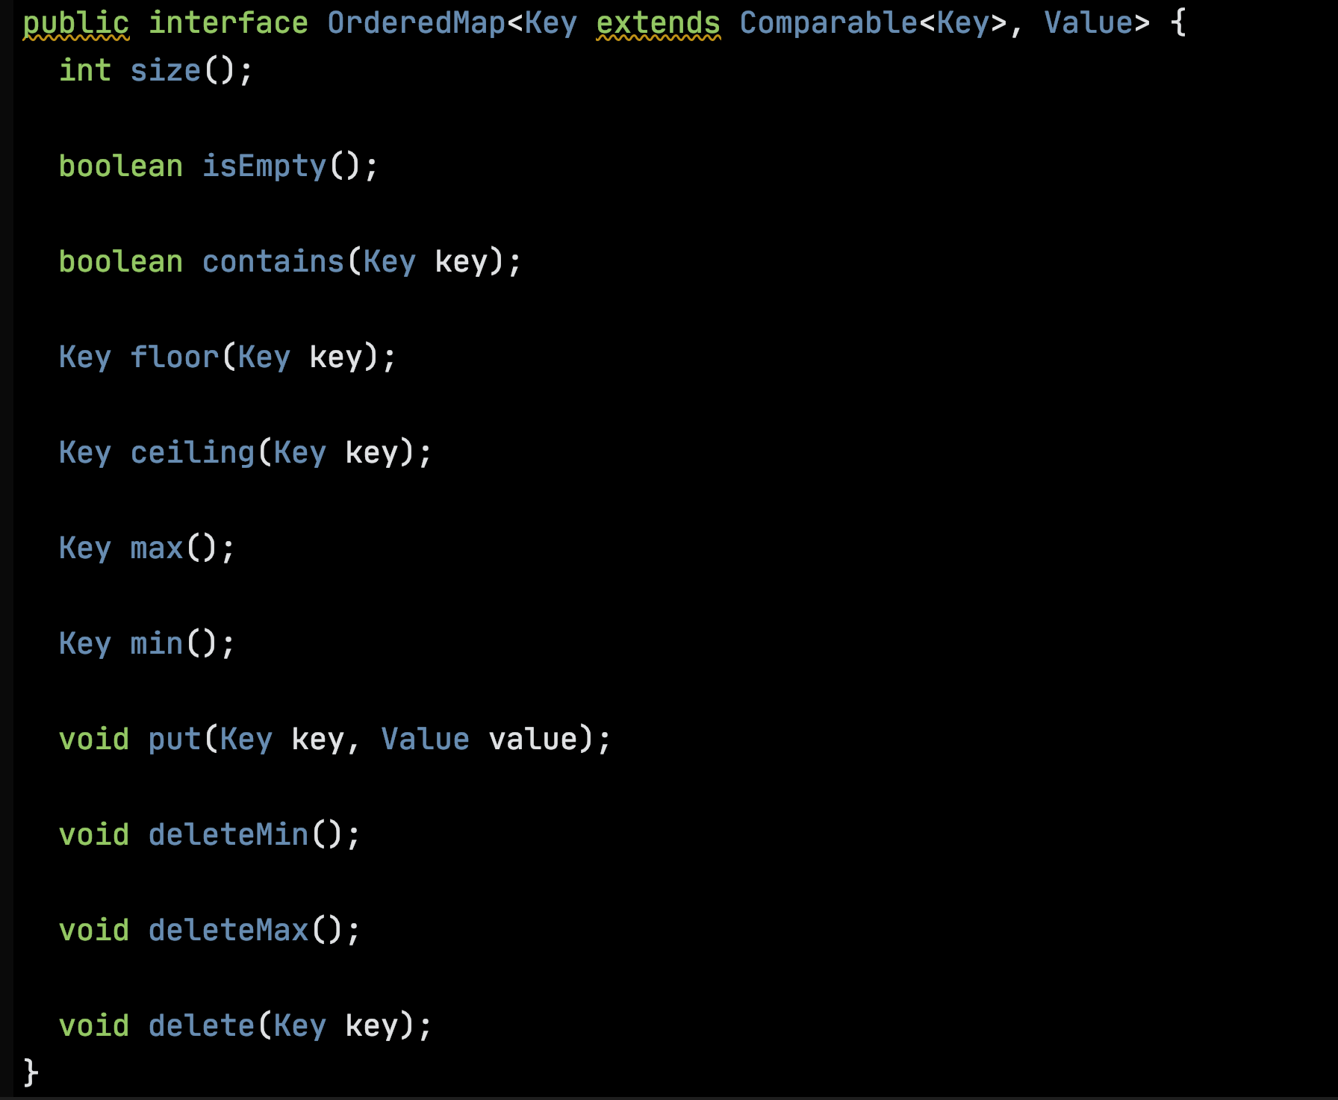

Slide 27
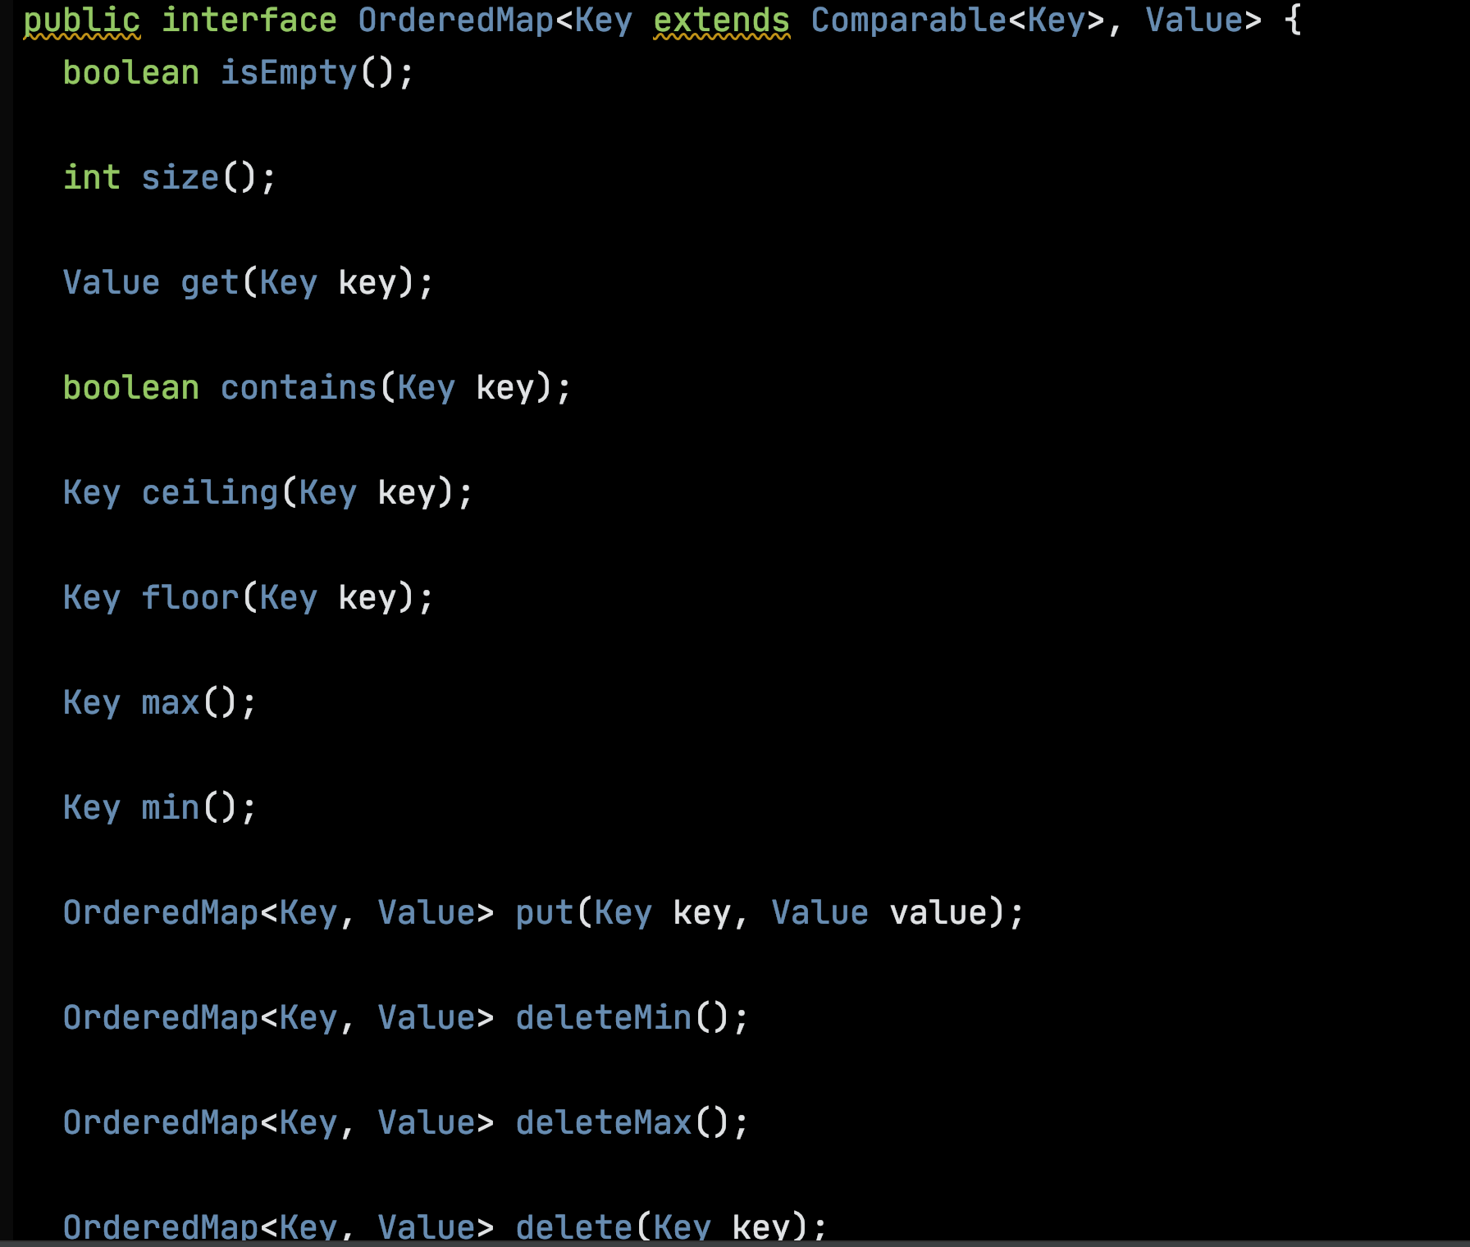

Slide 28
Code

Slide 29
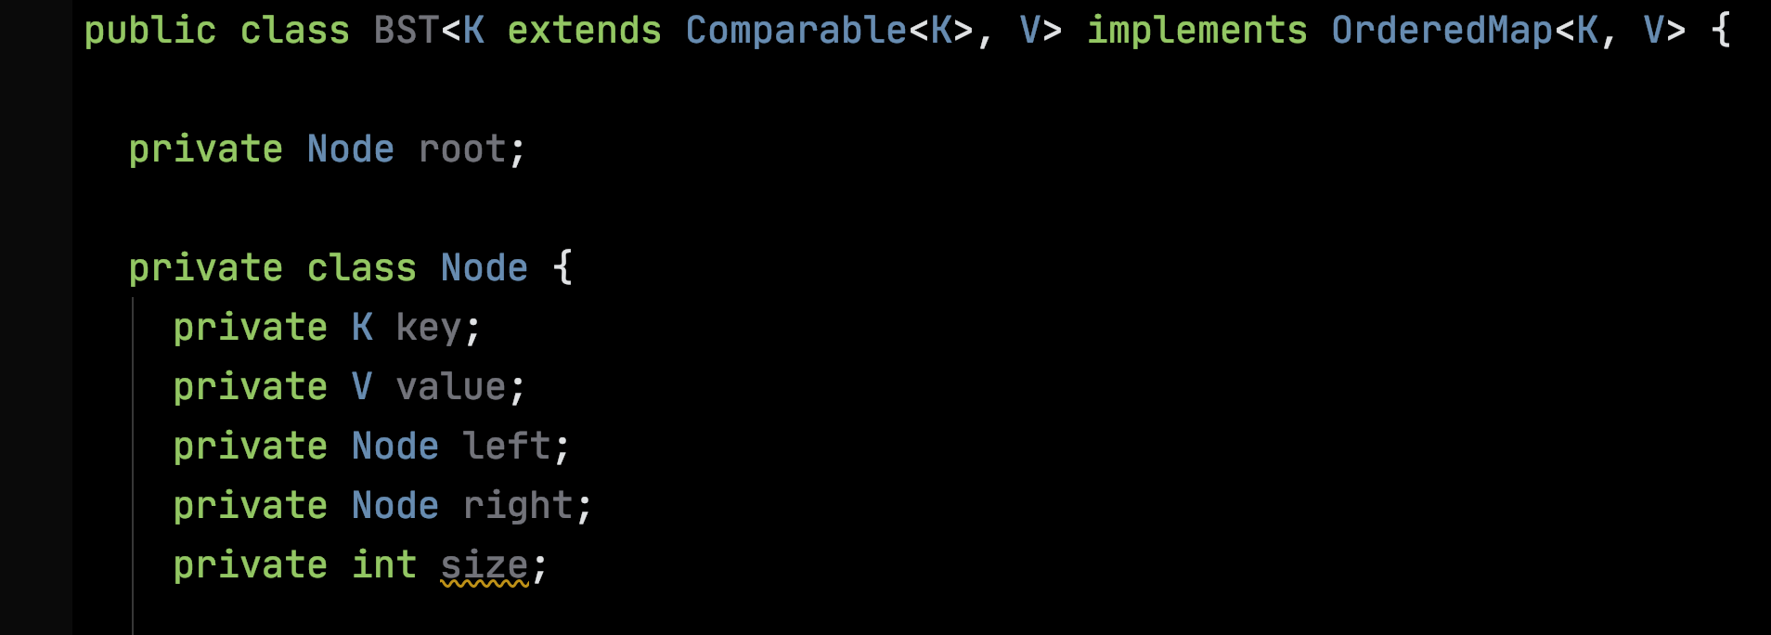

Slide 30
Work

Slide 31
How Much?
How much time does an operation take?
How much memory does it use?
In the worst case? On average?
How does the work grow as the input grows?

Slide 32
Measure the Input Size – N
Units of Work
Input Size – N

