Slide 1
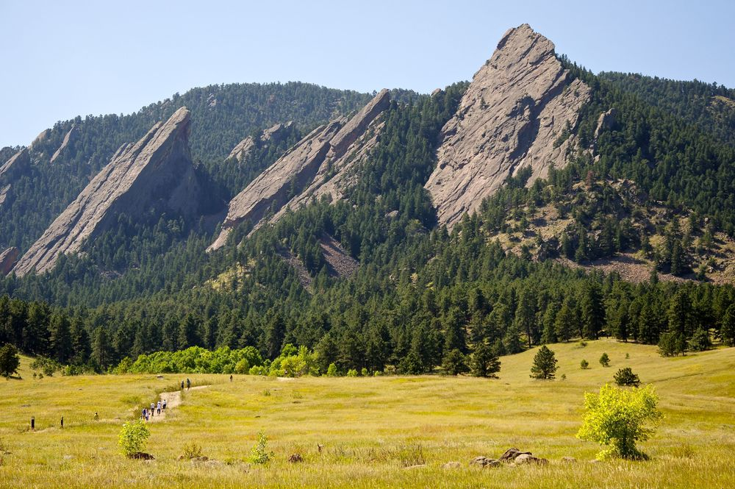
CSCI 1102 Computer Science 2
Meeting 22: Thursday 4/29/2021
Graphs

Slide 2
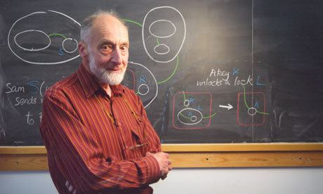
Robin Milner
Turing Award 1991

Slide 3
Graphs

Slide 4
Weight Directed Graph
A
8
D
B
4
C

Slide 5
Weight Directed Graph
Vertices
A
Weights
8
D
Edges
B
4
C

Slide 6
(Unweighted) Directed Graph
A
0
D
B
0
C

Slide 7
(Weighted) Undirected Graph
A
D
B
C

Slide 8
(Weighted) Undirected Graph
A
D
B
C

Slide 9
Paths
A
8
D
B
4
C

Slide 10
Cycles
A
D
B
C

Slide 11
Representations
V = { A, B, C, D }
E = { (A, 8, D), (D, 4, C)}
A
8
D
B
4
C

Slide 12
Representations
A
V = { A, B, C, D }
E = { (A, D), (D, C), (C, A)}
D
B
C

Slide 13
Adjacency
List
A
B
D
B
C
A
A
D
C
D
B
C

Slide 14
Adjacency
Matrix
A
B
C
D
A
-
1
0
1
B
0
-
0
0
C
1
0
-
0
A
D
0
0
1
-
D
B
C

Slide 15
Traversal
A
B
C
D
F
E

Slide 16
Depth First Traversal
A
B
C
D
F
E

Slide 17
Depth First Traversal
A
B
C
D
F
E

Slide 18
Depth First Traversal
A
B
C
D
F
E

Slide 19
Depth First Traversal
A
B
C
D
F
E

Slide 20
Depth First Traversal
A
B
C
D
F
E

Slide 21
Breadth First Traversal
A
B
C
D
F
E

Slide 22
Breadth First Traversal
A
B
C
D
F
E

Slide 23
Breadth First Traversal
A
B
C
D
F
E

Slide 24
Breadth First Traversal
A
B
C
D
F
E

Slide 25
Breadth First Traversal
A
B
C
D
F
E

Slide 26
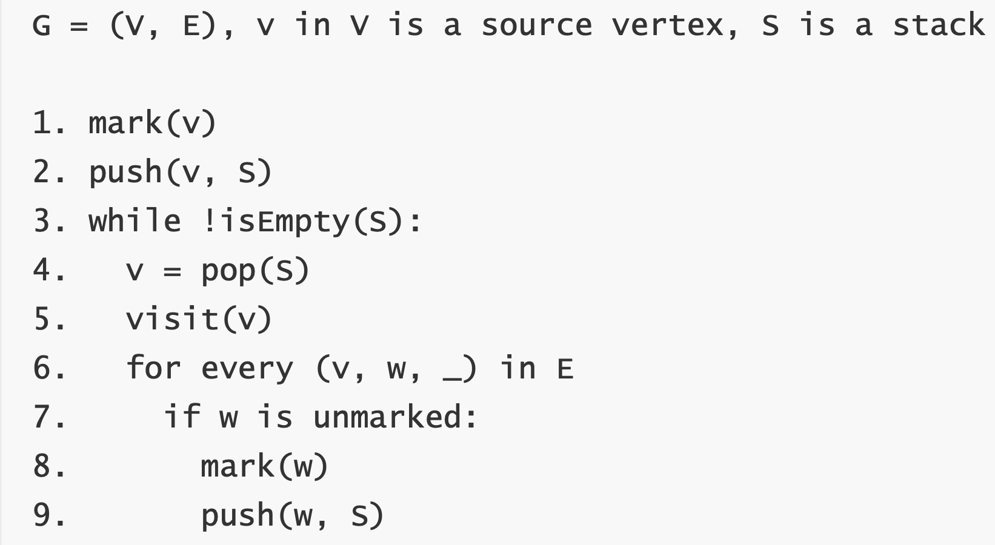
Depth First Traversal

Slide 27
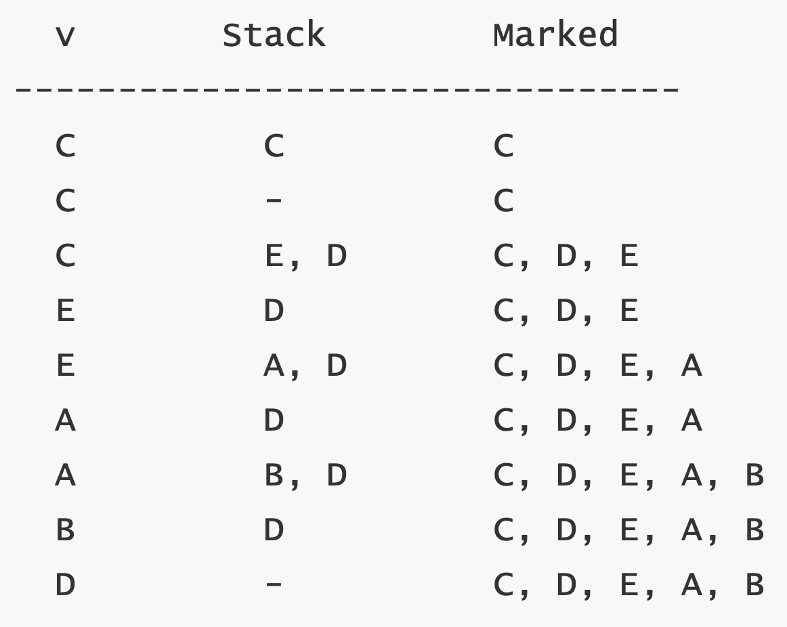
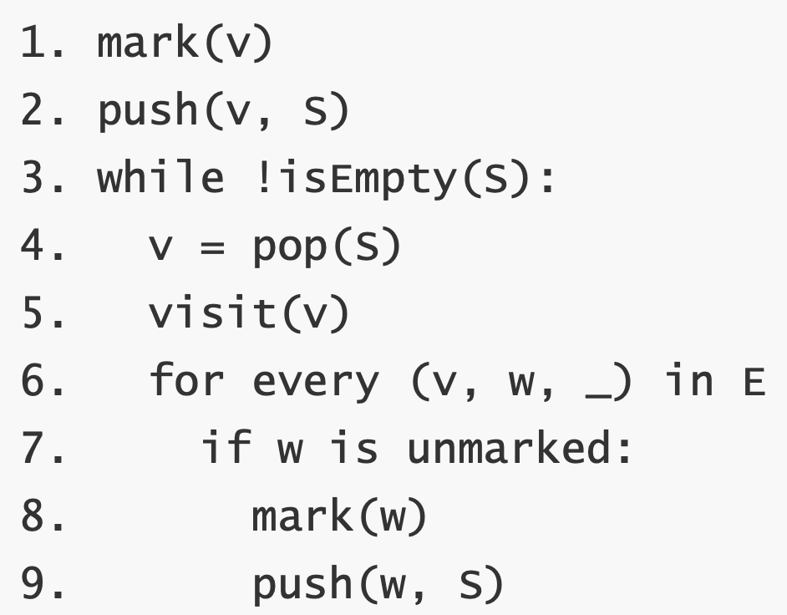
A
B
C
D
F
E

Slide 28
A
B
C
D
F
E

Slide 29
A
B
C
D
F
E

Slide 30
A
B
C
D
F
E

Slide 31
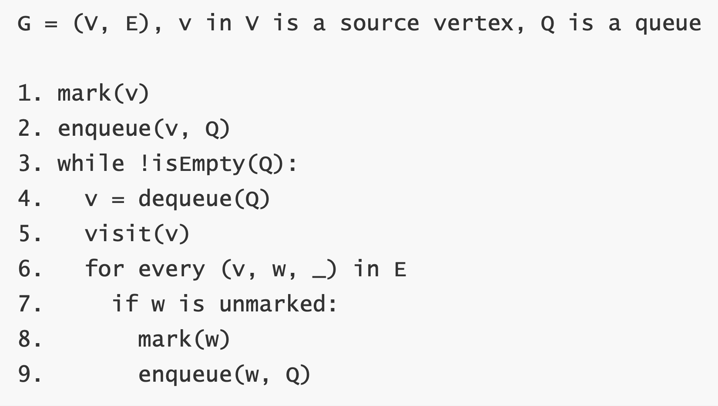
Breadth First Traversal

Slide 32
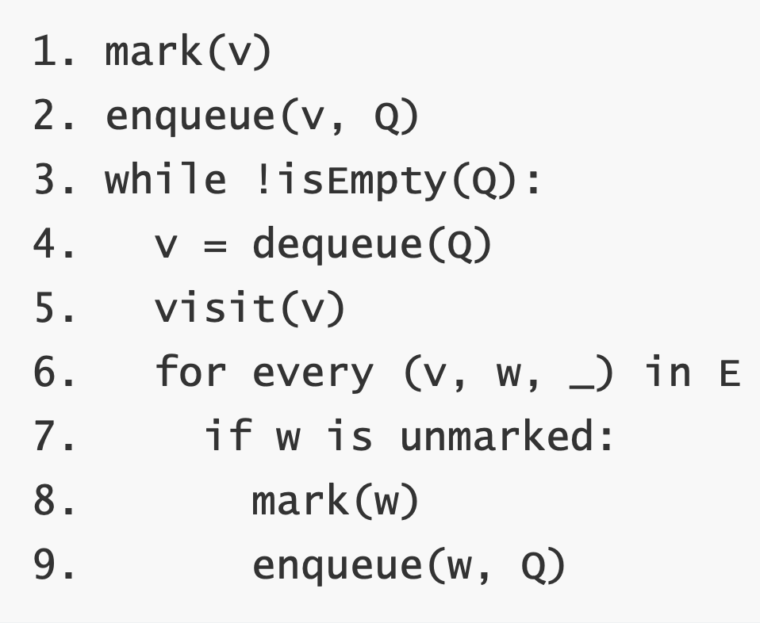
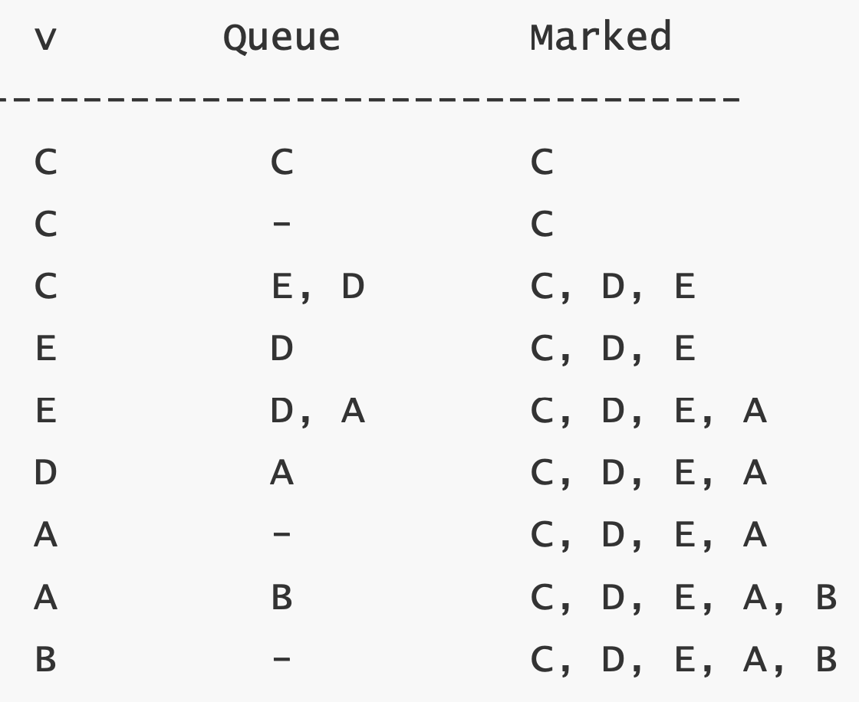
A
B
C
D
F
E

Slide 33
A
B
C
D
F
E

Slide 34
A
B
C
D
F
E

Slide 35
A
B
C
D
F
E

Slide 36
A
B
C
D
F
E

Slide 38
Work

Slide 39
How Much?
How much time does an operation take?
How much memory does it use?
In the worst case? On average?
How does the work grow as the input grows?

Slide 40
Measure the Input Size – N
Units of Work
Input Size – N

