Slide 1
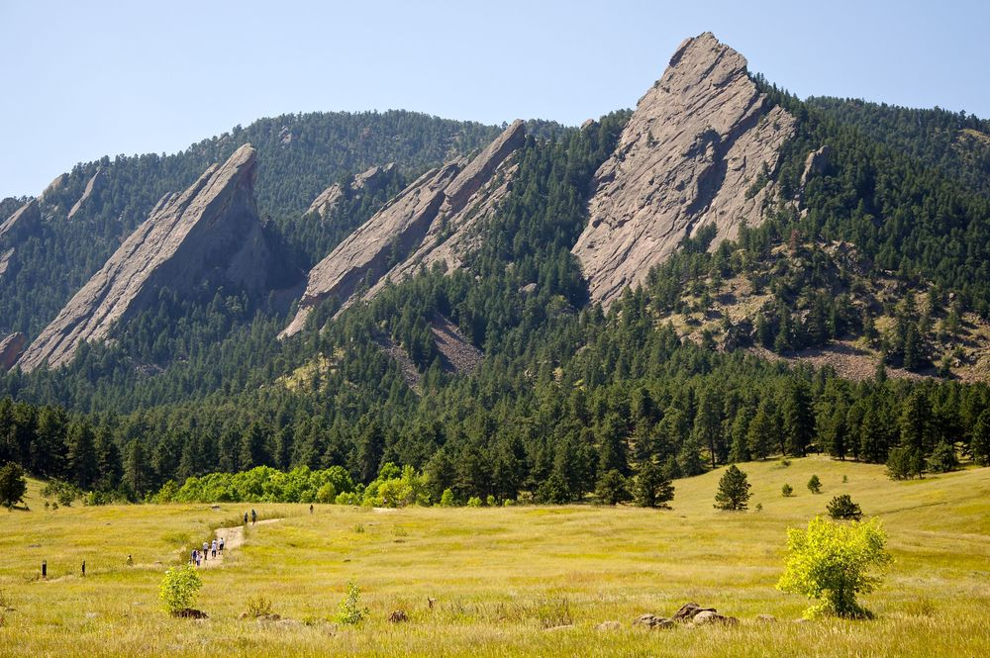
CSCI 1102 Computer Science 2
Meeting 21: Tuesday 4/13/2021
Immutable BSTs
2-3 Trees & Red Black Trees

Slide 2
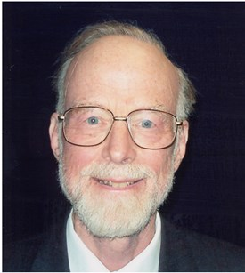
Anthony Hoare
Turing Award 1980
+ Record types
+ Logical systems for reasoning about programs (Hoare Logic)
+ CSP
+ Quicksort
etc

Slide 3
Binary Search Trees
Smaller keys to the left
Larger keys to the right
M
H
R
bst.get(K)
E
K

Slide 4
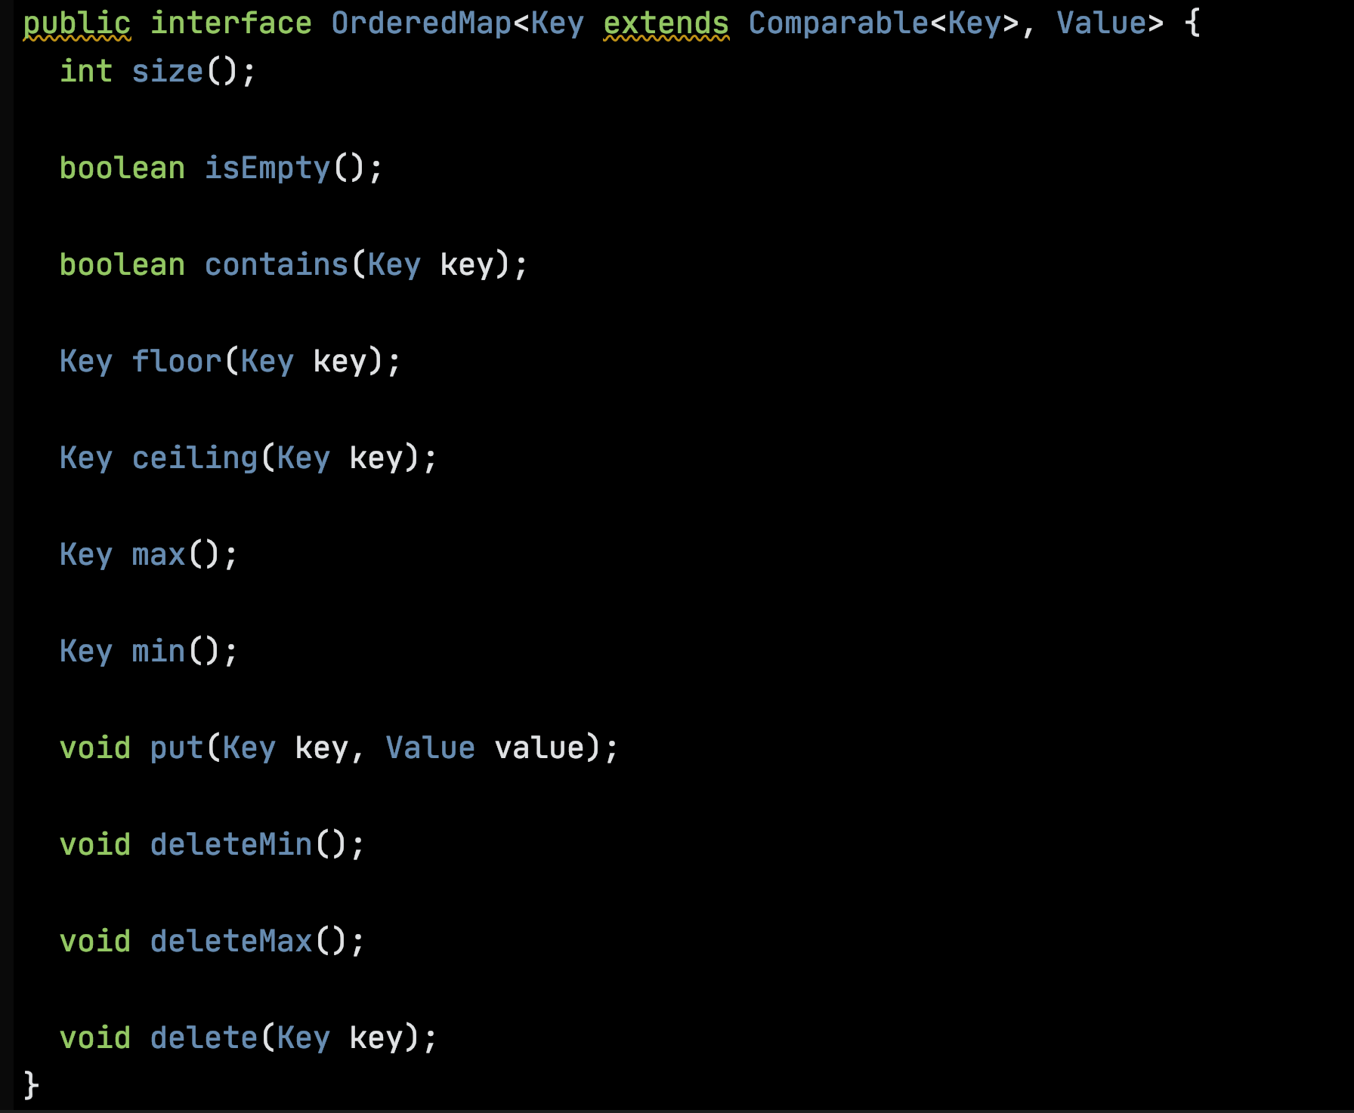
An API for the BST ADT in the style of Sedgewick & Wayne

Slide 5
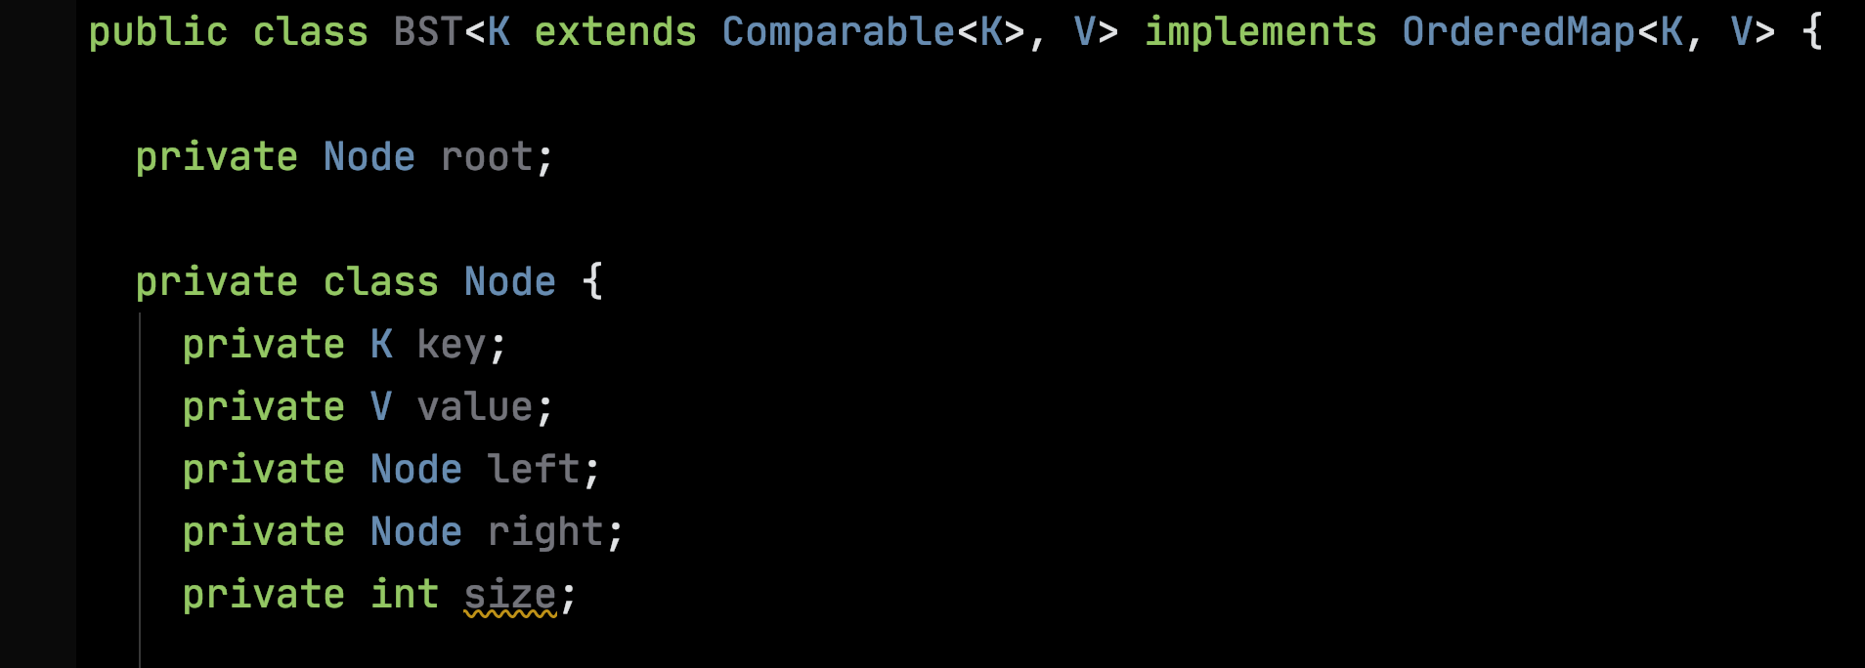
A private inner recursive class Node, empty BST represented by null.

Slide 6
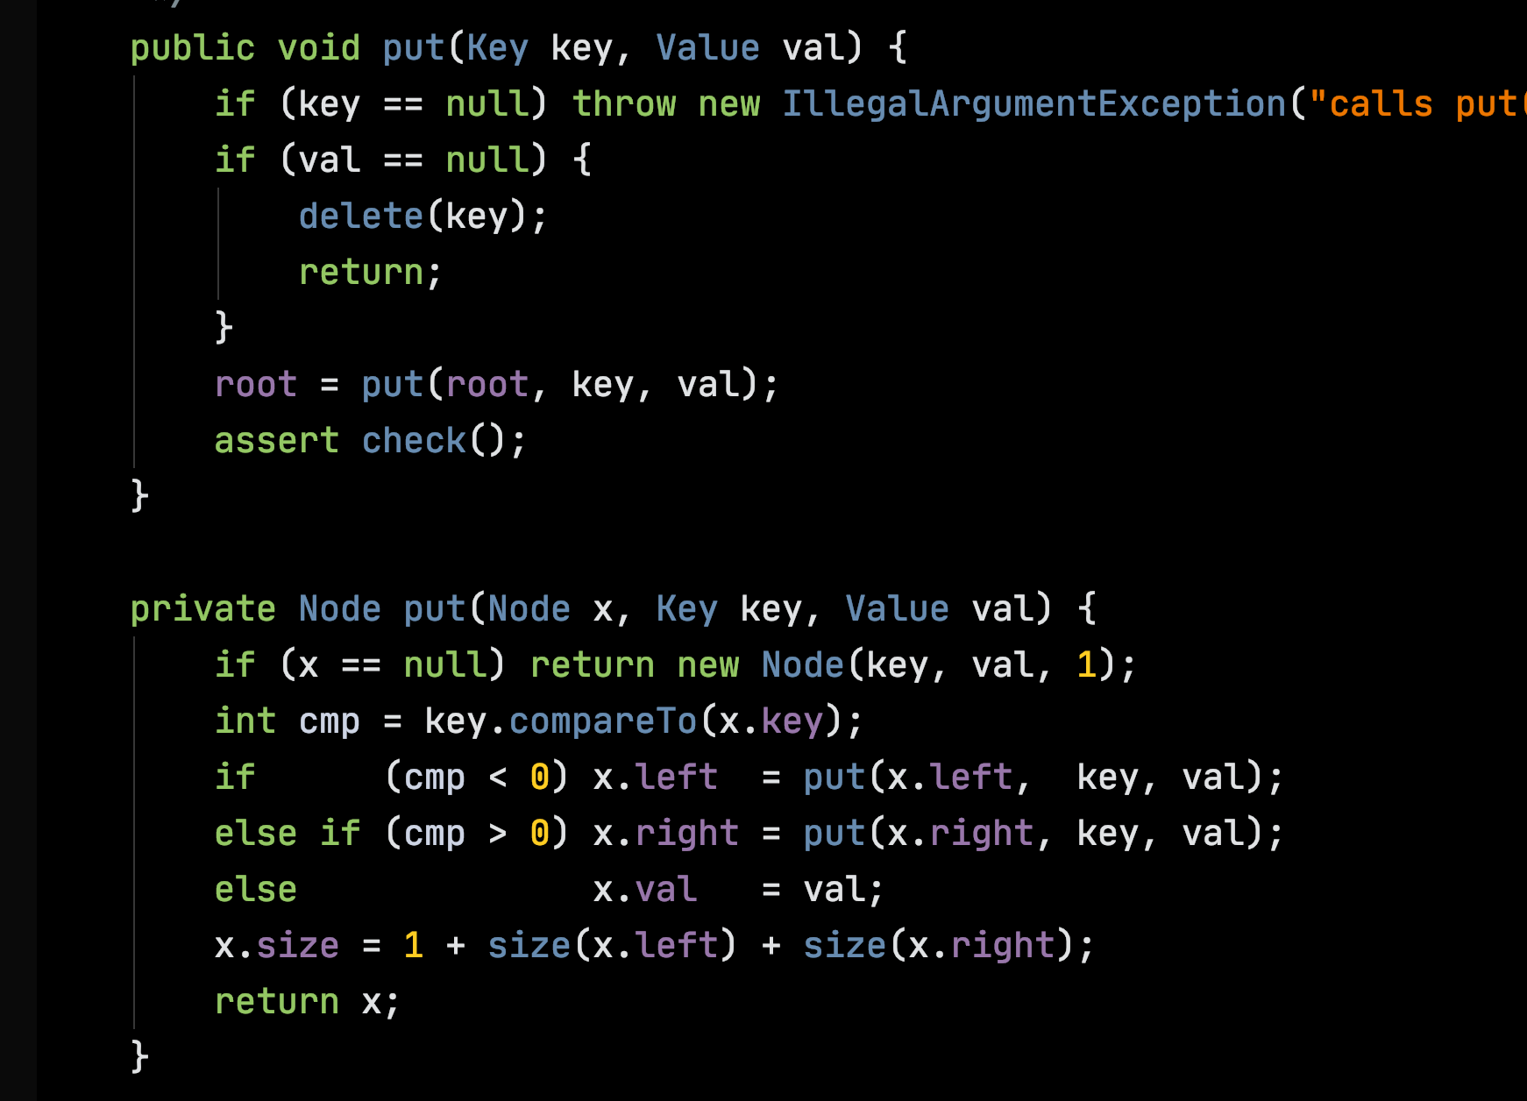

Slide 7
M
bst.put(L, 5)
Mutates all of the nodes on the path from the root to the insertion point.
H
R
E
K
L

Slide 8
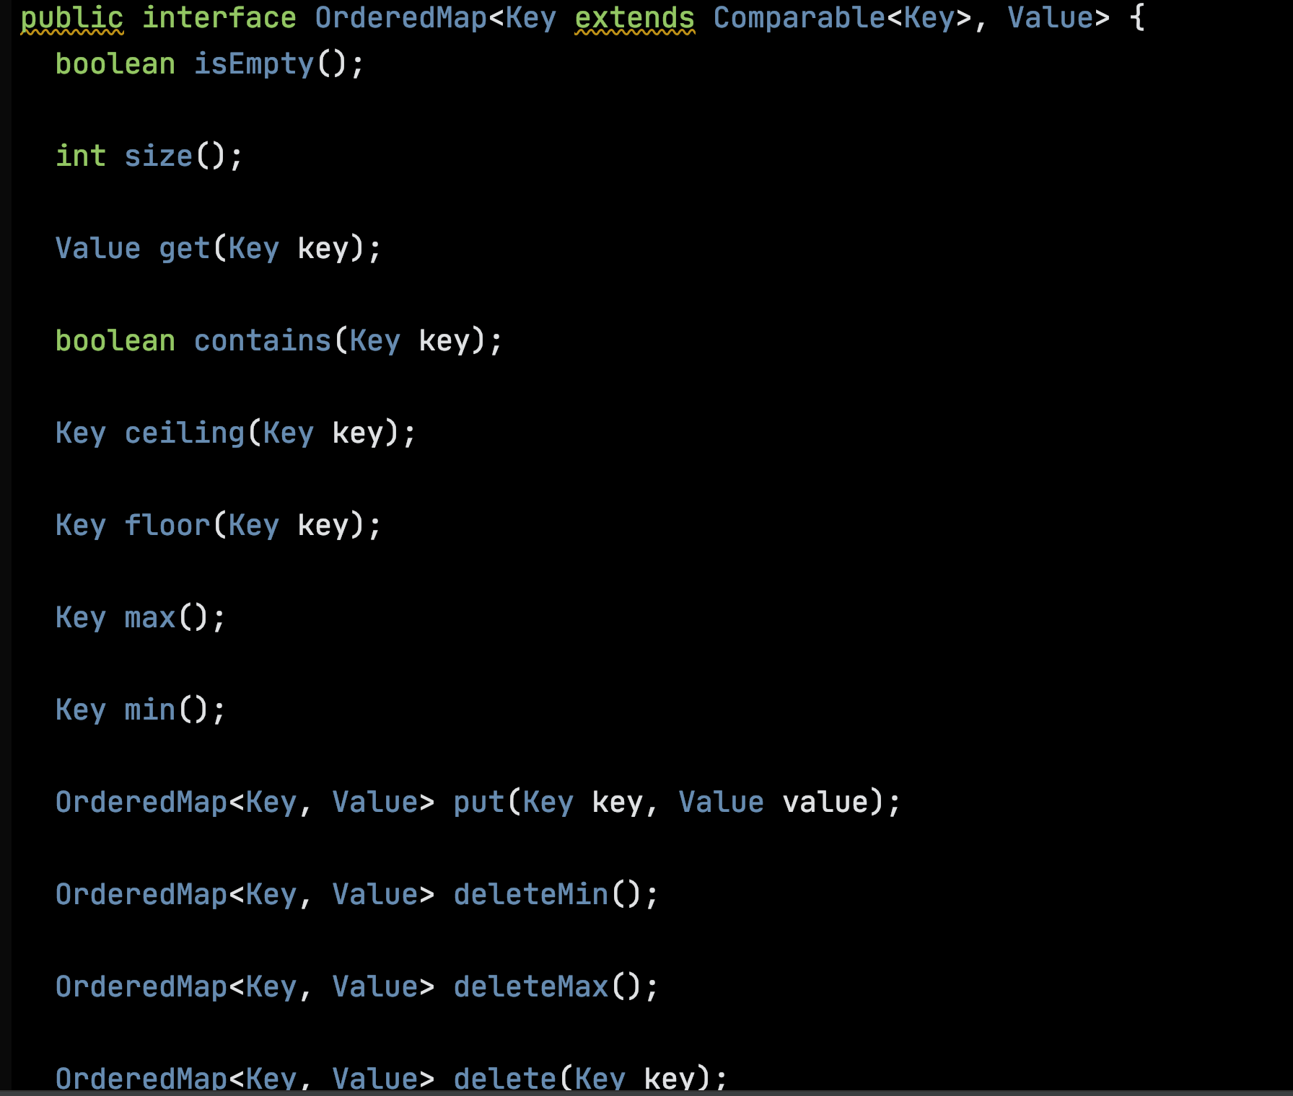
Making empty BSTs First-class
Public classes Node & Empty both implement
OrderedMap.

Slide 9
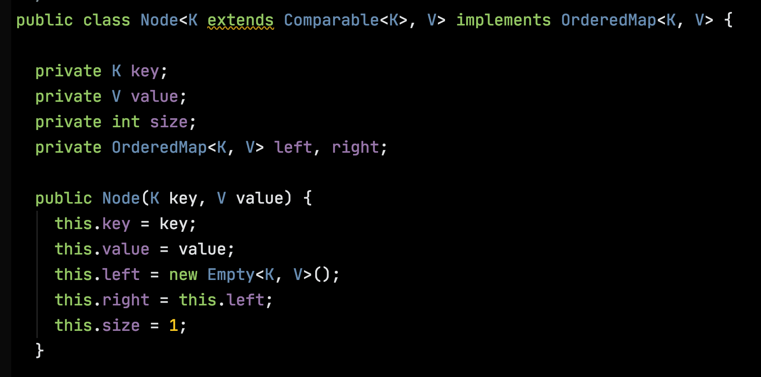

Slide 10
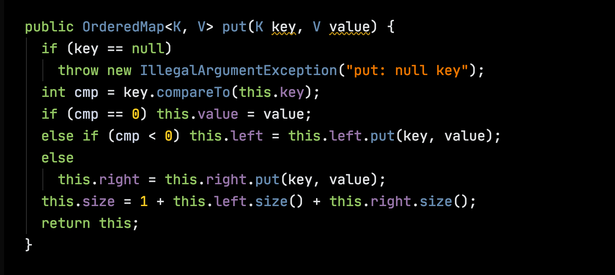

Slide 11
Immutable BSTs
Operations that might change a BST instead return a new one.
Structure Sharing

Slide 12
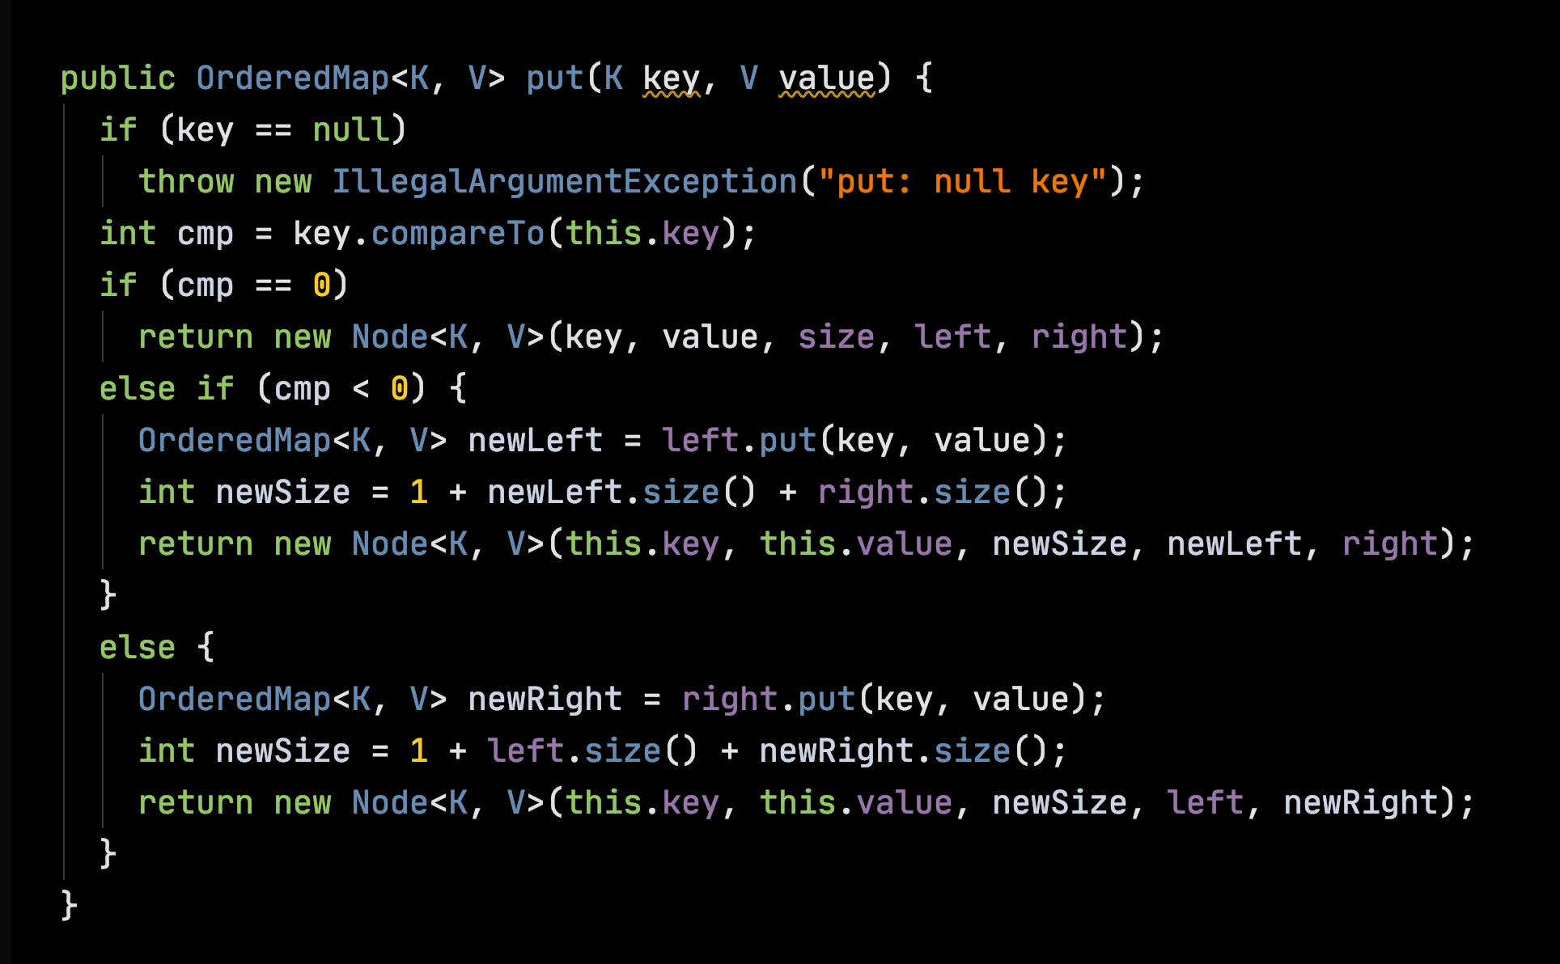

Slide 13
M
bst.put(L, 5)
Rebuilds all of the nodes on the path from the root to the insertion point.
H
R
E
K
L

Slide 15
Balanced Trees

Slide 16
2-3 Trees are Balanced all leaves at same depth
M
H P
t1
t2
t3
Keys less than H
Keys between H and P
Keys greater than P

Slide 17
2-3 Trees are Balanced all leaves at same depth
H P
C E
M
R W

Slide 18
Insert E
E

Slide 19
Insert M
E M

Slide 20
Insert R -- Split
E M R

Slide 21
Insert R -- Split
M
E M R
E
R

Slide 22
Insert C
M
C E
R

Slide 23
Insert H -- Split
M
C E H
R

Slide 24
Insert H -- Split
M
E M
C E H
R
C
H
R

Slide 25
Insert W
E M
C
H
R W

Slide 26
Insert P -- split
E M
C
H
P R W

Slide 27
Insert P -- split
E M
E M R
C
H
P R W
C
H
P
W

Slide 28
Split the root
M
E M R
E
R
C
H
P
W
C
H
P
W

Slide 29
Left-Leaning Red-Black Trees

Slide 30
Representing 3-nodes with colored 2-nodes
H P
t1
t2
t3

Slide 31
Representing 3-nodes with colored 2-nodes
P
H P
H
t1
t2
t3
t3
t1
t2

Slide 32
Representing 3-nodes with colored 2-nodes
P
H P
H
W
C E
M
R W
E
M
R
C

Slide 33
Invariants:
Path to every leaf passes through same number of black links;
Never 2 consecutive red links;
No node with 2 outgoing red links;
No right red links.
P
H
W
E
M
R
C

Slide 34
Tree Rotations

Slide 35
Rotate Left
H
t1
P
t2
t3

Slide 36
Rotate Left
H
P
t1
P
H
t3
t2
t3
t1
t2

Slide 37
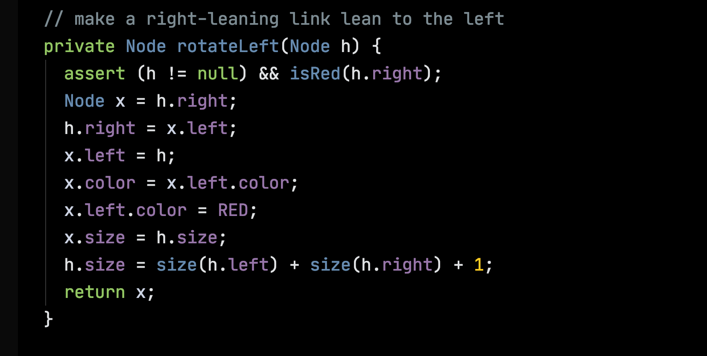

Slide 38
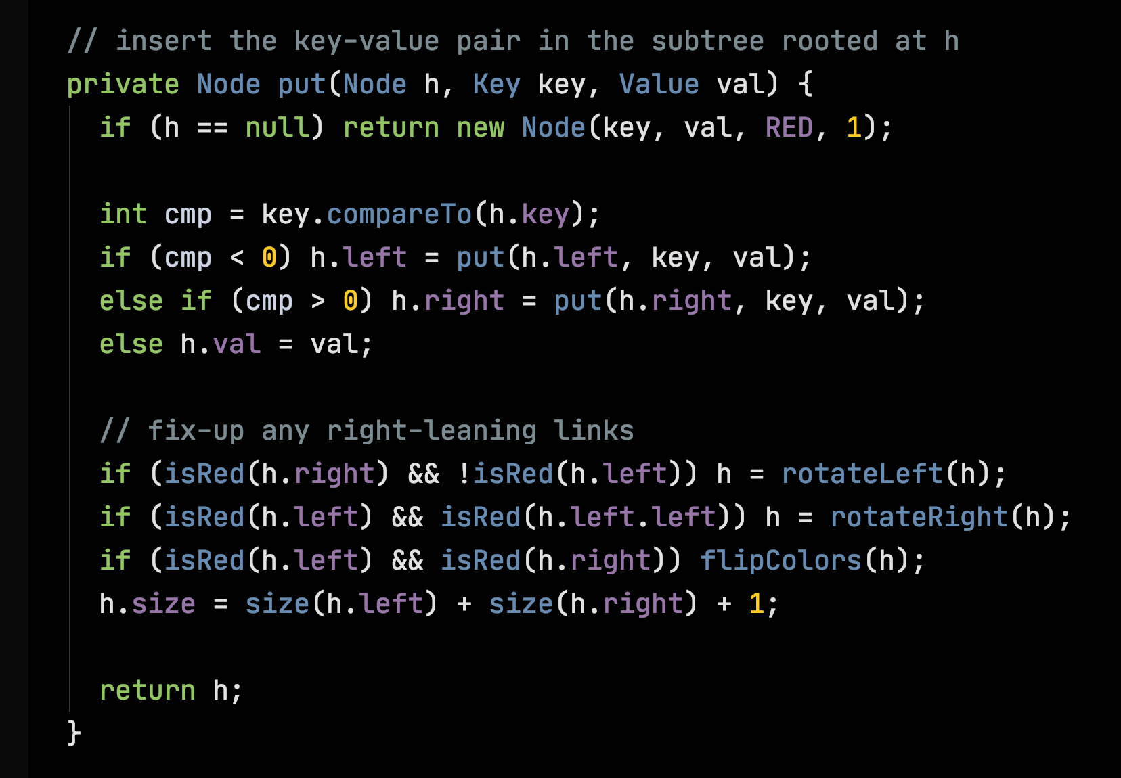

Slide 39
Rotate Right
P
H
t3
t1
t2

Slide 40
Rotate Right
P
H
H
P
t3
t1
t1
t2
t2
t3

Slide 41
Flip
P
P
t1
t2
t1
t2

