Slide 1
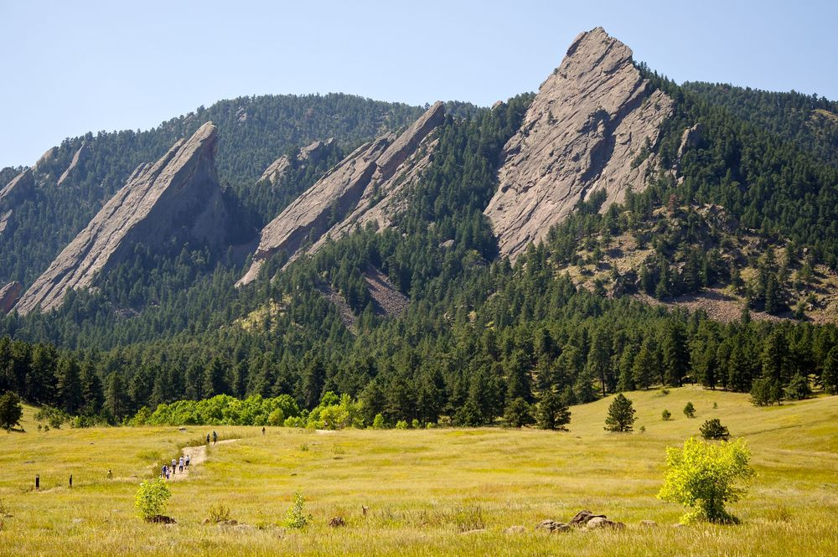
CSCI 1102 Computer Science 2
Meeting 21: Thursday 4/15/2021
More on Red Black Trees

Slide 2
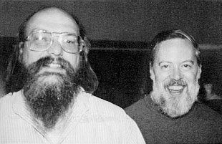
Ken Thompson & Dennis Ritchie
Inventors of Unix & C
Turing Award
1983

Slide 3
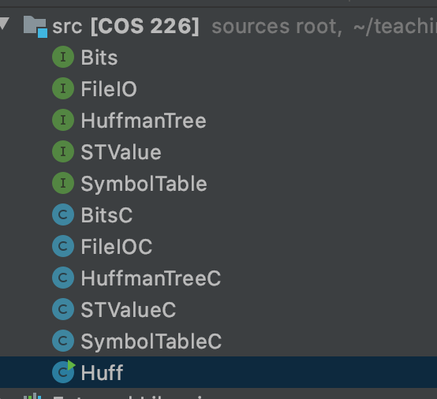

Slide 4
Show all of the 2-3 trees resulting from inserting the keys ABCDEFG

Slide 5
A

Slide 6
A B

Slide 7
A B C

Slide 8
B
A
C

Slide 9
B
A
C D

Slide 10
B
A
C D E

Slide 11
B D
A
C
E

Slide 12
B D
A
C
E F

Slide 13
B D
A
C
E F G

Slide 14
B D F
A
C
E
G

Slide 15
D
B
F
A
C
A
C
E
G

Slide 16
Left-Leaning Red-Black Trees

Slide 17
Rotate Left
H
P
t1
P
H
t3
t2
t3
t1
t2

Slide 18
Rotate Right
P
H
H
P
t3
t1
t1
t2
t2
t3

Slide 19
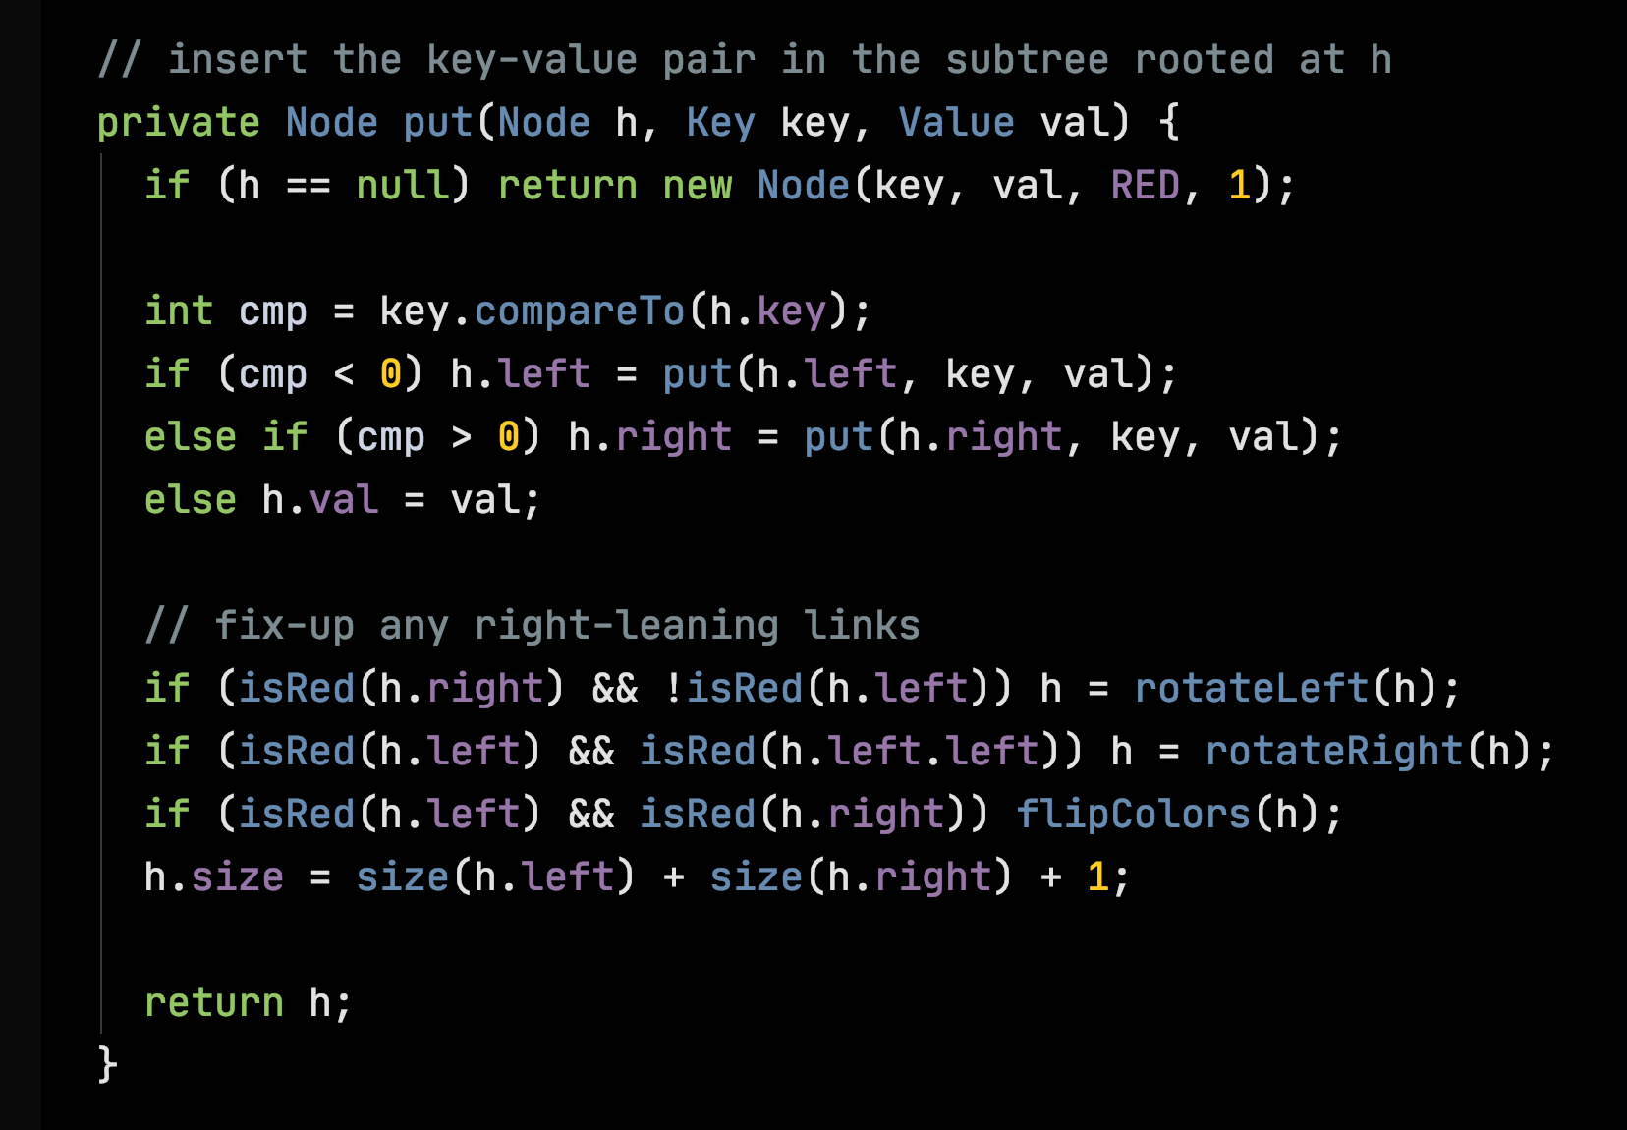

Slide 21
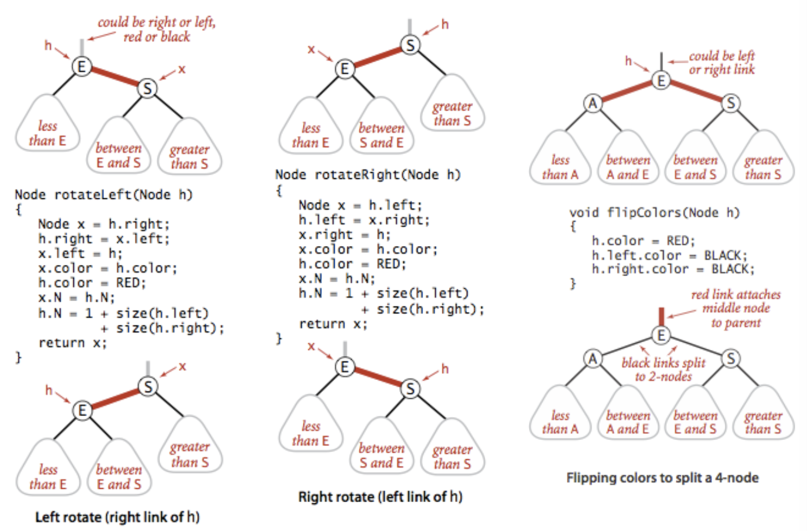
Always Red

Slide 22
Flip
P
P
t1
t2
t1
t2

Slide 23
Fixup on the way out
Insertion point in blue
Fixup code pending at each (red) node on the path from the insertion point back to the root.

Slide 24
REDBLACK

Slide 25
R
E
D
B
L
A
C
K
R

Slide 26
R
E
D
B
L
A
C
K
R
R
E

Slide 27
R
E
D
B
L
A
C
K
R
R
R
E
E
D

Slide 28
R
E
D
B
L
A
C
K
R
E
RR
E
D
R
D
FLIP
E
E
Root always black
D
R
D
R

Slide 29
R
E
D
B
L
A
C
K
Finish the sequence of insertions showing all tree transformations.
E
D
R

Slide 30
R
E
D
B
L
A
C
K
E
E
D
R
D
R
B

Slide 31
R
E
D
B
L
A
C
K
E
E
D
R
D
R
B
B
L

Slide 32
R
E
D
B
L
A
C
K
E
E
D
R
D
R
B
L
B
L
A

Slide 33
R
E
D
B
L
A
C
K
RR
E
E
D
R
B
R
B
L
A
A
D
L

Slide 34
R
E
D
B
L
A
C
K
E
FLIP
E
B
R
B
R
A
D
L
A
D
L

Slide 35
R
E
D
B
L
A
C
K
E
E
B
R
B
R
A
D
L
A
D
L
C

Slide 36
R
E
D
B
L
A
C
K
E
E
B
R
B
R
A
D
L
A
D
L
C
C
K

Slide 37
R
E
D
B
L
A
C
K
RR
E
E
B
R
B
L
A
L
D
A
D
K
R
C
K
C

Slide 38
R
E
D
B
L
A
C
K
FLIP
E
E
B
L
B
L
A
K
R
D
A
C
D
K
R
C

Slide 39
R
E
D
B
L
A
C
K
FLIP
E
B
L
A
D
K
R
C

Slide 40
R
E
D
B
L
A
C
K
E
Draw this RB tree as a 2-3 tree.
B
R
A
D
L
C

Slide 41
R
E
D
B
L
A
C
K
E
B
R
B E
A
D
L
A
C D
L R
C

Slide 42
M
A
R
T
I
N
M
Finish this sequence.

Slide 43
M
A
R
T
I
N
M
A

Slide 44
M
A
R
T
I
N
FLIP
M
M
A
R
A
R

Slide 45
M
A
R
T
I
N
RL
M
M
A
R
A
T
T
R

Slide 46
M
A
R
T
I
N
M
RL
M
A
T
I
T
I
R
A
R

Slide 47
M
A
R
T
I
N
RR
M
M
I
T
I
R
A
R
A
N
T
N

Slide 48
M
A
R
T
I
N
FLIP
M
M
I
R
I
R
A
N
T
A
N
T

Slide 49
M
A
R
T
I
N
RL
R
M
I
R
M
T
I
N
A
N
T
A

Slide 50
M
A
R
T
I
N
R
Draw this RB tree as a 2-3 tree.
M
T
I
N
A

Slide 51
M
A
R
T
I
N
R
M R
M
T
A I
N
T
I
N
A

Slide 52
W
Insert the letter T into this RB tree.
M
I
R
A
N

Slide 53
W
W
FLIP
M
M
I
R
I
R
A
N
T
A
N
T

Slide 54
W
W
RL
R
M
M
T
I
R
I
N
A
N
T
A

Slide 55
W
RR
R
R
M
W
M
T
I
N
T
I
N
A
A

Slide 56
R
FLIP
R
M
W
M
W
I
N
I
N
T
T
A
A

Slide 57
Review of this Storage Diagrams

Slide 58
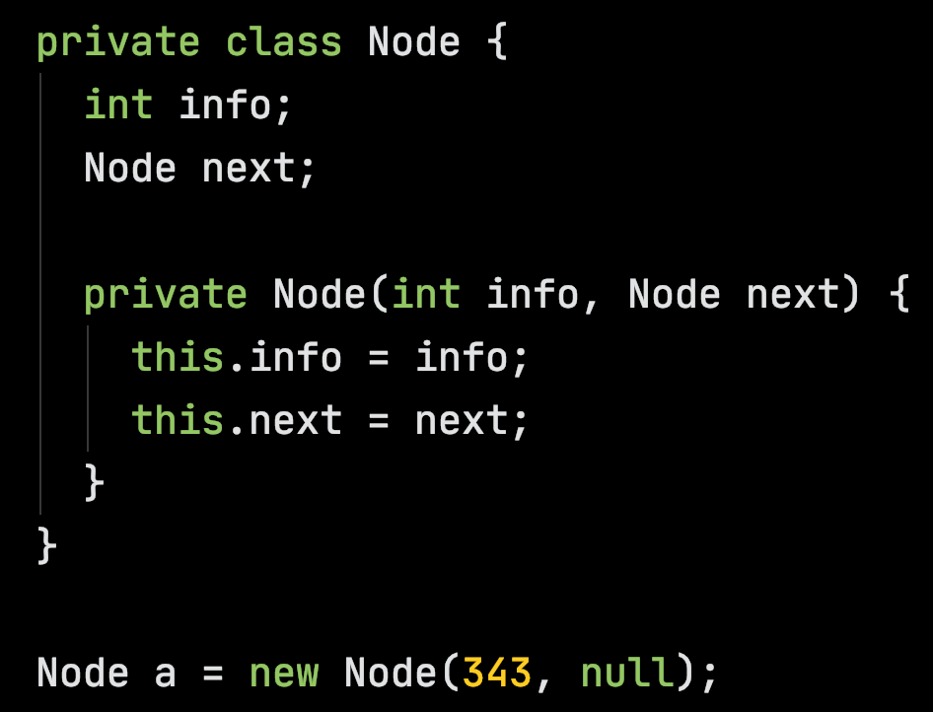
Heap
A Node object
methods:
info: 343
next:
a

Slide 59
Heap
We’ll ignore the methods for now
methods:
info: 343
next:
a

Slide 60
Heap
info: 343
next:
a

Slide 61
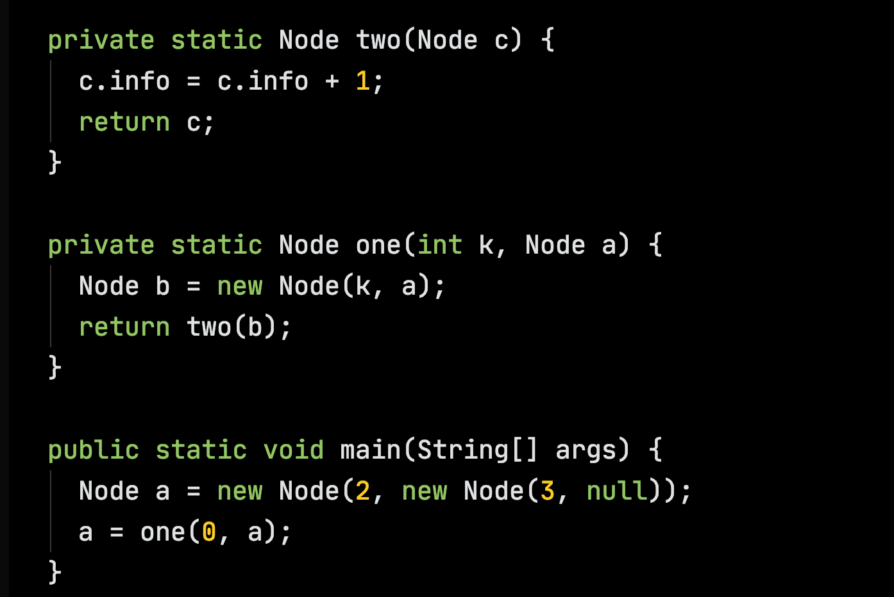

Slide 62
Stack
Heap
info: 2
next:
info: 3
main
next:
a:
args:

Slide 63
Stack
Heap
info: 0
next:
info: 2
one
k: 0
next:
b
a
info: 3
main
next:
a:
args:

Slide 64
Stack
Heap
info: 0
two
next:
c
info: 2
one
k: 0
next:
b
a
info: 3
main
next:
a:
args:

Slide 65
Stack
Heap
info: 1
two
next:
c
info: 2
one
k: 0
next:
b
a
info: 3
main
next:
a:
args:

Slide 66
Stack
Heap
info: 1
two
next:
c
info: 2
one
k: 0
next:
b
a
info: 3
main
next:
a:
args:

Slide 67
Stack
Heap
info: 1
next:
info: 2
one
k: 0
next:
b
a
info: 3
main
next:
a:
args:

Slide 68
Stack
Heap
info: 1
next:
info: 2
next:
info: 3
main
next:
a:
args:

Slide 69
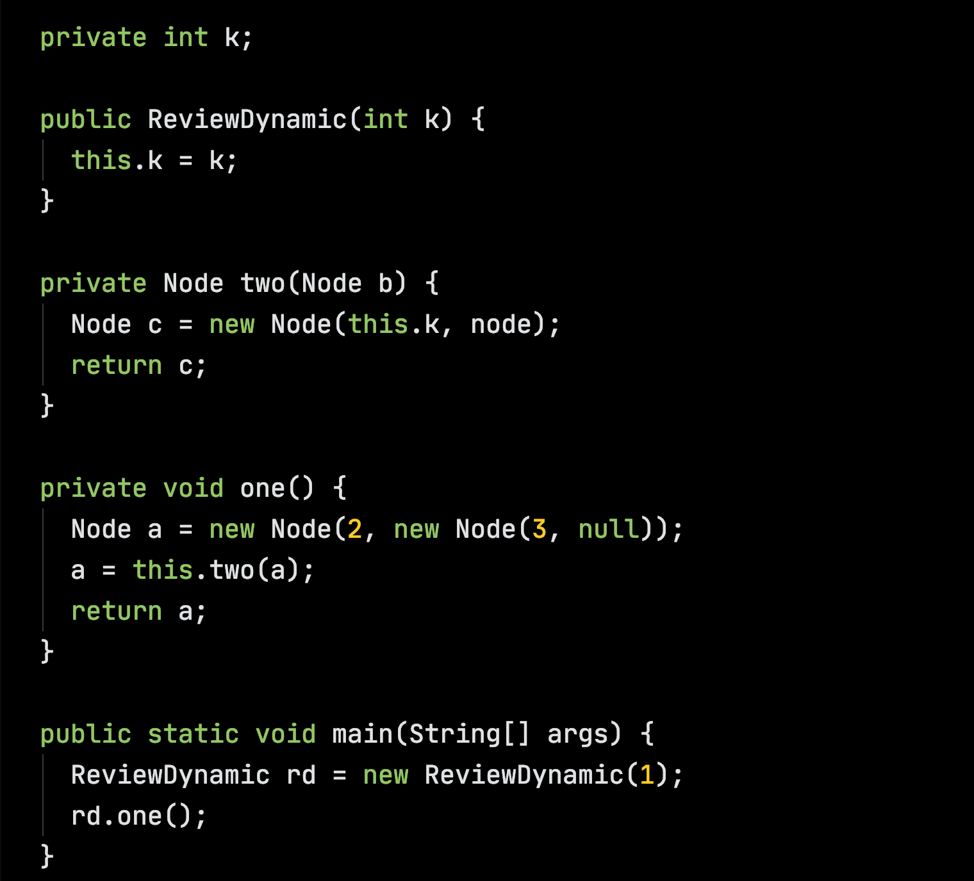

Slide 70
Stack
Heap
main
rd:
args:

Slide 71
Stack
Heap
this.k
ReviewDynamic
this:
k: 1
k:
main
rd:
args:

Slide 72
Stack
Heap
ReviewDynamic
this:
k: 1
k: 1
main
rd:
args:

Slide 73
Stack
Heap
ReviewDynamic
this:
k: 1
k: 1
main
rd:
args:

Slide 74
Stack
Heap
k: 1
main
rd:
args:

Slide 75
Stack
Heap
info: 2
rd.one
next:
a:
this:
k: 1
info: 3
main
next:
rd:
args:

Slide 76
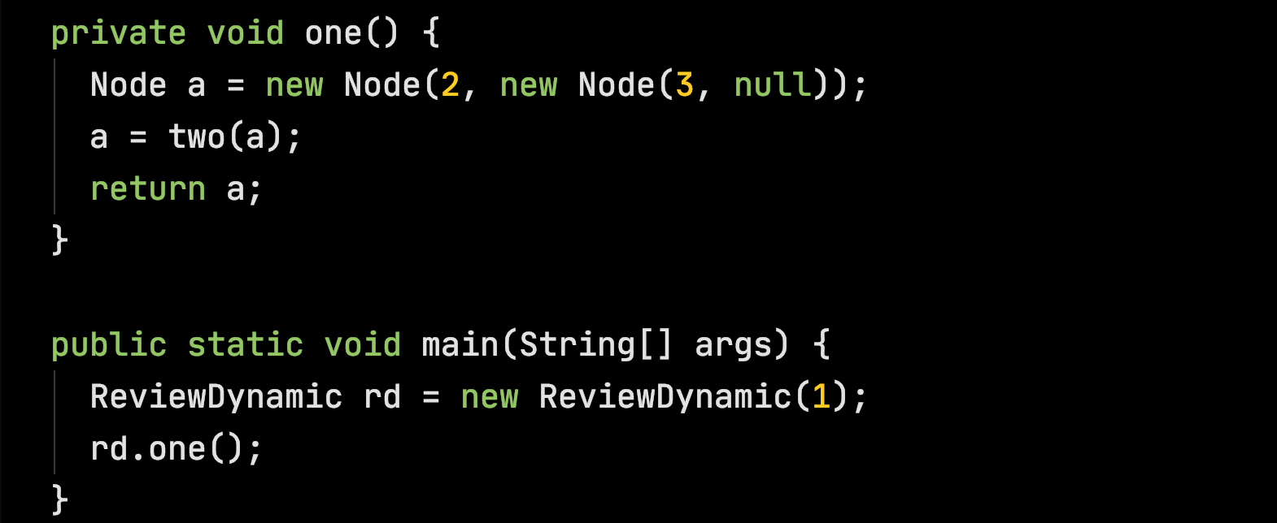
Stack
Heap
info: 2
rd.one
next:
a:
this:
k: 1
info: 3
main
next:
rd:
args:

Slide 77
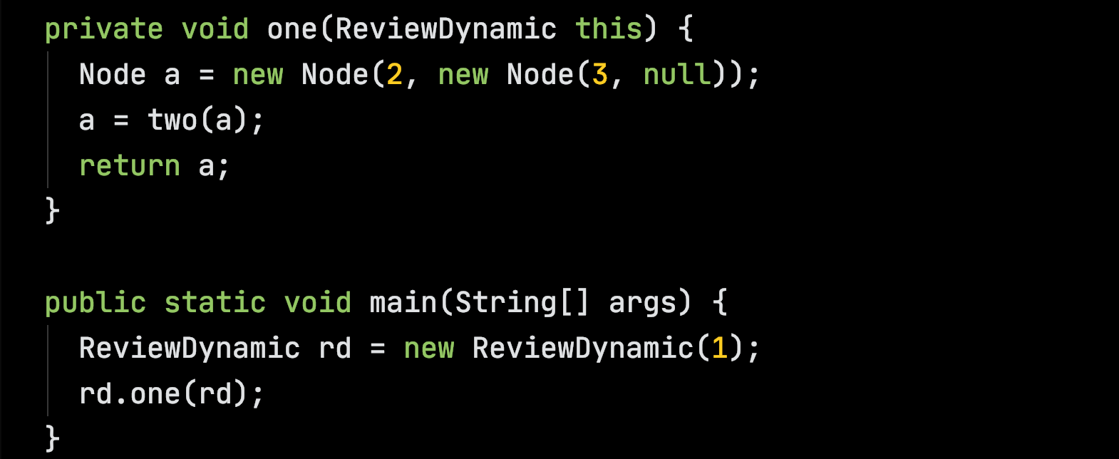
Compiler adds extra argument and this parameter
Stack
Heap
info: 2
rd.one
next:
a:
this:
k: 1
info: 3
main
next:
rd:
args:

Slide 78
Stack
Heap
info: 2
rd.one
next:
a:
this:
k: 1
info: 3
main
next:
rd:
args:

Slide 79
Stack
Heap
info: 1
rd.two
next:
c:
b:
this:
info: 2
rd.one
next:
a:
this:
k: 1
info: 3
main
next:
rd:
args:

Slide 80
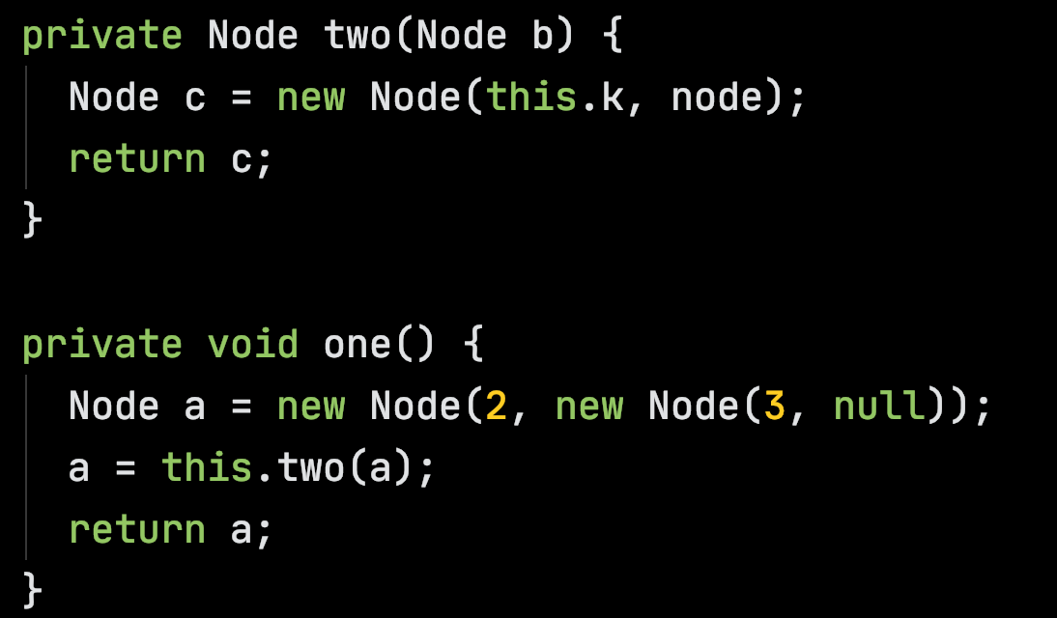
Stack
Heap
info: 1
rd.two
next:
c:
b:
this:
info: 2
rd.one
next:
a:
this:
k: 1
info: 3
main
next:
rd:
args:

Slide 81
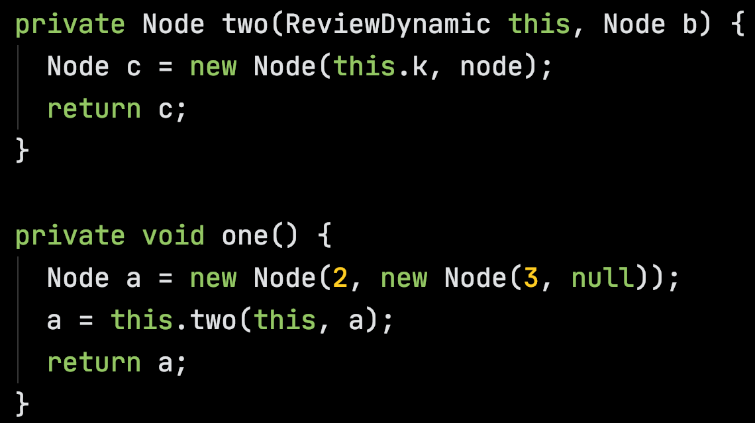
Stack
Heap
info: 1
rd.two
next:
c:
b:
this:
info: 2
rd.one
next:
a:
this:
k: 1
info: 3
main
next:
rd:
args:

Slide 82
Stack
Heap
info: 1
rd.two
next:
c:
b:
this:
info: 2
rd.one
next:
a:
this:
k: 1
info: 3
main
next:
rd:
args:

Slide 83
Stack
Heap
info: 1
rd.two
next:
c:
b:
this:
info: 2
rd.one
next:
a:
this:
k: 1
info: 3
main
next:
rd:
args:

Slide 84
Stack
Heap
info: 1
next:
info: 2
rd.one
next:
a:
this:
k: 1
info: 3
main
next:
rd:
args:

Slide 85
Stack
Heap
info: 1
next:
info: 2
rd.one
next:
a:
this:
k: 1
info: 3
main
next:
rd:
args:

Slide 86
Stack
Heap
info: 1
next:
info: 2
next:
k: 1
info: 3
main
next:
rd:
args:

