Slide 1
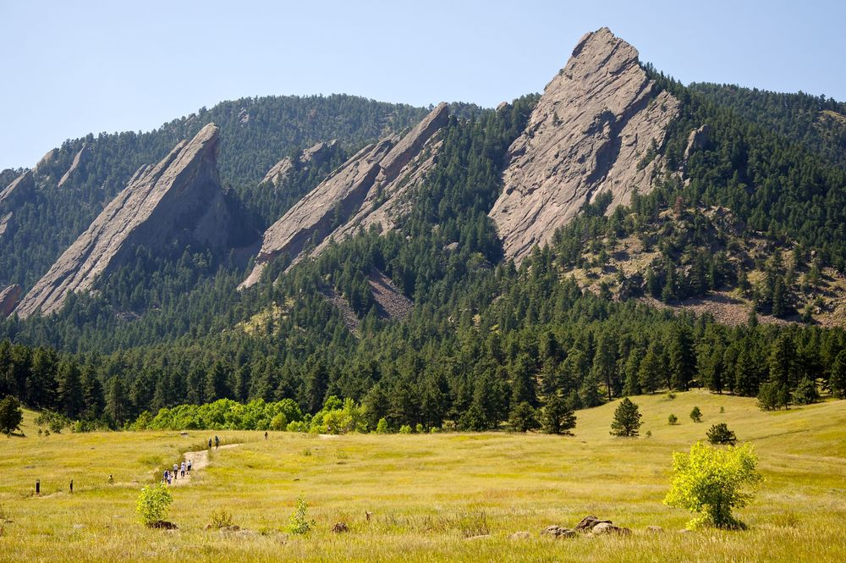
CSCI 1102 Computer Science 2
Meeting 21: Tuesday 4/13/2021
Immutable BSTs
2-3 Trees & Red Black Trees

Slide 2
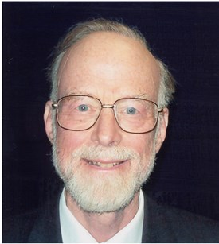
Anthony Hoare
Turing Award 1980
+ Record types
+ Logical systems for reasoning about programs (Hoare Logic)
+ CSP
+ Quicksort
etc

Slide 3
Binary Search Trees
Smaller keys to the left
Larger keys to the right
M
H
R
bst.get(K)
E
K

Slide 4
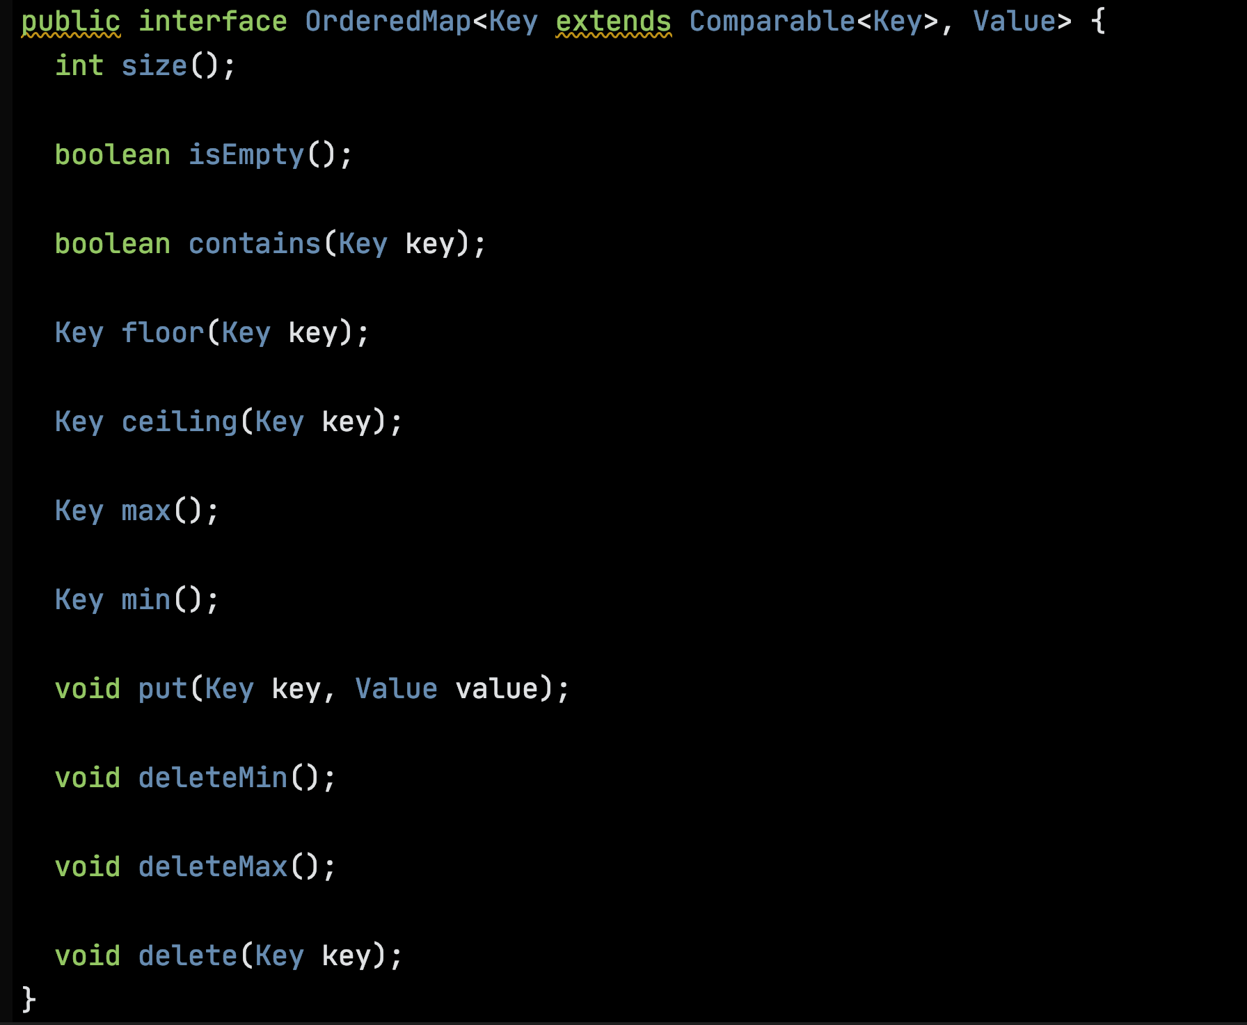
An API for the BST ADT in the style of Sedgewick & Wayne

Slide 5
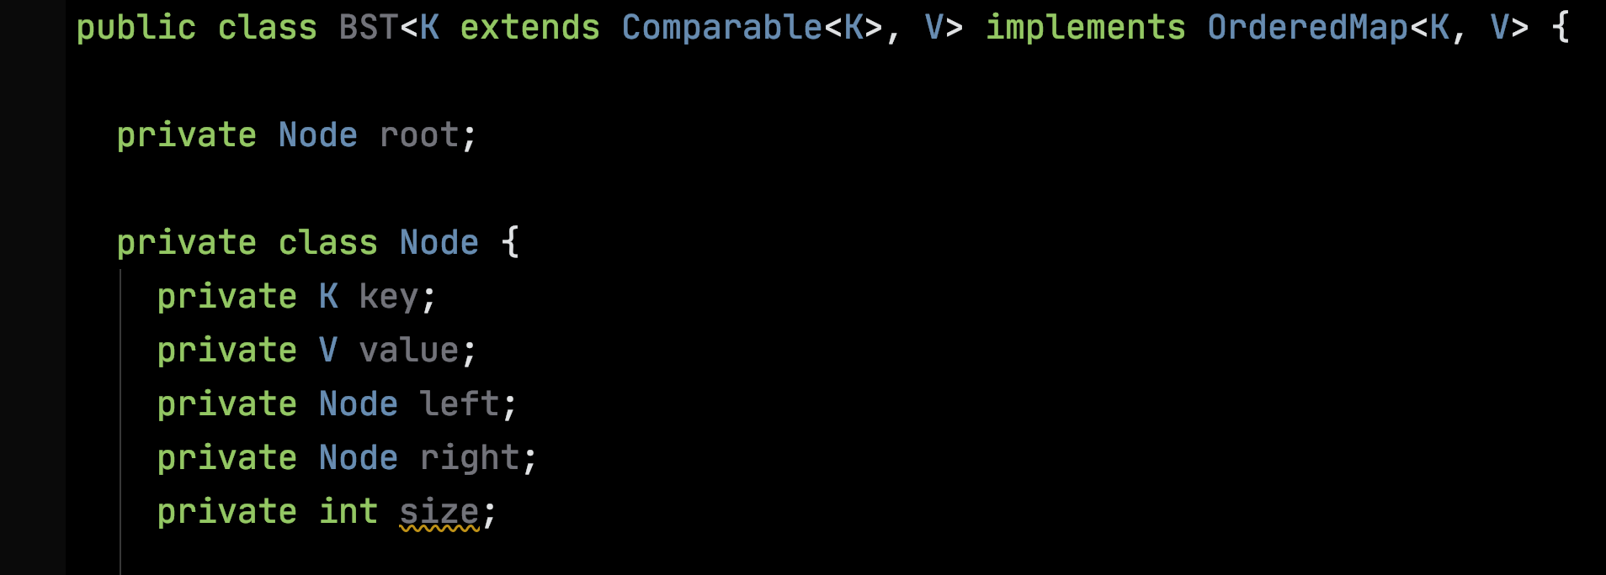
A private inner recursive class Node, empty BST represented by null.

Slide 6
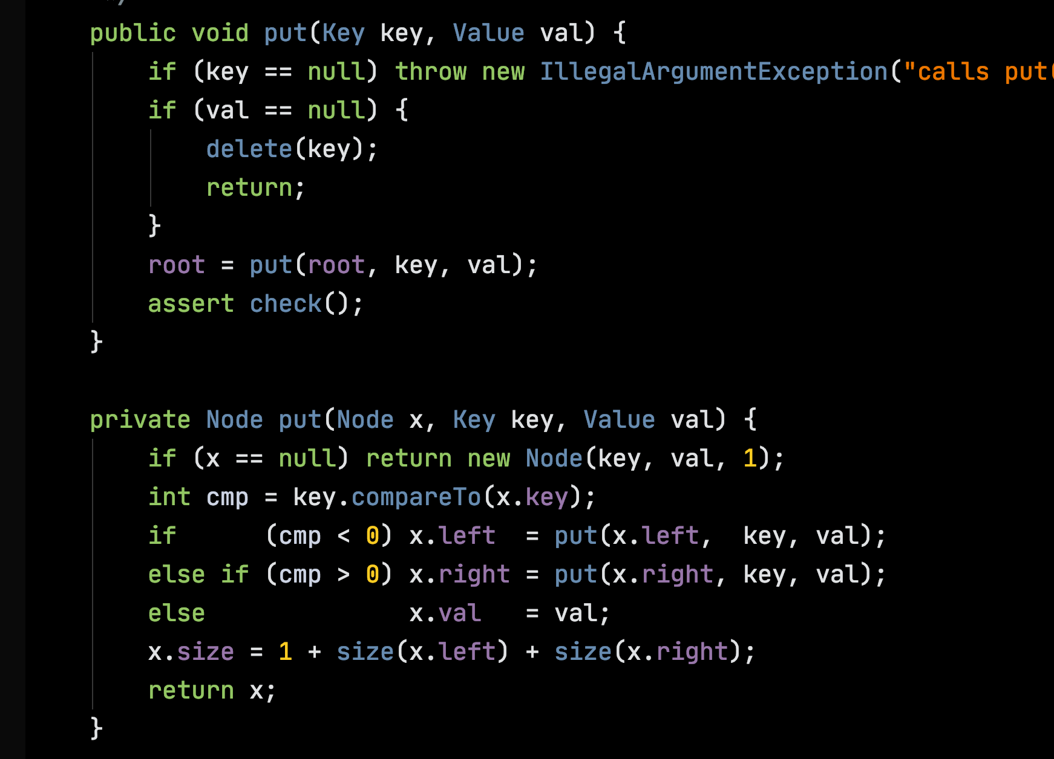

Slide 7
M
bst.put(L, 5)
Mutates all of the nodes on the path from the root to the insertion point.
H
R
E
K
L

Slide 8
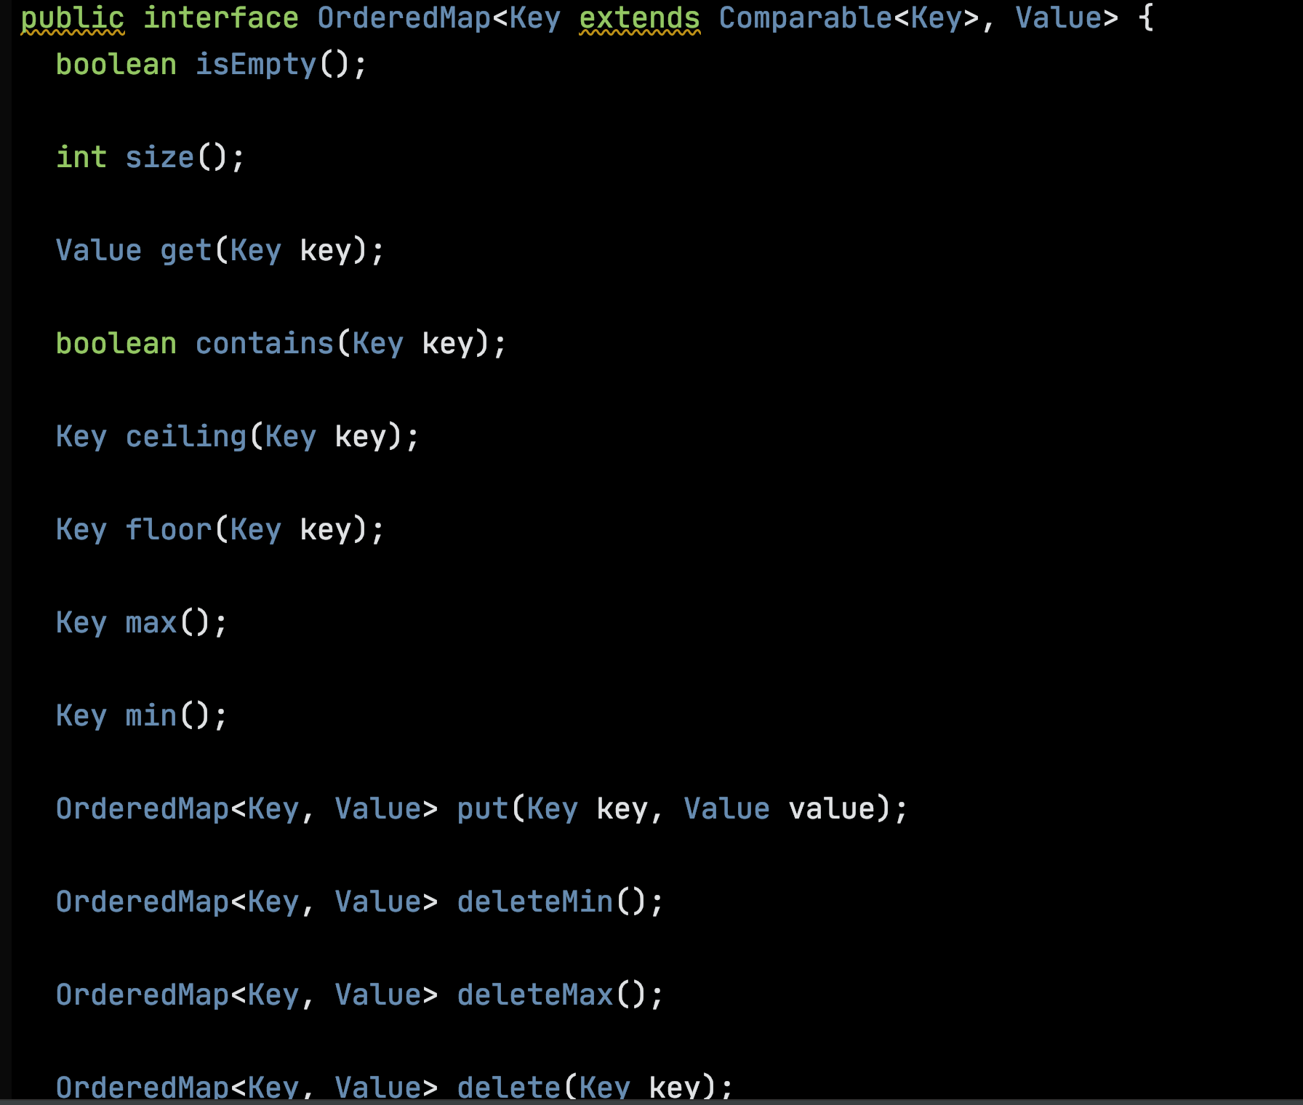
Making empty BSTs First-class
Public classes Node & Empty both implement
OrderedMap.

Slide 9
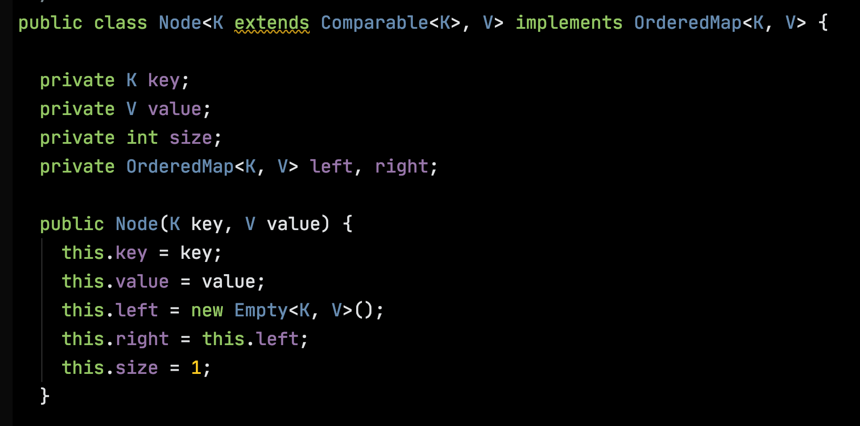

Slide 10
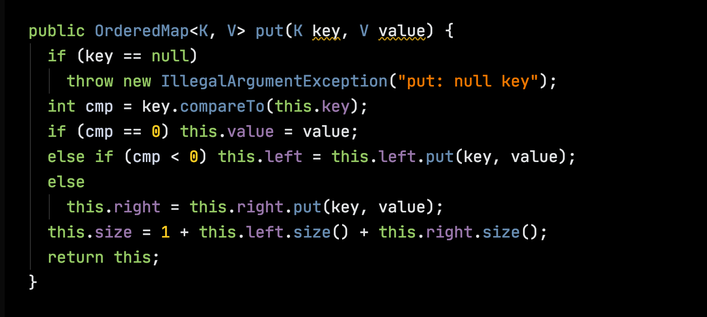

Slide 11
Immutable BSTs
Operations that might change a BST instead return a new one.
Structure Sharing

Slide 12
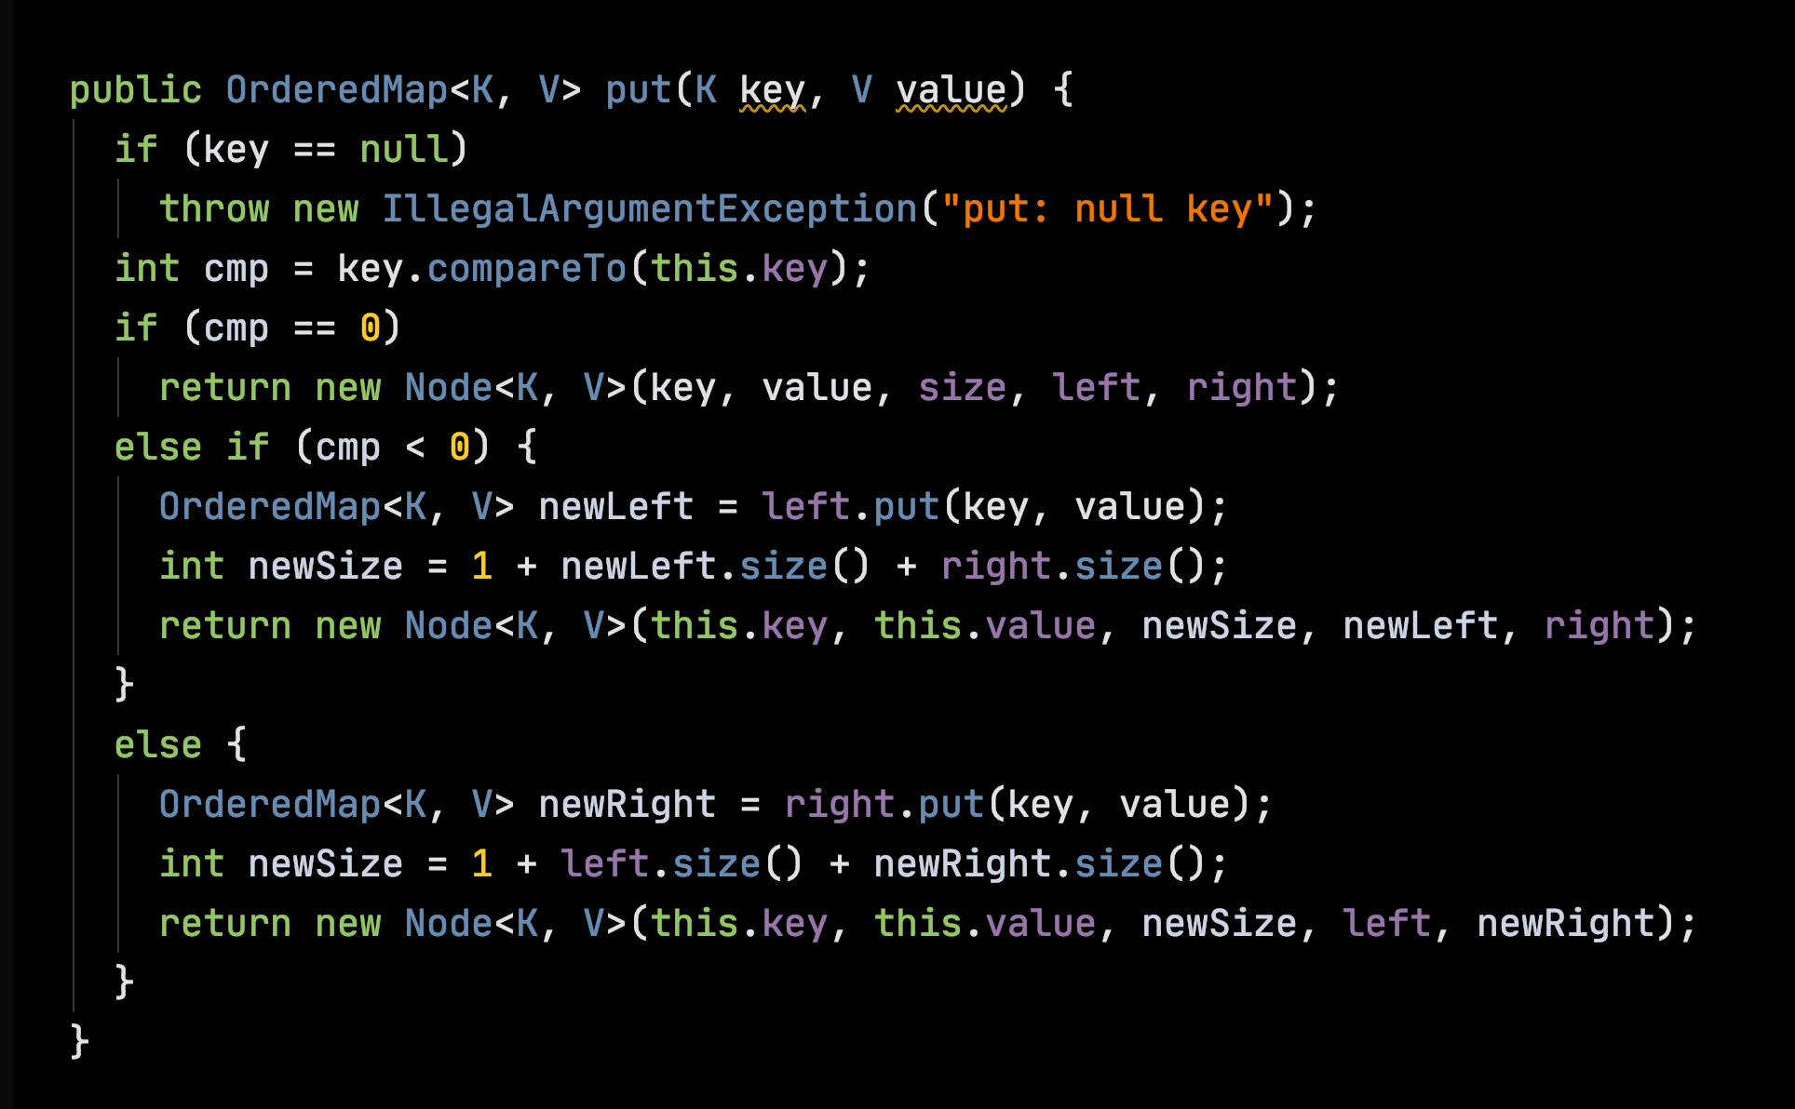

Slide 13
M
bst.put(L, 5)
Rebuilds all of the nodes on the path from the root to the insertion point.
H
R
E
K
L

Slide 15
Balanced Trees

Slide 16
2-3 Trees are Balanced all leaves at same depth
M
H P
t1
t2
t3
Keys less than H
Keys between H and P
Keys greater than P

Slide 17
2-3 Trees are Balanced all leaves at same depth
H P
C E
M
R W

Slide 18
Insert E
E

Slide 19
Insert M
E M

Slide 20
Insert R -- Split
E M R

Slide 21
Insert R -- Split
M
E M R
E
R

Slide 22
Insert C
M
C E
R

Slide 23
Insert H -- Split
M
C E H
R

Slide 24
Insert H -- Split
M
E M
C E H
R
C
H
R

Slide 25
Insert W
E M
C
H
R W

Slide 26
Insert P -- split
E M
C
H
P R W

Slide 27
Insert P -- split
E M
E M R
C
H
P R W
C
H
P
W

Slide 28
Split the root
M
E M R
E
R
C
H
P
W
C
H
P
W

Slide 29
Left-Leaning Red-Black Trees

Slide 30
Representing 3-nodes with colored 2-nodes
H P
t1
t2
t3

Slide 31
Representing 3-nodes with colored 2-nodes
P
H P
H
t1
t2
t3
t3
t1
t2

Slide 32
Representing 3-nodes with colored 2-nodes
P
H P
H
W
C E
M
R W
E
M
R
C

Slide 33
Invariants:
Path to every leaf passes through same number of black links;
Never 2 consecutive red links;
No node with 2 outgoing red links;
No right red links.
P
H
W
E
M
R
C

Slide 34
Tree Rotations

Slide 35
Rotate Left
H
t1
P
t2
t3

Slide 36
Rotate Left
H
P
t1
P
H
t3
t2
t3
t1
t2

Slide 37
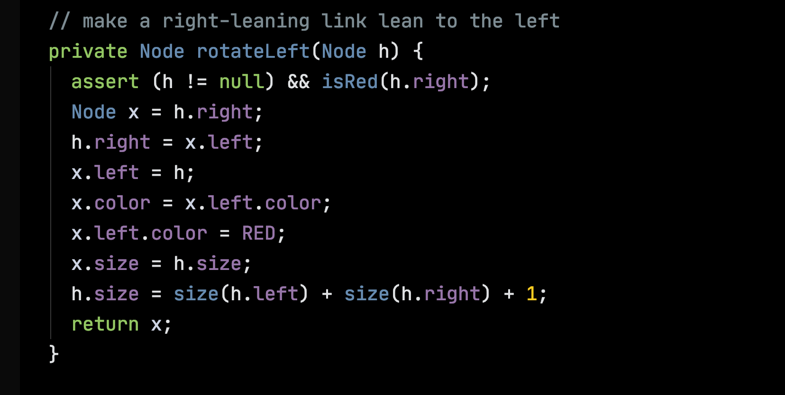

Slide 38
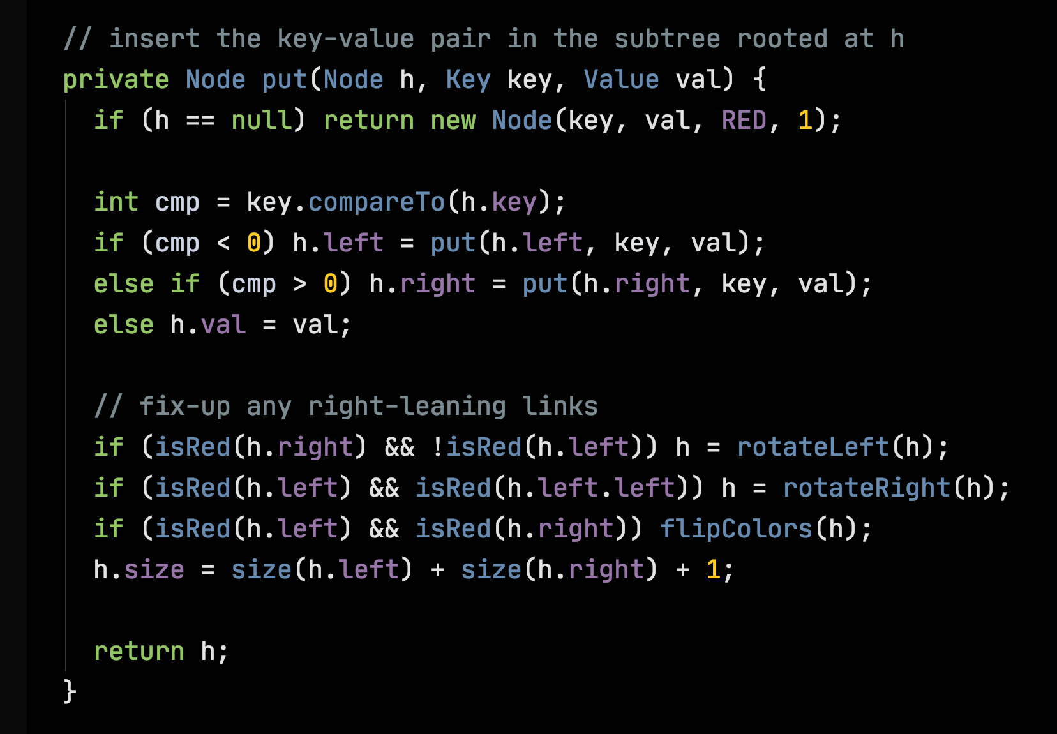

Slide 39
Rotate Right
P
H
t3
t1
t2

Slide 40
Rotate Right
P
H
H
P
t3
t1
t1
t2
t2
t3

Slide 41
Flip
P
P
t1
t2
t1
t2

Slide 42
Work

Slide 43
How Much?
How much time does an operation take?
How much memory does it use?
In the worst case? On average?
How does the work grow as the input grows?

Slide 44
Measure the Input Size – N
Units of Work
Input Size – N

