Slide 1
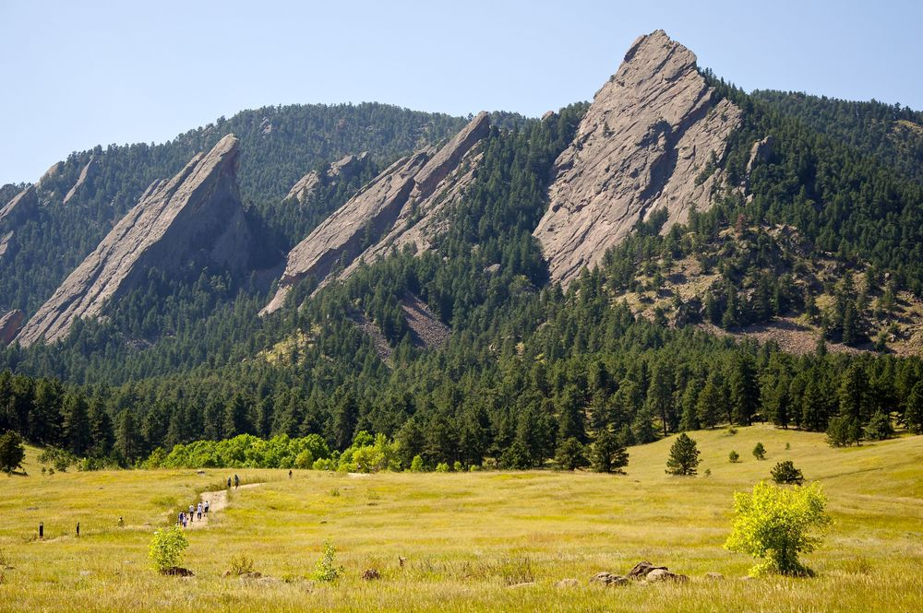
CSCI 1102 Computer Science 2
Meeting 22: Tuesday 4/20/2021
Review of this & Storage Diagrams

Slide 2

Barbara Liskov
Abstract Data Types
Turing Award 2008

Slide 3
Attribution & Creative Work
/* Part 1 is cribbed from … source … */
/* Algorithm A was partially inspired by … source … */
/* I had several long talks with Martha about threaded trees …. */
/* I found a related problem on geeksforgeeks.com and looked it over … */
/* A related problem was posed in my MATH class, some of the ideas here are drawn from a solution to that problem. */

Slide 4
Review of this & Storage Diagrams

Slide 5
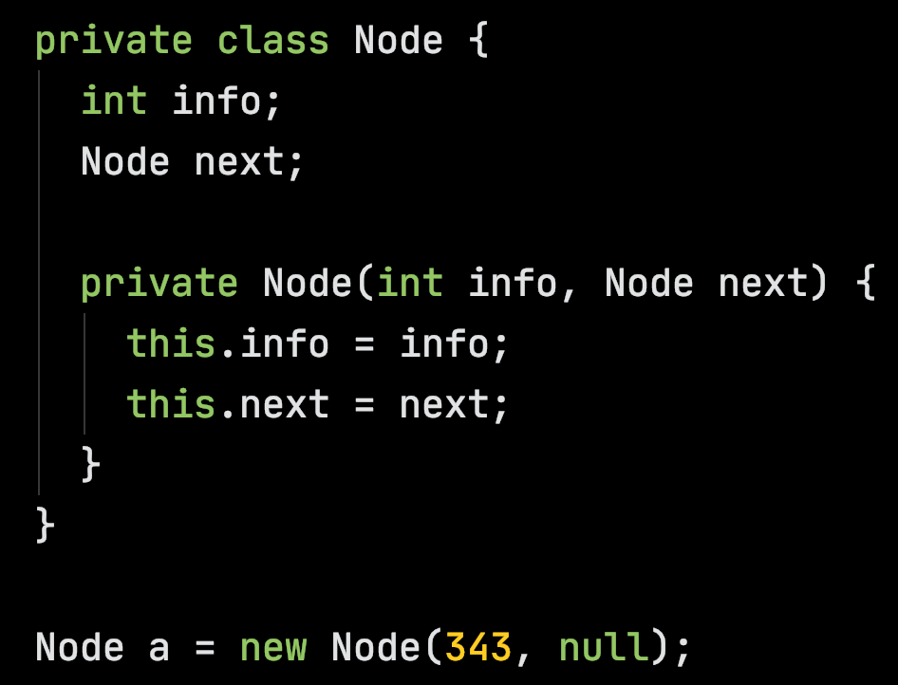
Heap
A Node object
methods:
info: 343
next:
a

Slide 6
Heap
We’ll ignore the methods for now
methods:
info: 343
next:
a

Slide 7
Heap
info: 343
next:
a

Slide 8
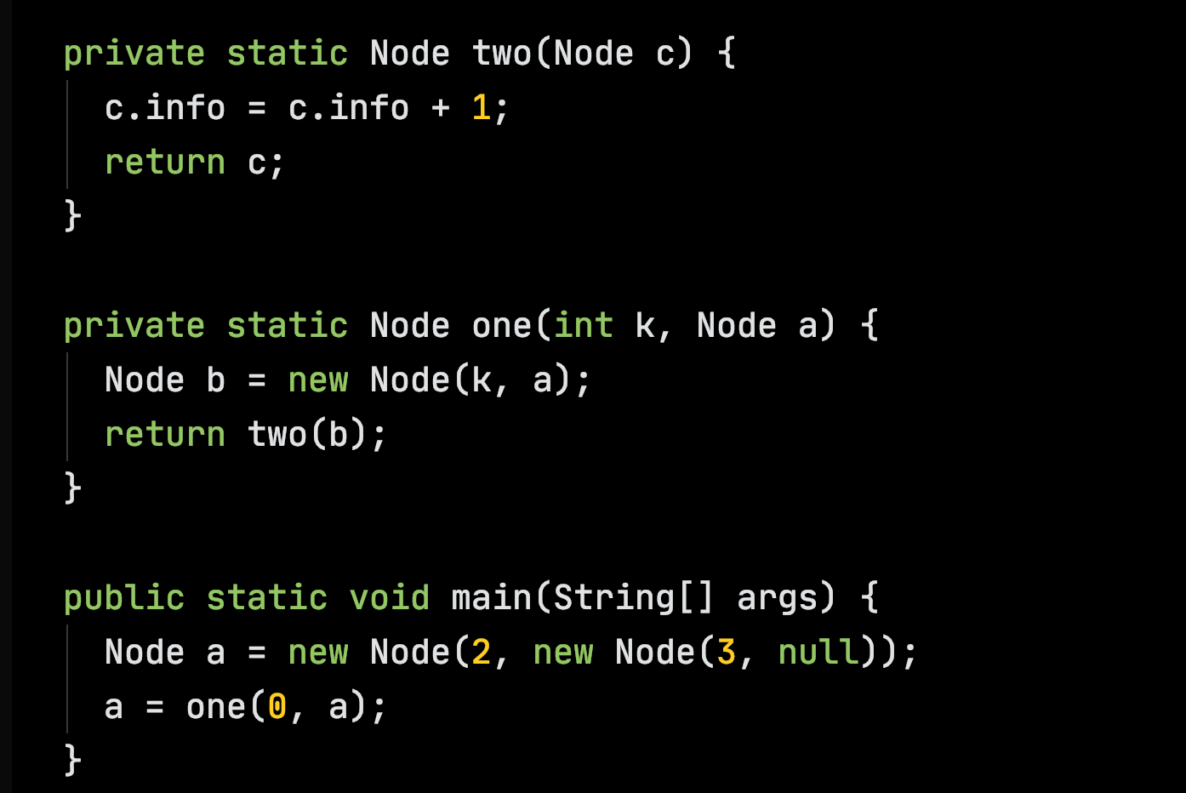

Slide 9
Stack
Heap
info: 2
next:
info: 3
main
next:
a:
args:

Slide 10
Stack
Heap
info: 0
next:
info: 2
one
k: 0
next:
b
a
info: 3
main
next:
a:
args:

Slide 11
Stack
Heap
info: 0
two
next:
c
info: 2
one
k: 0
next:
b
a
info: 3
main
next:
a:
args:

Slide 12
Stack
Heap
info: 1
two
next:
c
info: 2
one
k: 0
next:
b
a
info: 3
main
next:
a:
args:

Slide 13
Stack
Heap
info: 1
two
next:
c
info: 2
one
k: 0
next:
b
a
info: 3
main
next:
a:
args:

Slide 14
Stack
Heap
info: 1
next:
info: 2
one
k: 0
next:
b
a
info: 3
main
next:
a:
args:

Slide 15
Stack
Heap
info: 1
next:
info: 2
next:
info: 3
main
next:
a:
args:

Slide 16
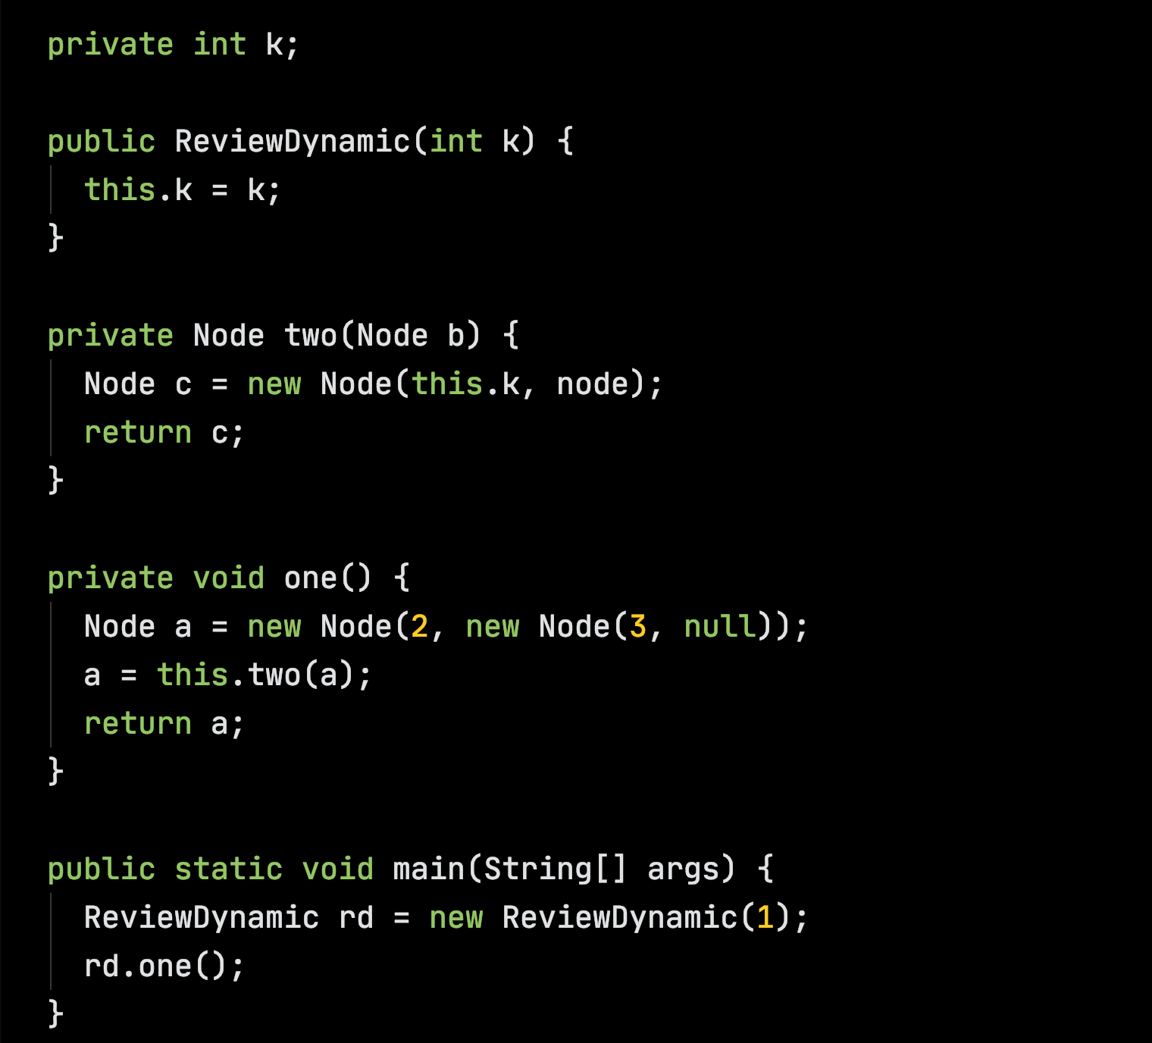

Slide 17
Stack
Heap
main
rd:
args:

Slide 18
Stack
Heap
this.k
ReviewDynamic
this:
k: 1
k:
main
rd:
args:

Slide 19
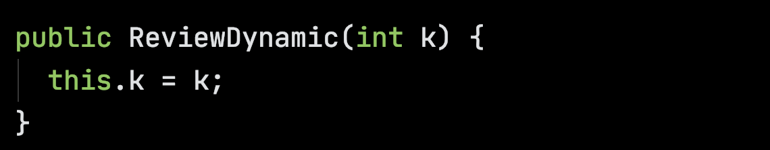
Stack
Heap
ReviewDynamic
this:
k: 1
k: 1
main
rd:
args:

Slide 20
Stack
Heap
ReviewDynamic
this:
k: 1
k: 1
main
rd:
args:

Slide 21
Stack
Heap
k: 1
main
rd:
args:

Slide 22
Stack
Heap
info: 2
rd.one
next:
a:
this:
k: 1
info: 3
main
next:
rd:
args:

Slide 23
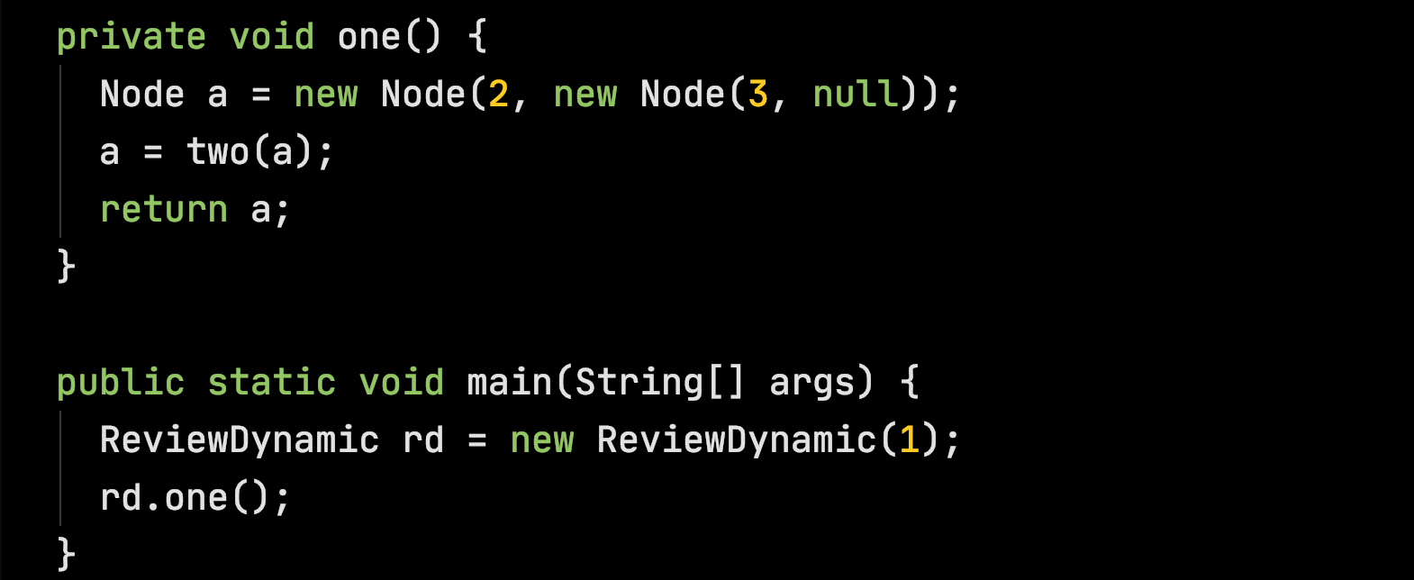
Stack
Heap
info: 2
rd.one
next:
a:
this:
k: 1
info: 3
main
next:
rd:
args:

Slide 24
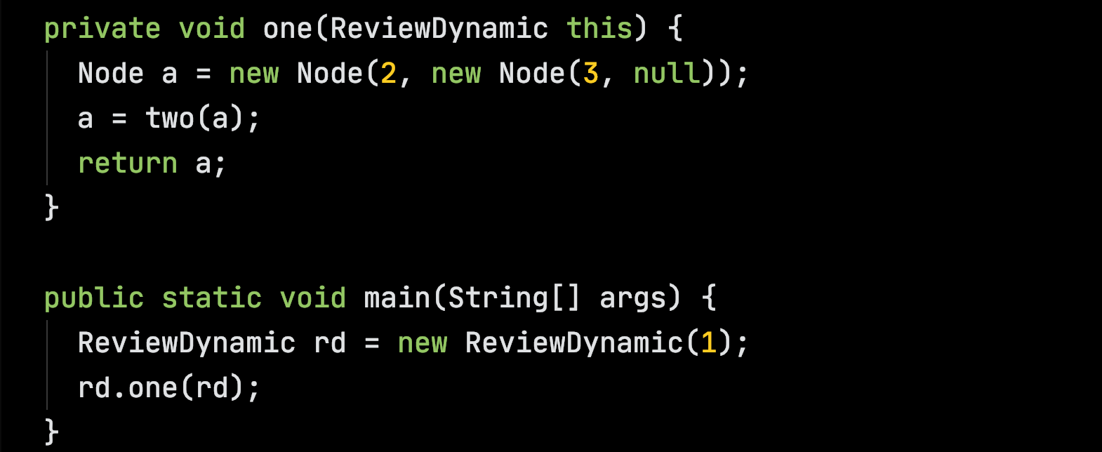
Stack
Heap
Compiler adds this parameter and extra argument
info: 2
rd.one
next:
a:
this:
k: 1
info: 3
main
next:
rd:
args:

Slide 25
Stack
Heap
info: 2
rd.one
next:
a:
this:
k: 1
info: 3
main
next:
rd:
args:

Slide 26
Stack
Heap
info: 1
rd.two
next:
c:
b:
this:
info: 2
rd.one
next:
a:
this:
k: 1
info: 3
main
next:
rd:
args:

Slide 27
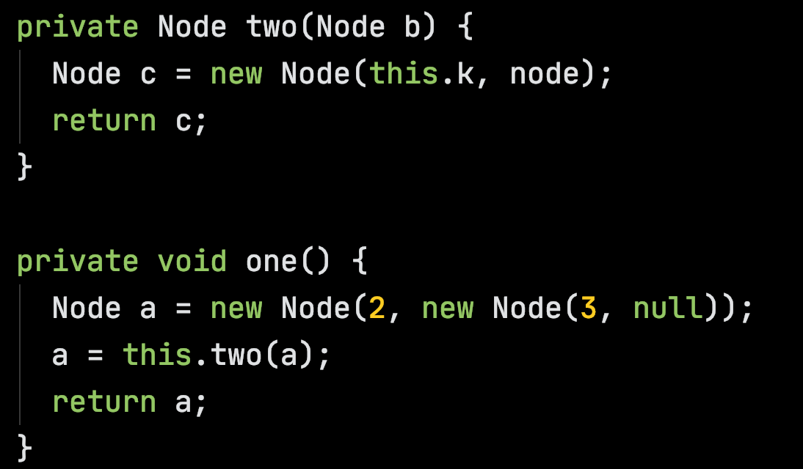
Stack
Heap
info: 1
rd.two
next:
c:
b:
this:
info: 2
rd.one
next:
a:
this:
k: 1
info: 3
main
next:
rd:
args:

Slide 28
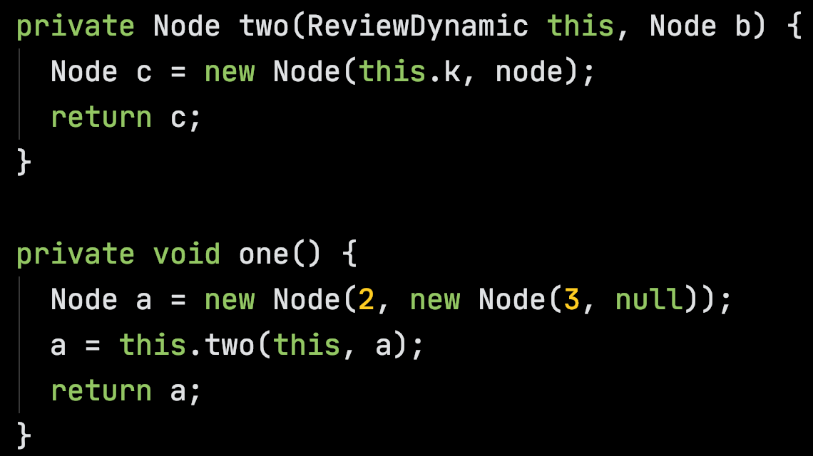
Stack
Heap
info: 1
rd.two
next:
c:
b:
this:
info: 2
rd.one
next:
a:
this:
k: 1
info: 3
main
next:
rd:
args:

Slide 29
Stack
Heap
info: 1
rd.two
next:
c:
b:
this:
info: 2
rd.one
next:
a:
this:
k: 1
info: 3
main
next:
rd:
args:

Slide 30
Stack
Heap
info: 1
rd.two
next:
c:
b:
this:
info: 2
rd.one
next:
a:
this:
k: 1
info: 3
main
next:
rd:
args:

Slide 31
Stack
Heap
info: 1
next:
info: 2
rd.one
next:
a:
this:
k: 1
info: 3
main
next:
rd:
args:

Slide 32
Stack
Heap
info: 1
next:
info: 2
rd.one
next:
a:
this:
k: 1
info: 3
main
next:
rd:
args:

Slide 33
Stack
Heap
info: 1
next:
info: 2
next:
k: 1
info: 3
main
next:
rd:
args:

Slide 34
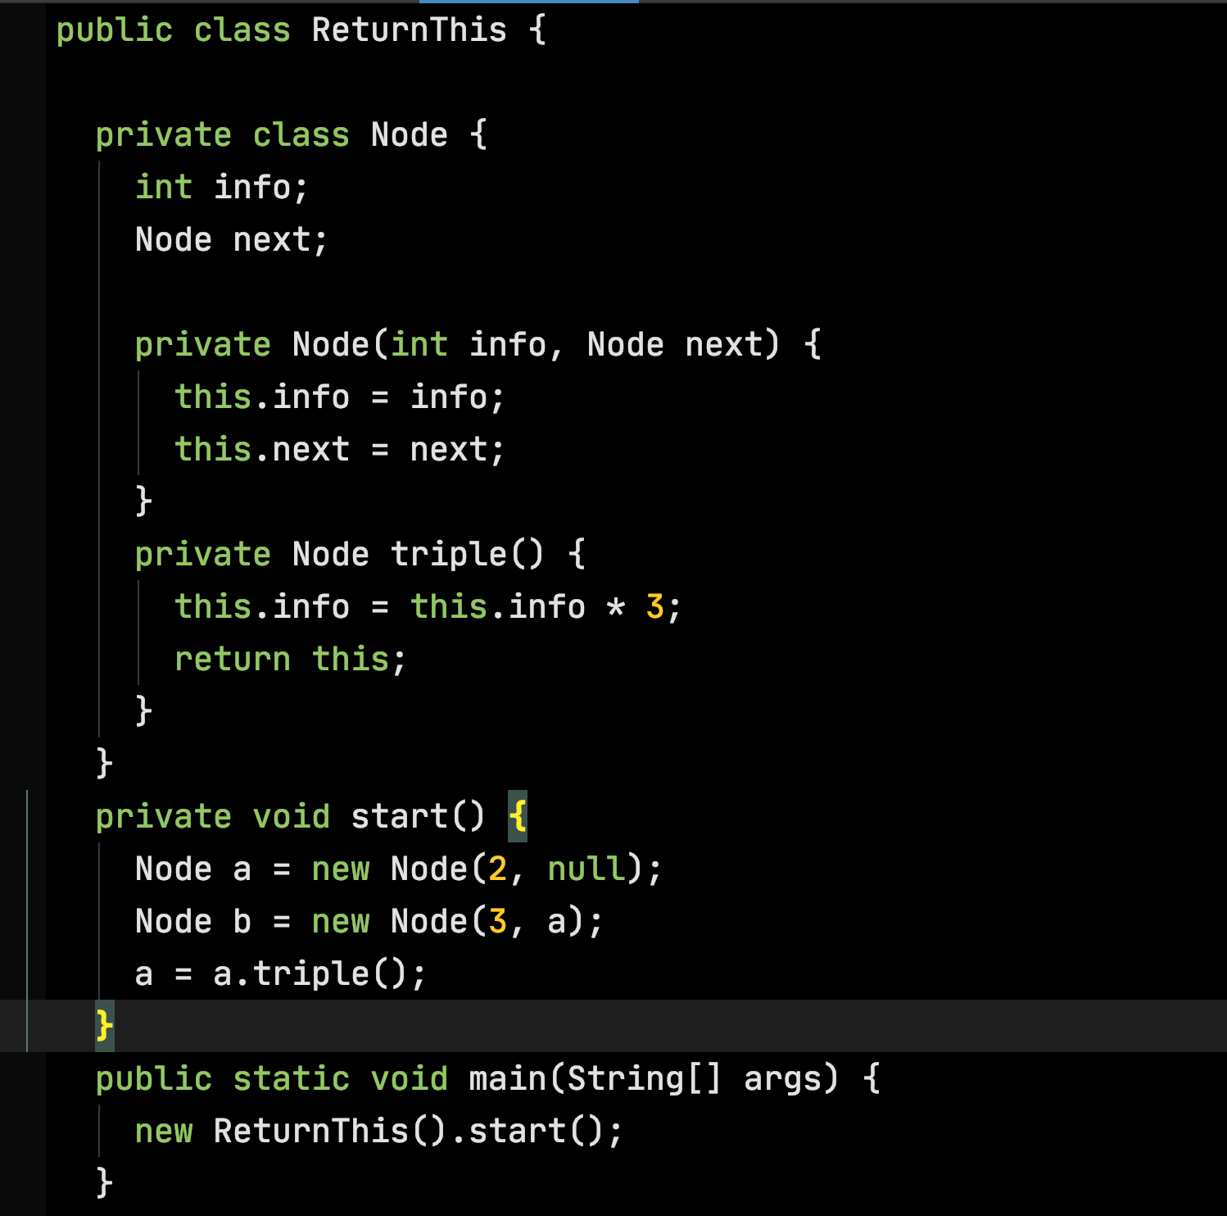

Slide 35
Stack
Heap
main
args:

Slide 36
Stack
Heap
info: 3
start
next:
b:
a:
info: 2
this:
…
next:
main
args:

Slide 37
Stack
Heap
a.triple
this:
info: 3
start
next:
b:
a:
info: 2
this:
next:
main
args:

Slide 38
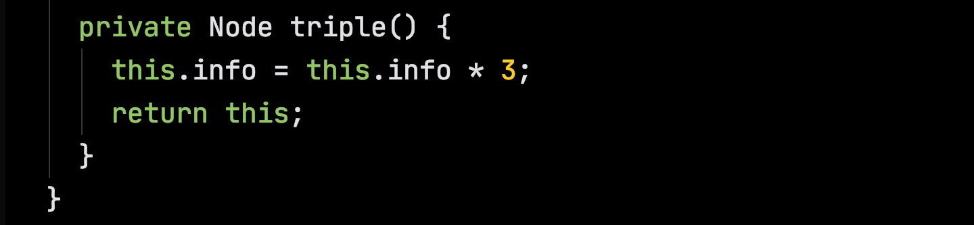
Stack
Heap
a.triple
this:
info: 3
start
next:
b:
a:
info: 6
this:
next:
main
args:

Slide 39
Stack
Heap
a.triple
this:
info: 3
start
next:
b:
a:
info: 6
this:
next:
main
args:

