Slide 1
CSCI 1103 CS 1 Honors
Meeting 23: Tuesday 11/8
Working with Memory

Slide 2
ADD SUB MUL DIV
MOV LI LOD STO
CMP BEQ BLT BGT
JMP JSR R HLT

Slide 3
ADD SUB MUL DIV
MOV LI LOD STO
CMP BEQ BLT BGT
JMP JSR R HLT

Slide 4
LOD Rd, disp(Rs)
STO Rs, disp(Rt)

Slide 5
Memory: Numbered 8-bit Storage Cells
Address
0x00
0000
0x00
Integers
0001
Addresses are natural numbers
0x00
0002
0x00
0003

Slide 6
2-byte Words
Address
0x0000
0000
0x0000
0002
0x8F24
0004
0x0000
0006

Slide 7
Loading
Address
0x0000
0xFFFF
0000
R0
0x0000
0002
0x0004
R2
0x8F24
0004
0x0000
LOD R0, 0(R2)
0006

Slide 8
Loading
Address
0x0000
0x8F24
0000
R0
0x0000
0002
0x0004
R2
0x8F24
0004
0x0000
LOD R0, 0(R2)
0006

Slide 9
Storing
Address
0x0000
0xFFFF
0000
R0
0x0000
0002
0x0004
R2
0x8F24
0004
0x0000
STO R0, 0(R2)
0006

Slide 10
Storing
Address
0x0000
0xFFFF
0000
R0
0x0000
0002
0x0004
R2
0xFFFF
0004
0x0000
STO R0, 0(R2)
0006

Slide 11
Offsets
Address
0x0000
0xFFFF
0000
R0
0x0000
0002
0x0004
R2
0x8F24
0004
0x0000
STO R0, -2(R2)
0006

Slide 12
Offsets
Address
0x0000
0xFFFF
0000
R0
0xFFFF
0002
0x0004
R2
0x8F24
0004
0x0000
STO R0, -2(R2)
0006

Slide 13
Offsets
type t = { a : int
; b : int
; c : int
}

Slide 14
Offsets are known by the Compiler
type t = { a : int
; b : int
; c : int
}
a = 0
b = 2
c = 4

Slide 15
Offsets
let p = { a = 10
; b = 20
; c = 30
}

Slide 16
Offsets
Address
let p = { a = 10
; b = 20
; c = 30
}
0x0000
0x0000
R0
0000
a
0x000A
0x0002
0002
R2
p
b
0x0014
0004
c
0x001E
0006

Slide 17
Addresses as Arrows/Pointers
Address
let p = { a = 10
; b = 20
; c = 30
}
0x0000
0x0000
R0
0000
0x000A
0x0002
0002
R2
p
0x0014
0004
0x001E
0006

Slide 18
Field Access
q
Address
let p = { a = 10
; b = 20
; c = 30
}
let q = p.b
0x0000
0x0000
R0
0000
0x000A
0x0002
0002
R2
p
0x0014
0004
0x001E
0006

Slide 19
Field Access
q
Address
let p = { a = 10
; b = 20
; c = 30
}
let q = p.b
0x0000
0x0000
R0
0000
0x000A
0x0002
0002
R2
p
0x0014
0004
0x001E
0006
Lod R0, 2(R2)

Slide 20
Field Access
q
Address
let p = { a = 10
; b = 20
; c = 30
}
let q = p.b
0x0014
0x0000
R0
0000
0x000A
0x0002
0002
R2
p
0x0014
0004
0x001E
0006
Lod R0, 2(R2)

Slide 21
(20, 30)

Slide 22
(20, 30)
Address
0x07FA
0x0000
R0
0000
…
0002
…
0004
…
0x0014
07FA
0x001E
07FC

Slide 23
(10, (20, 30))

Slide 24
(10, (20, 30))
Address
0x0002
0x0000
R0
0000
0x000A
0002
0x07FA
0004
…
0x0014
07FA
0x001E
07FC

Slide 25
Block Storage & Linked Storage
Consecutive words drawn side by side, i.e., 2-word blocks
0x0004
30 :: []
0x001E
0

Slide 26
Block Storage & Linked Storage
Consecutive words drawn side by side, i.e., 2-word blocks
0x0004
0x0014
20 :: 30 :: []
0x001E
0

Slide 27
Block Storage & Linked Storage
Consecutive words drawn side by side, i.e., 2-word blocks
0x000A
0x0004
0x0014
10 :: 20 :: 30 :: []
0x001E
0

Slide 28
Block Storage & Linked Storage
Consecutive words drawn side by side, i.e., 2-word blocks
0x000A
0x0004
0x0014
3 cons cells likely far away from one another in RAM
0x001E
0

Slide 29
Block Storage & Linked Storage
0x000A
0000
0x0014
0002
0x001E
0004
-1
0006

Slide 30
Block Storage & Linked Storage
3
0000
Array
[| 10; 20; 30 |]
0x000A
0002
0x0014
0004
0x001E
0006

Slide 31
Motherboard
CPU
RAM
SSD

Slide 32
CPU
Other Registers
ALU In 1
ALU In 2
Program Counter
Instruction Register
Arithmetic
& Logic Unit
Memory Address Register
Memory Data Register
ALU Out
CACHE

Slide 33
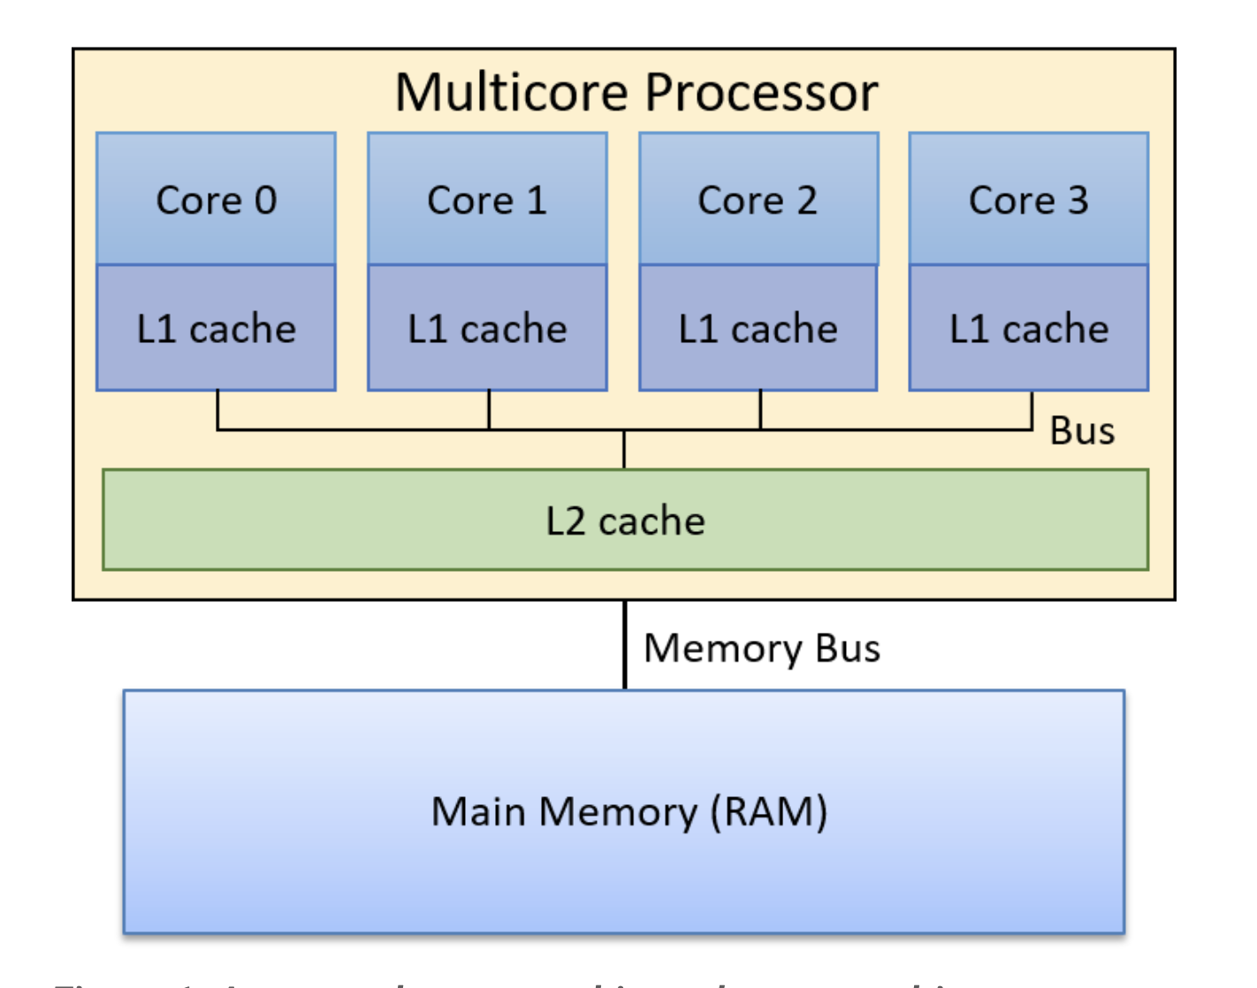

Slide 34
