Slide 1
CSCI 1103 CS 1 Honors
Meeting 26: Friday 10/30
Applications: Working with Digital Audio

Slide 2
Today
Sound Waves
Analog Recording
Pulse Code Modulation and Digital Recording
Uncompressed Sound Protocols:
CDs, Wave Files
Working with Wave Files
Sound Protocols with Compression:
MP3s

Slide 3
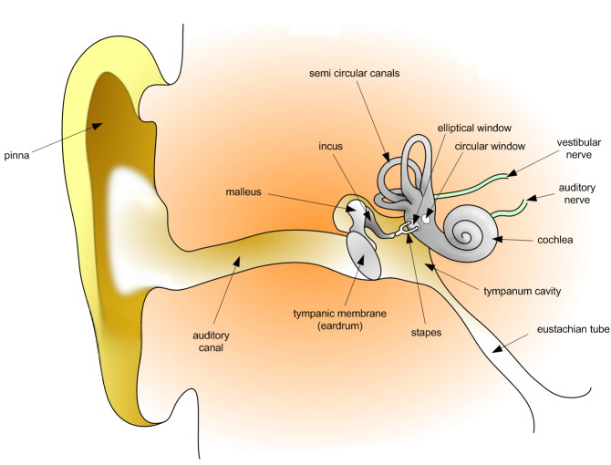
Humans “hear” Fluctuations in Air Pressure

Slide 4
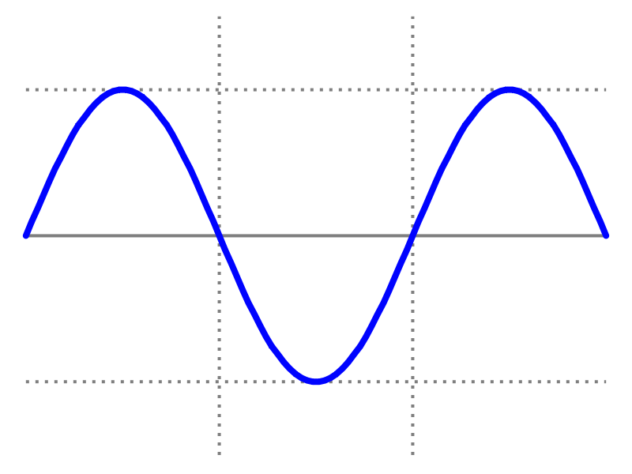
Waves
length of a complete wave (cycle)
measured in meters (m)
amplitude

Slide 5
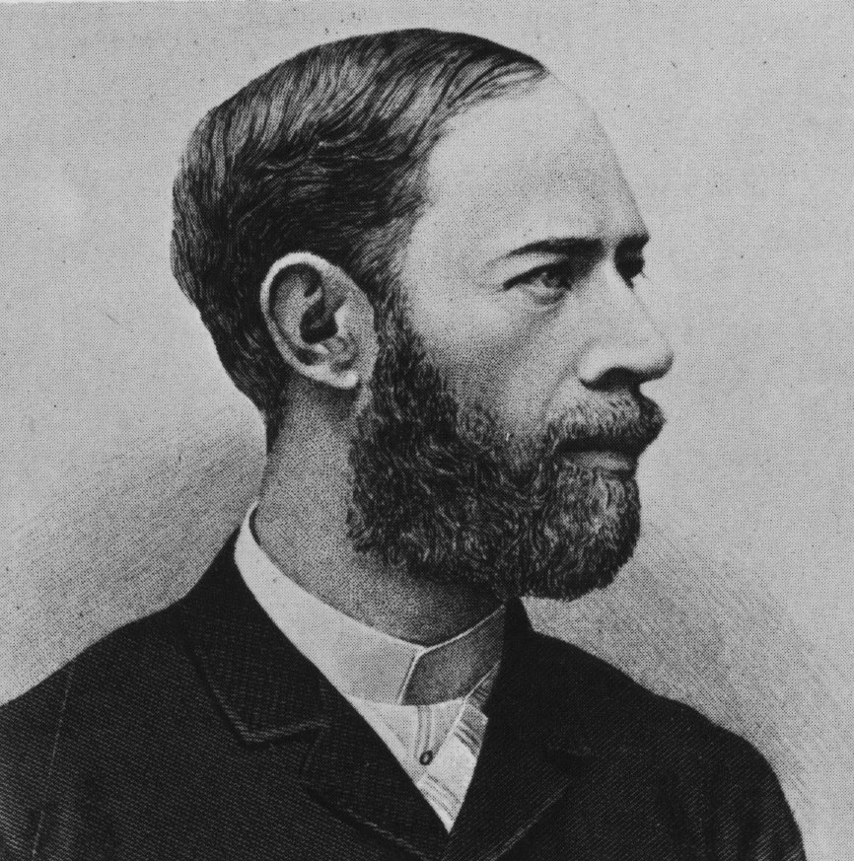
Frequency
Cycles per second
Measured in Hertz (Hz, hz)

Slide 6
Amplitude = Loudness
Frequency = Pitch

Slide 7
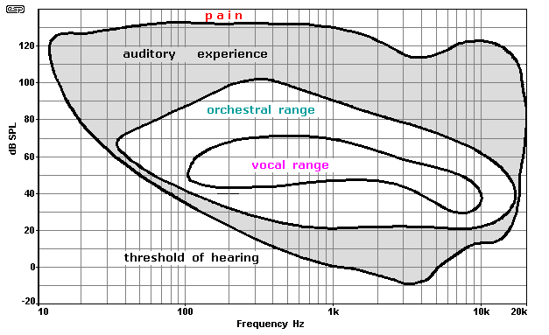
Human Hearing: 20Hz – 20KHz; Speech: 340Hz – 3KHz

Slide 8
Recording Audio
Audio signal sensed by a transducer and recorded on a physical artifact, i.e., a record
Record has a co-designed “player” that uses the recording to reconstruct the recorded signal and to amplify it so that it can drive a “speaker” which emits the acoustic signal

Slide 9
Transducers
A transducer is a device that converts one type of energy to another or to a physical attribute.
Examples: Ears, Microphones, Speakers, Voice Boxes, Radios, Televisions, Sonar Devices, ….

Slide 10
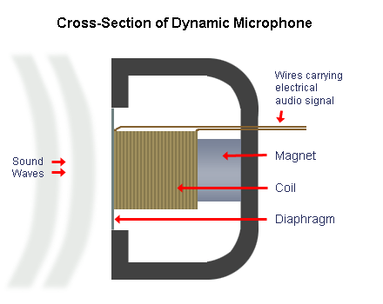
Transducers : microphones e.g.

Slide 11
Pulse Code Modulation
Break time up into discrete intervals;
Record the integer quantifying the amplitude at each interval;
The audio signal is represented by the sequence of discrete samples.

Slide 12
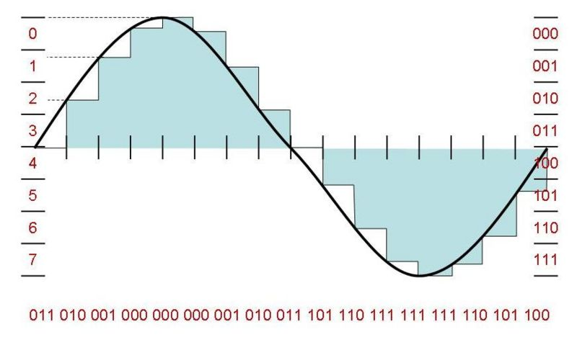
Digital Audio and PCM

Slide 13
Digital Audio
Bit Depth : How many bits are used to record a given amplitude. We’ll use 16-bit samples.
Sample Rate : How many samples are required for one second? CDs use 44.1K samples/sec. We’ll use 11,025 samples/sec.

Slide 14
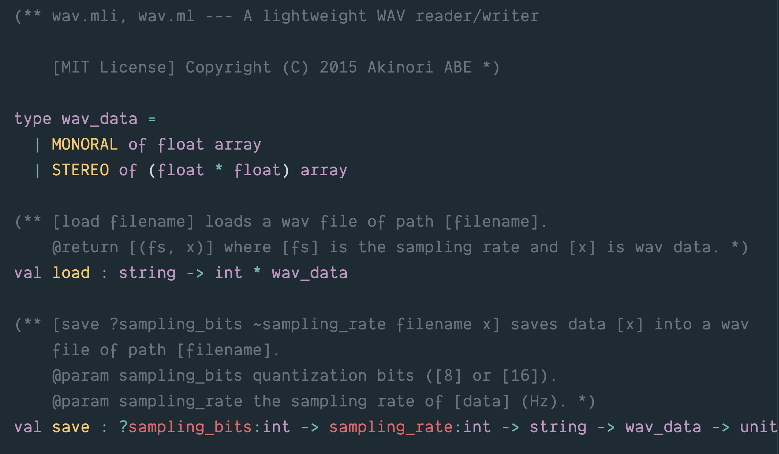
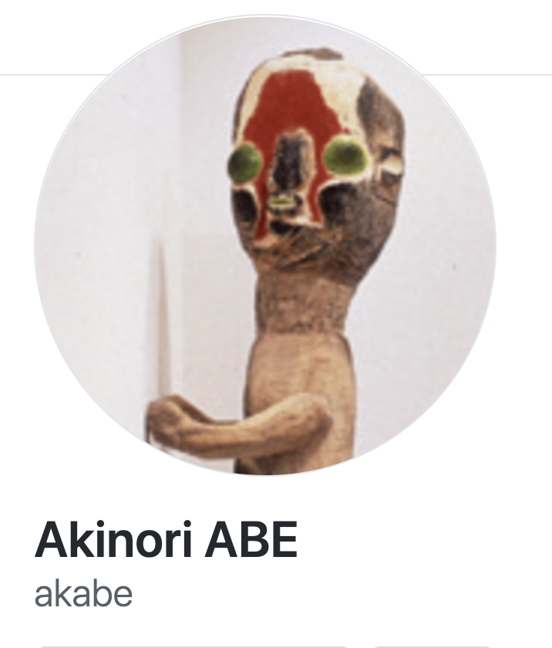

Slide 15
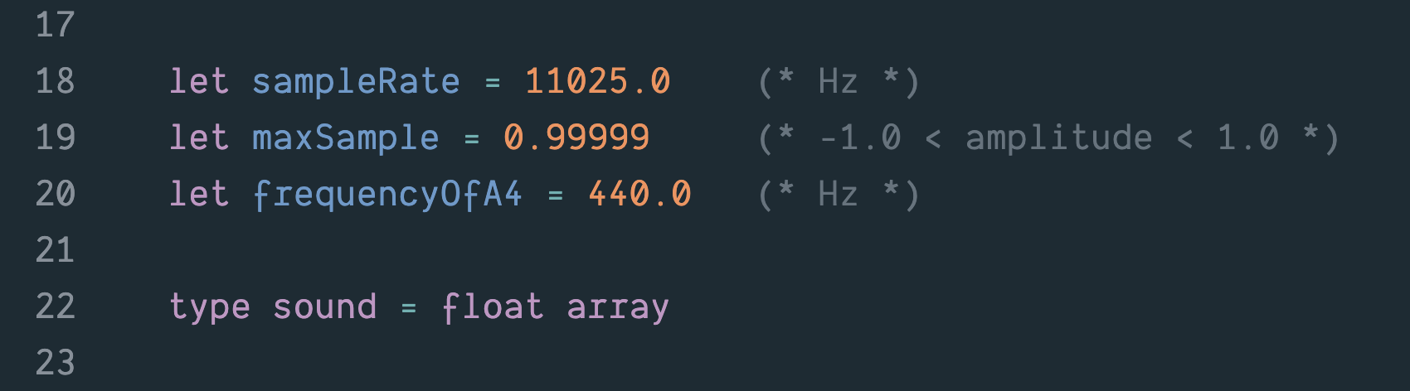

Slide 16
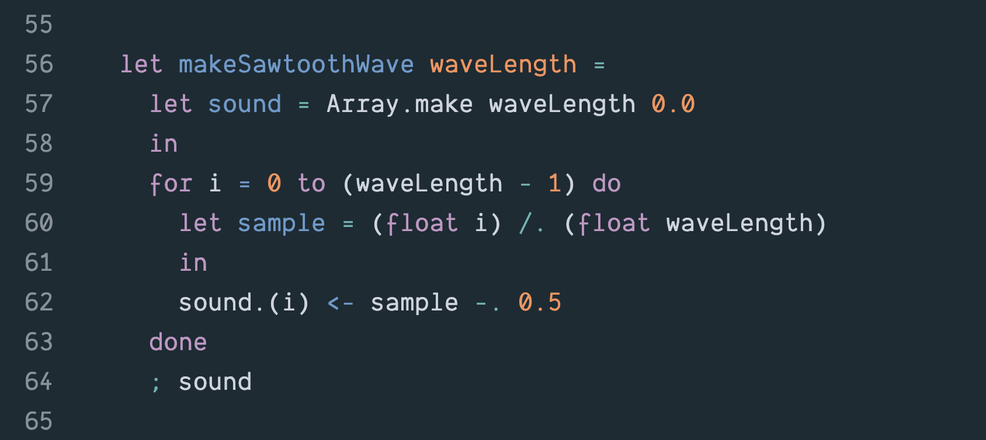

Slide 17
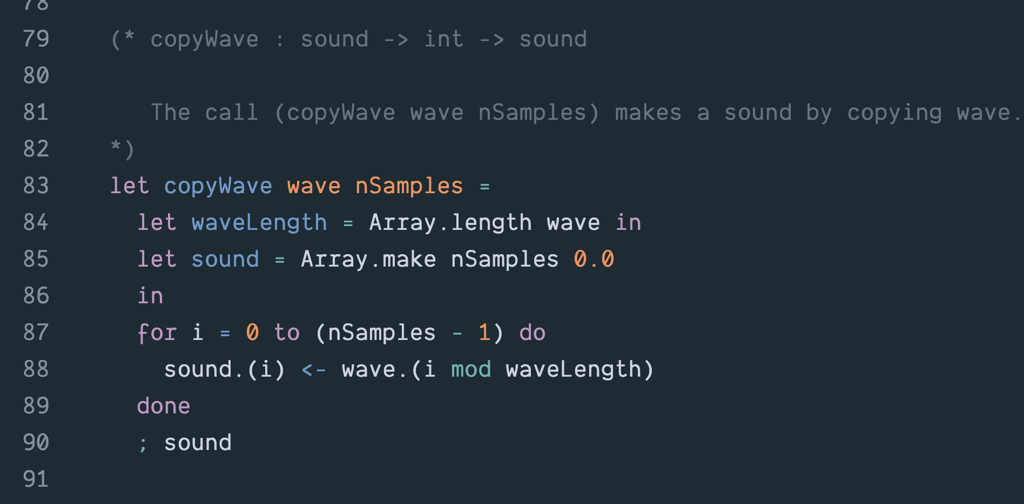

Slide 18
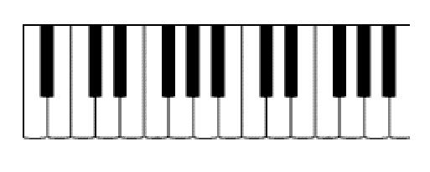
A3
Middle C
A4

Slide 19
220 Hz
440 Hz
A3
Middle C
A4

Slide 20
Well-tempered Scale
What frequency is associated with a give note?
Given a frequency f₀ of some fixed note, (typically A4 = 440Hz):
f_{n} = f₀ * 2^{n/12}
where n is the number of half-steps from f₀.

Slide 21
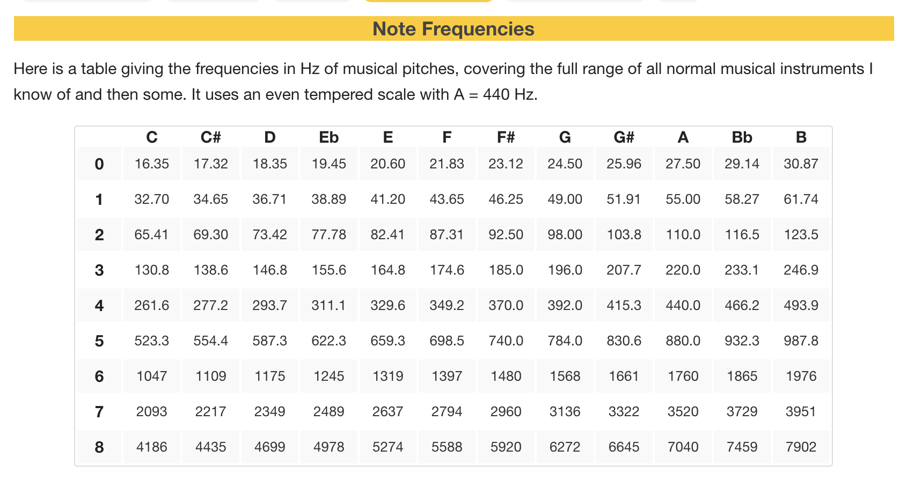

Slide 22
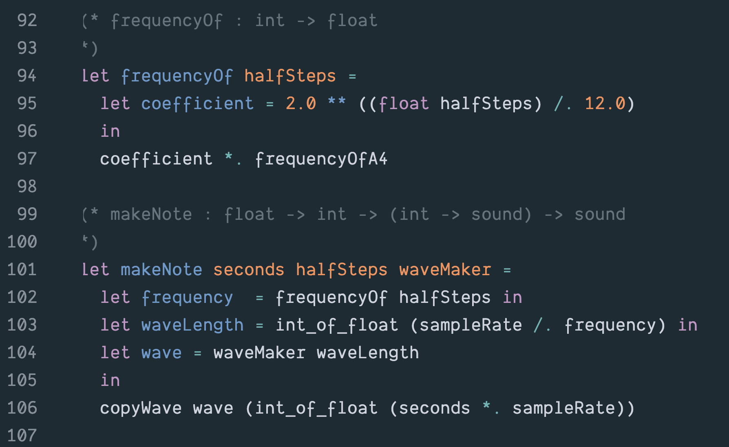

Slide 23
Nyquist/Shannon Sampling Theorem
If a signal contains no frequencies higher than W cycles per second, it is completely determined by giving its ordinates at a series of points spaced 1/(2W) seconds apart.

Slide 24
Psychoacoustic Factors
Since most humans top-out at 22KHz, recordings that sample at 44KHz should capture everything that humans can hear.
Most experts believe that humans can only resolve between 16 and 18 bits per sample.

Slide 25
Digital Audio
Various representation protocols, some proprietary, some public
representation protocols and format information packed into “headers”
software parses the header to “understand” the layout of the data

Slide 26
Digital Audio
Bit-stream may or may not:
be packaged-up with error detection/correction information
be compressed
be encrypted (e.g., Digital Rights Management DRM). More on these topics later

Slide 27
Uncompressed Digital Audio
Sony Compact Discs
Microsoft WAV Files

Slide 28
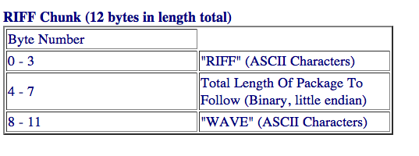
WAV Protocol
Microsoft WAV protocol : uncompressed PCM
3 Chunks:

Slide 29
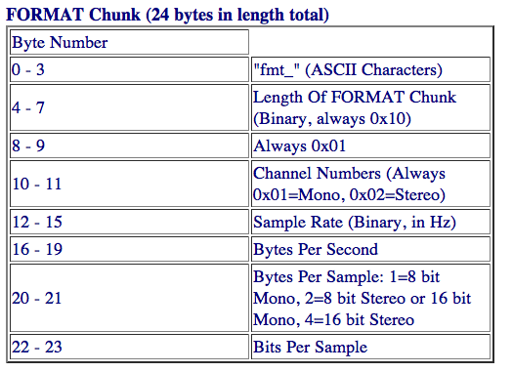
WAV Format Chunk

Slide 30
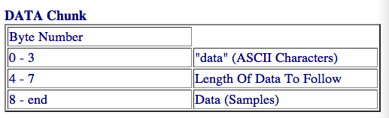
WAV Data Chunk

Slide 31
Compressed Digital Audio
Many different protocols: MP3, OGG, ACC, M4p, …
MP3: a de facto standard, reasonable fidelity + small size
Motion Picture Experts Group (MPEG)
1991: MPEG-1 Standard, Audio Layer 3, aka MP3 (not to be confused with MPEG-3).
User specifies desired bits/sec for audio. E.g., at 128 bps, 11 X compression .vs. CD file.
Uses both lossy and lossless compression

Slide 32
Compression
Lossless Compression: the data can be compressed and then expanded without loss of information (more on this later)
Lossy Compression: when we compress the data we’ll lose information (but it won’t matter)

