Slide 1
CSCI 1103 CS 1 Honors
Meeting 26: Friday 10/30
Applications: Working with Digital Audio

Slide 2
Today
Sound Waves
Analog Recording
Pulse Code Modulation and Digital Recording
Uncompressed Sound Protocols:
CDs, Wave Files
Working with Wave Files
Sound Protocols with Compression:
MP3s

Slide 3
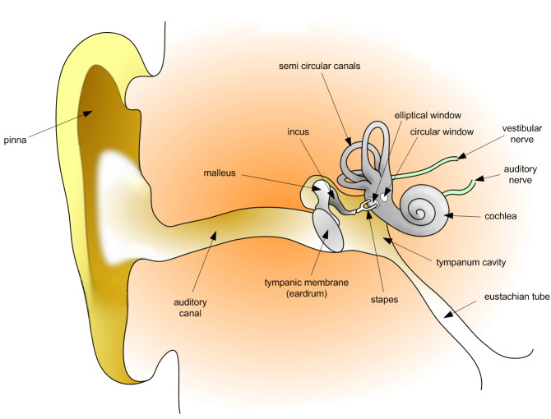
Humans “hear” Fluctuations in Air Pressure

Slide 4
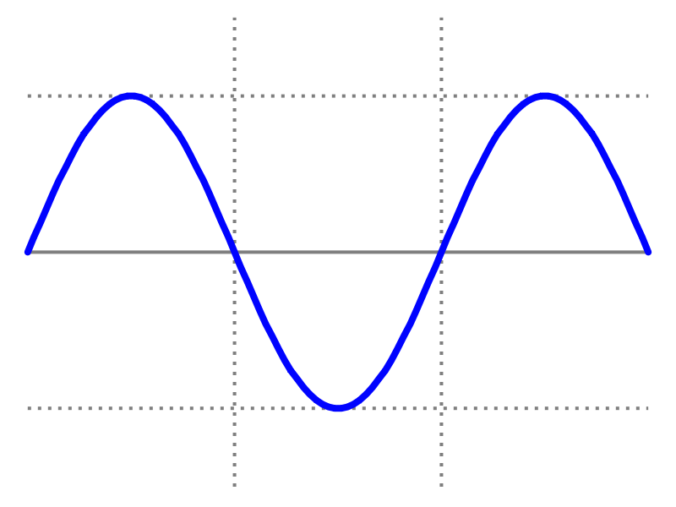
Waves
length of a complete wave (cycle)
measured in meters (m)
amplitude

Slide 5
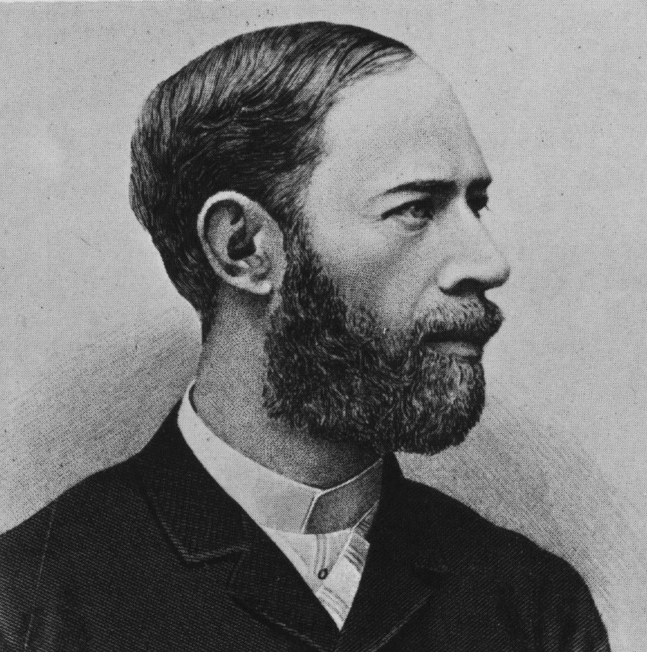
Frequency
Cycles per second
Measured in Hertz (Hz, hz)

Slide 6
Amplitude = Loudness
Frequency = Pitch

Slide 7
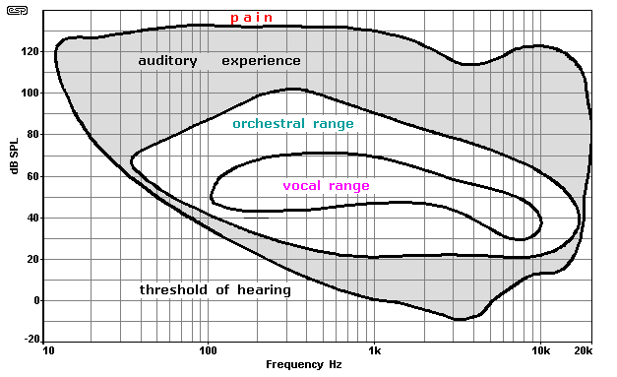
Human Hearing: 20Hz – 20KHz; Speech: 340Hz – 3KHz

Slide 8
Waves are Additive

Slide 9
Asynchronous Waves

Slide 10
Waves are Additive
Audio signal

Slide 11
Recording Audio
Audio signal sensed by a transducer and recorded on a physical artifact, i.e., a record
Record has a co-designed “player” that uses the recording to reconstruct the recorded signal and to amplify it so that it can drive a “speaker” which emits the acoustic signal

Slide 12
Transducers
A transducer is a device that converts one type of energy to another or to a physical attribute.
Examples: Ears, Microphones, Speakers, Voice Boxes, Radios, Televisions, Sonar Devices, ….

Slide 13
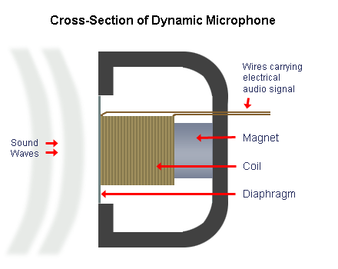
Transducers : microphones e.g.

Slide 14
Pulse Code Modulation
Break time up into discrete intervals;
Record the integer quantifying the amplitude at each interval;
The audio signal is represented by the sequence of discrete samples.

Slide 15
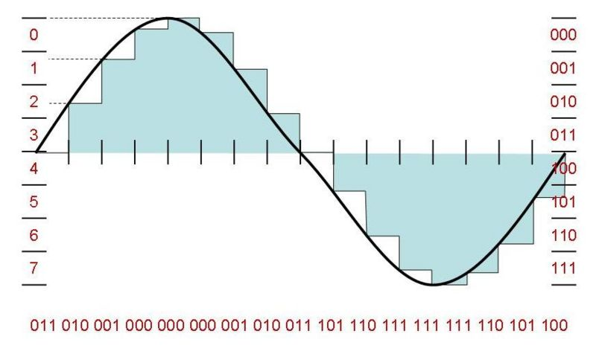
Digital Audio and PCM

Slide 16
Digital Audio
Bit Depth : How many bits are used to record a given amplitude. We’ll use 16-bit samples.
Sample Rate : How many samples are required for one second? CDs use 44.1K samples/sec. We’ll use 11,025 samples/sec.

Slide 17
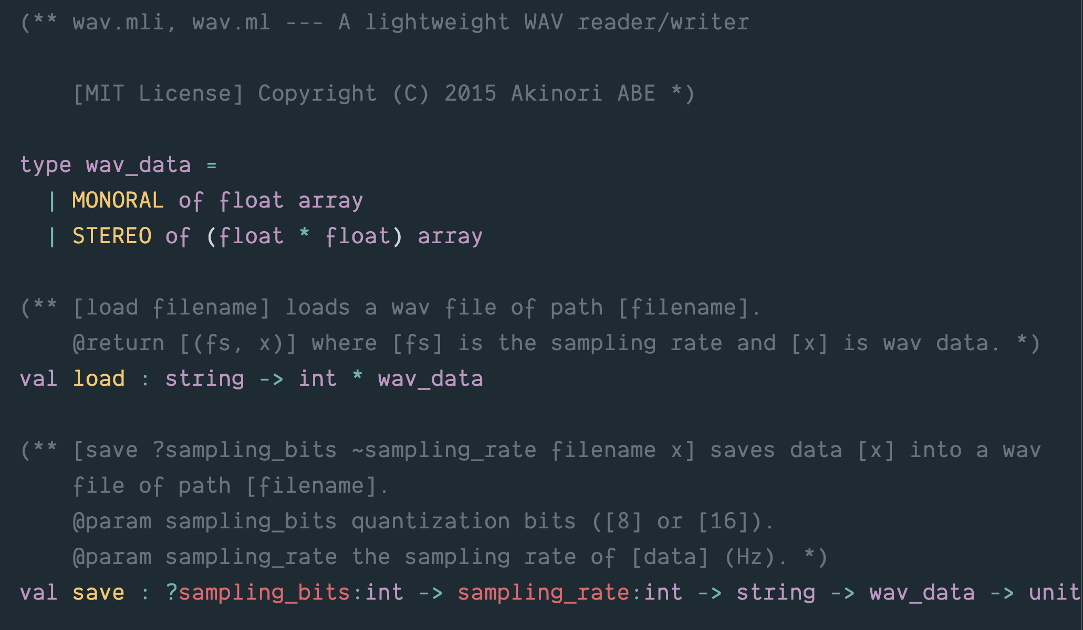
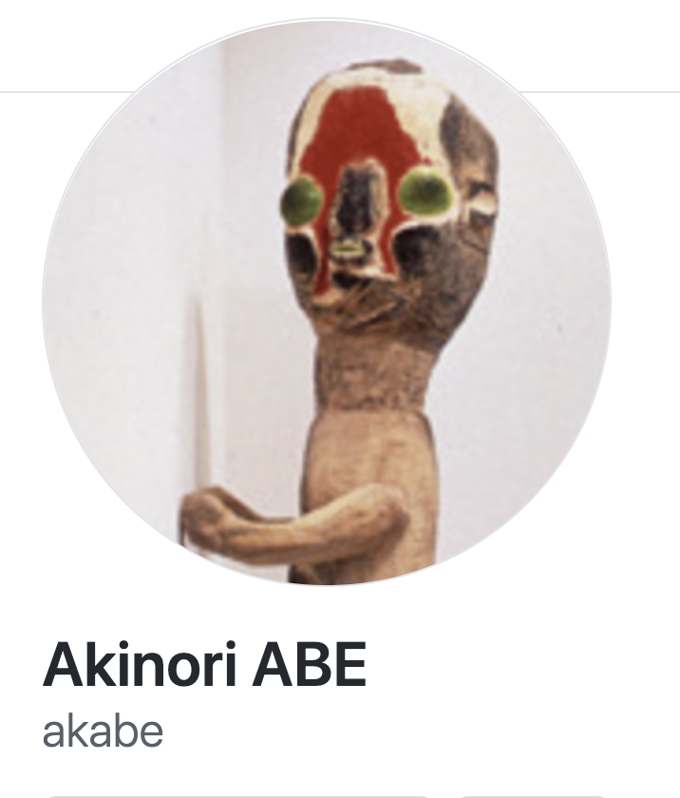

Slide 18
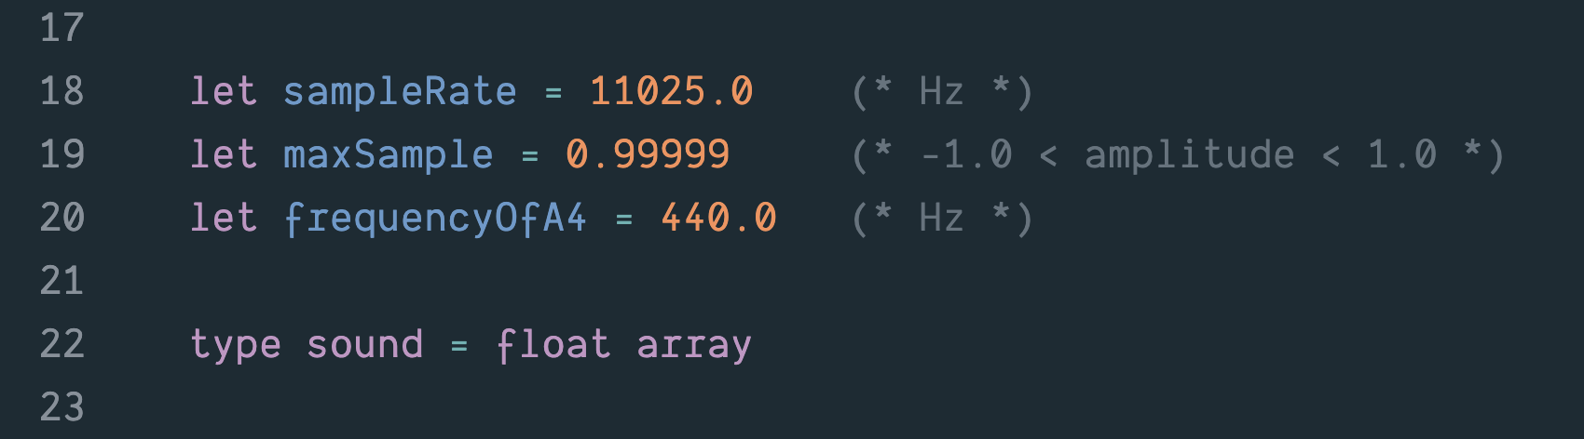

Slide 19
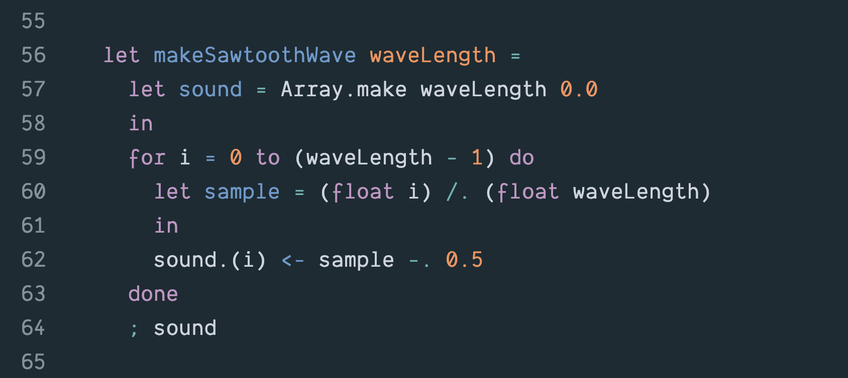

Slide 20
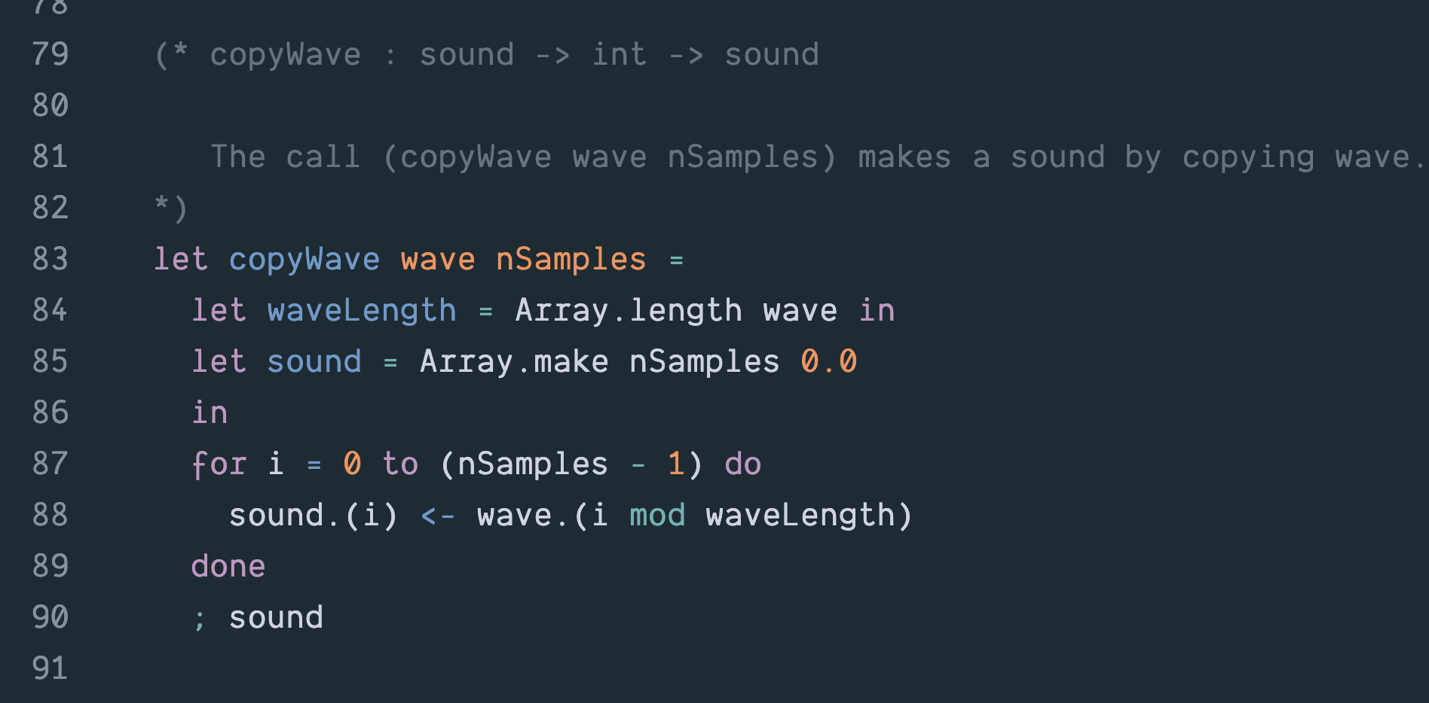

Slide 21
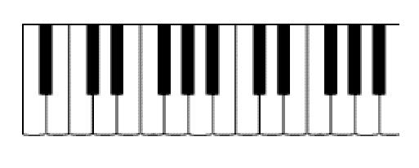
A3
Middle C
A4

Slide 22
220 Hz
440 Hz
A3
Middle C
A4

Slide 23
Well-tempered Scale
What frequency is associated with a give note?
Given a frequency f₀ of some fixed note, (typically A4 = 440Hz):
f_{n} = f₀ * 2^{n/12}
where n is the number of half-steps from f₀.

Slide 24
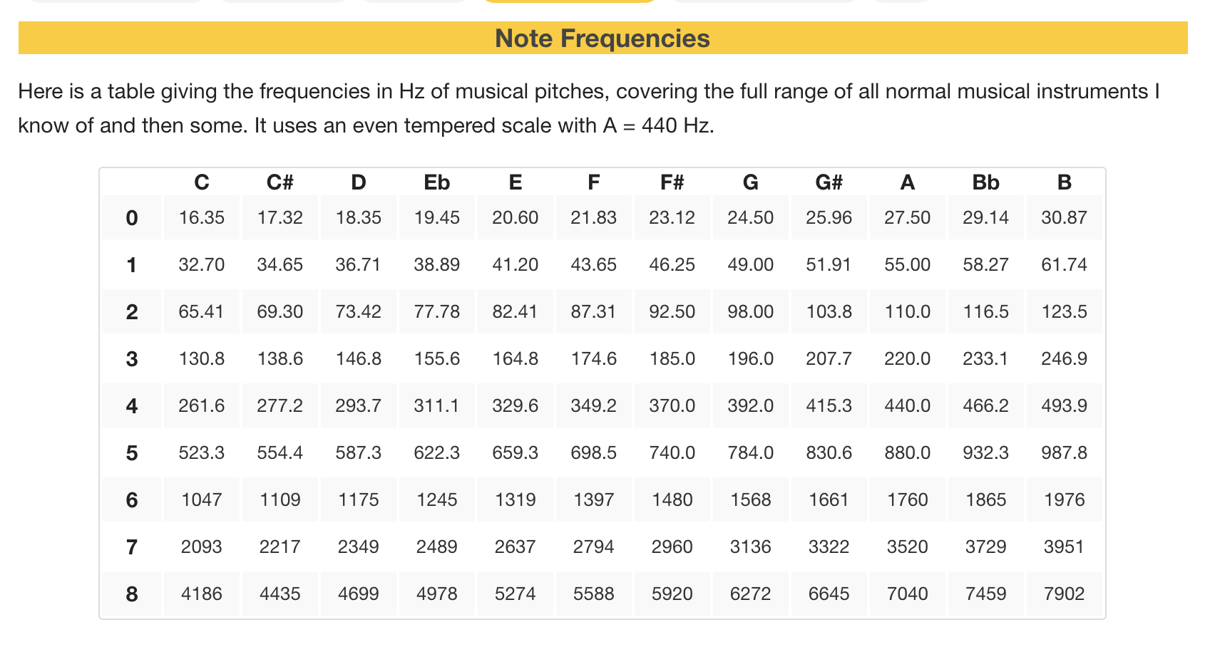

Slide 25
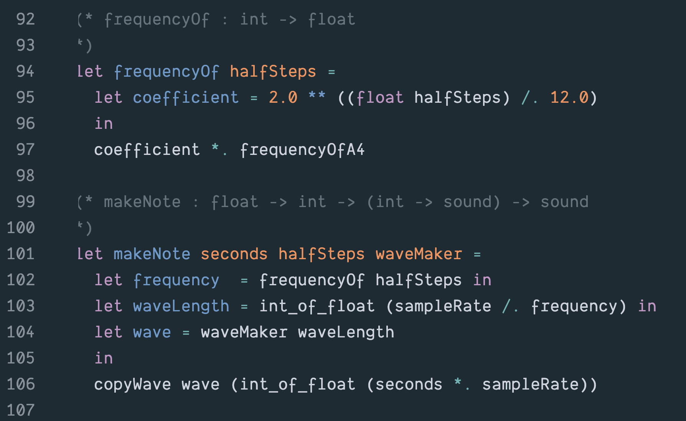

Slide 26
Nyquist/Shannon Sampling Theorem
If a signal contains no frequencies higher than W cycles per second, it is completely determined by giving its ordinates at a series of points spaced 1/(2W) seconds apart.

Slide 27
Psychoacoustic Factors
Since most humans top-out at 22KHz, recordings that sample at 44KHz should capture everything that humans can hear.
Most experts believe that humans can only resolve between 16 and 18 bits per sample.

Slide 28
Digital Audio
Various representation protocols, some proprietary, some public
representation protocols and format information packed into “headers”
software parses the header to “understand” the layout of the data

Slide 29
Digital Audio
Bit-stream may or may not:
be packaged-up with error detection/correction information
be compressed
be encrypted (e.g., Digital Rights Management DRM). More on these topics later

Slide 30
Uncompressed Digital Audio
Sony Compact Discs
Microsoft WAV Files

Slide 31
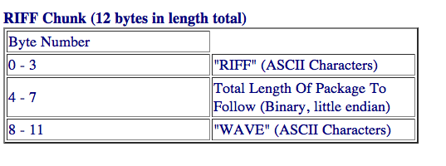
WAV Protocol
Microsoft WAV protocol : uncompressed PCM
3 Chunks:

Slide 32
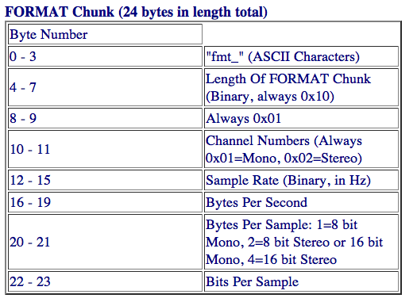
WAV Format Chunk

Slide 33
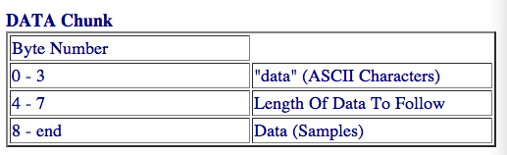
WAV Data Chunk

Slide 34
Compressed Digital Audio
Many different protocols: MP3, OGG, ACC, M4p, …
MP3: a de facto standard, reasonable fidelity + small size
Motion Picture Experts Group (MPEG)
1991: MPEG-1 Standard, Audio Layer 3, aka MP3 (not to be confused with MPEG-3).
User specifies desired bits/sec for audio. E.g., at 128 bps, 11 X compression .vs. CD file.
Uses both lossy and lossless compression

Slide 35
Compression
Lossless Compression: the data can be compressed and then expanded without loss of information (more on this later)
Lossy Compression: when we compress the data we’ll lose information (but it won’t matter)

