Slide 1
CSCI 1103 CS 1 Honors
Meeting 27: Monday 11/2
Applications: Working with Digital Audio

Slide 2
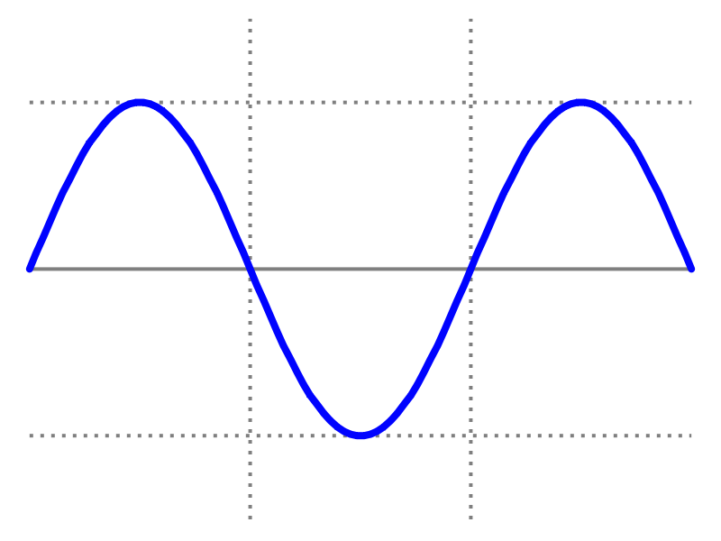
Waves
length of a complete wave (cycle)
measured in meters (m)
amplitude

Slide 3
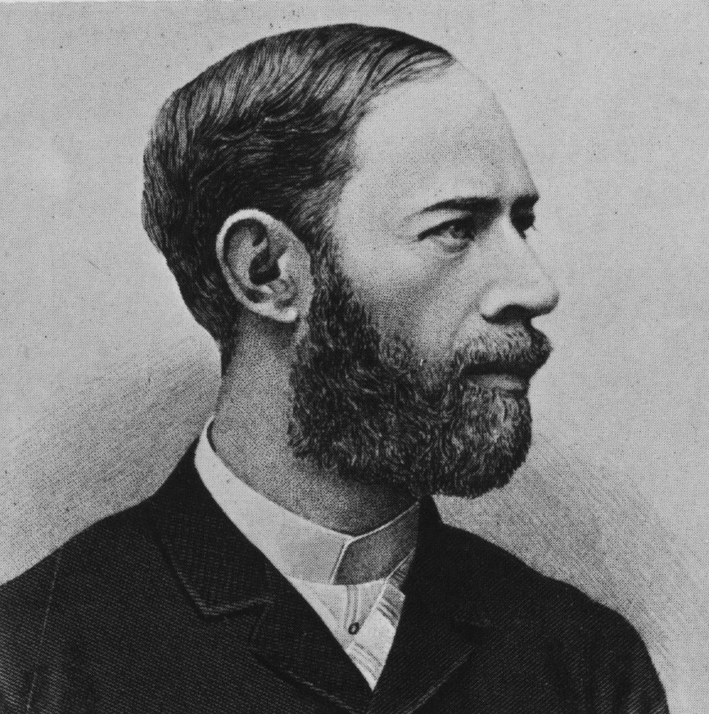
Frequency
Cycles per second
Measured in Hertz (Hz, hz)

Slide 4
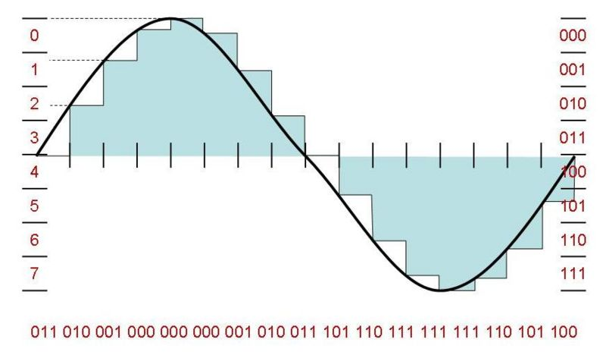
Digital Audio and PCM

Slide 5
Digital Audio
Bit Depth : How many bits are used to record a given amplitude. We’ll use 16-bit samples.
Sample Rate : How many samples are required for one second? CDs use 44.1K samples/sec. We’ll use 11,025 samples/sec.

Slide 6
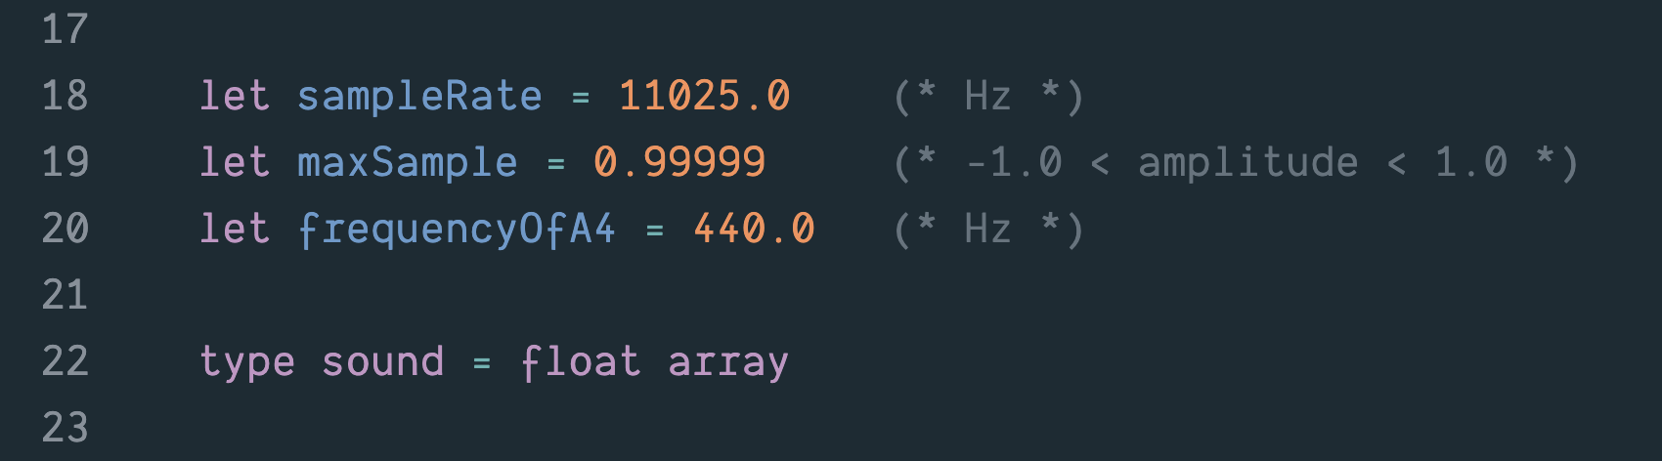

Slide 7
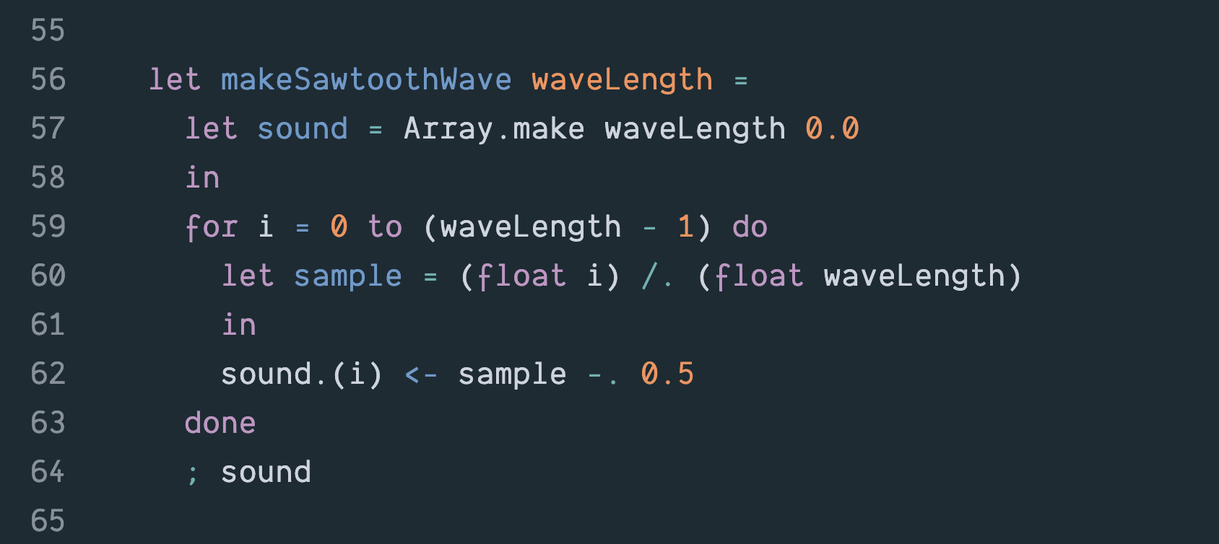

Slide 8
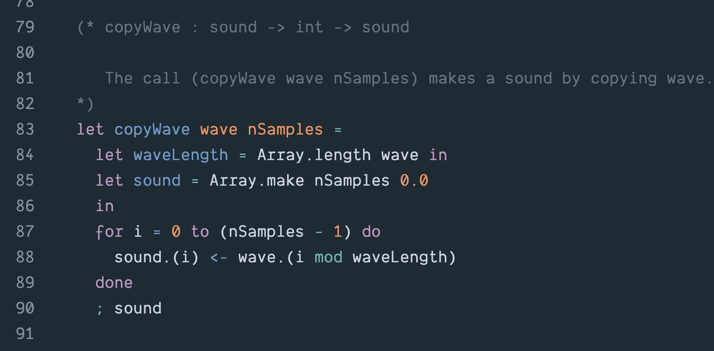

Slide 9
Well-tempered Scale
What frequency is associated with a give note?
Given a frequency f₀ of some fixed note, (typically A4 = 440Hz):
f_{n} = f₀ * 2^{n/12}
where n is the number of half-steps from f₀.

Slide 10
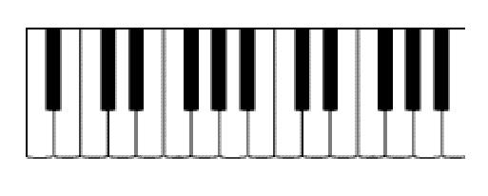
220 Hz
440 Hz
A3
Middle C
A4

Slide 11
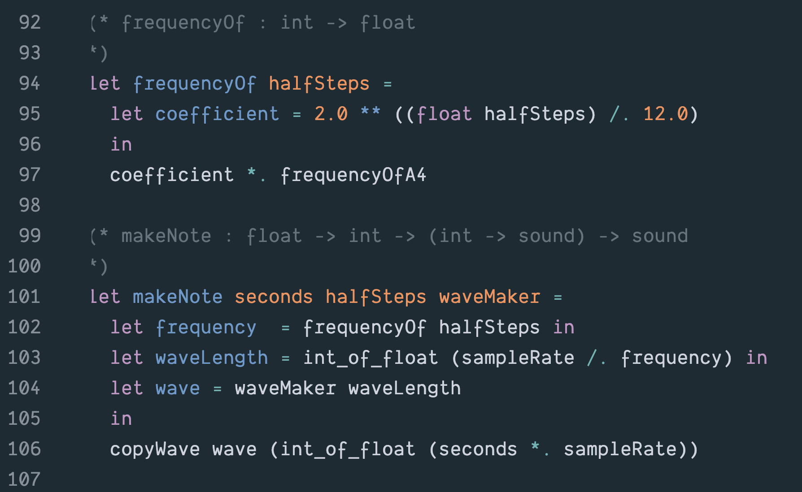

Slide 12
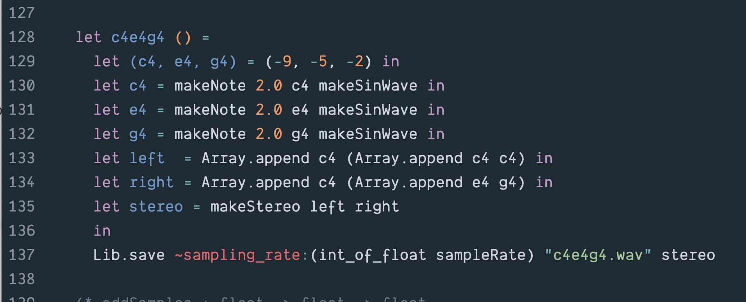

Slide 13
Waves are Additive
Audio signal

Slide 14
