Slide 1
CSCI 1103 CS 1 Honors
Meeting 31: Wednesday 11/11
Storage Review

Slide 2
Dynamic Memory
Storage for function variables
Stack
Storage for large values & long-living values
Heap

Slide 3
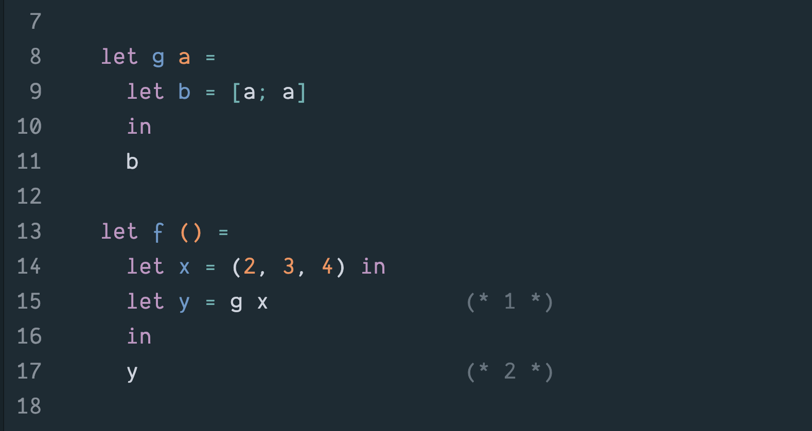

Slide 4
Stack
Heap
f
2
y
3
x
4

Slide 6
Stack
Heap
g
b
a
f
2
y
3
x
4

Slide 8
Stack
Heap
g
b
a
f
2
y
3
x
4

Slide 10
Stack
Heap
g
b
a
f
2
y
3
x
4

Slide 11
Stack
Heap
f
2
y
3
x
4

Slide 12
Stack
Heap
2
3
4

Slide 13
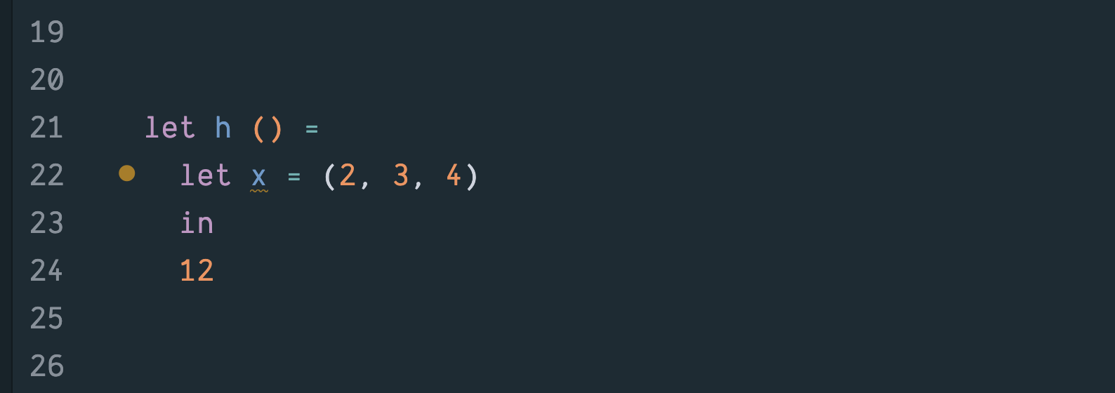

Slide 14
Stack
Heap
h
2
x
3
4

Slide 16
Stack
Heap
h
2
x
3
4
12

Slide 17
Stack
Heap
Garbage
h
2
x
3
4
12

