Slide 1
CSCI 1103 CS 1 Honors
Meeting 32: Friday 11/13
Dictionaries; Files; Modules

Slide 2
Dictionaries (aka maps)
“Martha”
21
“Gavin”
22
“Chris”
19
“Peiyu”
20

Slide 3
Dictionaries (aka maps)
“Martha”
()
“Gavin”
()
“Chris”
()
“Peiyu”
()

Slide 4
Dictionaries (aka maps)
type key = string
type dictionary = …
empty : dictionary
add : key -> value -> dictionary -> dictionary
find : key -> dictionary -> value

Slide 5
Dictionaries as New Types
dictionary.mli --- an interface file
type key = string
type 'a t
val empty : 'a t
val find : key -> 'a t -> 'a
val add : key -> 'a -> 'a t -> 'a t

Slide 6
Interface File has companion Implementation File
dictionary.ml
type key = string
type 'a t = …
let empty = …
let add key value dictionary = …
let rec find key dictionary = …

Slide 7
Modules
The pair of companion files:
dictionary.mli and
dictionary.ml
form a new type, in a module called
Dictionary

Slide 8
Modules & Types
dictionary.mli is the specification
dictionary.ml is an implementation

Slide 9
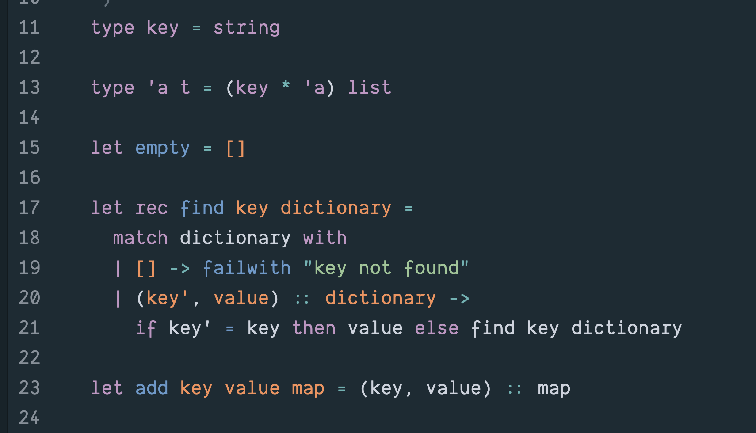
Association List Implementation

Slide 10
Association List Implementation
Unit time work for add operation
Linear time work for find operation

Slide 11
If keys are ordered
We can speed up the find operation by sorting the keys/value pairs
Use binary search

Slide 12
Keys
Values
Start looking
for key in the
Middle
find is log₂ N

Slide 13
Keys
Values
Need to add?
Ouch!
Linear cost.

Slide 14
Use a Binary Search Tree
“Gavin” 22
“Erma” 20
“Tom” 19
“Alice” 22
“Fannie” 22

Slide 15
Use a Binary Search Tree
Smaller Keys
“Gavin” 22
Larger Keys
“Erma” 20
“Tom” 19
“Alice” 22
“Fannie” 22

Slide 16
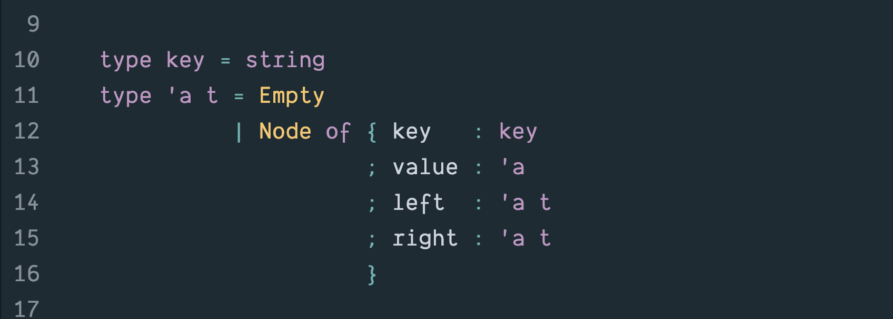
Binary Search Tree Implementation

Slide 17
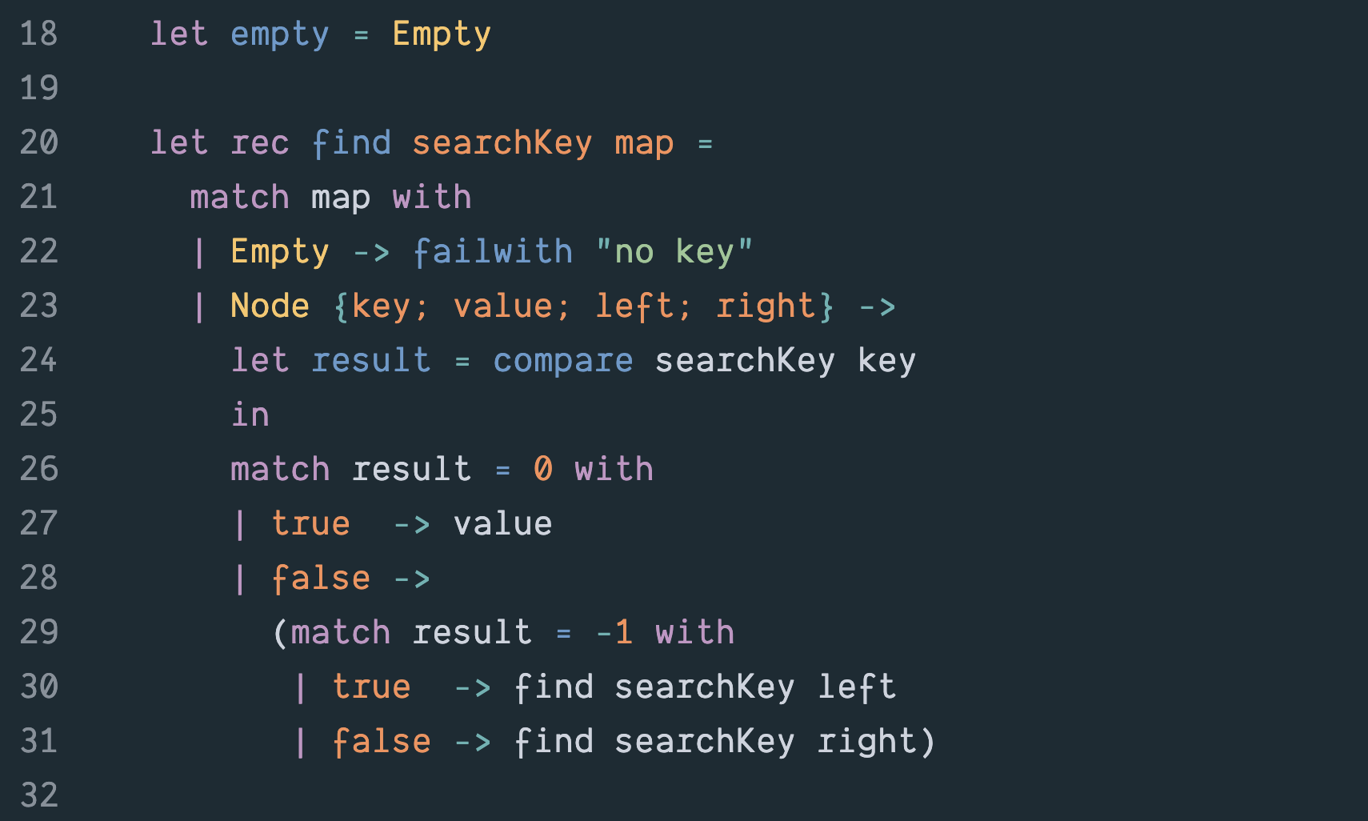
Binary Search Tree Implementation

Slide 18
Binary Search Tree Implementation

Slide 20
add in a balanced BST? Rebuild only nodes on path to insertion point => only log₂ N space.

Slide 21
BST structure is sensitive to insertion order. In the worst case, it’s a linear list.

