Slide 1
CSCI 1103 CS 1 Honors
Memory Diagrams, Arrays in OCaml

Slide 2
Ephemeral Memory
System Space
User Space

Slide 3
User Space
Dynamic Memory
Data
Static Memory
Code

Slide 4
Static Memory
Data Segment
Images
Text Segment
Data Segment
Text Segment
Data Segment
Text Segment

Slide 5
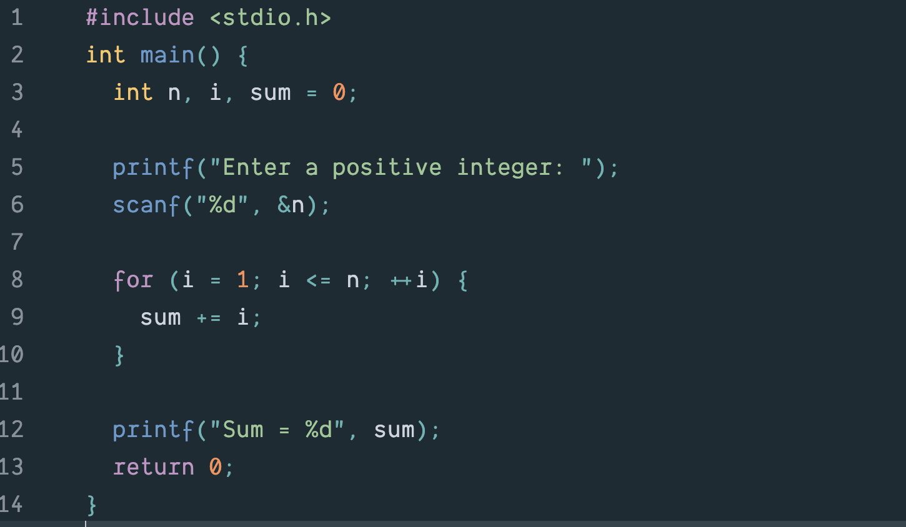

Slide 6
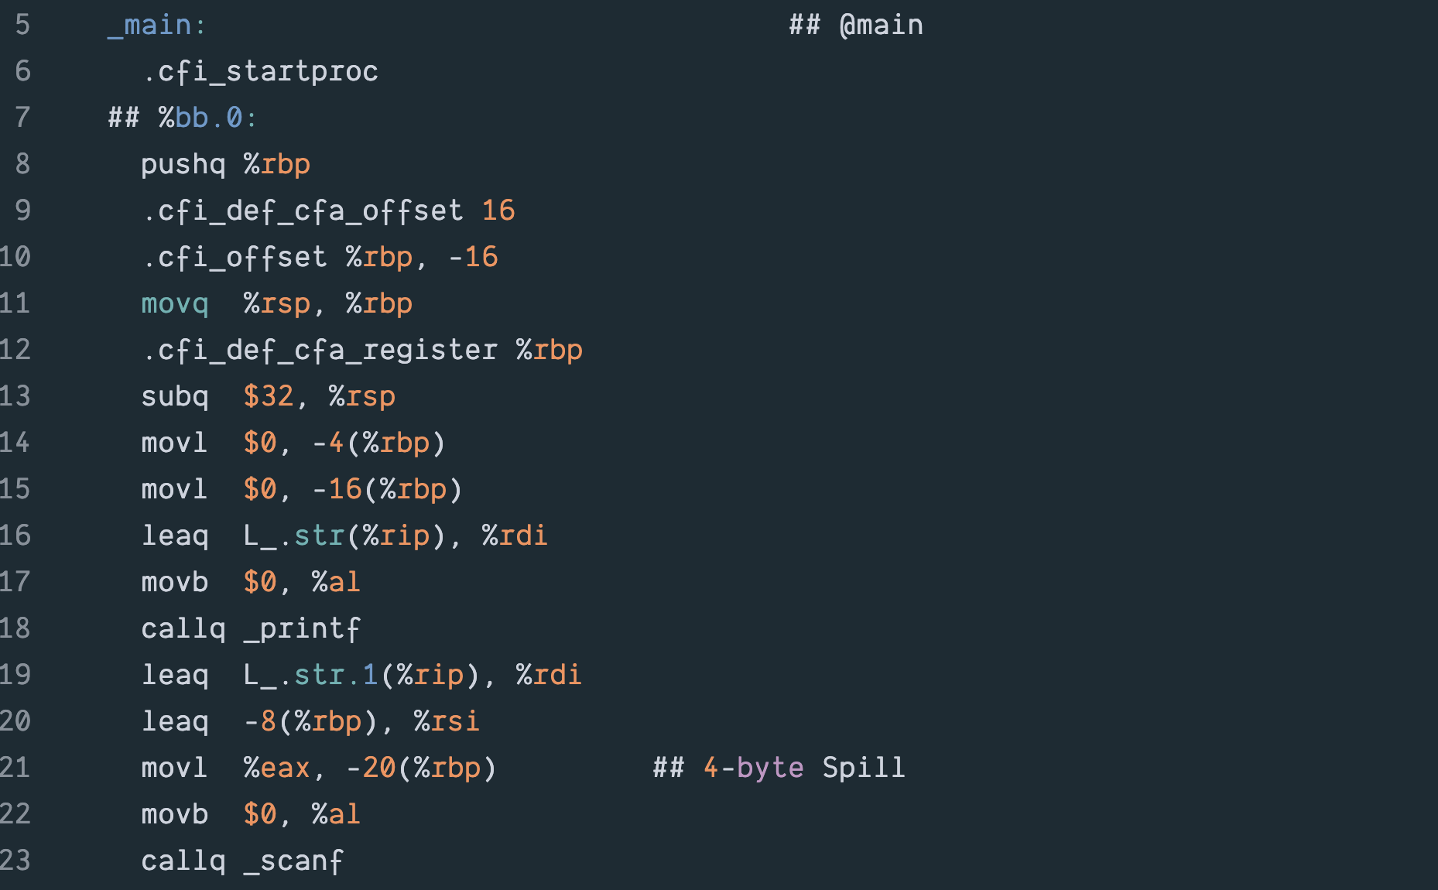

Slide 7
Dynamic Memory
Storage for function variables
Stack
Storage for large values & long-living values
Heap

Slide 8
The Call Stack
The plug-in/simplify model works (!) and is a good way to reason about functions:
let double n = n * 2
(double 12)
12 * 2

Slide 9
But Implementations Don’t Work That Way
let double n = n * 2
double
n = 12
(double 12)
call frame/activation record
Body of function evaluated with respect to a call frame.

Slide 10
Call Frames/Activation Records
function name
a = …
…
Word-size slots for local variables.
z = …
Body of function evaluated with respect to a call frame.

Slide 11
Call Frames Stack up like Cafeteria Trays
let double n = n * 2
let quadruple n =
double (n * 2)
quadruple
Top
n = 12
(quadruple 12)

Slide 12
Call Frames Stack up like Cafeteria Trays
let double n = n * 2
double
Top
let quadruple n =
double (n * 2)
n = 24
quadruple
n = 12
(quadruple 12)

Slide 13
Call Frames are De-allocated on Function Return
let double n = n * 2
double
let quadruple n =
double (n * 2)
n = 24
48
quadruple
Top
n = 12
(quadruple 12)

Slide 14
The Heap – Large/Long-lived Items
Heap
let a = (2, 3)
2
a
3

Slide 15
The Heap – Large/Long-lived Items
Heap
let a = (2, 3)
2
a
3

Slide 16
The Heap – Inaccessible -- garbage
Heap
let a = (2, 3)
2
a
3

Slide 17
The Heap – Large/Long-lived Items
Heap
let a = (2, (3, 4))
2
a
3
4

Slide 18
let a = [1; 2; 3] = 1 :: (2 :: (3 :: []))
a
1
Heap
2
3

Slide 19
let a = [1; 2; 3] let b = (a, a, [1; 2; 3])
a
Heap
1
b
2
1
3
2
3

Slide 20
let a = (1, 2) let b = [a; a; a]
Heap
b
a
1
2

Slide 21
Block Allocation – Arrays in OCaml
let a = [| 2; 4; 6; 8 |]
Heap
a
2
0
4
1
6
2
8
3

Slide 22
Block Allocation – Arrays in OCaml
Pro:
Random access:
cost of access to a.(999) same as a.(0)
Cache friendly
Heap
a
2
0
4
1
6
2
8
3

Slide 23
Block Allocation – Arrays in OCaml
Con:
Insertion:
linear cost
put(a, 5)
Heap
a
2
0
4
1
5
2
6
3
8

Slide 24
Block Allocation – Arrays
let a = [| 2; 4; 6; 8 |]
let b = a.(2)
Heap
a
2
0
4
1
6
b = 6
2
8
3

Slide 25
Arrays are Mutable
Heap
let a = [| 2; 4; 6; 8 |]
let b = a.(2)
a.(3) <- 12
a
2
0
4
1
6
b = 6
2
12
3

Slide 26
Block Allocation – Arrays
Heap
3
a
3
0
3
let a = Array.make 4 3
3
1
3
3
2
3
3
3

Slide 27
Array.make 1000 true
Heap
3
a
true
0
3
…
…
3
true
999

Slide 28
let a = Array.make 4 3 let b = Array.map double a
a
3
b
6
3
6
3
6
3
6

Slide 29
let a = [|10; 20; 30; 40|] let b = Array.sub a 1 2
a
10
b
20
20
30
30
40

Slide 30
let a = Array.make_matrix 4 3 6
0
1
2
a
0
6
6
6
1
6
6
6
2
6
6
6
3
6
6
6

Slide 31
let a = Array.make_matrix 4 3 6 a.(2).(1) <- 12
0
1
2
a
0
6
6
6
1
6
6
6
2
6
12
6
3
6
6
6

Slide 32
let a = Array.make_matrix 4 3 6
a
0
6
1
6
6
2
6
6
6
3
6
6
6
6
6
6

Slide 33
Better to Think of a 2D Array as a Grid
a
0
1
2
0
6
6
6
1
6
6
6
2
6
6
6
3
6
6
6

