Slide 1
CSCI 1103 CS 1 Honors
Meeting 37: Monday 11/30
Data Consistency & Assertions
Exposing Inconsistencies to the Type Checker

Slide 2
Dealing with Inconsistent Data

Slide 3
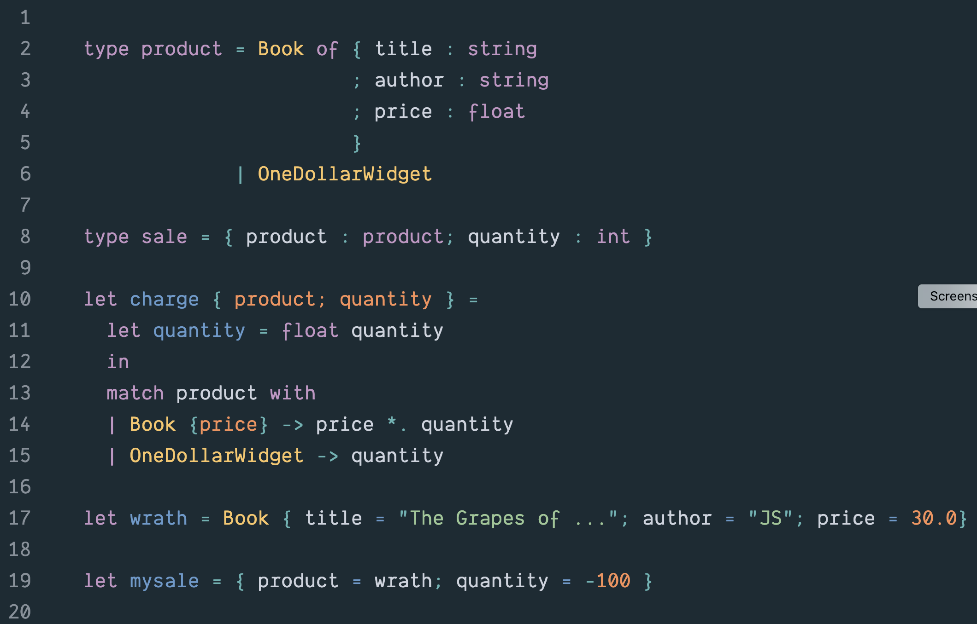

Slide 4
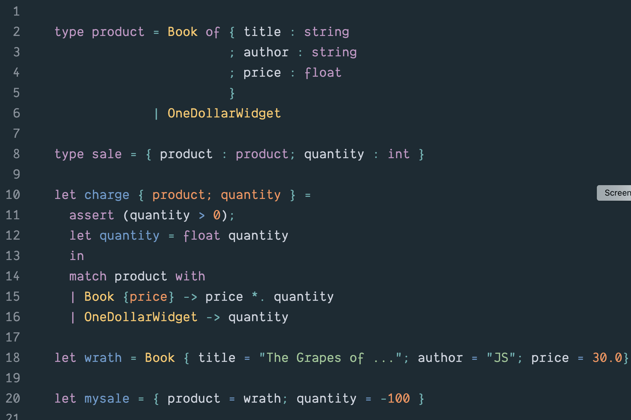

Slide 5
Wrong Programs

Slide 6
Wrong Programs
Correct
Programs

Slide 7
Wrong Programs
Bad Syntax

Slide 8
Wrong Programs
For dynamically-typed PLs like JavaScript & Python, compiler can’t flag any wrong programs
other than the ones with bad syntax.
Bad Syntax

Slide 9
Statically-typed languages like Java and Ocaml flag a very large class of wrong programs at compile time.
Syntax OK, Bad Types
Bad Syntax

Slide 10
Types OK, other errors trapped at run-time
Types OK, other
errors not trapped
at run-time
Syntax OK, Bad Types
Bad Syntax

Slide 11
Types OK, other errors trapped at run-time
Types OK, other
errors not trapped
at run-time
Syntax OK, Bad Types
Bad Syntax

Slide 12
Exposing Data Inconsistencies to the Type Checker

Slide 13
Types OK, other errors trapped at run-time
Types OK, other
errors not trapped
at run-time
Syntax OK, Bad Types
Bad Syntax

Slide 14
Types OK, other errors trapped at run-time
Types OK, other
errors not trapped
at run-time
Syntax OK, Bad Types
Bad Syntax

Slide 15
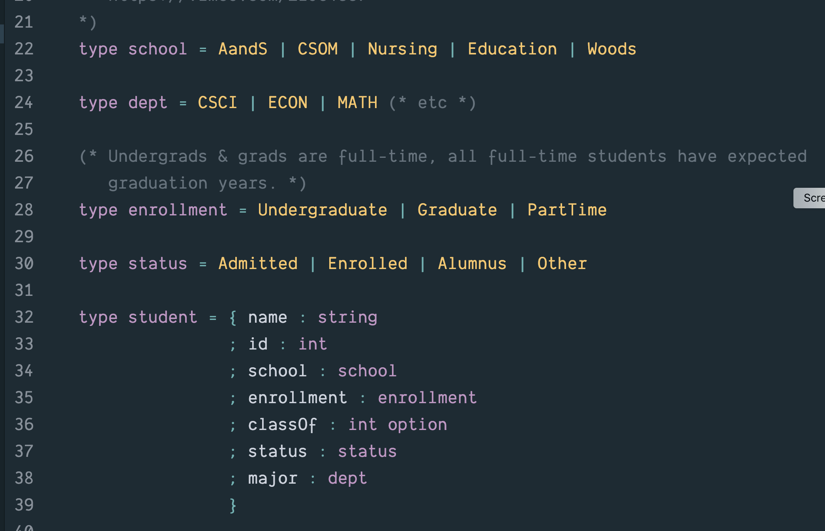

Slide 16
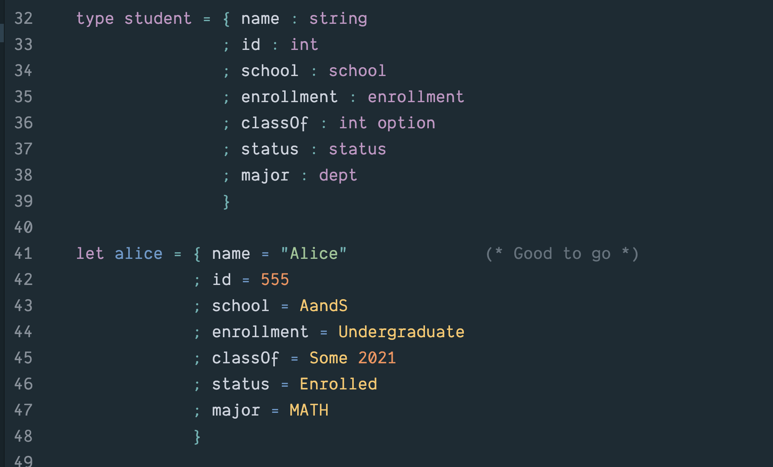

Slide 17
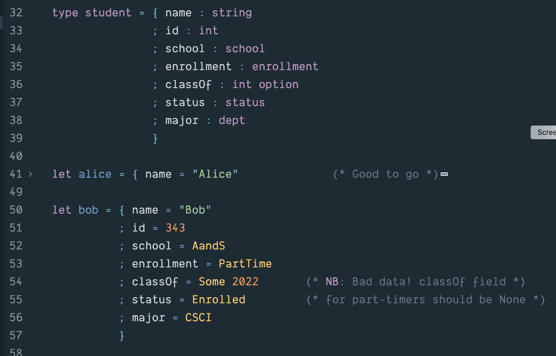

Slide 18
The Types aren’t defined Correctly

Slide 19
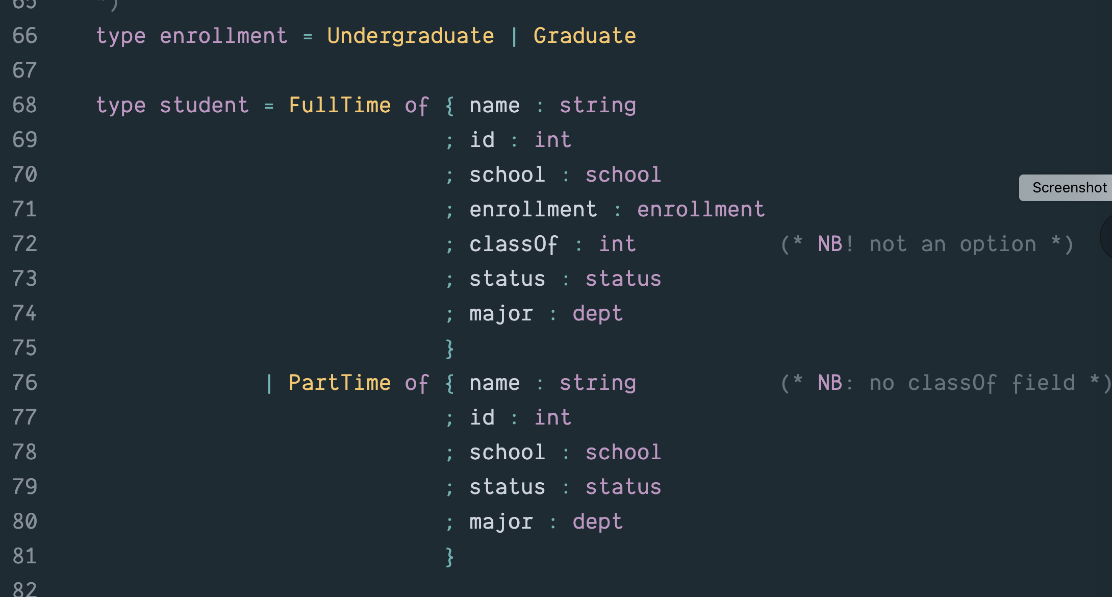

Slide 20
