Slide 1
CSCI 1103 CS 1 Honors
Meeting 38: Wednesday 12/2
Message Passing Style
Abstract Data Types in Ocaml & Java

Slide 2
Message Passing Style

Slide 3
“toString”
Computational
Artifact
Computational
Artifact
Computational
Artifact
Computational
Artifact
Computational
Artifact
Computational
Artifact

Slide 4
Represent an “artifact” by a Record

Slide 5
Some fields of the record hold functions

Slide 6
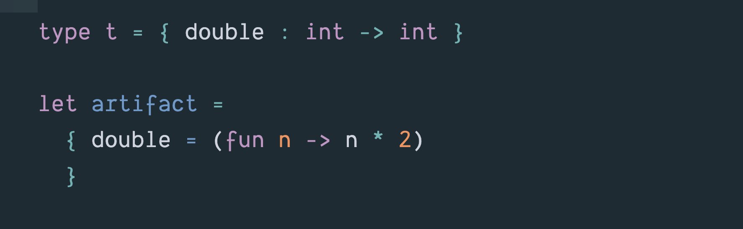
artifact points to a record, i.e., a block in the heap

Slide 7
Stack
Heap
top
double:
code for double
artifact:

Slide 8
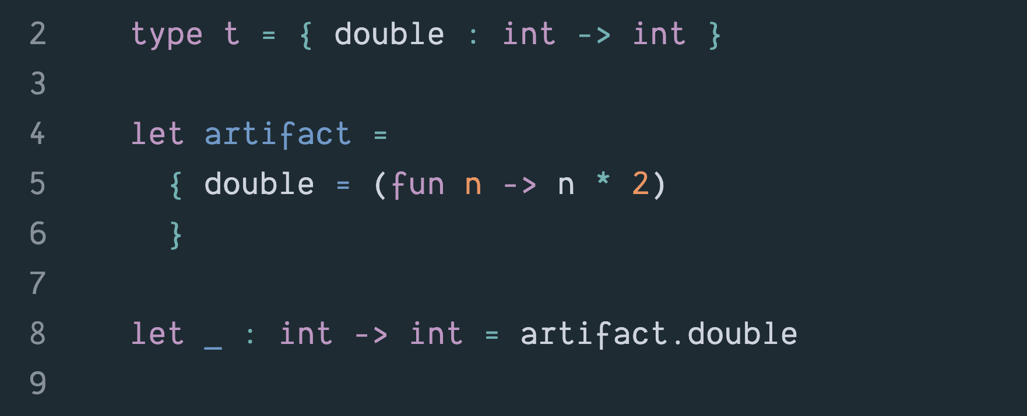
Retrieve the value of artifact’s double field

Slide 9
Names of fields viewed as messages

Slide 10
Send the double message to artifact

Slide 11
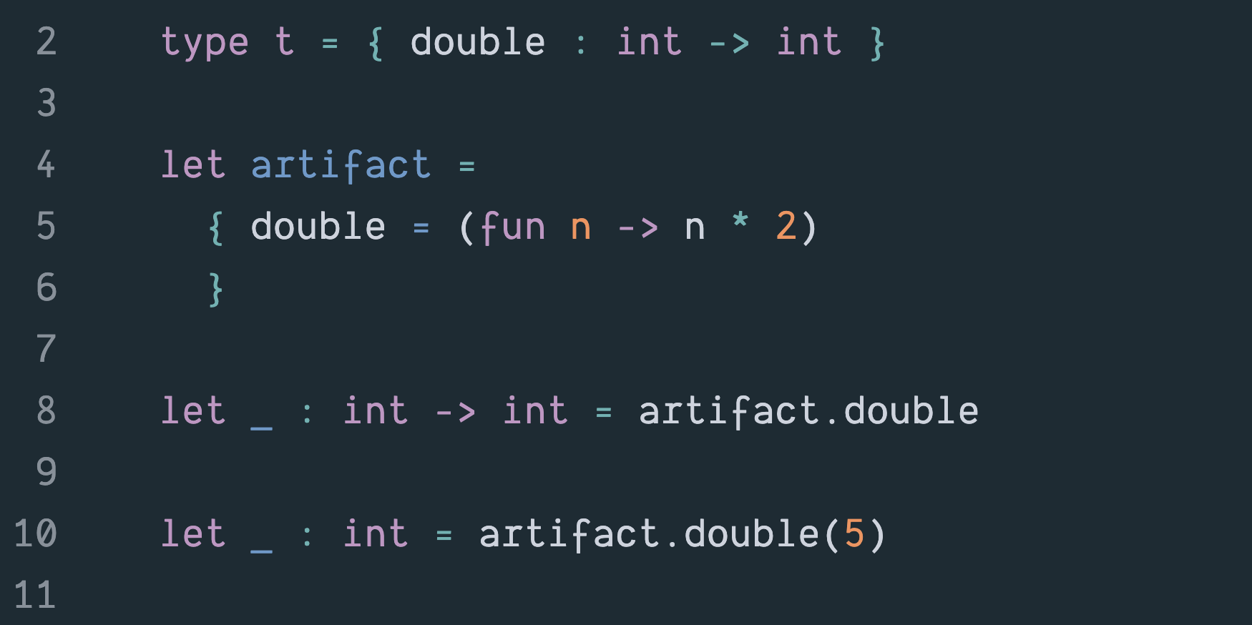
Send the double message to artifact and give it the input 5

Slide 12
Object-Oriented Programming

Slide 13
OO artifacts have state, functions in the artifact can operate on that state

Slide 14
- lots of terminology - artifacts called objects functions called methods

Slide 15
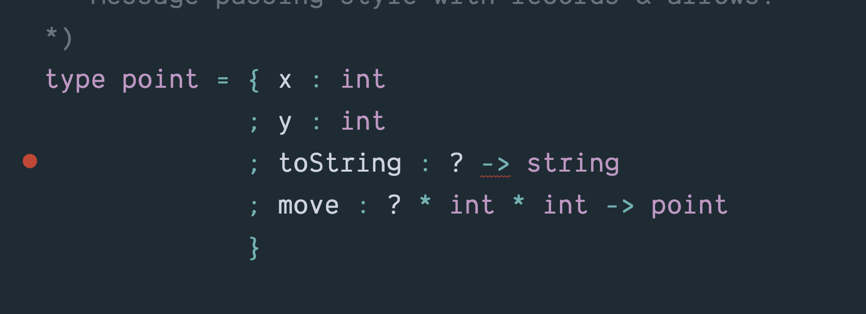
The type of a point object with fields x, y, toString and move.

Slide 16
Q: How can the toString and move methods access fields x and y?

Slide 17
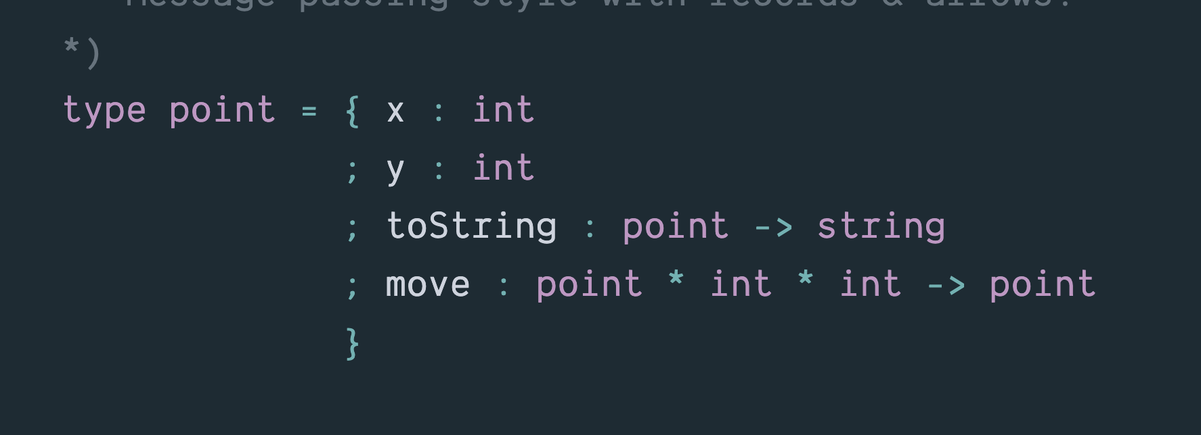
A: Provide them with an extra argument pointing to the record in the heap.

Slide 18
In Java the extra parameter is hidden and is called this

Slide 19
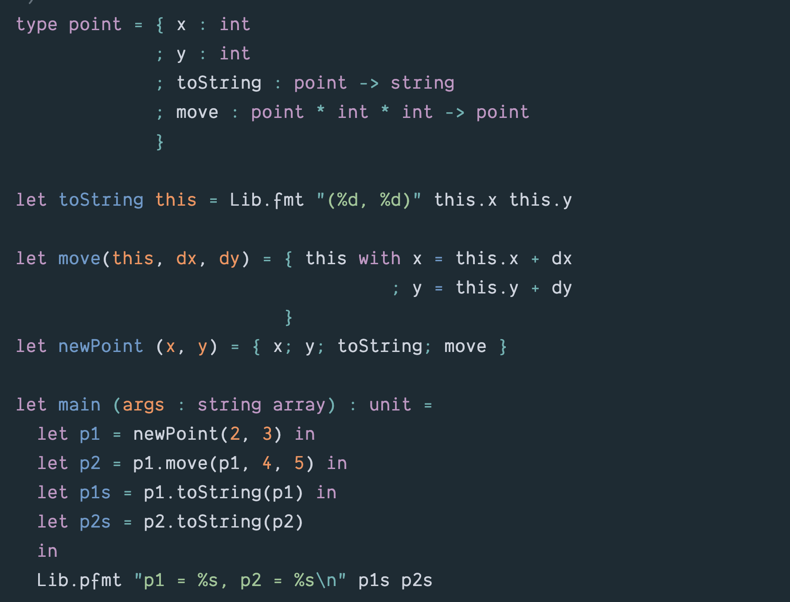

Slide 20
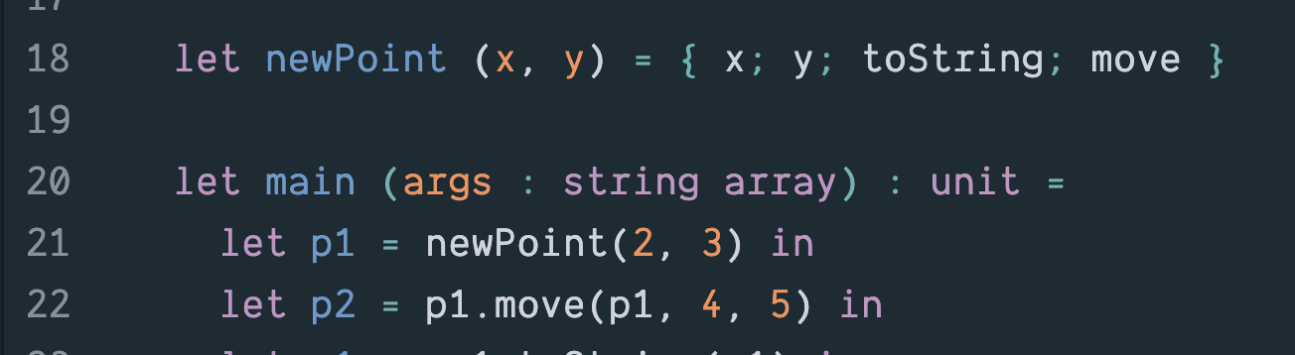
Stack
Heap
x: 2
newPoint
y: 3
x: 2
toString:
y: 3
move:
main
p1:
p2:

Slide 21
Stack
Heap
x: 2
newPoint
y: 3
x: 2
toString:
y: 3
move:
main
p1:
p2:

Slide 22
Stack
Heap
x: 2
newPoint
y: 3
x: 2
toString:
y: 3
move:
main
p1:
p2:

Slide 23
Stack
Heap
p1.move
this:
x: 2
y: 3
dx:
toString:
dy:
move:
main
p1:
p2:

Slide 24
Stack
Heap
p1.move
this:
x: 2
y: 3
dx: 4
toString:
dy: 5
move:
main
p1:
p2:

Slide 25
Stack
Heap
p1.move
this:
x: 2
y: 3
dx: 4
toString:
dy: 5
move:
x: 6
main
y: 8
p1:
toString:
p2:
move:

Slide 26
Stack
Heap
p1.move
this:
x: 2
y: 3
dx: 4
toString:
dy: 5
move:
x: 6
main
y: 8
p1:
toString:
p2:
move:

Slide 27
Extra Fields

Slide 28
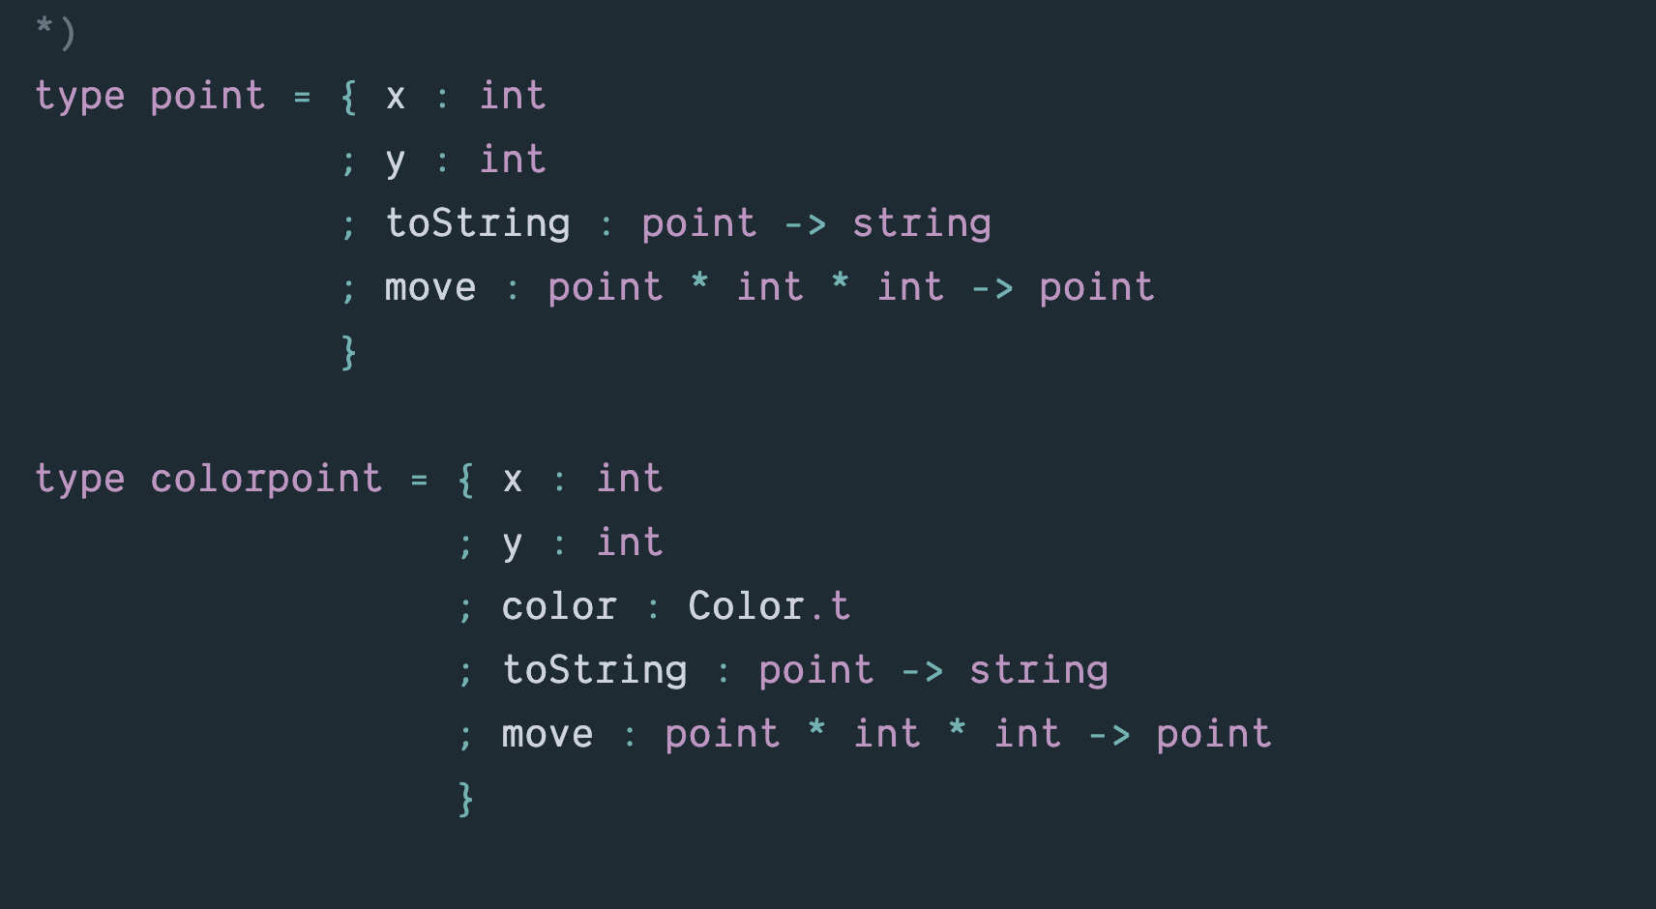
A colorpoint has all the fields of a point and also a color field.

Slide 29
A value of type colorpoint can be used wherever a value of type point is expected.

Slide 30
point
colorpoint
weightedpoint

Slide 31
Inheritance

Slide 32
type colorpoint extends point with { color : Color.t }

