Slide 1
CSCI 1103 CS 1 Honors
Stray Topics & Wrap Up

Slide 2
Topics
A Common Pattern in ”Functional” Style
The Road Ahead
Systems & Theory

Slide 3
A Common Pattern in “Functional” Style

Slide 4
# let n = “Boston” |> String.length;; val n : int = 6 # let m = “Boston” |> String.length |> (+) 1;; val n : int = 7
Pipes: x|> f for (f x)

Slide 5
Pipe Notation is Convenient for Stream Processing
data
f
g
h
p
q
q(p(h(g(f(data)))))

Slide 6
# let n = (+) 2 3;; val n : int = 5 # let double = ( * ) 2;; val double : int -> int # let n = 3 |> (+) 2;; val n : int = 5
Prefix Notation for Operators

Slide 7
# let f x = 2.0 |> ( ** ) x |> (+.) 1.0;; val f : float -> float
Stacked Pipes: f(x) = x² + 3
|> ( ** ) x
|> (+.) 3.0;;

Slide 8
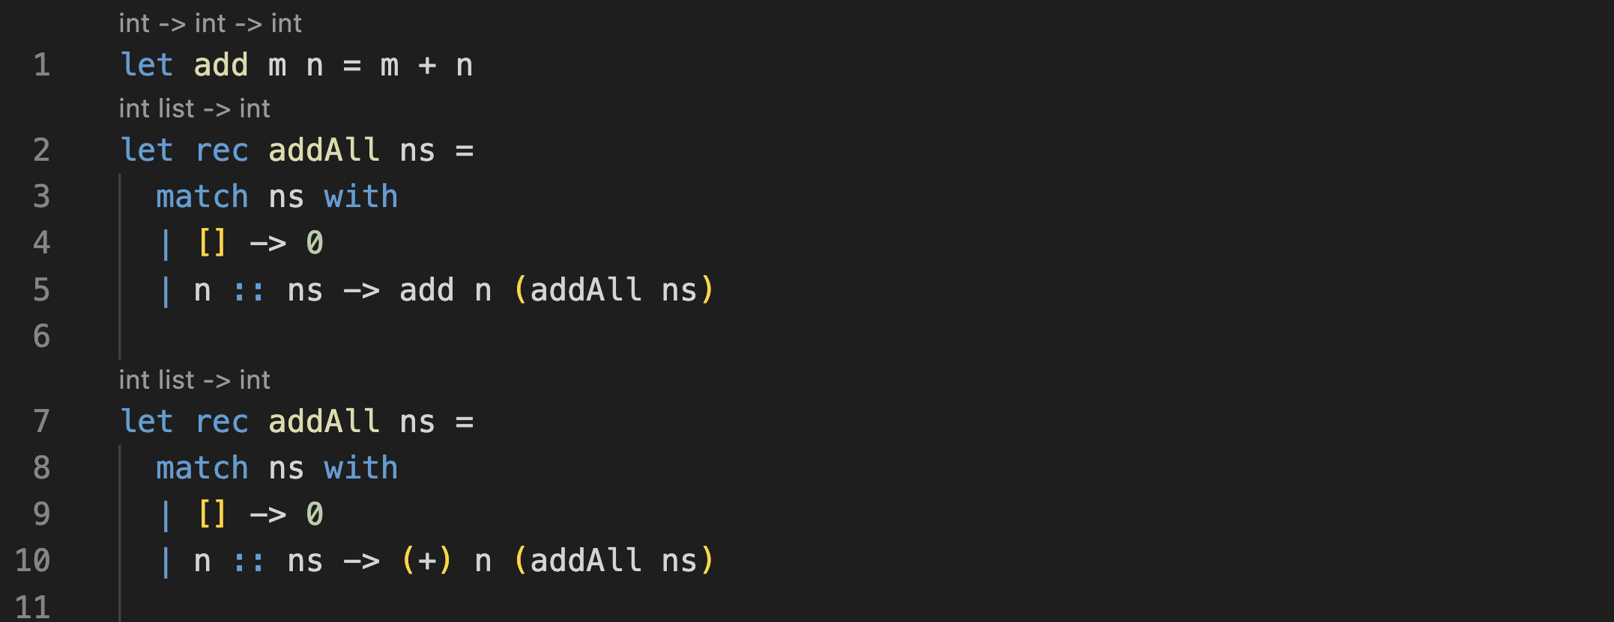
Folding/Reducing

Slide 9
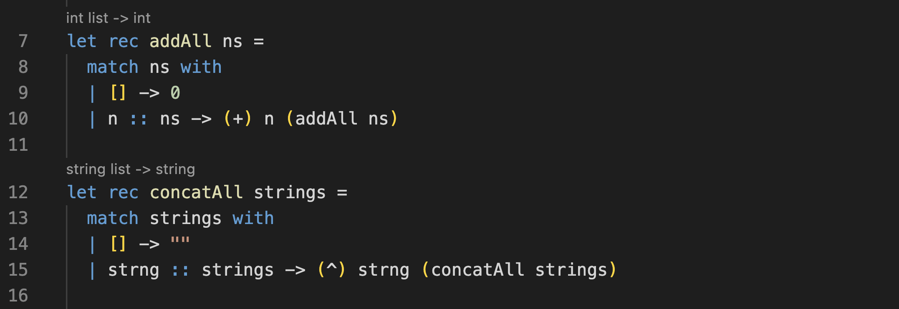
Folding/Reducing

Slide 10
Folding/Reducing

Slide 11
Folding/Reducing

Slide 12
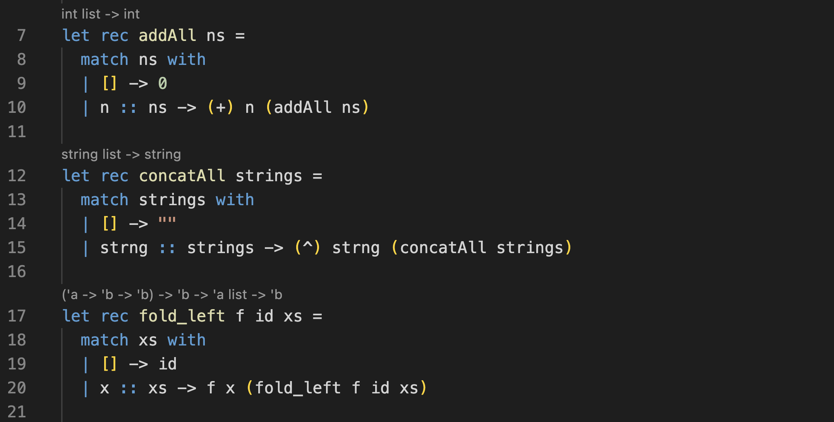
Folding/Reducing

Slide 13
Folding/Reducing

Slide 14
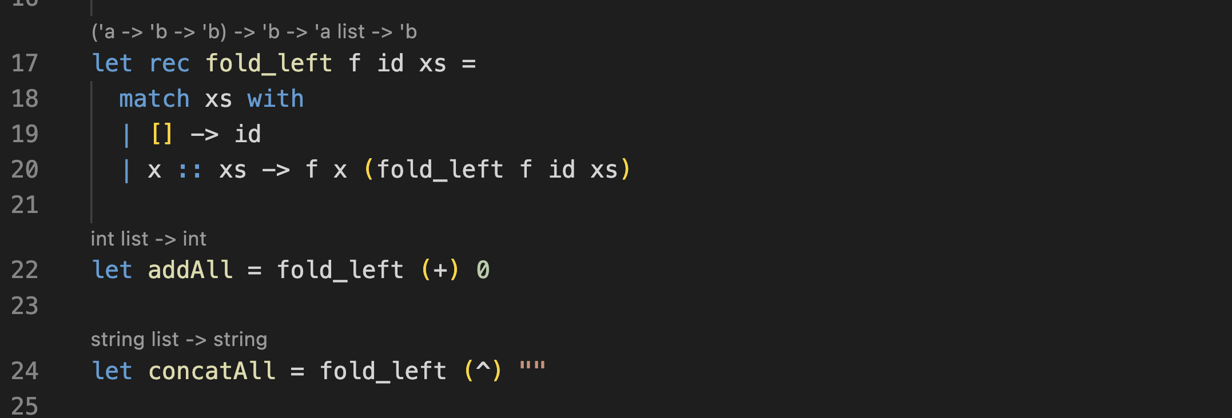
Folding/Reducing
Folding/Reducing
Folding/Reducing

Slide 15
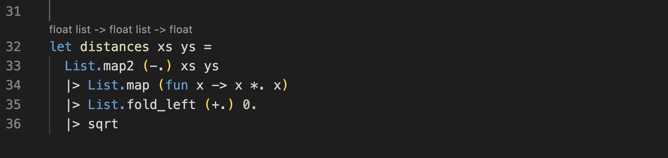
Stacked Style

Slide 16
The Road Ahead

Slide 17
What this course has been about
An introduction to the principal subjects of study: computation and information
Developing skill in the art of coding
An introduction to the field of CS

Slide 18
CS1
Computer Science Core
CS2
L&C
Org
Systems
R&C
Algorithms

Slide 19
Themes in CS2
Further developing the art of crafting good software
How to design and develop new data types
Efficiency & good representation choices
Modularity & composability

Slide 20
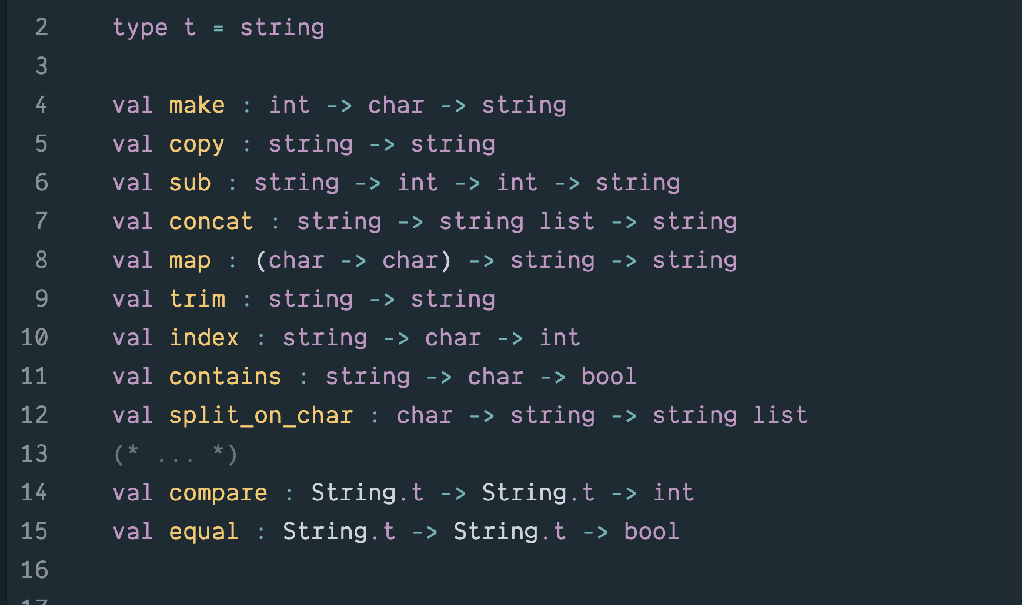

Slide 21
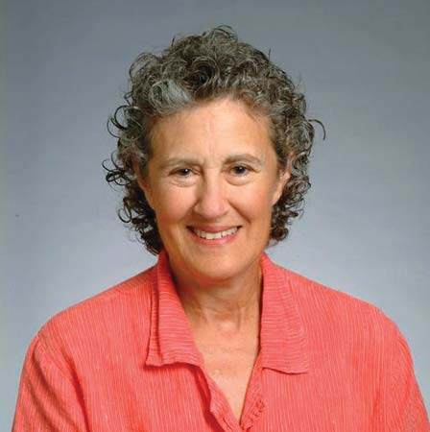
Barbara Liskov

Slide 22
A New Type is like a Product or Service
Client Code 1
My new Widget Type
Client Code 2
Client Code 3

Slide 23
When Introducing a new Type
Implementation 1
Name of the Type
Type signatures of all of the related operations
The API
Implementation 2
Specification

Slide 24
An implementation will have one or more secret representation types used only within the implementation.
Implementation 1
Name of the Type
Type signatures of all of the related operations
The API
Implementation 2

Slide 25
This implementation may have a fast find operation.
Implementation 1
Name of the Type
Type signatures of all of the related operations
The API
Implementation 2

Slide 26
Implementation 1
Name of the Type
Type signatures of all of the related operations
The API
Implementation 2
This one may have a small memory footprint.

Slide 27
If you’re using a typed PL the type checker can confirm the fit
Implementation 1
Name of the Type
Type signatures of all of the related operations
The API
Implementation 2

Slide 28
I.e., the implementation has a well-formed definition for everything required by the specification
Implementation 1
Name of the Type
Type signatures of all of the related operations
The API
Implementation 2

Slide 29
Information Hiding
Client Code 1
API
Client Code 2
Client Code 3
Client code knows only what is in the specification.

Slide 30
From Ocaml to Java

Slide 31
In OCaml ADTs are built using modules
In Java ADTs can be built using classes and interfaces

Slide 32
Procedural & Message Passing Styles
 | Empty | Not Empty
add | --- | ---
find | --- | ---

Slide 33
Procedural Style
 | Empty | Not Empty
add | --- | ---
find | --- | ---
add & find discriminate between Empty or Not Empty

Slide 34
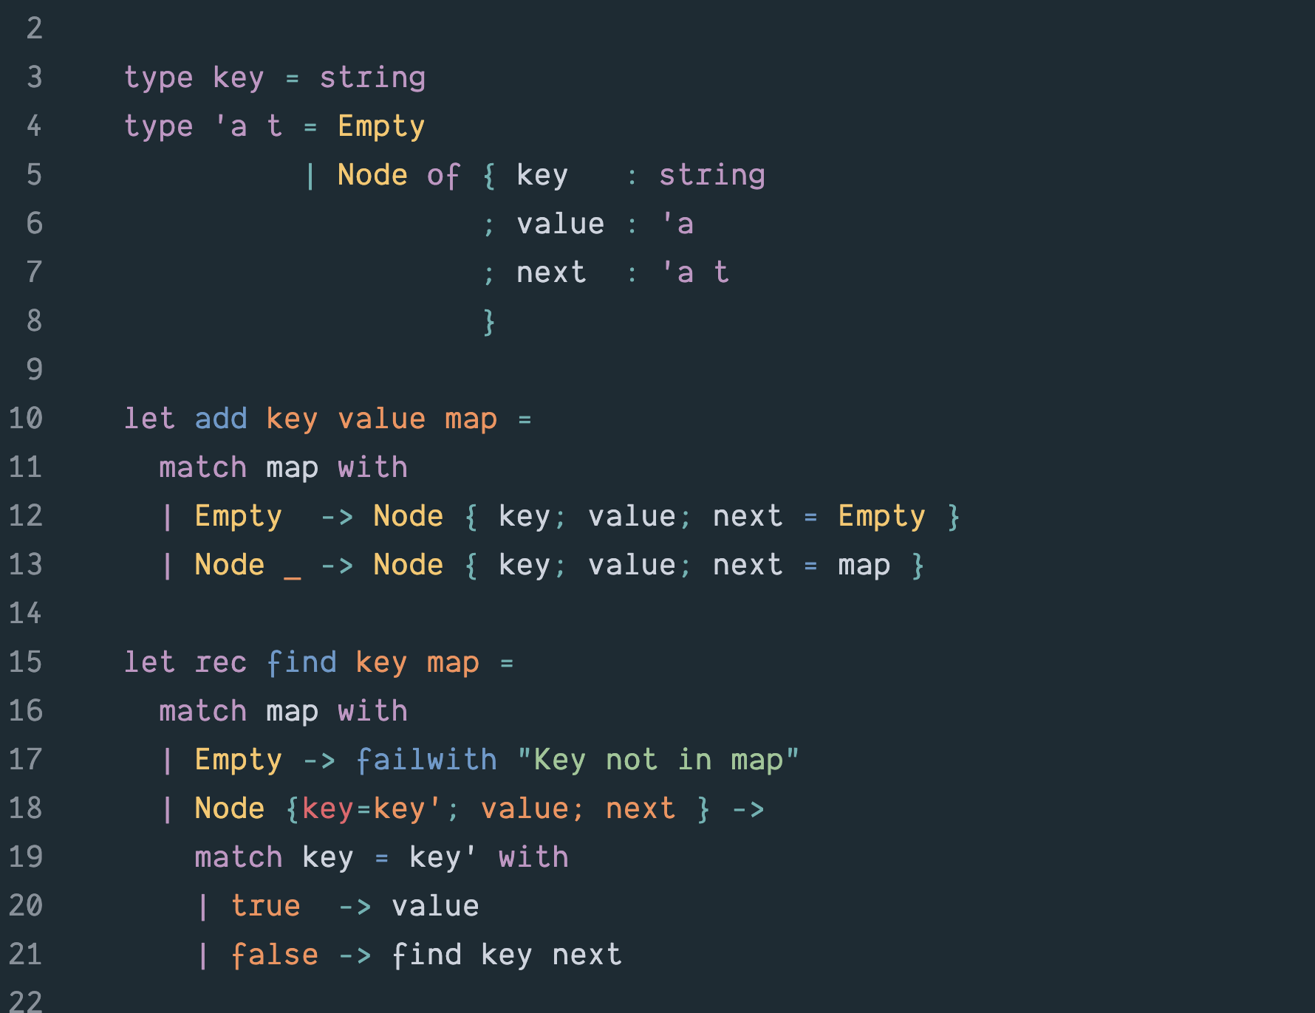

Slide 35
Message Passing Style
Empty & Not Empty can field both add and find messages
 | Empty | Not Empty
add | --- | ---
find | --- | ---

Slide 36
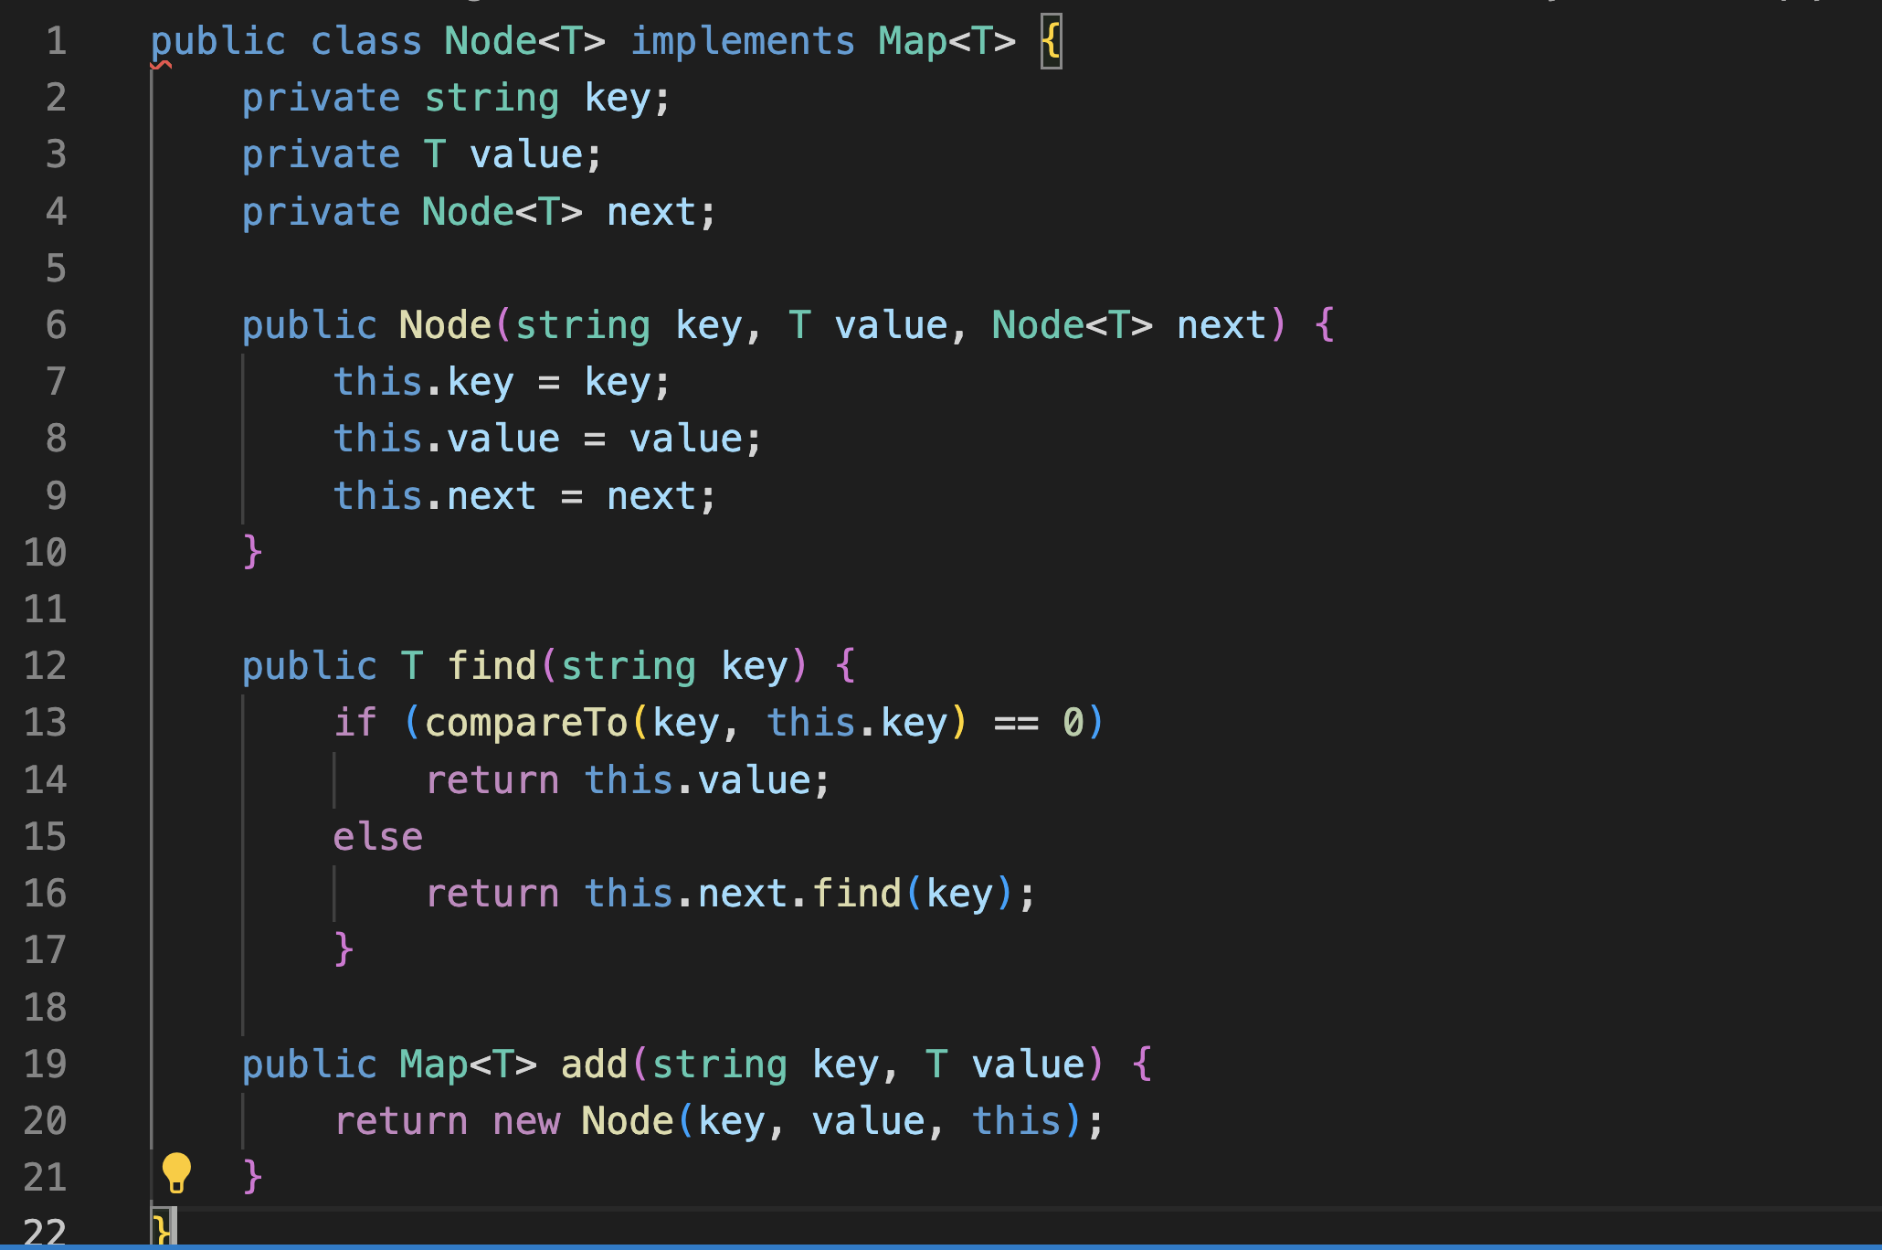

Slide 37
CS – Systems + Theory

Slide 38
Systems
Both
Theory

Slide 39
Logic & Semantics
Both
Analysis & Complexity

Slide 40
Sudoku & the Zoo

Slide 41
Try to Remember

Slide 42
Remember – Problem Solving
Use functions to break a problem into smaller parts.
If you’re writing a function to solve a task and you come across a non-trivial sub-task, immediately make up a function name and introduce a call to that function.
Provide inputs to the function that you think it will probably need;
You can revise the function inputs when you get around to writing that helper function.

Slide 43
Remember – Naming
Choose names for functions and variables very carefully! There is no rush, ask “What does this thing do?” Then pick an appropriate name;
If you’re having trouble explaining what a function does or what kind of value a variable holds, the person you’re talking to is probably being thrown off by poorly chosen names;
Future you may have to review your own code and/or explain it to a colleague and future you will be led astray by poorly chosen names.

Slide 44
Final Exam
Saturday December 17, 12:30 – 2PM in this room
Final will look like the second midterm + storage diagrams
Regular office hours next week and by appt. if needed.

Slide 45
Thank you!

