Slide 1
CSCI 1103 CS 1 Honors
Stray Topics

Slide 2
Dynamic Memory
Storage for function variables
Stack
Storage for large values & long-living values
Heap

Slide 3
A thread is a sequence of instructions together with memory
Stack
Heap

Slide 4
Stack
Stack
Two threads
Heap

Slide 5
Two threads
Stack
Heap
Stack

Slide 6
Main Thread
Network Thread
g
g
b
x
a
y
f
f
2
y
y
3
x
4
x

Slide 7
Main Thread
Network Thread
g
g
b
x
a
y
f
f
2
y
y
3
x
4
x

Slide 8
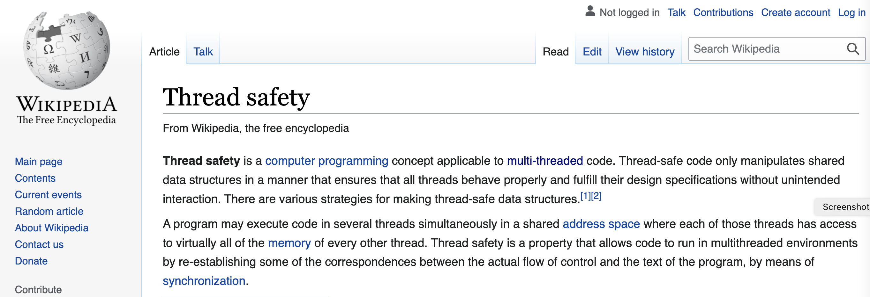

Slide 9
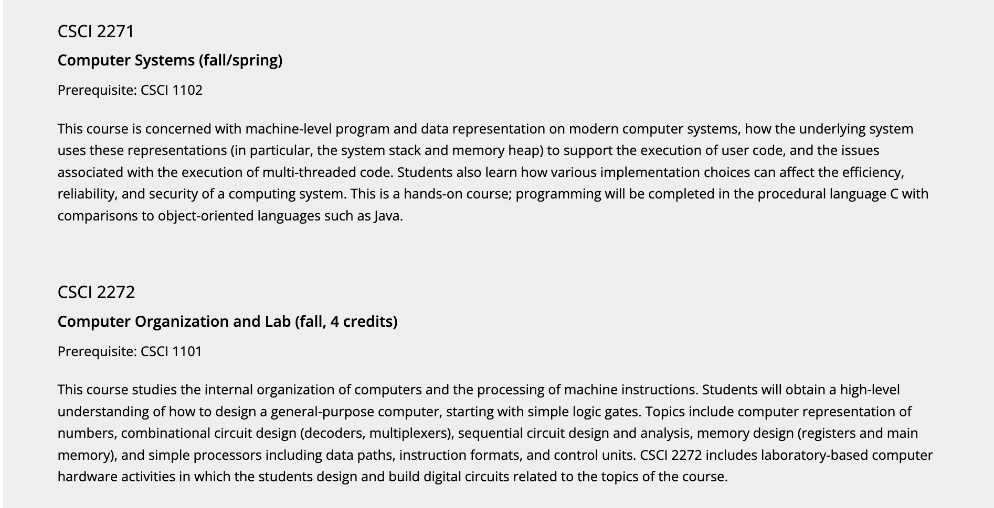

Slide 10
The 3rd Built-in Sum Type – ’a option
What to do if there is no answer?
k / 0 ??
find unknownKey dictionary ??

Slide 11
(* find : key -> dictionary -> value option *)
let rec find searchKey dictionary =
match dictionary with
| [] -> None
| (key, value) :: dictionary ->
if compare searchKey key = 0 then
Some value
| else
find searchKey dictionary

Slide 12
Exceptions

Slide 13
Something Unusual Happens at Run-Time
exception Name of arguments
raise exception
try expression with handlers

Slide 14
Stack
Exceptions
raiser
b
a
f
a
Heap
f
a
catcher
a
k
b
a

Slide 15
Stack
Exceptions
raiser
b
a
f
a
Heap
f
a
catcher
a
k
b
a

Slide 16
Stack
Raising an exception unwinds the call stack
raiser
b
a
f
a
Heap
f
a
catcher
a
k
b
a

